Slide 1
SWBAT define sustainability in relationship to the economy.
APES Unit 6 12/22/15

Slide 2
Agenda
Current Event Presentation
Lecture
Math Worksheet Key on Class Website!

Slide 3
Sustainability
Meeting the needs of the present generation without compromising the ability of future generations to meet their own needs

Slide 4
Sustainability
Well-being: the status of being healthy, happy and prosperous
Can lead to exploitation of natural resources

Slide 5
Economics
How humans, as individuals or as companies, allocate scarce resources in the productive distribution and consumption of goods and services.
Stewardship school of environmental thought:
We have an ethical responsibility to be caring and responsible managers of the earth

Slide 6
Economics and Human population growth
Higher economic standards result in fewer children
Both mothers and fathers tend to work
More money is available for parents’ retirement
Higher educational levels postpone the age at which a woman has her first child
Parents are able to focus on their children’s futures and not daily survival
In the long term, stable economic growth encourages stable population growth

Slide 7
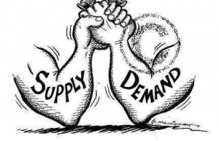
Supply, Demand and the Market
Market economy: cost of a good determined by supply and demand
Factors that influence supply:
Cost of resources used to produce
Number of people selling the product
Technology
Expectations about future prices

Slide 8
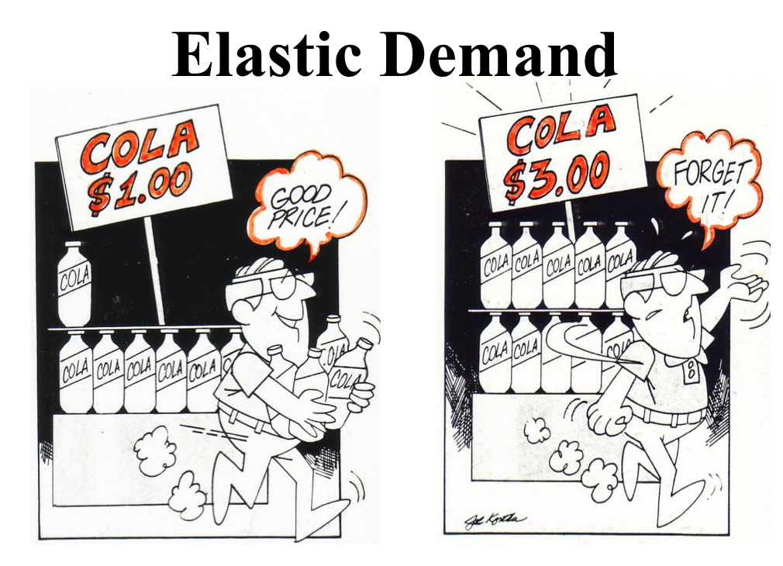
Economics
Factors that influence demand:
Income
Price of goods
Taste
Expectations
Number of people who want the good

Slide 9
Supply and Demand
Law of demand (view of the consumer):
Price of good rises → quantity demanded falls
Price falls→ demand rises

Slide 10
Supply and Demand
Law of supply (view of the business owner):
Price of a good rises→ quantity supplied of that good will rise
Price of good falls→ quantity of the good also falls

Slide 11
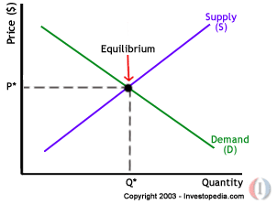
Supply and Demand
Equilibrium point: where quantity demanded and quantity supplied are equal
Best price

Slide 12
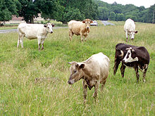
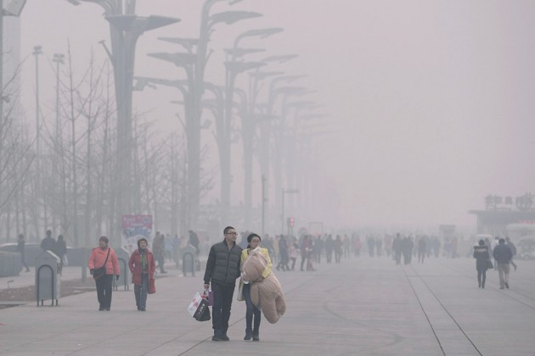
Externalities
The costs or impact of a good or impact of a good or service not included in the economic price of that good or service.
Tragedy of the commons

Slide 13
Genuine Progress Indicator (GPI)
Includes:
Personal consumption
Levels of higher education
Resource depletion
Pollution
Health of a population

Slide 14
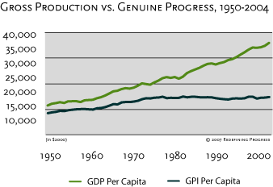
GPI

Slide 15
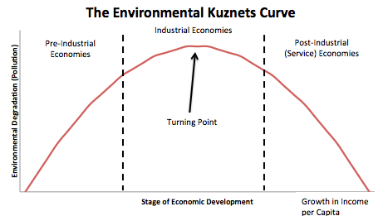
The Kuznets Curve
Per capita income increases→ environmental degradation increases and then decreases

Slide 16
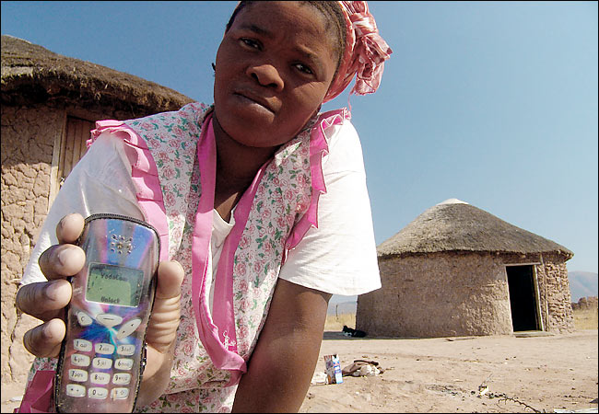
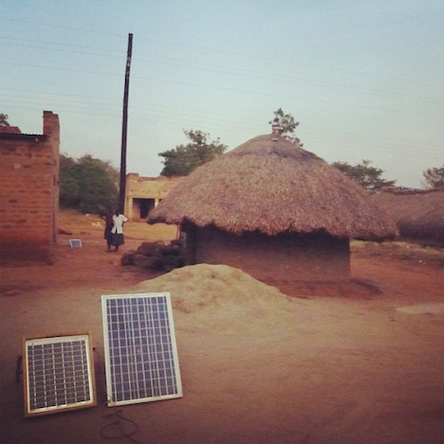
The Kuznets Curves
Technology transfer: when less developed countries adopt technological innovations developed in wealthy countries
Leapfrogging: new technology develops and makes old technology obsolete

Slide 17
Microlending (Microfinance)
Loaning small amounts of money to people who intend to start a small business in less developed countries.
http://www.kiva.org/

Slide 18
Homework
Research a small business that has benefitted from microlending and write one paragraph
Describe how much money they needed, what they needed it for
Read the background for the IPAT lab (posted on the website) and answer questions

Slide 19
Break Homework
Google Scholar

