Slide 1
SWBAT apply the 1st and 2nd laws of thermodynamics to real-world situations.
APES Unit 1 9/21/15

Slide 2
Do Now:
#1 Which of the following terms is NOT a unit of power?
Joule/s
Horsepower
Kilowatt
Joule
All are units of power

Slide 3
Agenda
Mini-lecture
Check on Plants
Energy math problems
Outdoor lab ☺

Slide 4
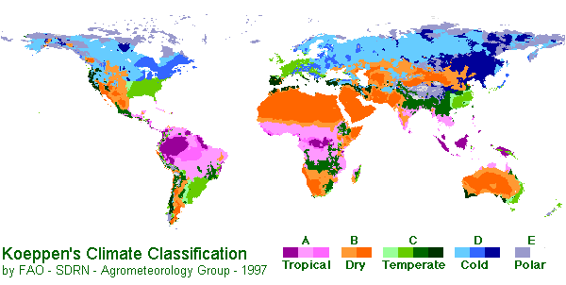
Properties of Water
Specific heat is the amount of heat required to change a unit mass of a substance by one degree in temperature.
High specific heat = A lot of heat is needed to change the temperature
Water has a high specific heat which moderates the earth’s climate.

Slide 5
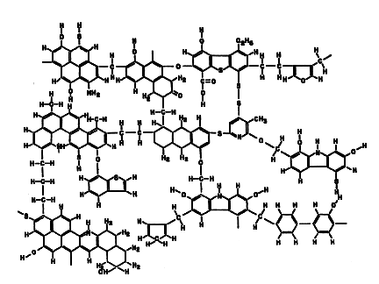
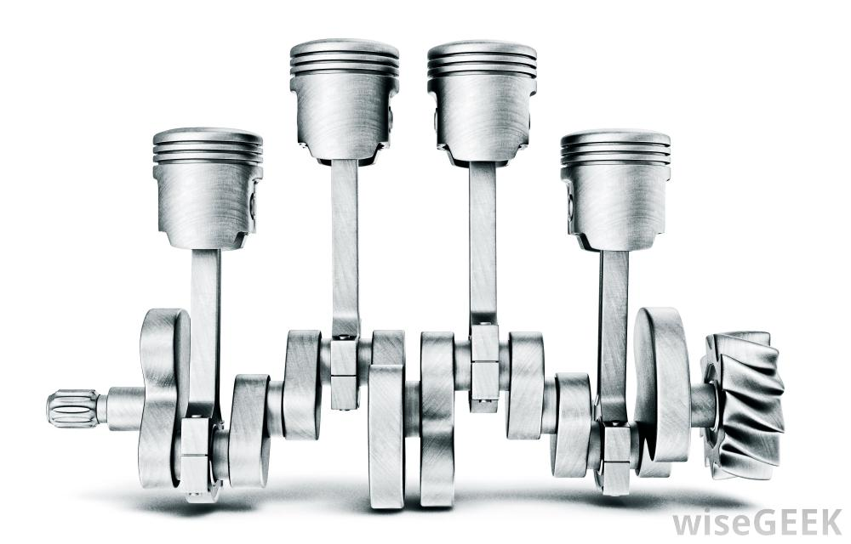
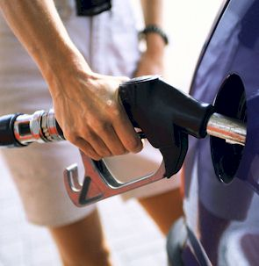
First law of thermodynamics
Energy is neither created nor destroyed.
Energy can be converted from one form to another

Slide 6
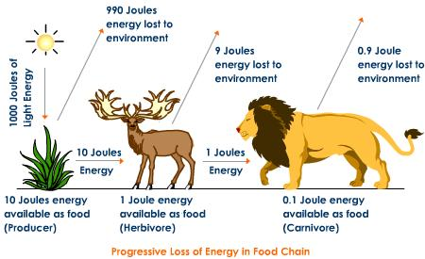
Second law of thermodynamics
When energy is transformed, the quantity of energy remains the same, but its ability to do work decreases.

Slide 7
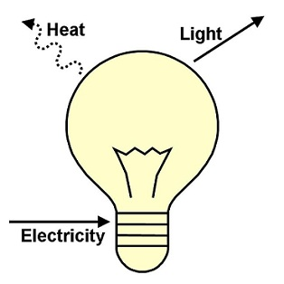
Second law of thermodynamics
Energy is ALWAYS degraded to a lower quality energy when it is used to do work.
Lower quality energy is usually heat

Slide 8
Energy Efficiency
The ratio of the amount of work that is done to the total amount of of energy that is introduced into the system.

Slide 9
Energy Quality
The ease with which an energy source can be used for work.

Slide 10
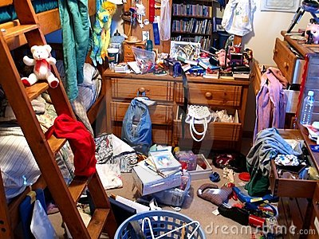
Entropy
Randomness is always increasing in a system, unless new energy from outside the system is added to create order.

Slide 11
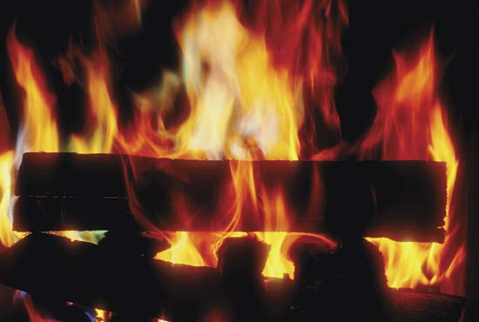
Increases in the entropy of a system are caused by
Conversion of heat energy to light
Combustion of a piece of wood
Transformation of chemical energy to kinetic energy
Making glucose through photosynthesis

Slide 12
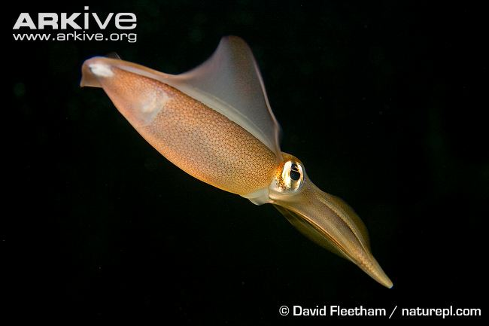
Energy Conversions
Are important for all life!

Slide 13
Open System
Exchanges of matter or energy occur across system boundaries.

Slide 14
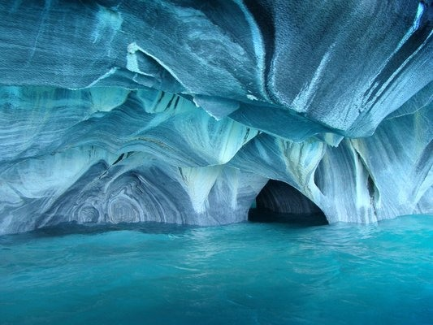
Closed Systems
Matter and energy exchanges across system boundaries do not occur

Slide 15
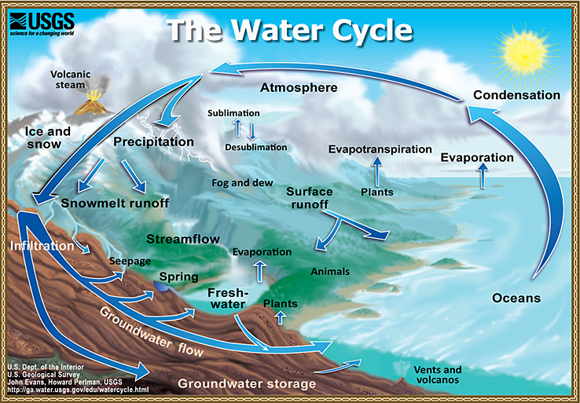
Inputs and Outputs
Inputs are given to a system
Outputs are losses from the system
Steady state is when inputs equal outputs

Slide 16
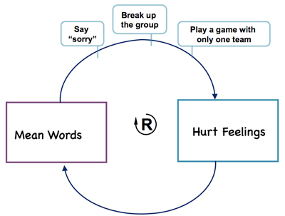
Feedback Loops!
Feedback is when the result of a process feed back into the system to change the rate of the process.

Slide 17
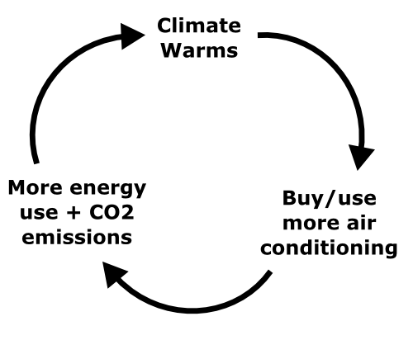
Positive Feedback Loop
Amplifies changes
Is unstable

Slide 18
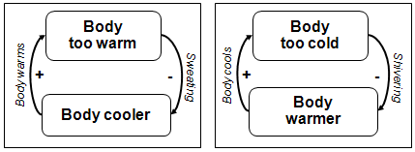
Negative feedback loop
Resist changes
Is stable

Slide 19
Announcements
Unit Exam on Friday will be 25 questions
Tips for exam: memorize formulas!
Half-life
Energy and power

Slide 20
Check on Plants!

Slide 21
Math groups!
Group #1: Ramlah, Rimsha, Rahila, Cynthia, Group #2: Attia, Monica, Desire, Uzma
Group #3: Mehrangiz, Bukurie, Hamna, Harmanpreet
Group #4: Wendy, Shayna, Wyllana, Saliha
Group #5: Kaylah, Amrat, Mahnoor

Slide 22
Popcorn Lab
Group #1: Ramlah, Rimsha, Rahila, Cynthia, Kaylah
Group #2: Attia, Monica, Desire, Uzma, Amrat
Group #3: Mehrangiz, Bukurie, Hamna, Harmanpreet, Mahnoor
Group #4: Wendy, Shayna, Wyllana, Saliha

Slide 23
Homework
Finish Energy conversions worksheet
Finish Popcorn lab questions

