Slide 1
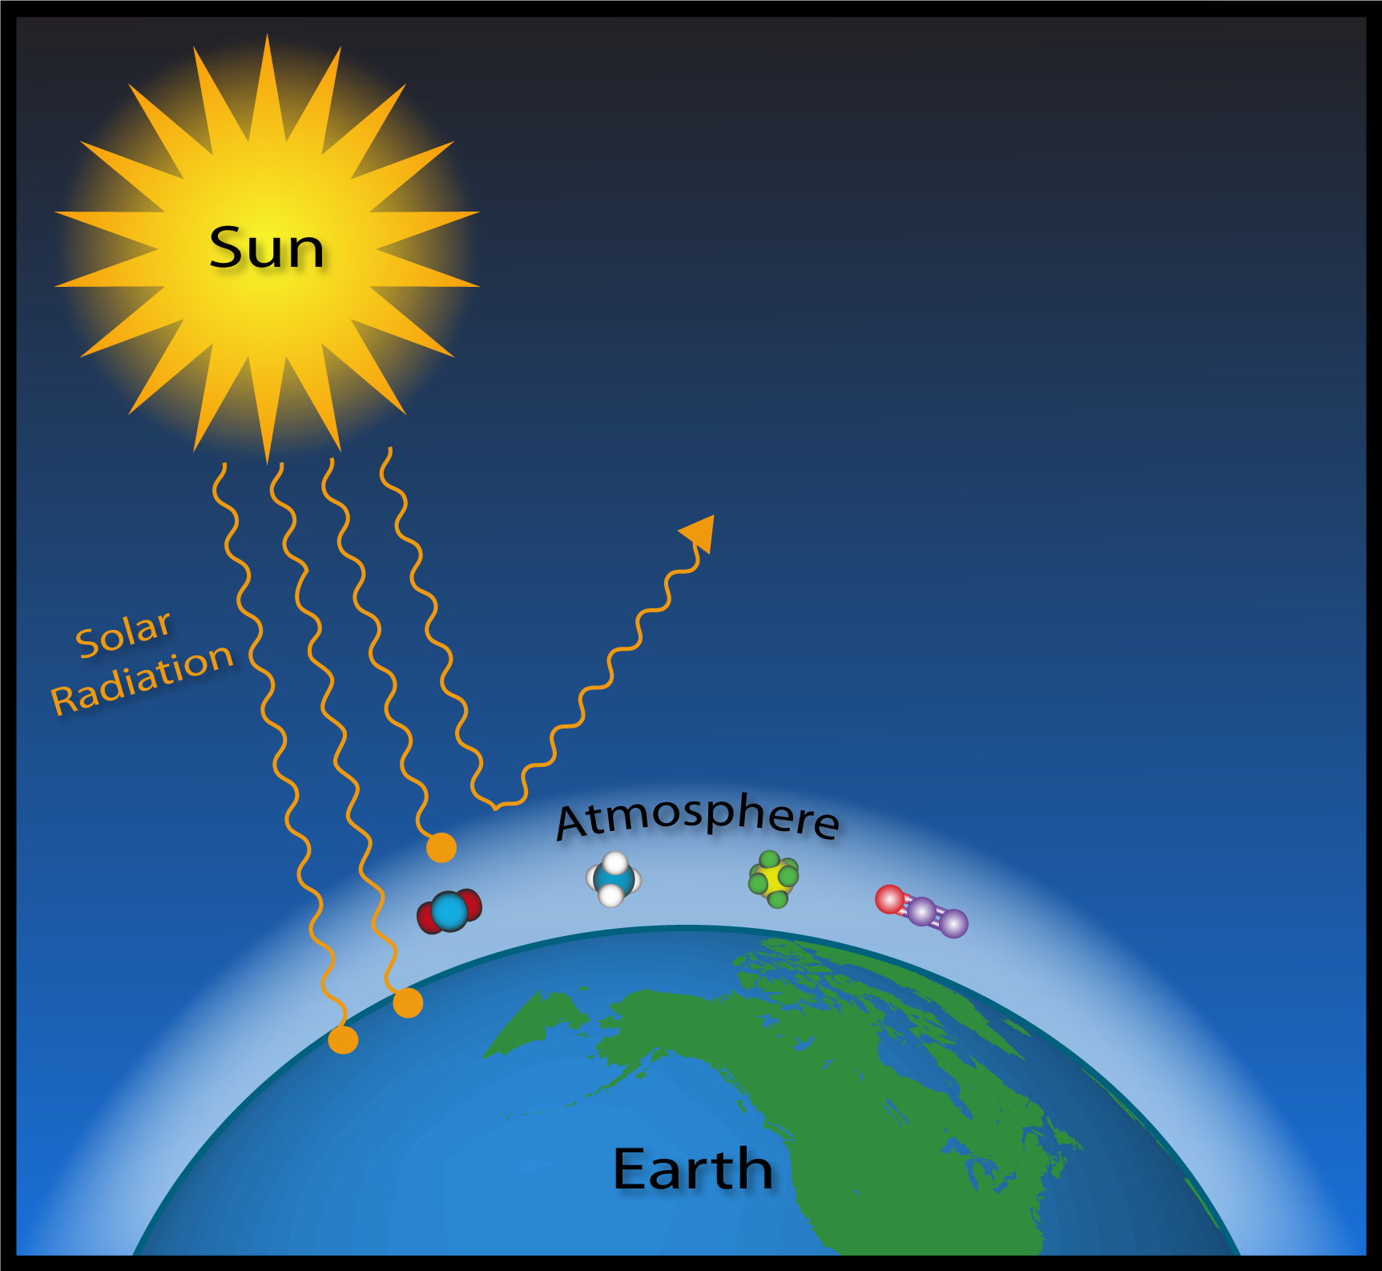
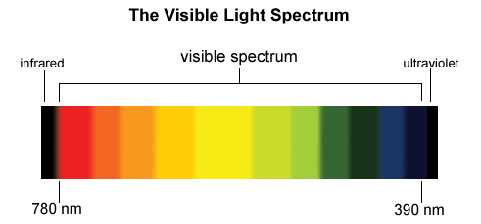
APES Unit 1 Lesson 4 9/17/15
Aim: How do the properties of water make it unique?

Slide 2
Turn and Talk
Share out the current event article you read last night

Slide 3
Agenda
Mini-lecture
Water/Check on plants
Unit-conversion problems

Slide 4
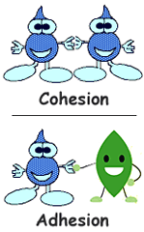
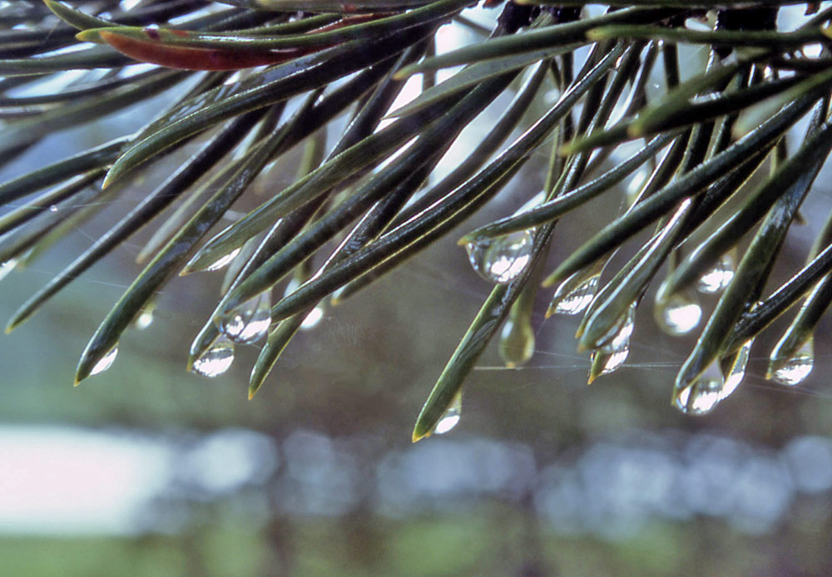
Properties of Water
Surface tension results from the cohesion of water molecules at the surface of a body of water.

Slide 5
Properties of Water
Capillary action occurs when adhesion molecules of water molecules to a surface is stronger than cohesion between the molecules.

Slide 6
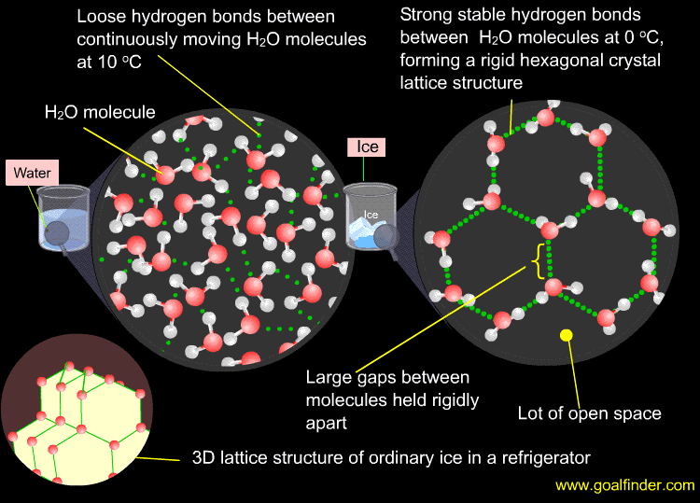
Properties of Water
Boiling point = 100 C
Freezing point = 0 C
Solid form has a larger volume than liquid form
Solid is LESS dense than liquid

Slide 7
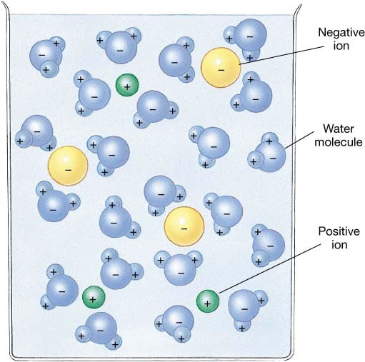
Properties of Water
Water as a solvent:
Dissolves polar molecules

Slide 8
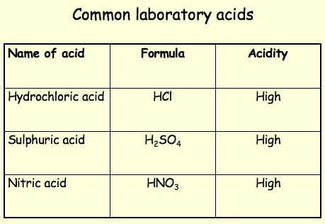
Acids, Bases, and pH
An acid contributes hydrogen ions (H⁺) to a solution

Slide 9
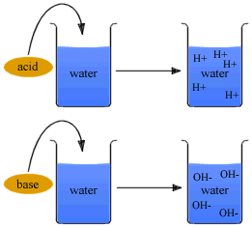
Acids, Bases, and pH
A base is a solution that contributes hydroxide ions (OH⁻) to a solution.

Slide 10
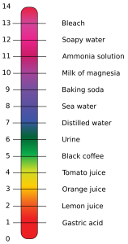
pH Scale

Slide 11
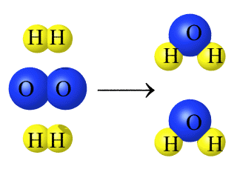
Chemical Reactions and Conservation of Matter
Chemical reactions occur when atoms separate from the molecules they are a part of or recombine with other molecules.

Slide 12
Chemical Reactions and Conservation of Matter
Law of conservation of matter states that matter cannot be created or destroyed

Slide 13
Check on Plants!!
Water them and record data!

Slide 14
Group Work
Group #1: Ramlah, Rimsha, Rahila, Cynthia
Group #2: Attia, Monica, Desire, Uzma
Group #3: Mehrangiz, Bukurie, Hamna, Harmanpreet
Group #4: Wendy, Shayna, Wyllana, Saliha
Group #5: Kaylah, Amrat, Mahnoor

Slide 15
Dimensional Analysis (unit conversions)
What is a conversion factor?
A fraction in which the numerator and the denominator both represent the same measurement.
They can be flipped!

Slide 16
Steps for doing unit conversions
Write the answer unit first!
Find the conversion unit that involves the answer unit
Write the unit conversion factor with the answer units on top
Find a value in the problem that has the same units that appear on the bottom of the unit conversion factor
Repeat steps 3 and 4 until all units (except the answer units) have cancelled

Slide 17
Homework
Finish Unit Conversions Worksheet
Read pg. 35-39 (stop before the laws of thermodynamics)

