Slide 1
Aim: How does matter form the basis of environmental systems?
APES Unit 1 9/11/15
Lesson 2

Slide 2
Announcements
Metric system quiz on Wednesday!!
Check your answers to the metric system worksheets on the website

Slide 3
Agenda
Mini-lecture
Half-life problems
Design Inquiry Lab

Slide 4
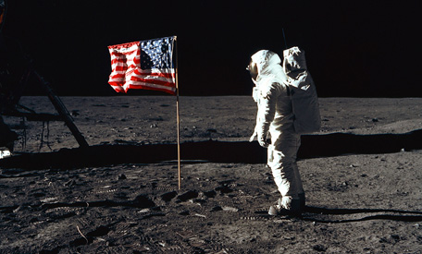
Matter
Matter is anything that occupies space and has mass.
The mass of an object is the amount of matter it contains.

Slide 5
Atoms and Molecules
An atom is the smallest particle that can contain the chemical properties of an element.
An element is a substance composed of atoms that cannot be broken down into smaller parts.

Slide 6
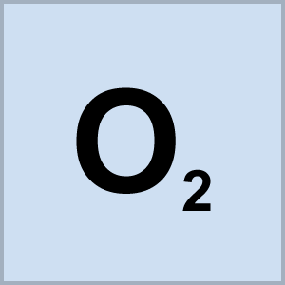
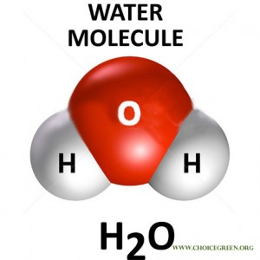
Molecules and compounds
Molecules are particles containing more than one atom.
Compounds are molecules that are composed of more than one element.

Slide 7
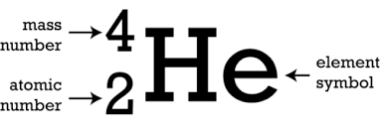
Atoms and Molecules
The atomic number is the number of protons in a particular element.
The mass number is the total number of protons and neutrons.
Isotopes are atoms that have the same number of protons but different amounts of neutrons.

Slide 8
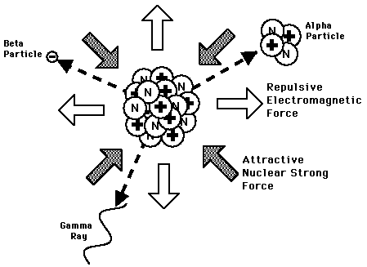
Radioactivity
Radioactive decay is the spontaneous release of material from the nucleus.
Half-life is the time it takes for one-half of the original radioactive parent atoms to decay.

Slide 9
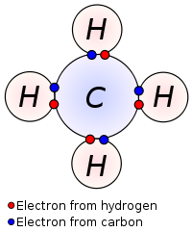
Chemical Bonds
Covalent bonds are formed between compounds that share electrons.

Slide 10
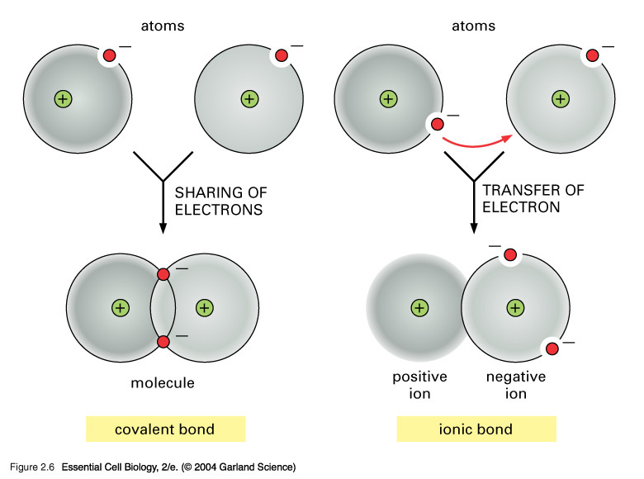
Chemical Bonds
Ionic bonds involve the transfer of electrons

Slide 11
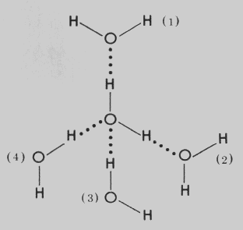
Chemical Bonding
Hydrogen bonds form when hydrogen atoms that are covalently bonded to one atom are attracted to another atom on another molecule.

Slide 12
Group Work-Half life problems
Group #1: Ramlah, Rimsha, Rahila, Cynthia
Group #2: Attia, Monica, Desire, Uzma
Group #3: Mehrangiz, Bukurie, Hamna, Harmanpreet
Group #4: Wendy, Shayna, Wyllana, Saliha
Group #5: Kaylah, Amrat, Mahnoor

Slide 13
Half life problems
What do we know?
What are we solving for?
(starting amount) x (1/2)^{number of half-lives} = ending amount

Slide 14
Fertilizer Inquiry Lab
Formulate testable question, independent variable, dependent variable, and hypothesis.
Hypothesis: If…. Then…. because
STOP
Determine Constants and Control and how you will collect data
STOP
Write Procedure
Construct Data Tables

Slide 15
Homework
Finish half-life worksheet
Complete Easter Island reading and questions

