Slide 1
SWBAT review water use and water pollution for a midterm.
APES 1/20/15

Slide 2
Agenda
Water Pollution Review
Water Use Review

Slide 3
Quick Poll
Midterm FRQ:
Wednesday or Friday?

Slide 4
Group Work Rules
Ask 3 before me!
Check answers with your group mates!

Slide 5
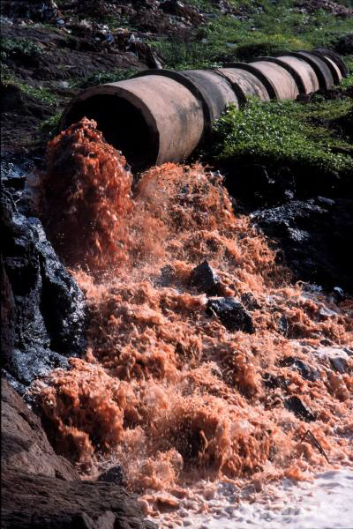
Water Pollution
Organic Effluent: outflow from a sewer or sewage system

Slide 6
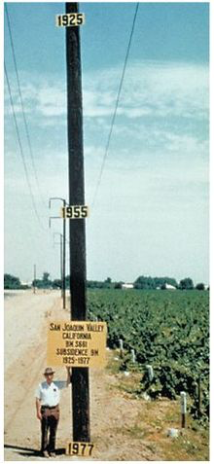
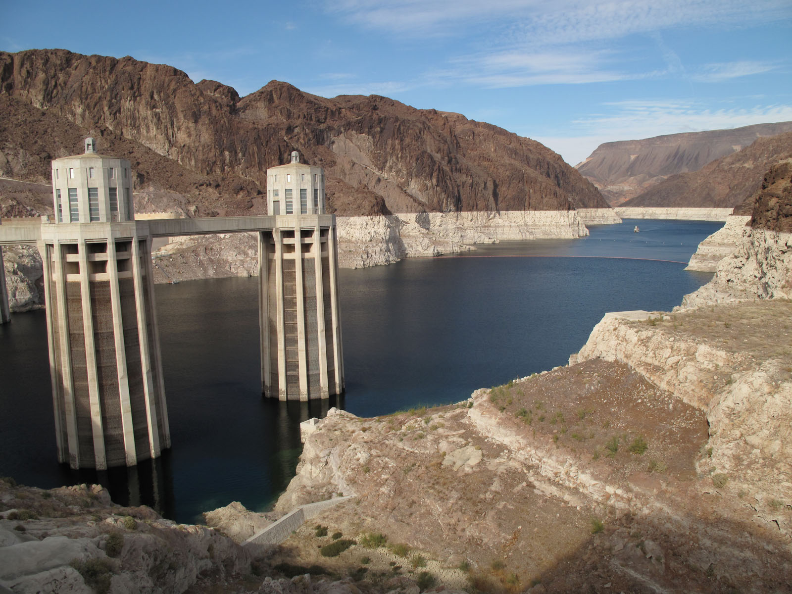
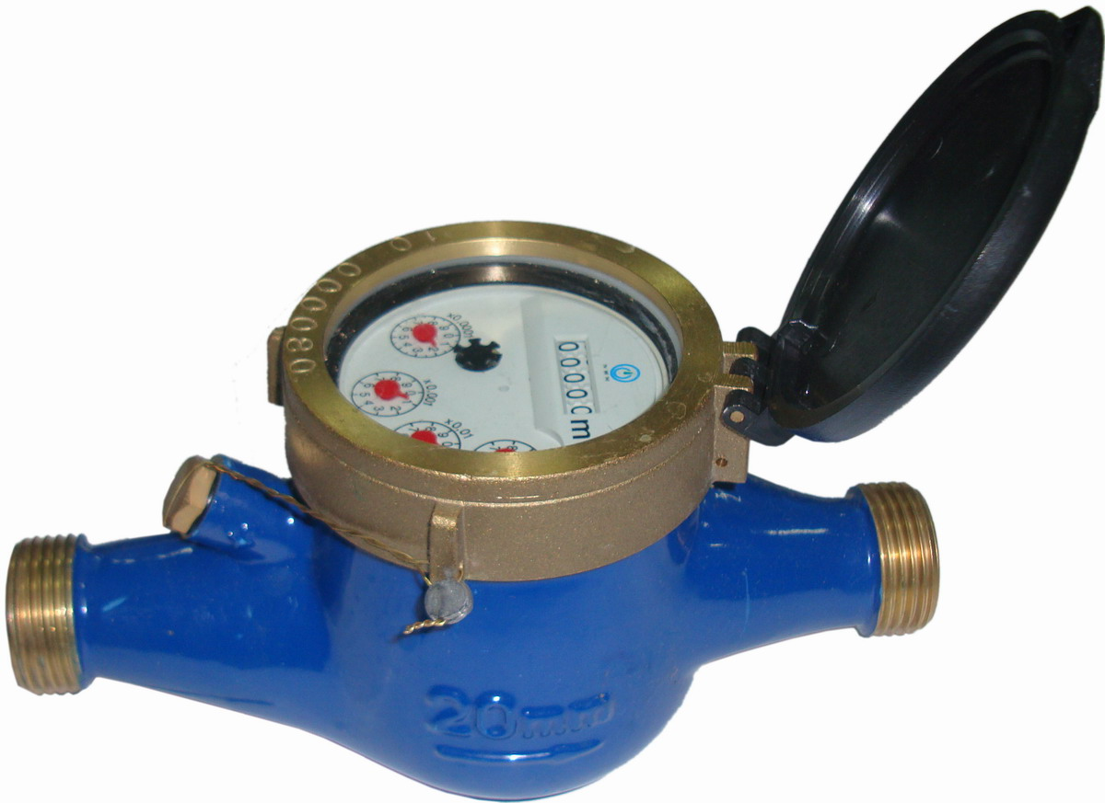
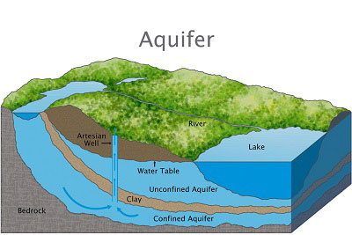
Water Use

Slide 7
Homework
Multiple Choice Questions
Read article posted online and take notes

