Slide 1
SWBAT identify the ecological effects of climate change and evaluate stabilization wedges to reduce climate change. Do Now: What is Coral Bleaching? Why is it happening?
APES Unit 6 1/14/16

Slide 2
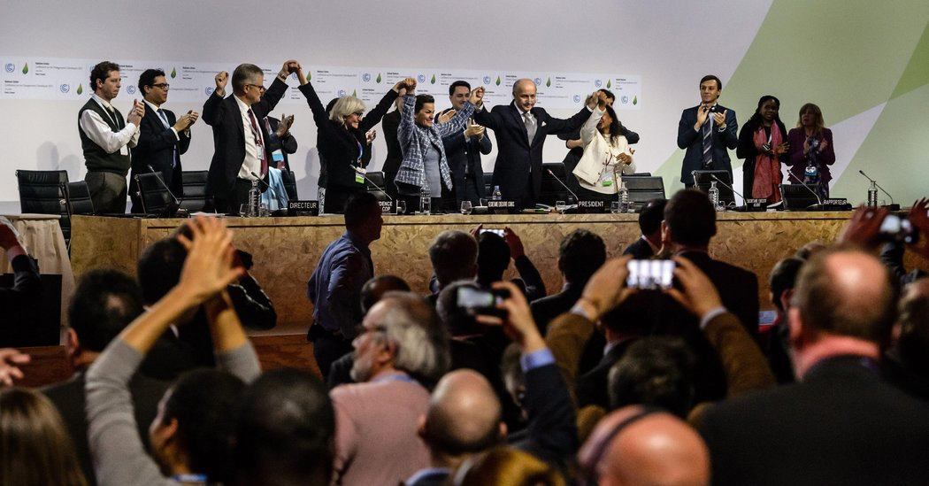
Homework Share Out
What is the Paris Climate Accord?
How is it different from the Kyoto Protocol?
Do you believe it will be successful? Why or why not?

Slide 3
Ecological Impacts Jigsaw
Expert Group: Read the article and answer the questions
Compare answers to the article to group members at your table
Jigsaw Group: Take turns teaching your article to your group members

Slide 4
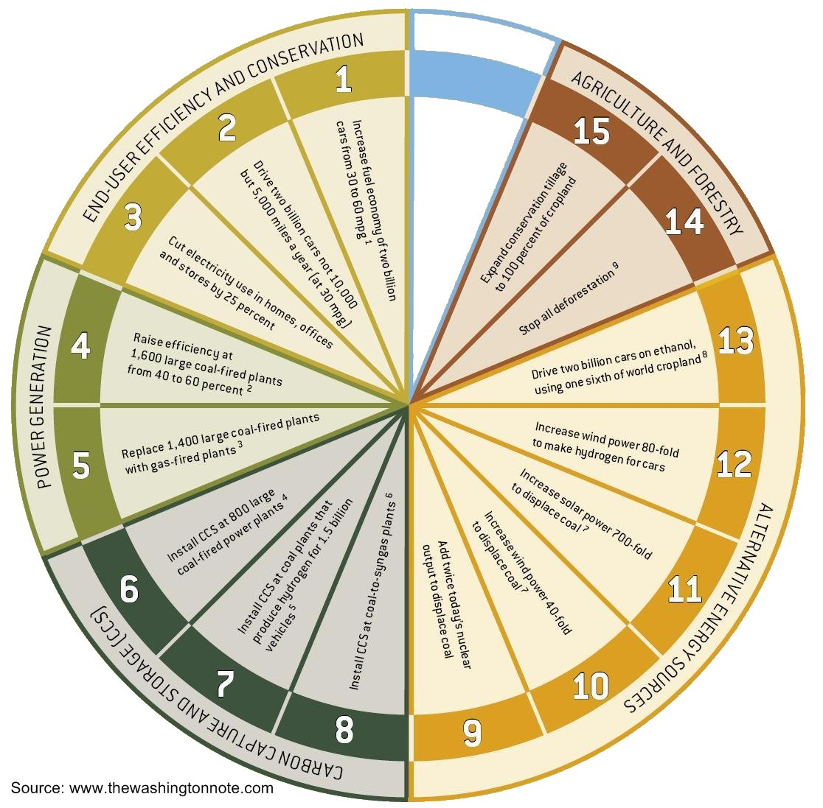
Stabilization Wedges
2006 Scientific American Article by Princeton Researchers
Methods to solve the current climate crisis for the next 50 years with current technologies
Each wedge will result in a 25 billion ton reduction of CO₂ over 50 years

Slide 5
Stabilization Wedges
Increase fuels economy of two billion cars from 30 to 60 mpg.
Cut electricity usage in homes, offices, and stores by 25%
Stop all deforestation
Increase solar power 700-fold to displace coal
Increase wind power 40-fold to displace coal

Slide 6
Making the wedge a reality
Propose three actions that the government or society at large needs to take in order to make the stabilization wedge become a reality.

Slide 7
Exit Ticket:
Why should humans be concerned with the ecological impacts of climate change?

Slide 8
Homework
Study for the exam tomorrow!
FRQ re-write due by Monday

