Slide 1
SWBAT identify the consequences of climate change for living organisms.
APES Unit 7 1/13/16

Slide 2
Turn and Talk
Share out your homework research

Slide 3
Agenda:
Finish lecture on Ch. 19
Graphing Lab

Slide 4
Consequences to Living Organisms
Wild plants and animals
Many species of plants now flower earlier
Birds arrive at their breeding ground earlier
Insects emerge earlier
Rapid temperatures cause harm if organisms can’t adapt in time

Slide 5
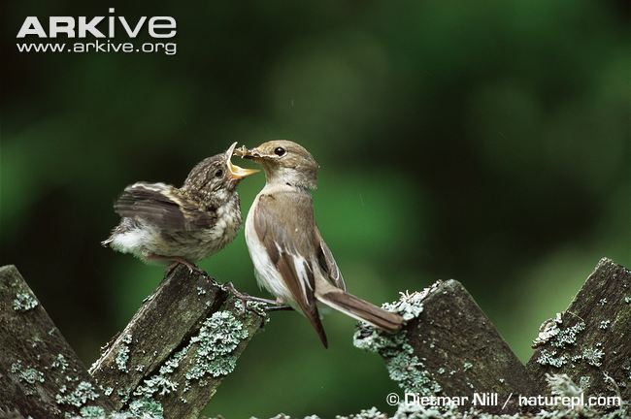
Case Study: Pied Flycatcher
Chicks hatch at the same time as there is an abundance of caterpillars
Warmer temperatures→ spring comes earlier→ caterpillars peak earlier
Pied flycatcher chicks have no food

Slide 6
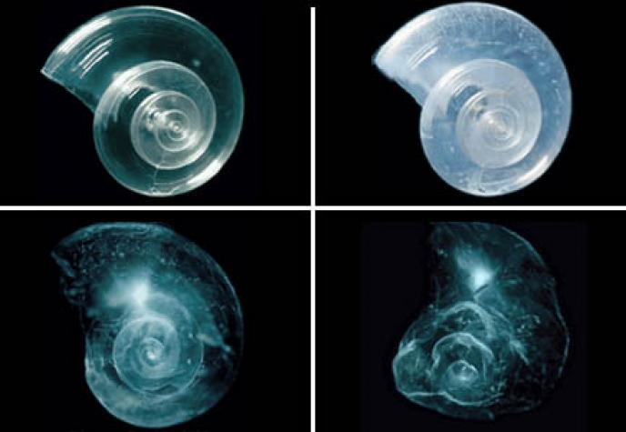
Ocean Acidification
Increase in dissolved CO₂ increases the amount of carbonic acid
H₂O + CO₂ = H₂CO₃
Increase due to:
Industrial revolution → more fossil fuels burned
Concentration of CO₂ in atmosphere has increased

Slide 7
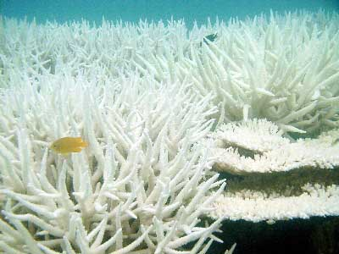
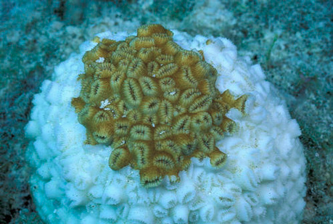
Case Study: Coral Bleaching
Corals are formed by massive colonies of tiny animals called polyps
Coral depend on symbiotic relationship with algae called zooxanthellae
Algae provide oxygen for coral
Coral provides algae with nutrients (CO₂) for photosynthesis
Warmer water→ corals expel algae

Slide 8
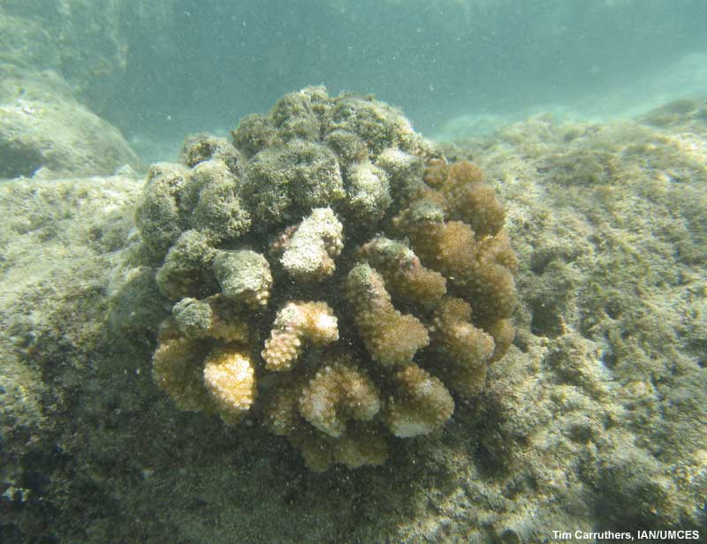
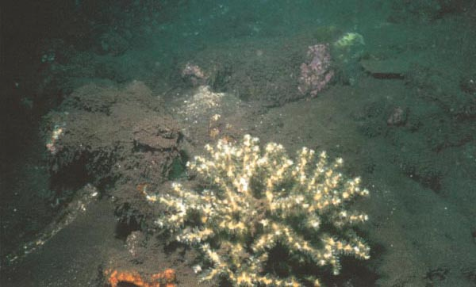
Case Study: Coral Bleaching
Coral bleaching caused by
Thermal stress (increase in water temperature)
Sedimentation from runoff
Overexposure to sunlight
Extreme low tides

Slide 9
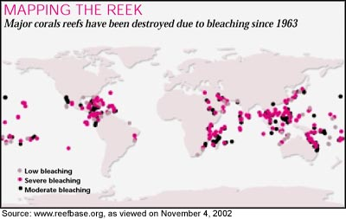
Coral Bleaching

Slide 10
Case Study: Coral Reefs
High water temperatures + increased ocean acidity = loss of coral reefs
Environmental impact of loss of coral reefs:
Loss of habitat
Elimination of food source for marine life
Loss of shelter/ hiding places
Loss of breeding grounds for fish and bird species
Loss of biodiversity
Extinction or decrease in population of marine organisms
Economic Impact:
Locations for commercial fishing put at risk

Slide 11
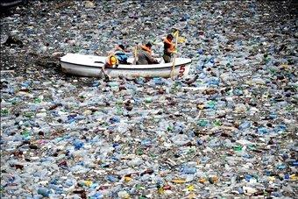
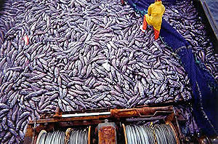
Environmental Issues and Marine Ecosystems
Overfishing
Nutrient pollution and eutrophication
Hypoxia and dead zones
Garbage/Plastic debris (great pacific garbage patch)

Slide 12
The Effect of global warming on Humans
Relocation of people from coastal communities and islands
Increase of infectious diseases, especially those carried by mosquitos :
West Nile Virus
Malaria
Dengue Fever
The IPCC estimates that 65% of the world’s population will be at risk of infectious diseases due to global warming
Economics consequences:
Shorter winters → Less winter tourism (skiing)

Slide 13
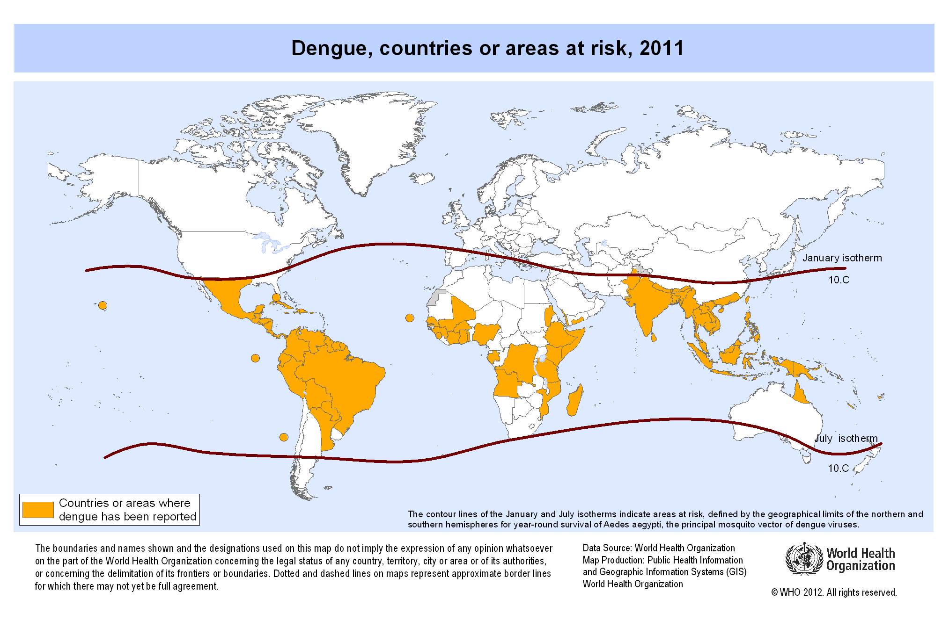
Dengue fever

Slide 14
The Kyoto Protocol
Representatives of 38 countries convened in Kyoto, Japan in 1997 to determine how to control global warming
Global emissions of greenhouse gases from all industrialized nations will be reduced by at least 5% below their 1990 levels by 2012.
U.S. would have an 8% reduction of emissions
China and India would have no reduction in emissions
Unfairly exposed to consequences of global warming

Slide 15
The Kyoto Protocol
The Kyoto Protocol was NOT ratified by the U.S.
2001- more amendments made
Bush said there wasn’t enough evidence for climate change and didn’t ratify it

Slide 16
Carbon Sequestration
Removing CO₂ from the atmosphere
CO₂ stored in soil
CO₂ emissions trapped and pumped into abandoned oil wells or the deep ocean
Disadvantages:
expensive

Slide 17
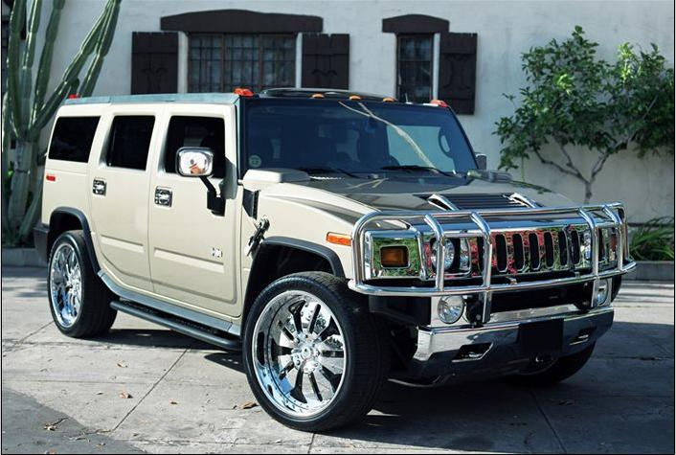
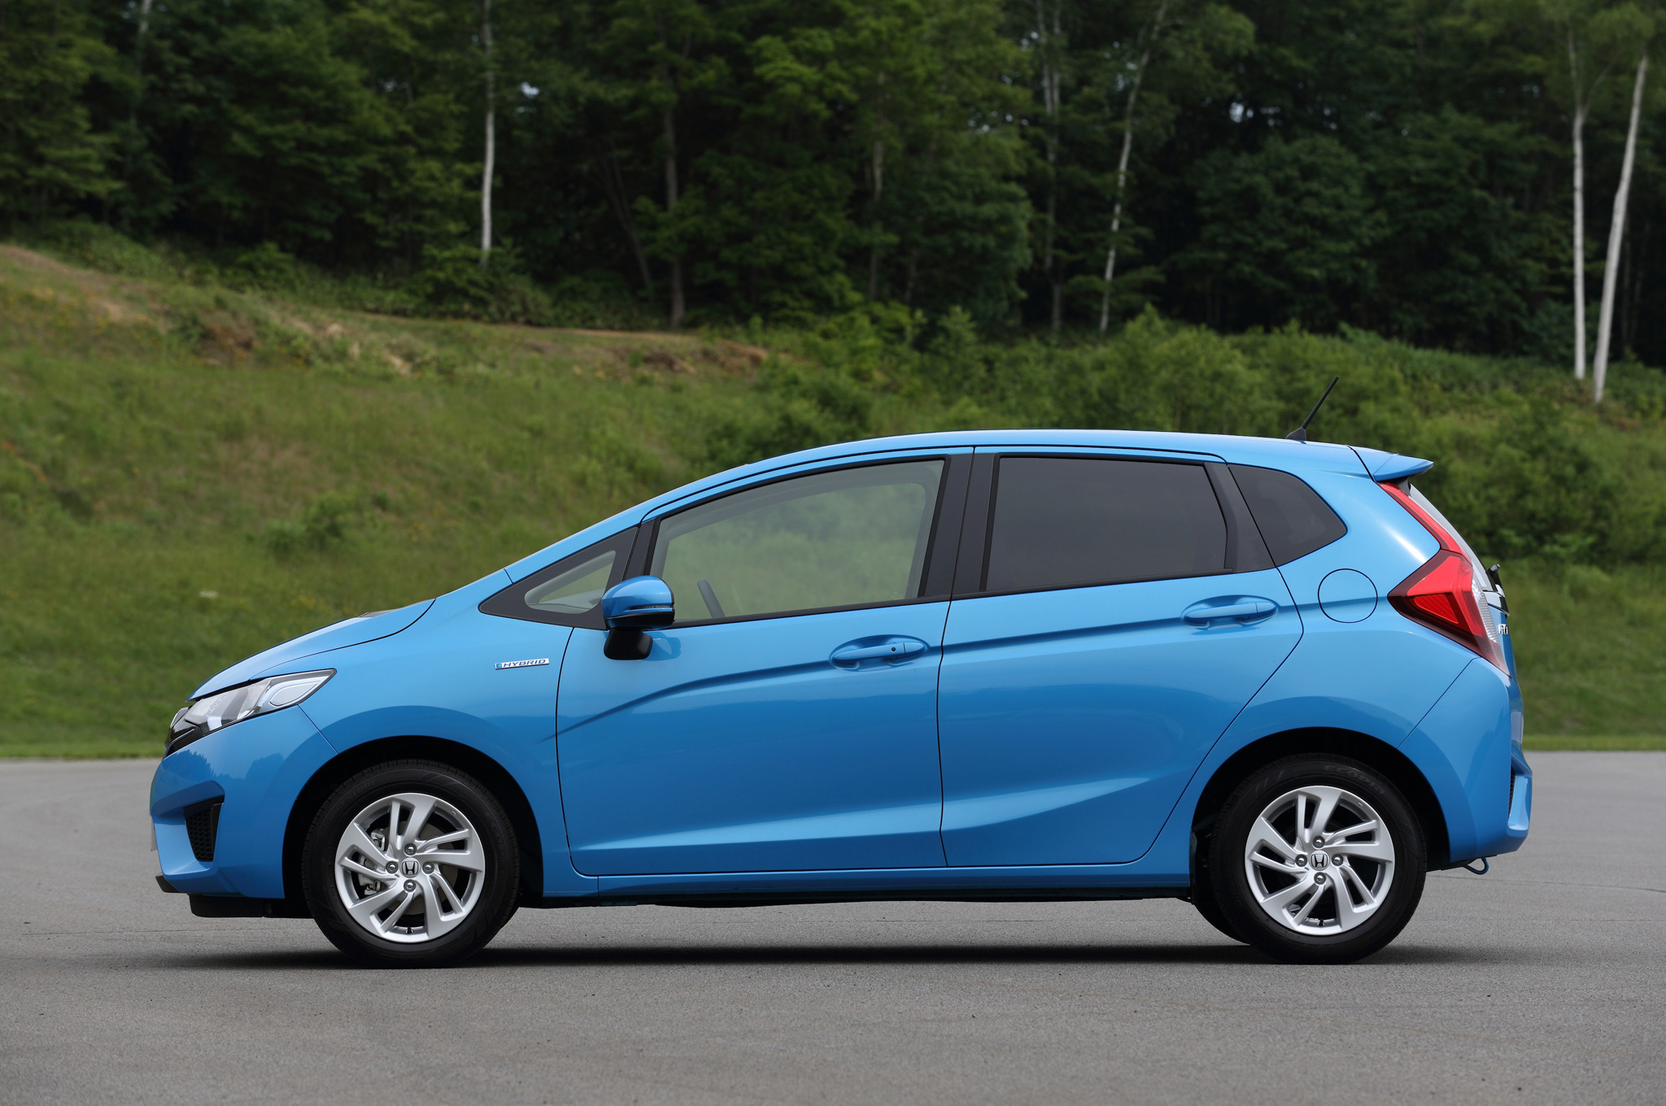
U.S. recent policy
2007: Supreme Court ruled that EPA can regulate CO₂ emissions under the Clean Air Act
Initiatives to increase gas mileage

Slide 18
Rising Greenhouse Gas Concentrations
PPM Data Table:
Gas | 1850 | 1980 | 1990 | 2030
CO₂
CH₄
N₂O
CFCs

Slide 19
Homework
Research the Paris Climate Accord and answer the following questions:
What is the Paris Climate Accord?
How is it different from the Kyoto Protocol?
Do you believe it will be successful? Why or why not?

