Slide 1
SWBAT identify the consequences of global warming for the environment. Do Now: How is current climate change different from historic climate change? How does the energy of the sun cause Earth to heat?
APES Unit 7 1/12/16

Slide 2
Turn and Talk
Share out your answer to the article

Slide 3
Agenda
Lecture
Video
Pass Back Exams
Announcements:
Help me with my room!

Slide 4
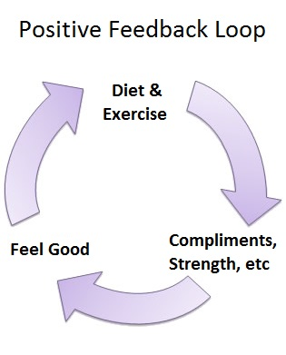
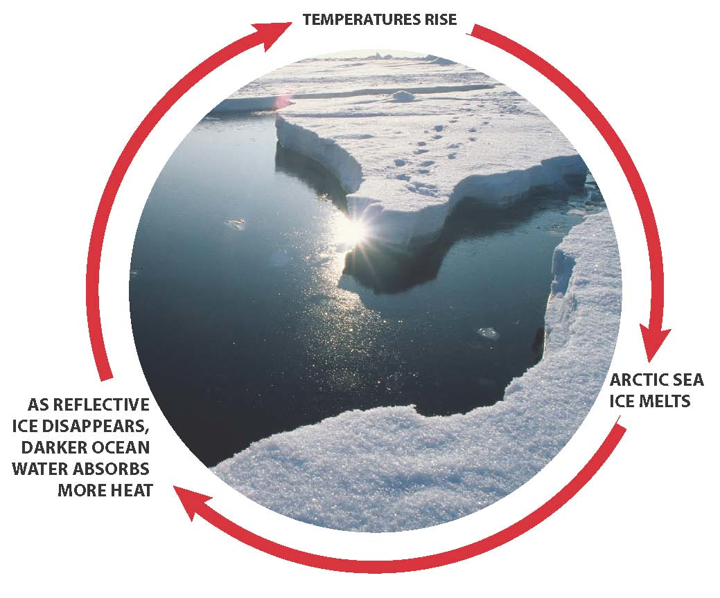
Feedback Loops
Positive feedback loops amplify changes
Unstable
Ex: Higher temperature → more decomposition → more CO₂ released
Higher temperatures→ melting tundra→ more anaerobic decomposition→ more methane released

Slide 5
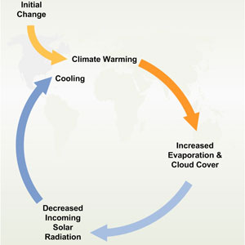
Negative Feedback Loop
Negative feedback loops dampen change
More stable
Ex: More CO₂ → more plant growth→ more photosynthesis

Slide 6
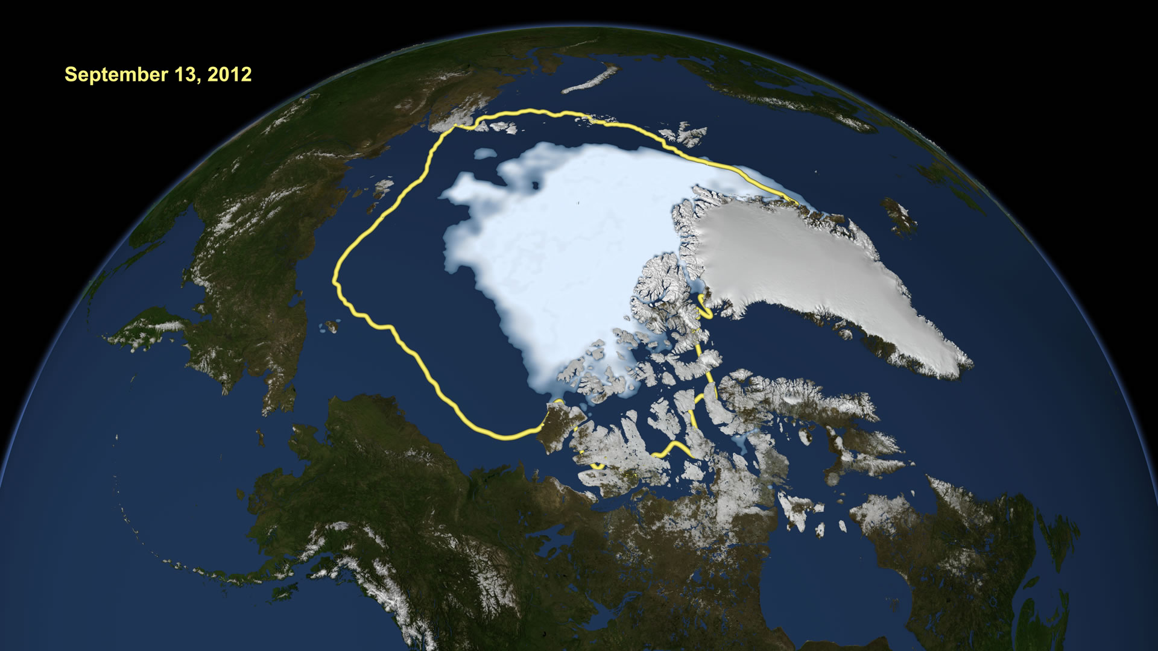
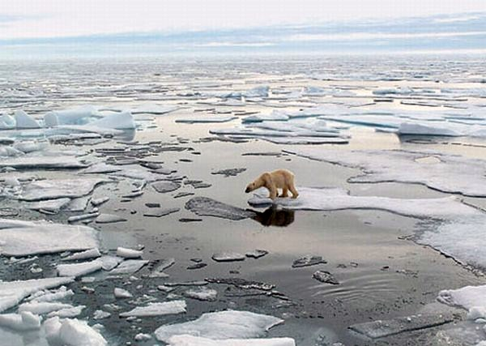
Polar Ice Caps
Global warming is supposed to be the strongest at this region
Warming of the arctic→ melting ice→ destroys environment
Melted polar ice cap might make oil more available

Slide 7
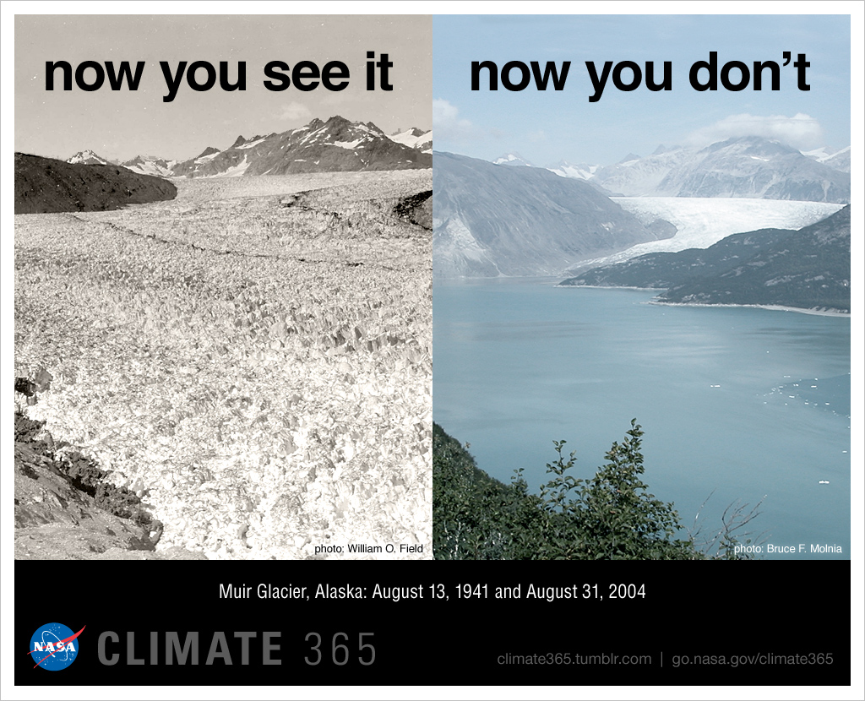
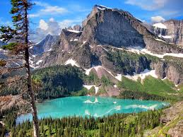
Melting Glaciers
May leave people without a reliable fresh water source

Slide 8
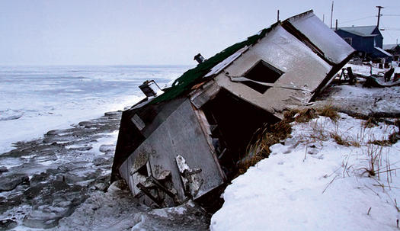
Permafrost
Permanently frozen ground
Exists in tundra and boreal forest biomes
20% of land on earth contains permafrost
Effects of melting permafrost
Ground can slide away (can affect houses)
Lots of organic matter will start to decompose→
Releases methane

Slide 9
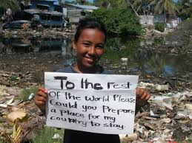
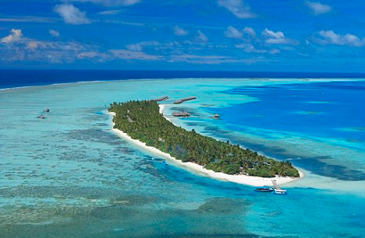
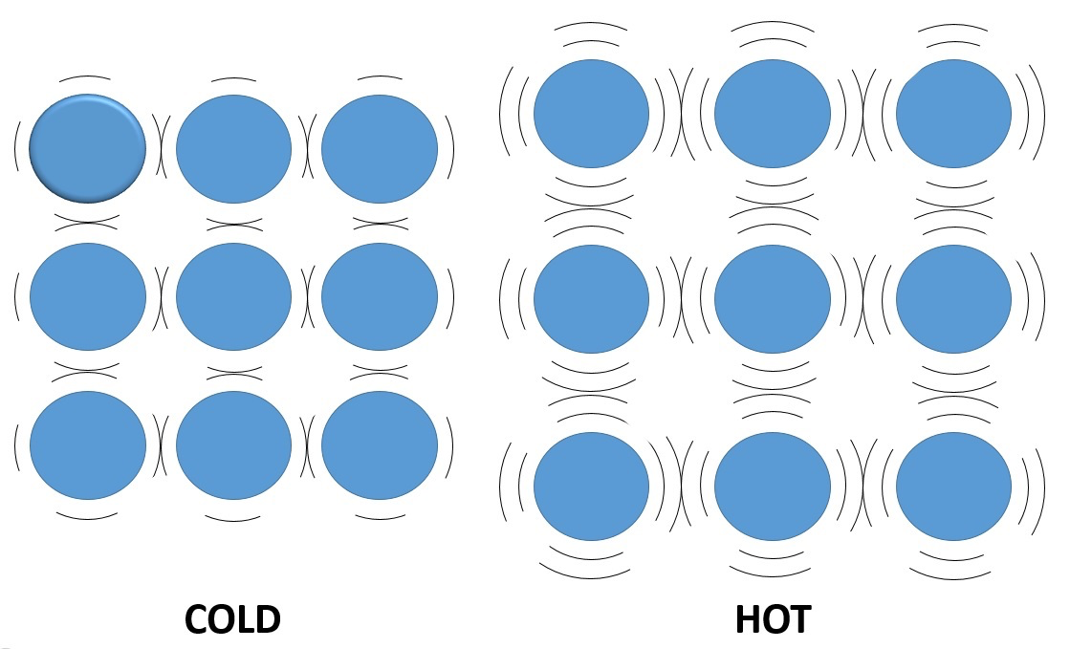
Sea Levels
Sea levels rising due to
Melting glaciers→ more water
Thermal expansion of the water:
warmer water→ water molecules move farther apart→ volume of water in ocean increases
Negative effects
Endanger coastal cities and low-lying island nations
More saltwater intrusion into aquifers
Increased soil erosion

Slide 10
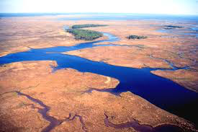
Sea Levels
Impact of sea level rise on estuaries:
Flooding and erosion of estuary habitat
Can lead to loss of migratory bird species that rely on estuaries as stopover
Loss of species that rely on estuary for protection form predators
Change in salinity
Salinity may increase
Loss of species that have a low salinity tolerance
Waterlogged soils due to flooding
Loss of march plant species

Slide 11
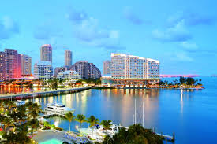
Sea Levels
Negative economic impact of sea level rise on people who live on the coast
Damage to private property
Decrease in property values
Cost of replacement, relocation or improved instruction
Loss of income/livelihood
Loss of tourism
Loss of commercial fishing

Slide 12
Sea Level
Strategies the government can use to discourage people from moving to coastal areas
Raise property taxes in coastal areas
Use education campaigns to discourage people from moving to the coast OR encourage people moving away from the coast
Designate areas as a preserve, making it illegal to build there

Slide 13
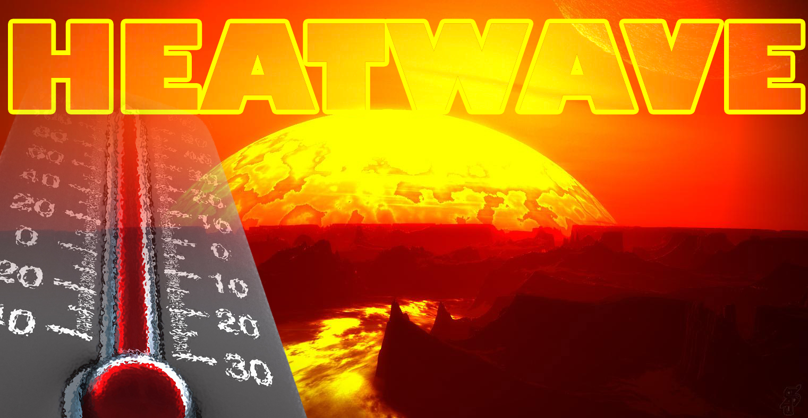
Heat Waves
Increase of long periods of hot weather
Negative effects:
Increased risk of death for those without air conditioning (the elderly)
Drought
Damage to crops
More expensive food

Slide 14
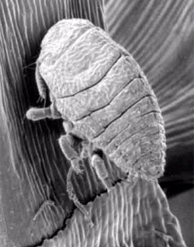
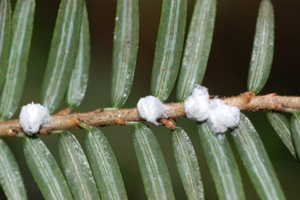
Cold Spells
Fewer extremely cold spells and fewer days below freezing
Positive effects:
Fewer deaths
Decrease in risk of crop damage
Decrease energy needed to heat buildings
Negative effects:
Pests can expand their range

Slide 15
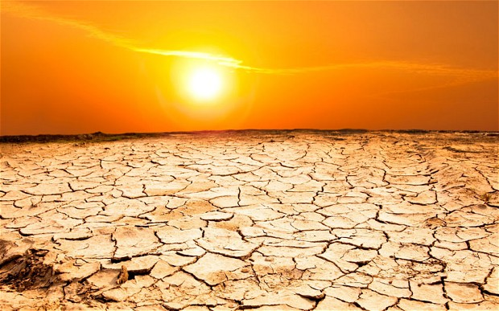
Precipitation Patterns
Warmer temperatures→ increased evaporation
Some areas will receive more precipitation
Benefits:
Aquifer recharge, higher crop yields
Disadvantages
More flooding, landslides, and soil erosion
Some areas will receive less rainfall

Slide 16
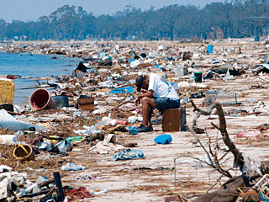
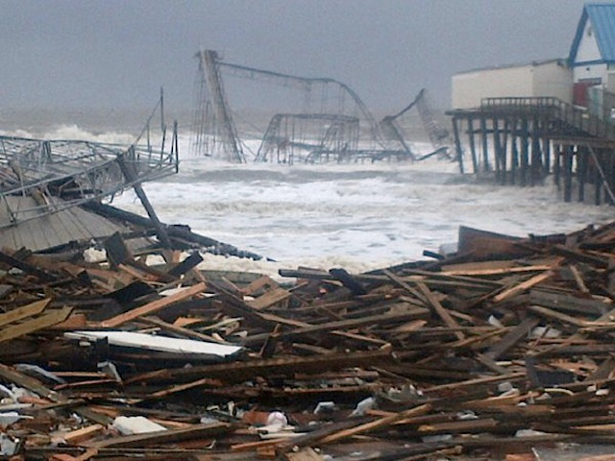
Storm Intensity
Warmer ocean water can lead to more frequent, intense hurricanes
Examples: Sandy and Katrina

Slide 17
Ocean Currents
Melting glaciers→ adds more freshwater to the ocean
More freshwater→ lower salinity
Lower salinity could affect thermohaline circulation
If thermohaline circulation shuts down, Europe will be much colder

Slide 18
Thermohaline Circulation

Slide 19
Exam Notes: FRQ
Huge improvement!!
Review birth and death rates throughout the demographic transition
Government incentives-be as specific as possible! free higher education
If it says mention two causes- only the first two causes are graded!
Graphs must be perfect (an x denotes a misplaced point)
How is biodiversity being affected?
If you list pollution, always always always list the specific pollutant

Slide 20
Sea Level Rise
http://www.cnn.com/2015/06/10/opinions/sutter-climate-sea-level-facts/

Slide 21
Homework
Finish Reading Chapter 19
Research one country or city that will be affected by rising sea levels
Write two paragraphs summarizing how it will be affected

