Slide 1
SWBAT identify anthropogenic sources of climate change.
APES Unit 7 1/11/16

Slide 2
Regents Week Schedule
Mon. (25th): School as regular
Tuesday, Wednesday and Friday: APES 1:15- 2:45 pm
NO APES class on Thursday

Slide 3
Agenda
Lecture
Math practice!

Slide 4
Natural Sources of Greenhouse Gases
Volcanic eruptions
Can add a large amount of CO₂ to the atmosphere (can also release SO₂, HCl and H₂O)
Large quantity of ash reflect solar light and cools the earth (only last for a few years)

Slide 5
Natural Sources of Greenhouse Gases
Methane
Methane is created when there is not enough oxygen to create carbon dioxide
Wetlands are the largest natural source of methane
Animals that consume large quantities wood or grass
Example: termites and cows

Slide 6
Natural Sources of Greenhouse Gases
Nitrous Oxide:
N₂O is produced through denitrification
NO₃- → N₂O
Water Vapor
Produced by evaporation form land, bodies of water and transpiration
85% of the water vapor in the atmosphere comes form the oceans

Slide 7
Mitigation of Global Warming
Absorption of carbon dioxide by the oceans
The aerosol effect
fine, solid particles or liquid droplets
Ex: fog, smoke, air pollutants
Scatter sunlight directly back to earth
Increased forest growth and productivity
The formation of thick, low clouds

Slide 8
Anthropogenic sources of greenhouse gases
The use of fossil fuels
Adds CO₂ and O₃ to the atmosphere
Rate of putting CO₂ into atmosphere > rate of photosynthesis
Fossil fuel CO₂ emissions:
#1 Coal
#2 Oil
#3 natural gas
Particulate matter→ lower albedo→ more global warming

Slide 9
Agricultural Practices
Rice fields are low oxygen environments due to over flooding→
Produce methane
Gut bacteria in cattle and sheep produce methane
Manure from livestock decomposes to CO₂ (with oxygen) or to methane (without oxygen)

Slide 10
Deforestation
Decomposing trees add CO₂ to the atmosphere
Slash and burn agriculture exacerbates this
Net destruction of vegetation contributes to increase in CO₂

Slide 11
Landfills
Household waste not aerated and decomposes slowly→
Decomposition produces methane

Slide 12
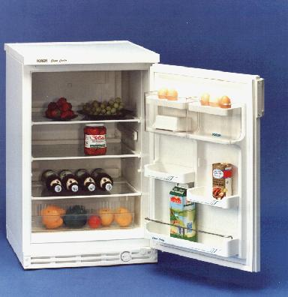
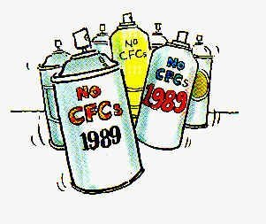
Industrial Production of New Greenhouse Chemicals
CFCs
HCFCs
Alternative refrigerants
Still contribute to the greenhouse effect

Slide 13
Sources of greenhouse gases
Major contributors of N₂O:
agricultural soil (nitrogen from synthetic fertilizers)
Nitrogen fixing crops
Manure

Slide 14
Increasing CO₂ concentrations
IPCC: 3,000 scientists working together to assess climate change

Slide 15
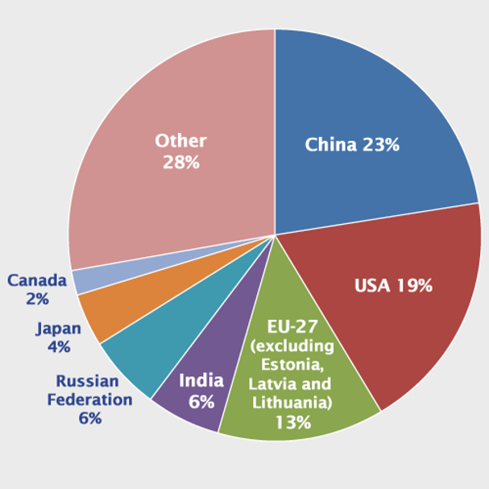
Developed vs. Developing World emissions
China is leading emitter of CO₂
Developed countries have a higher per capita emission of CO₂
U.S. is first in per capita emissions of CO₂

Slide 16
Global Temperatures since 1880
Temperatures are rising, especially in the extreme northern latitude

Slide 17
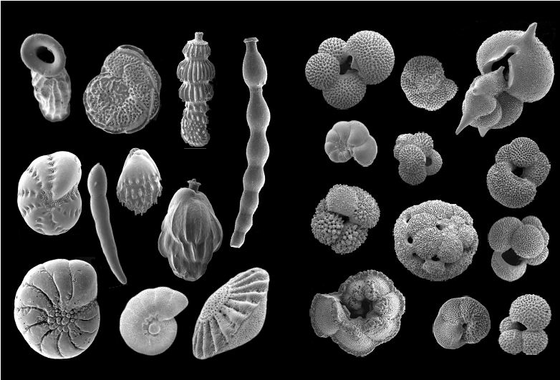
Methods to measure ancients temperatures
Foraminifera: tiny protists that resist decay
Build up in sediments in the ocean floor
Different species prefer different temperatures
Ice Cores
Ice captures air bubbles
Measure concentrations of CO₂ and CH₄
Determine temperature with oxygen isotopes

Slide 18
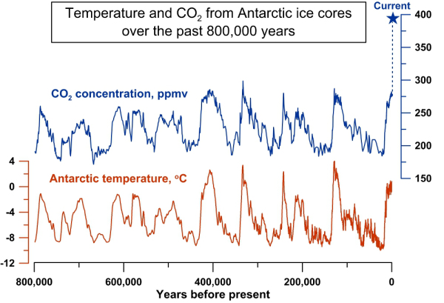
CO₂ and Temperature
Increase in CO₂ → increase in greenhouse effect
Warmer temperatures→ ocean holds less CO₂
Average temperatures experienced today are highest in 2,000 years

Slide 19
Climate Change and Models
Models are used to predict future climates
Models must make assumptions
Same prediction from multiple models ensures accuracy

Slide 20
Homework
Read through page 537 in the textbook
Read climate change article and answer questions

Slide 21
Math Groups!
Group 1: Rimsha, Ramlah, Monica
Group 2: Cynthia, Wyllana, Rahila, Uzma
Group 3: Hamna, Shayna, Amrat, Mahnoor
Group 4: Attia, Wendy, Bukurie, Saliha
Group 5: Mehrangiz, Desire, Kaylah, Harmanpreet

Slide 22
Group Rules
Start with the end!
Ask 3 before me!
Check answers with each other!
Then check answers with me before moving on the the next section!

Slide 23
Notes
#1: bukurie and bob are the same person
Do #1, 2 and 4 without a calculator

Slide 24
Al Gore: Climate Change
https://www.ted.com/playlists/151/earth_appreciated

