Slide 1
SWBAT identify natural sources of climate change.
APES Unit 7 1/8/16

Slide 2
Agenda
Rahila’s Presentation
Lecture
Hw
Help with room next week (lunch, before, or after school)!!

Slide 3
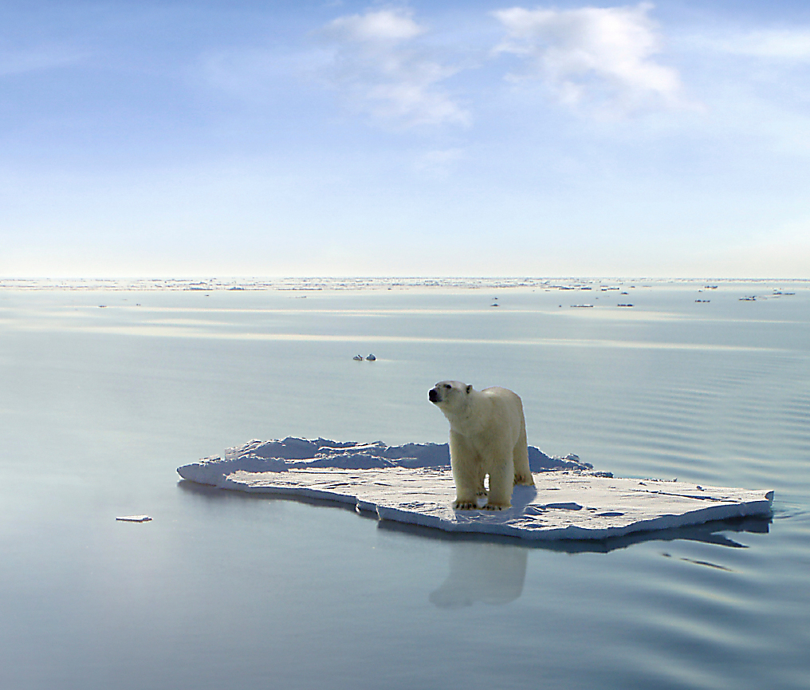
Global Climate Change
Ch. 19
1.5 weeks
Essential Questions:
How are humans impacting the planet?
Can organisms adapt to climate change?
Current Event Presenters: Bukurie and Uzma on Tues. Jan. 19th
Email me topic idea by Friday Jan. 15th

Slide 4
Announcements
Unit 7 Exam: Friday 1/15
Midterm on 1/22

Slide 5
Global Climate Change
Scientists are in consensus that global climate change is occurring
Global Climate Change: increased storm intensity, altered patterns of precipitation and ocean circulation
Global warming: warming of the earth’s oceans, landmasses and atmosphere, reduced cold spells

Slide 6
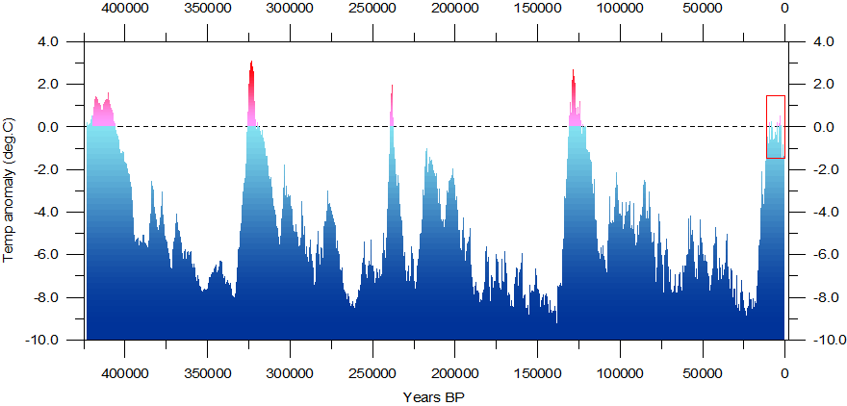
Global Climate Change
Over the past 1 million years of earth’s history, the average trend in Earth’s temperature would be best described as a number of fluctuations varying by a few degrees.

Slide 7
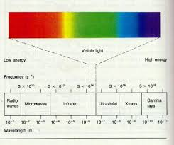
Sun-Earth Heating System
Sun emits energy in the form of UV radiation and visible radiation
Some of this energy is absorbed by earth
Earth re-radiates this energy as infrared radiation

Slide 8
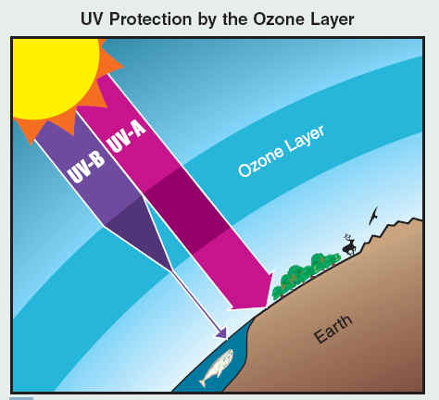
Sun-Earth Heating System
UV and visible light pass easily through the atmosphere
Some UV rays absorbed by ozone layer

Slide 9
The greenhouse effect
Greenhouse gases absorb various wavelengths of infrared and transform this radiation to longer wavelengths of radiation.
Infrared radiation cannot pass through the atmosphere
Some of it trapped by gases, which then warm the atmosphere (The Greenhouse Effect)
Without the greenhouse effect, energy would escape the Earth’s atmosphere

Slide 10
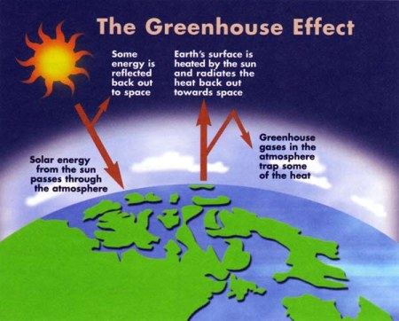
The Greenhouse Effect

Slide 11
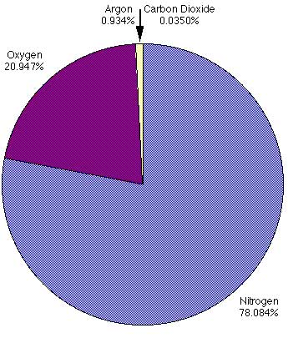
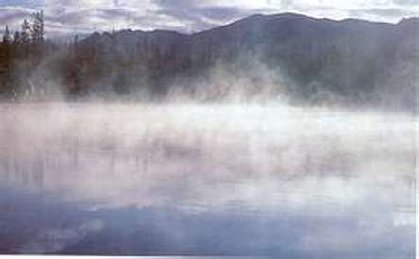
Greenhouse Gases
H₂O (most common)
Shorter residence time (doesn’t persist as long in the atmosphere)
The energy that is stored in water vapor is called latent heat

Slide 12
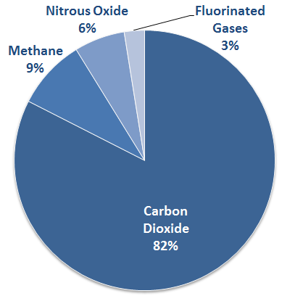
Greenhouse Gases
CO₂
Concentration: 401.85 ppm
Has the longest life span (longest residence time)
The primary environmental abiotic carbon source for the carbon cycle is carbon dioxide in the air
U.S. Greenhouse Gas Emissions in 2012

Slide 13
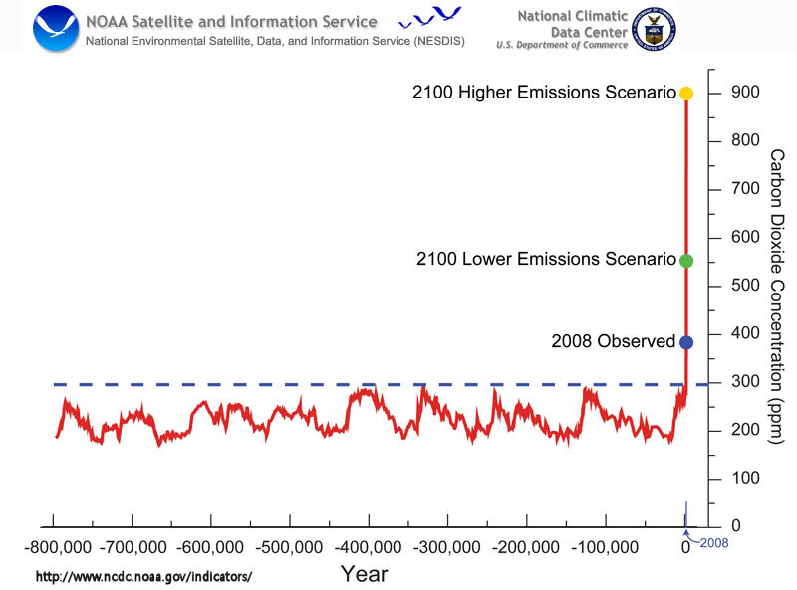
CO₂ Projections

Slide 14
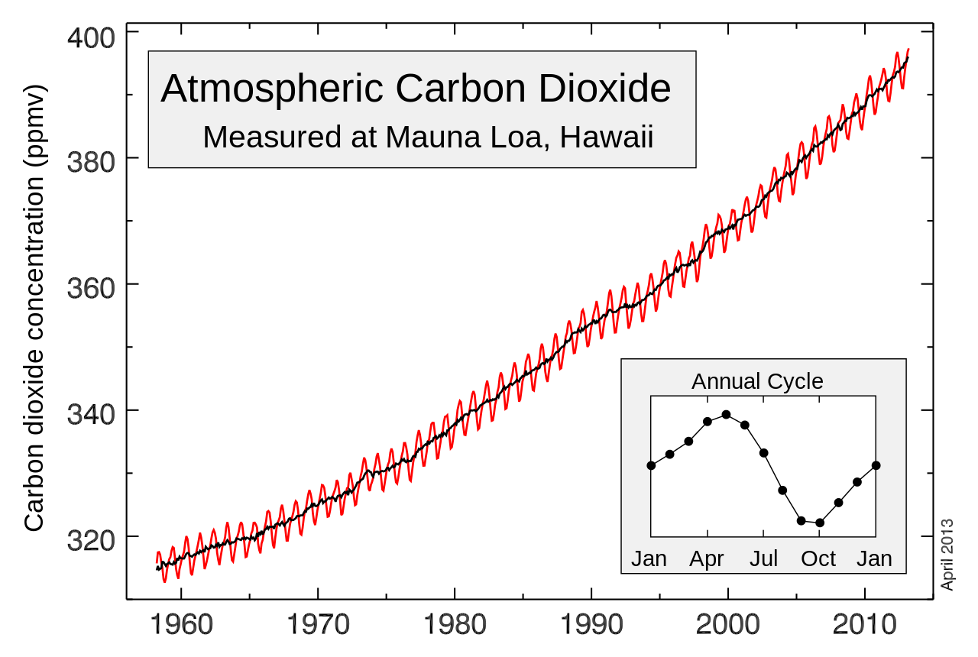
CO₂
Periodic fluctuations in atmospheric CO₂ levels are most directly explained by seasonal variations in photosynthetic activity.

Slide 15
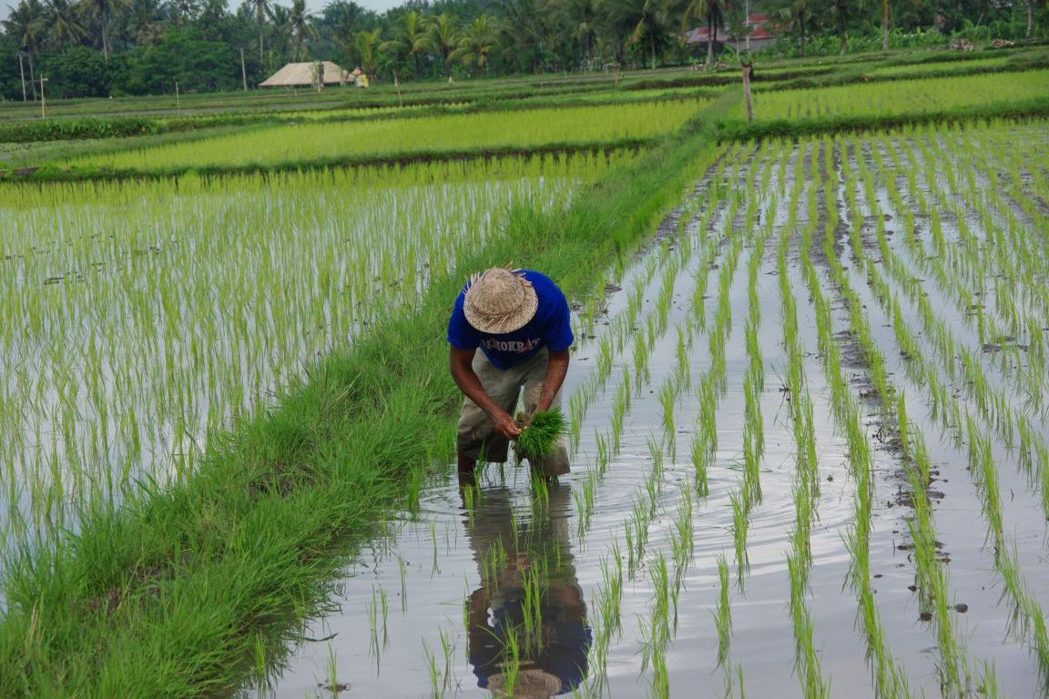
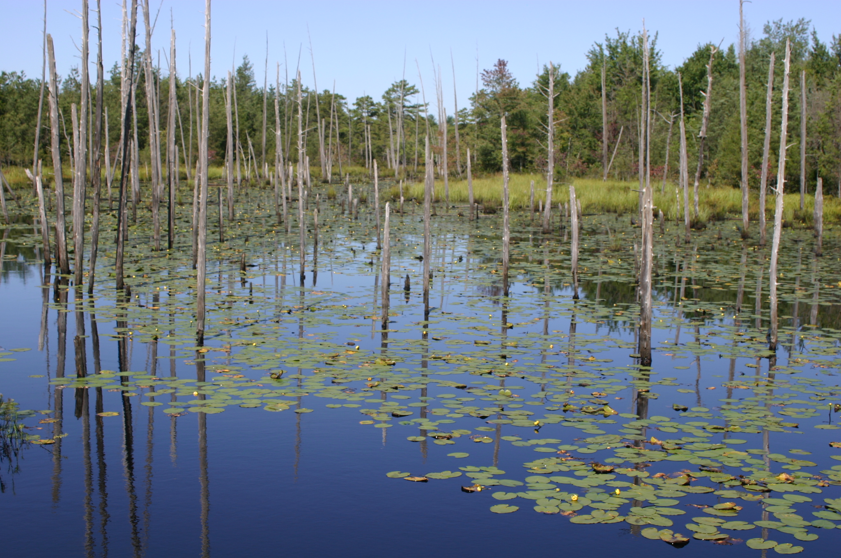
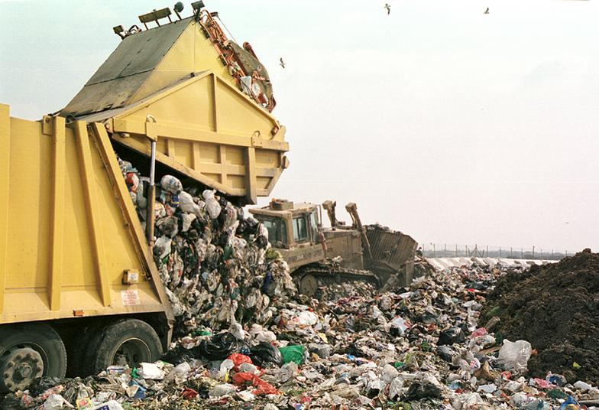
Greenhouse Gases
Methane (CH₄)
Methane sources include:
landfills
Wetlands
natural gas extraction
termites
rice cultivation
enteric fermentation (farts-specifically from cows)
Atmospheric methane concentration is about 1.7 ppm
Over the past 1,000 years, methane concentrations have increased exponentially

Slide 16
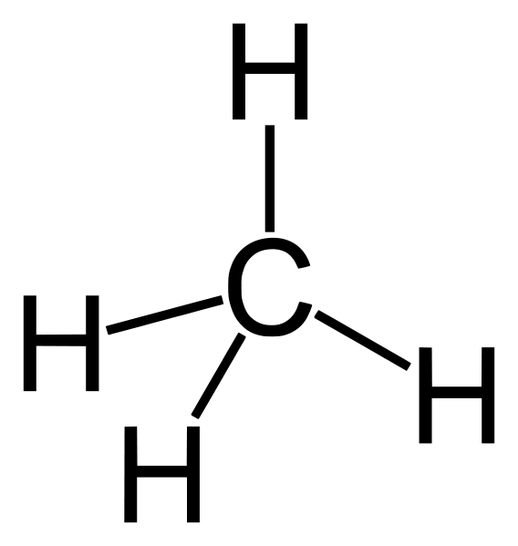
Greenhouse Gases
Methane (CH₄)
Methane is the most effective cause of the Greenhouse Effect (traps heat very well)
Methane is removed from the atmosphere by stratospheric oxidation

Slide 17
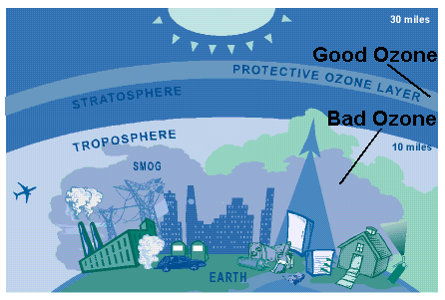
Greenhouse Gases
Nitrous Oxide (N₂O)
CFCs
Releases chlorine in the atmosphere once hit by UV radiation
Primary agent in the destruction of the ozone layer
SF₆
Used in the electrical industry

Slide 18
Homework
Read pages 523-531 in the textbook
Write summaries of the current event presentations (Harmanpreet, Cynthia, Rahila and Hamna) in your current event notebook

