Slide 1
Aim: How can humans preserve biodiversity?
APES Unit 3 11/5/15

Slide 2
Agenda:
Lecture
Video- BEES!!
Zebra Mussel Article
Pass back Ch. 6 Quizzes
Reminder: Current event presentations tomorrow!

Slide 3
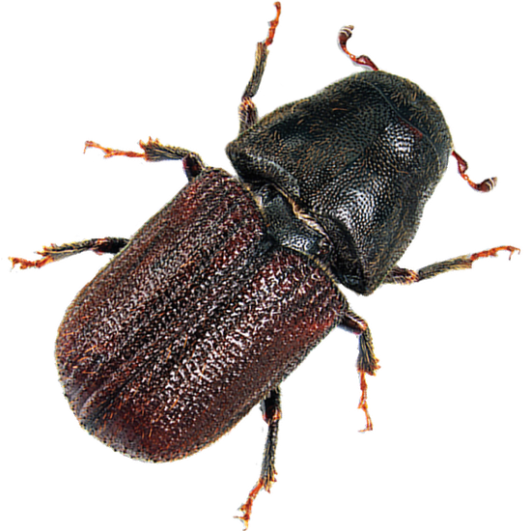
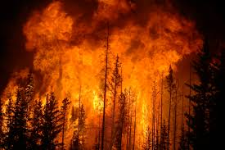
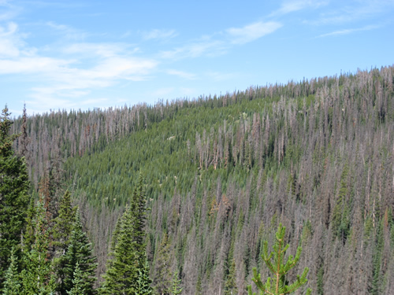
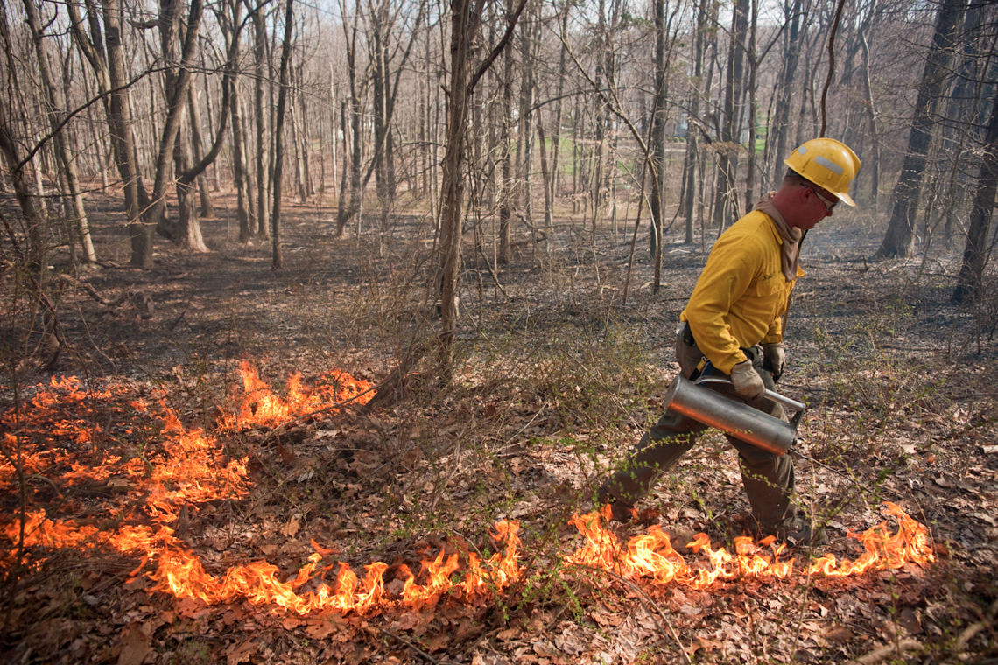
Case Study: Mountain Pine Beetles
Outbreaks of mountain pine beetles can result in losses of millions of trees

Slide 4
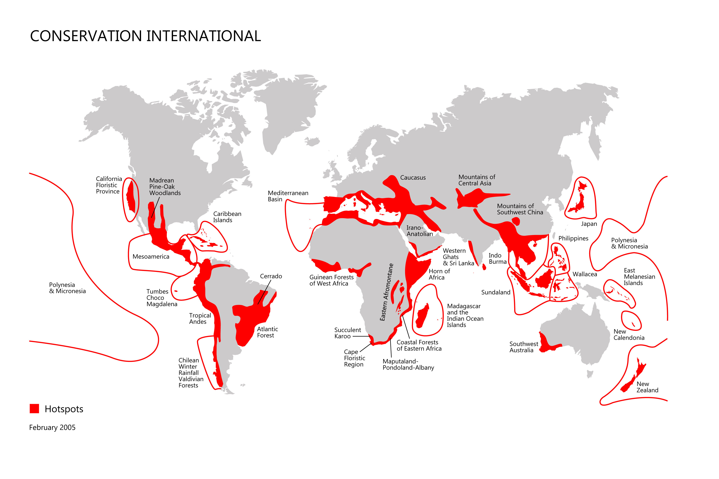
Biodiversity Hot Spot
A highly diverse region that faces severe threats and has already lost 70% of its original vegetation

Slide 5
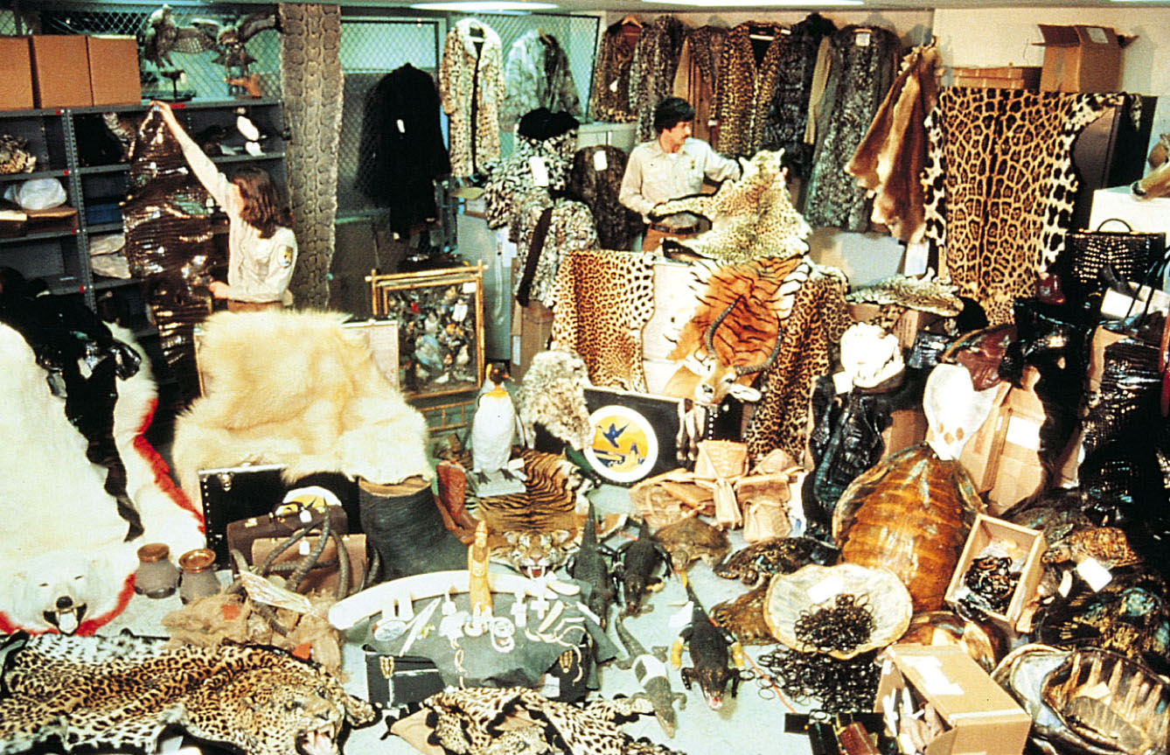
Plant and Animal Trade
Lacey Act (U.S.): Prohibited the transport of illegally harvested game animals and plants across state lines.

Slide 6
Plant and Animal Trade
CITES (U.N.) (Convention on international trade in Endangered Species of Wild Fauna and Flora, 1975)
Determines which species can be listed as threatened or endangered and prohibits the harming of such species
Prohibits the commerce of those species considered to be endangered or threatened
Red list: list of threatened species
U.S. Fish and Wildlife Service regulates import and export of species on the list.

Slide 7
Illegal trade
Trading illegal wildlife is worth billions of dollars
Case study: Philippines forest turtle
Very endangered but high demand on illegal market

Slide 8
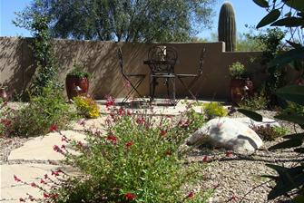
Legal trade can be dangerous too
Case Study: Desert landscape
Not much water → more demand for desert plants

Slide 9
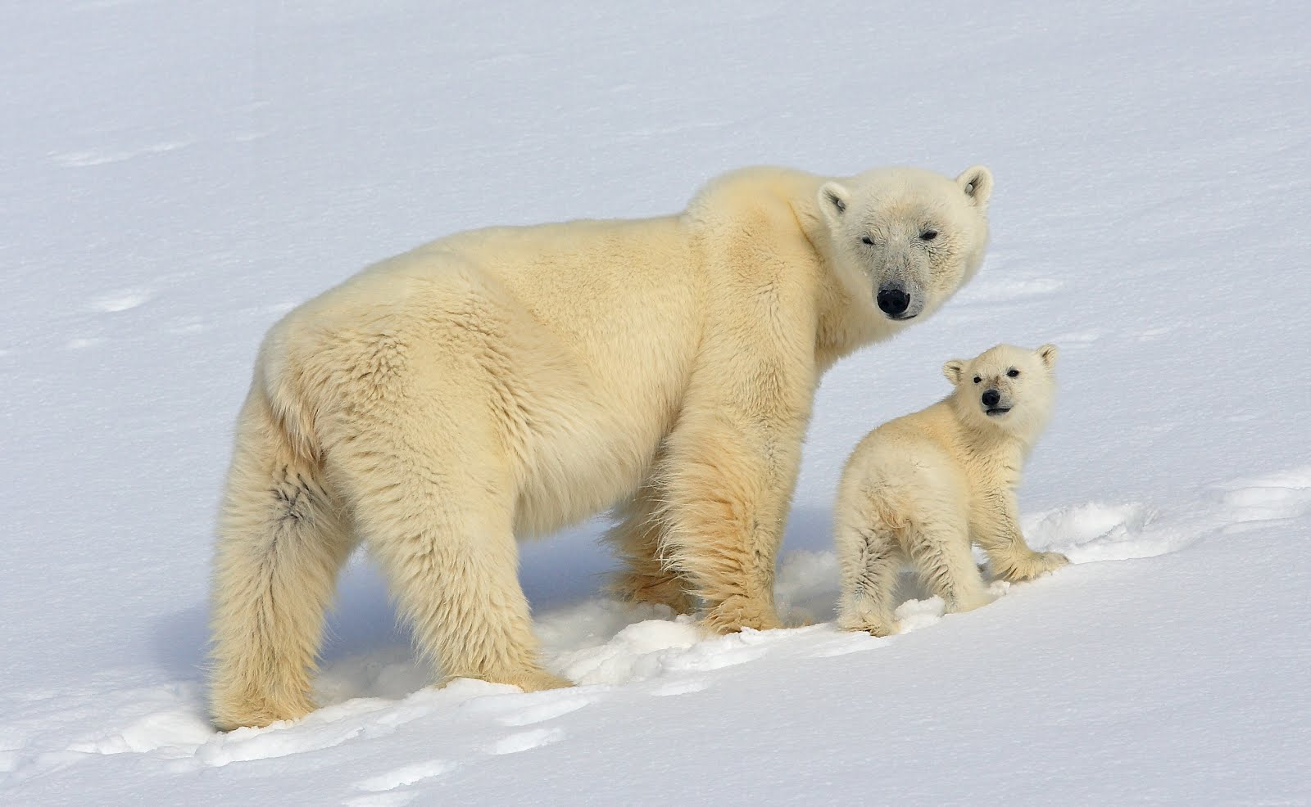
Conservation Legislation
Marine Mammal Protection Act (1972): Prohibits the killing of all marine mammals in the U.S. and prohibits the import or export of any marine mammal body parts.
Protects:
Polar bears
Sea otters
Manatees
California sea lions

Slide 10
Conservation Legislation
Endangered Species Act:
Government can purchase habitat in order to conserve species
Controversial: Should the government protect the habitat of endangered species at the expense of the economy?
Endangered species can make a comeback!
Bald Eagle
American Alligator
Gray whale

Slide 11
Conservation Legislation
Convention on Biological Diversity (1992): International Treaty to protect biodiversity
Objectives:
Conserve biodiversity
Sustainably use biodiversity
Share the benefits that emerge from commercial use of genetic resources

Slide 12
Conservation of biodiversity
Current trends:
¼ of all plant species threatened with extinction
Species at risk of extinction closer to extinction
Widespread loss of ecosystem function
☹

Slide 13
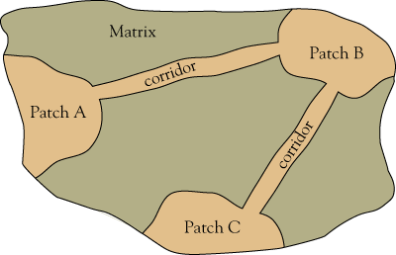
Conservation of biodiversity
Theory of island biogeography and biodiversity
When creating smaller protected areas, need to be close enough for species to move among them

Slide 14
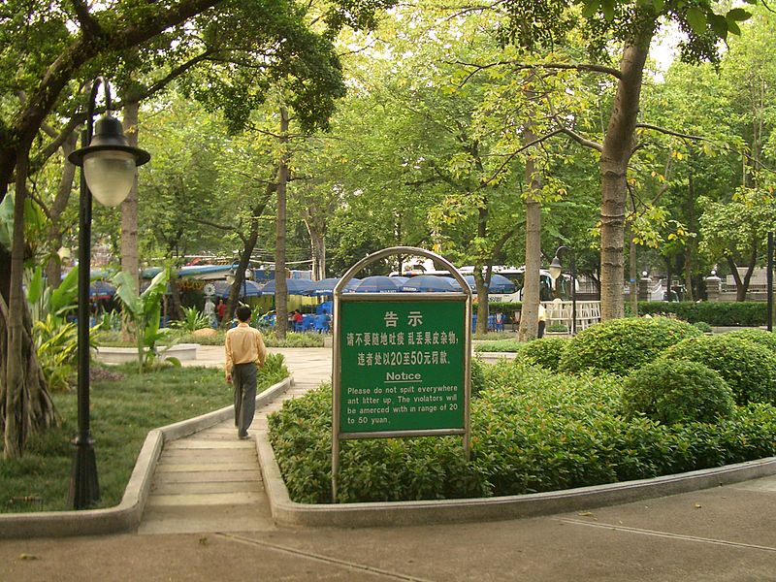
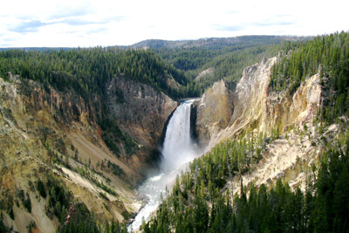
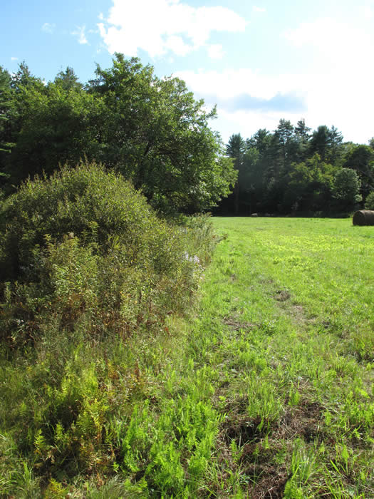
SLOSS
Single large or several small habitats?
Edge habitat occurs where two different communities come together, forming a transition.
Problem: More small preserves→ more edge habitat→ more species that inhabit the edge habitat

Slide 15
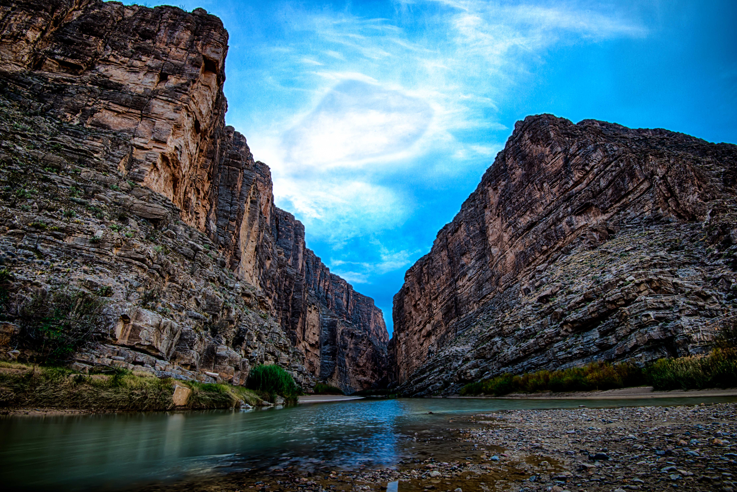
Biosphere Reserves
Biosphere reserves protect biodiversity without excluding all human human activity.
Core: minimal human contact
Buffer zone: modest amounts of human activity
Transition area: housing, agriculture, etc.

Slide 16
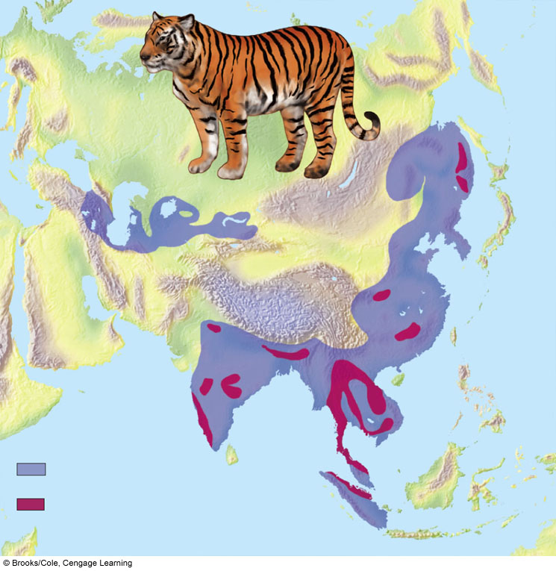
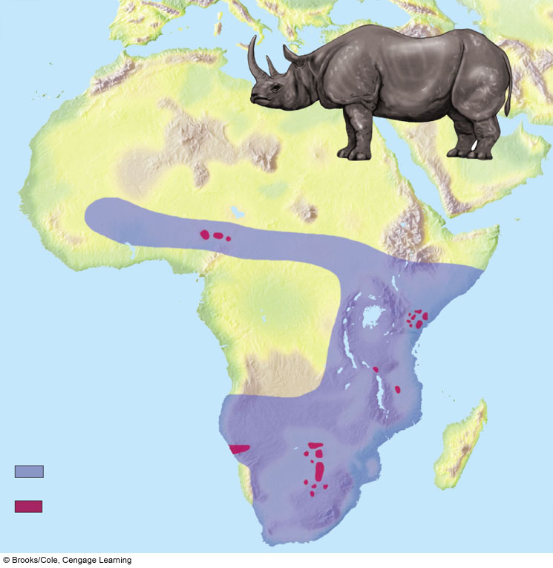
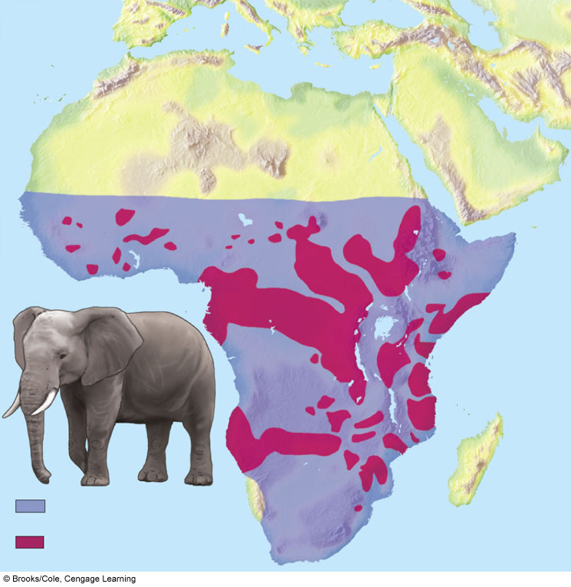
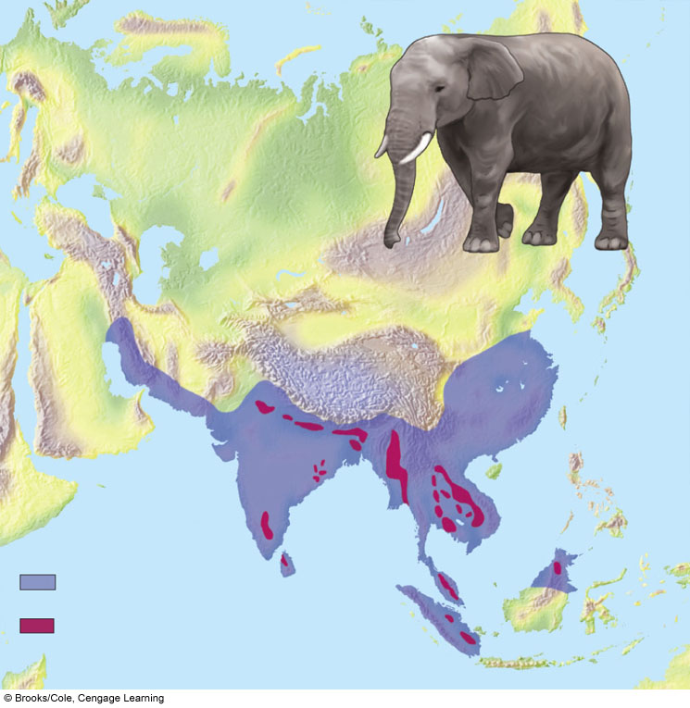
Indian Tiger
Black Rhino
Range 100 years ago
Range today
Range in 1700
Range today
African Elephant
Asian or Indian Elephant
Former range
Probable range 1600
Range today
Stepped Art
Range today
Fig. 9-10, p. 199

Slide 17
Discussion Question:
What is our best option for conserving biodiversity?

Slide 18
Aim: What are the causes and effect of colony collapse disorder?

Slide 19
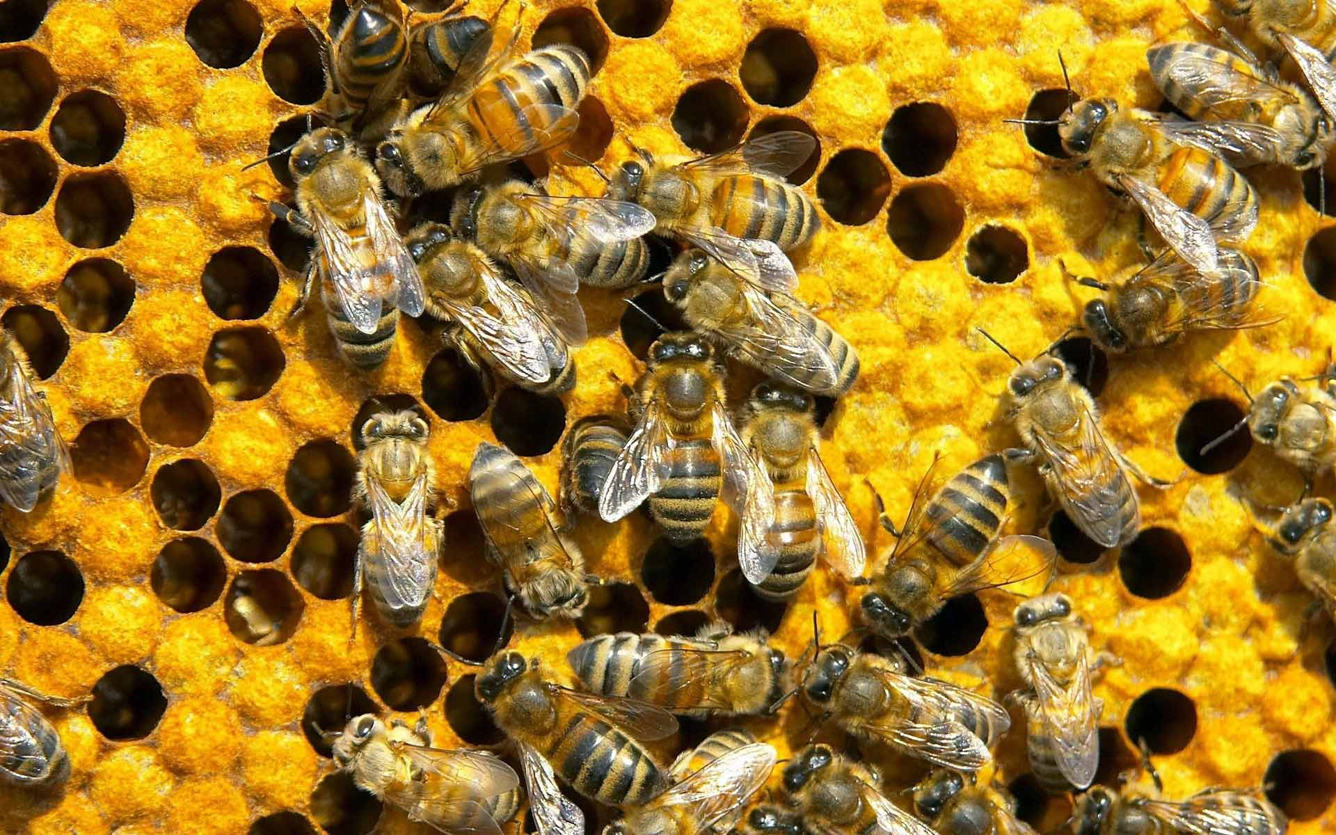
Turn and Talk
What is the purpose of bees?
How do you think the disappearance of bees could affect humans?

Slide 20
Ted Talk
http://www.ted.com/talks/marla_spivak_why_bees_are_disappearing.html

Slide 21
Discussion
Do you think many people are aware of the disappearance of bees? Why or why not?
How might we increase awareness?

Slide 22
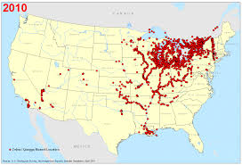
Invasive Species Case Study: Zebra Mussels

Slide 23
Homework
Zebra Mussel Reading
Unit 2 FRQ re-write

