Slide 1
Aim: How do humans affect biodiversity?
APES Unit 3 11/4/15

Slide 2
Agenda
Lecture
Homework/wrap up
Video

Slide 3
Homework Share Out
Endangered species

Slide 4
Alien Species
Native species: species that live in their historical range.
Alien (exotic) species: live outside their historical range
Introducing exotic species can lead to decreased biodiversity
Biotic pollution entails introducing exotic species to a new environments

Slide 5
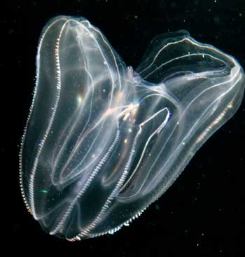
Exotic species: Case Study
Ctenophere introduced to the black sea
Eliminated commercially important fisheries
Outcompeted other small fishes

Slide 6
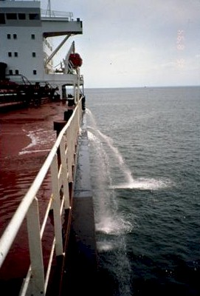
Invasive Species
Invasive Species: When alien species spread rapidly across large areas
Have no natural enemies in the area
Often transported to other continents by way of:
Aircrafts
Ballast water in tankers
Imported products such a wooden packing crates

Slide 7
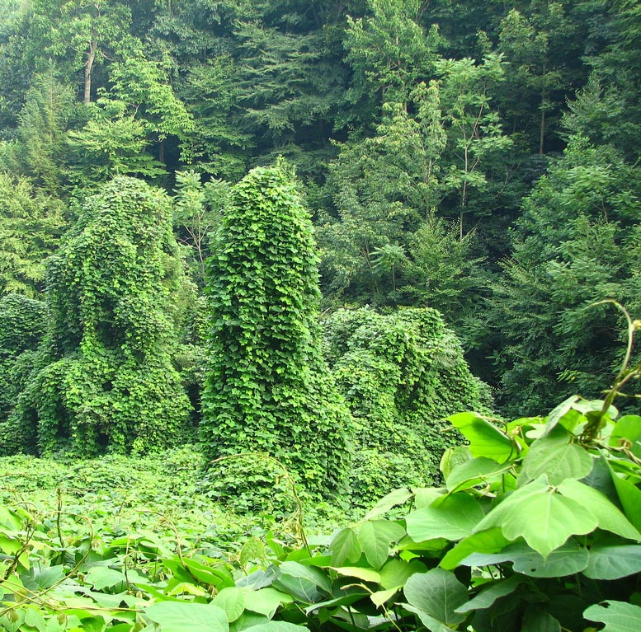
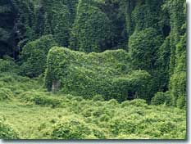
Invasive Species Case Study: The Kudzu Vine
Native to southeast japan and southeast china
Farmers encouraged to plant it reduce erosion
Blocks out sunlight
Covers about 7 million acres in the U.S.

Slide 8
Controlling invasive species
Chemical control: use pesticides
Physical control: Put up physical barriers (fence)
Biological control: Introduce a predator to control the invasive species
Introduced cane toads to prey on insect pests
Negative impact: toxic to native predators
Introduced Mongooses to sugarcane fields to protect them from rat and snake damage
Negative impact: Prey on birds and small reptiles

Slide 9
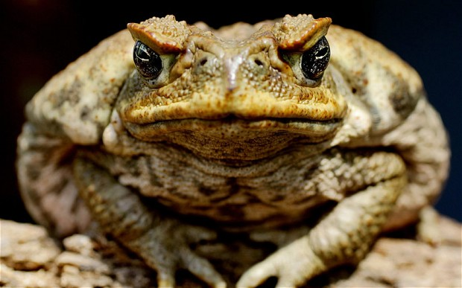
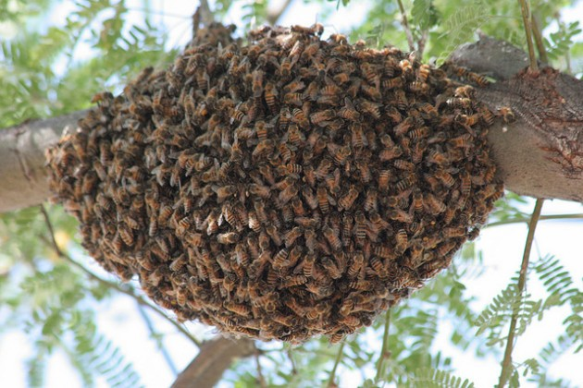
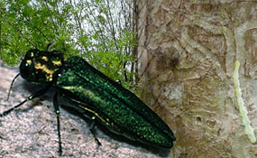
Other Invasive Species
Cane Toad: Toxins Kill native Predators
Africanized/killer bees: Attacks people/ displaces honeybees
Esmerald ash borer: burrowing and feeding kill trees

Slide 10
Why invasive species thrive in new environments
Possible reasons:
Generalist species
R-selected species
Superior defense against predators in a new environment
Superior skills as a predator in a new environment

Slide 11
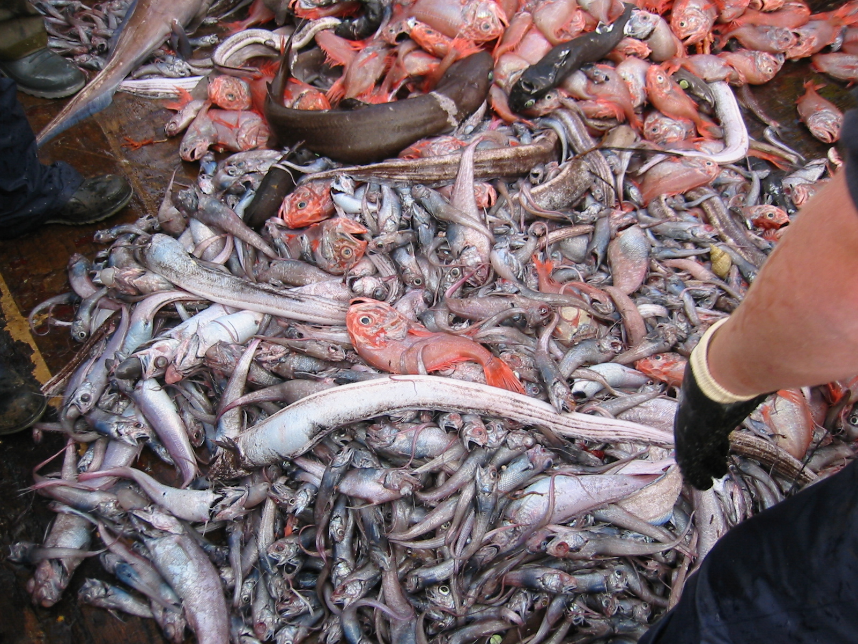
Overharvesting
Huge decline in the worldwide fish population
Is of grave concern because
Loss in biodiversity outweigh gains in food supply
One-fourth of the global catch is by-catch

Slide 12
Effects of Overharvesting on the Ocean
Coral is being crushed and degraded from deepwater fishing
Whales and dolphins die in the process of fishing for other marine species
Pollution has led to the decrease in yield of marine catch, causing increased fishing
Sea Turtles often drown from shrimping operations

Slide 13
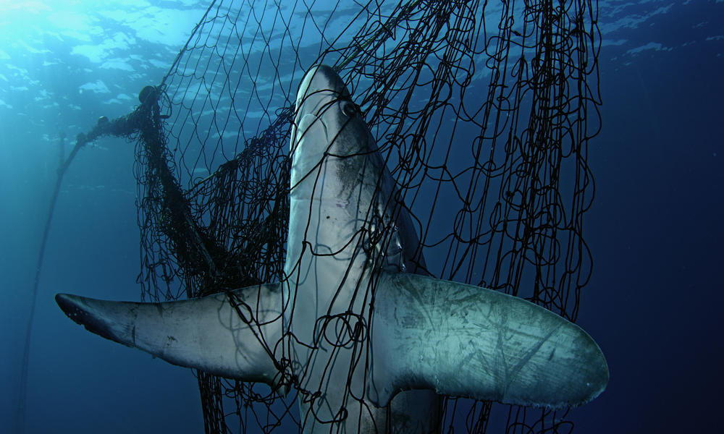
By-catch

Slide 14
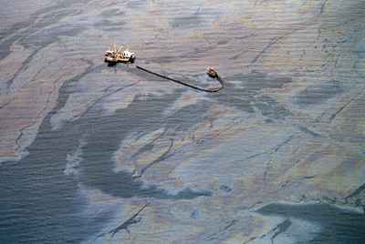
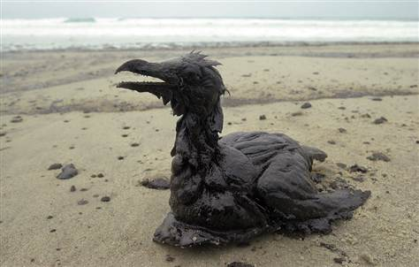
Pollution
Threats to biodiversity:
Pesticides
Heavy metals
Acids
Oil spills

Slide 15
Climate Change and Biodiversity
Climate change can affect biodiversity by
Increasing CO₂ levels in the atmosphere
Increased nitrogen deposition
Increased acid deposition
Global temperature changes
In the future, climate change is likely to cause invasive species to dominate in freshwater ecosystems, especially lakes

Slide 16
Invasive Species Article
Any invasive species OTHER than the zebra mussel
Can be an animal or a plant!

Slide 17
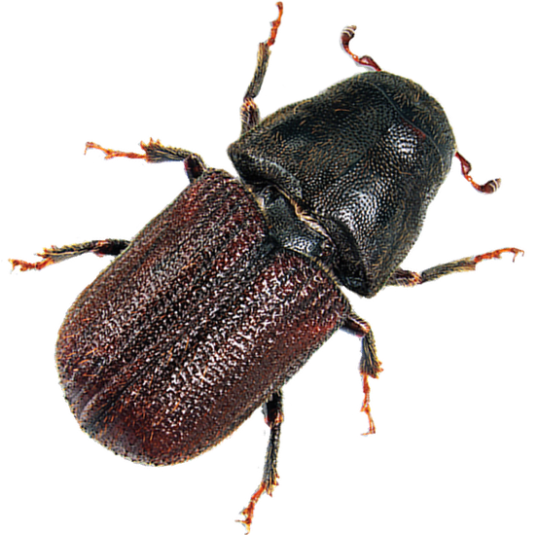
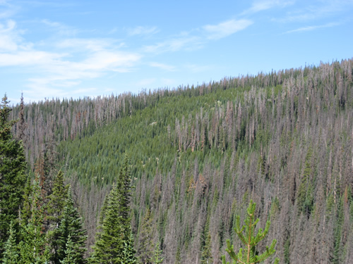
Case Study: Mountain Pine Beetles
Outbreaks of mountain pine beetles can result in losses of millions of trees

Slide 18
Homework
Finish reading Chapter 18 (ALL the way to the end)!
Read the article on Mountain Pine Beetles and answer questions

