Slide 1
SWBAT use unit conversions to solve an FRQ.
APES Unit 3 11/2/15

Slide 2
Agenda
Math FRQ
Lecture
Pass back Unit 2 Exams
Check on Seeds
Announcement: Unit 3 Exam on Monday (11/9)
All late/absent work for this unit due by Monday
When handing in reading notes late or absent, label it as reading notes Ch. ___ #1, #2 or #3
Monica and Desire: Current event presentations on Friday

Slide 3
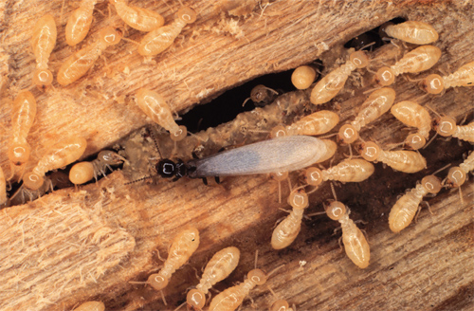
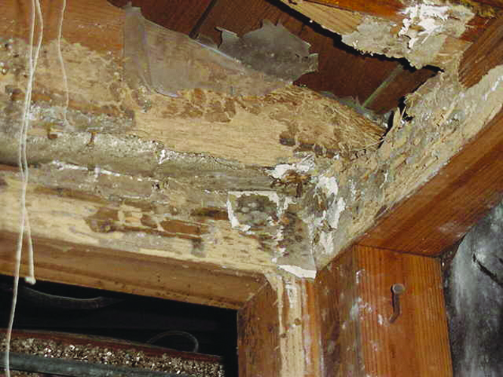
Termites!!
Infest dead or dying trees and speed up the natural cycle of deterioration
Found in dark, damp areas
Need a source of moisture to survive
41 species found in the U.S., most in the southwest.
Have symbiotic protists that live in their gut and help eat wood

Slide 4
Termite FRQ
Read the math FRQ fully
When you finish math call me over to check it
Start answering the non-math portions of the FRQ with group members

Slide 5
Dimensional Analysis (unit conversions)
What is a conversion factor?
A fraction in which the numerator and the denominator both represent the same measurement.
They can be flipped!

Slide 6
Steps for doing unit conversions
Write the answer unit first!
Find the conversion unit that involves the answer unit
Write the unit conversion factor with the answer units on top
Find a value in the problem that has the same units that appear on the bottom of the unit conversion factor
Repeat steps 3 and 4 until all units (except the answer units) have cancelled

Slide 7
Groups!
Group 1: Rimsha, Ramlah, Monica
Group 2: Cynthia, Wyllana, Rahila, Uzma
Group 3: Hamna, Shayna, Amrat, Mahnoor
Group 4: Attia, Wendy, Bukurie, Saliha
Group 5: Mehrangiz, Desire, Kaylah, Harmanpreet

Slide 8
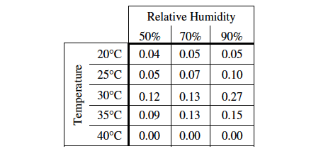
Termite FRQ
Read part A(i): What do the numbers in the table represent?
Answer part A

Slide 9
Termites, Humidity, and Temperature
Reason: Temperature and humidity are limiting factors for plant growth and survival
Explanation: With fewer plants available, less food will be available and termite numbers will decline

Slide 10
Termite FRQ
B (i)
Forest cleared→ more wood→ more food for termites!
B (ii)
Termite population exceeds carrying capacity and crashes
Consume all of their food supply and die off due to lack of food

Slide 11
Aim: How are humans affecting biodiversity?
APES Unit 3 11/2/15
Ch. 18

Slide 12
Extinction
Extinction: last member of a species dies
99% of all species on earth have gone extinct
Average species becomes extinct after 5 million to 10 million years
The 6th mass extinction:
Caused by humans
Rate of decline of species is 100 to 1,000 times faster

Slide 13
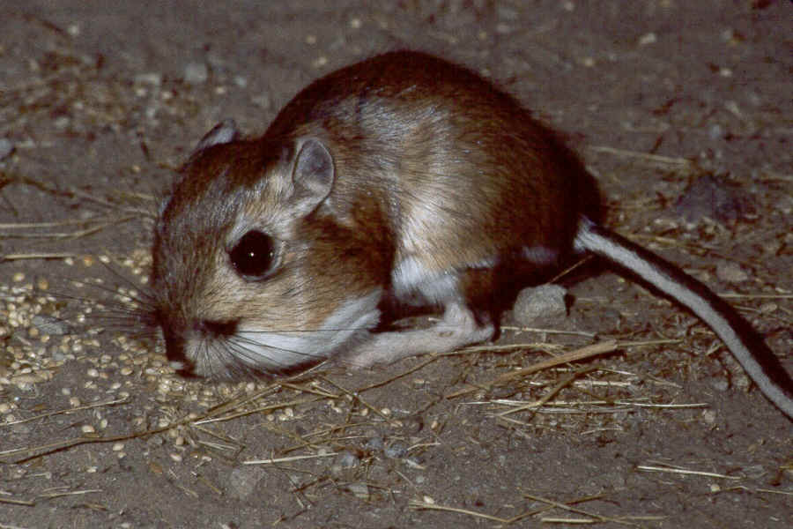
Ecological Smoke Alarms
Endangered species: could soon be extinct
Example:
Kangaroo rat
Characteristics that tend to increase the risk of a species becoming endangered
Having a very limited distribution
Being a specialist at the end of a long food chain
Having a small population size

Slide 14
Ecological Smoke Alarms
Indicator Species: Species that provide early warnings of damage to a community or ecosystem
Examples:
Birds
Found almost everywhere
Affected quickly by environmental changes
Butterflies
Amphibians
Indicates presence of pollution and pathogens

Slide 15
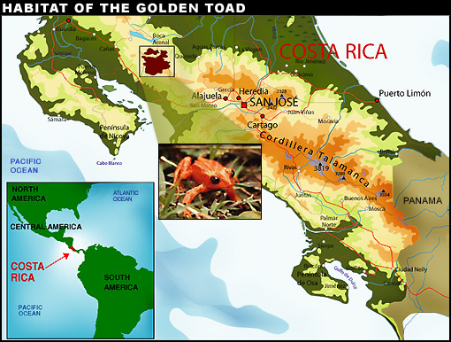
Golden Toad Crisis

Slide 16
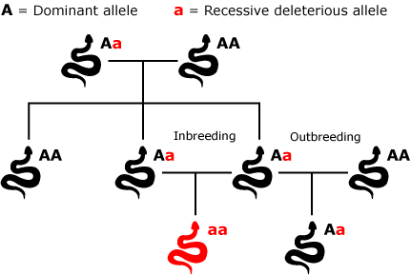
Declines in Genetic Diversity
Low genetic diversity → less chance of surviving environmental change
Inbreeding depression: When individuals with similar genotypes– typically relatives--- breed with each other and produce offspring that are less likely to survive and reproduce.

Slide 17
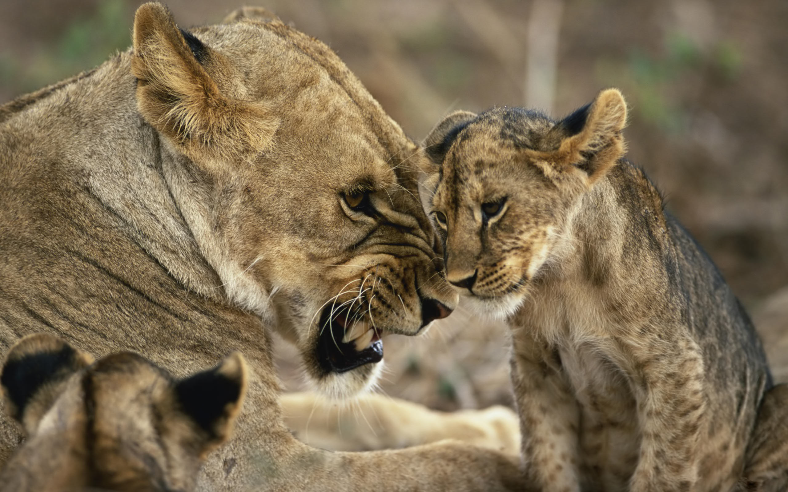
Declines in Genetic Diversity
Can have natural causes
Example: Cheetahs have very low genetic diversity
Cause: Population bottleneck
Can have human causes
Example: Florida cougar populations have low genetic diversity
Cause: hunting and habitat destruction

Slide 18
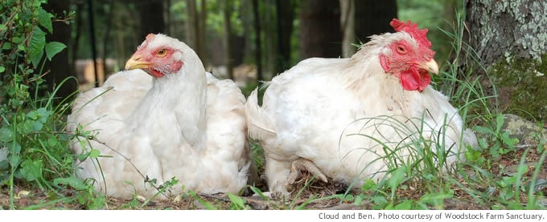
Declining genetic diversity in livestock
Majority of livestock comes from seven species of mammals and four species of birds
80% of breeds of domesticated animals are declining or facing extinction

Slide 19
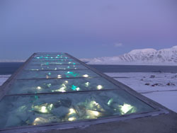
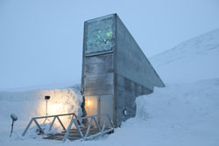
Declining genetic diversity in crops
Green revolution: productivity favored over genetic variation
Disadvantage: crops are not resistant to biotic or abiotic changes
1970s corn fungus in U.S. killed half the crop
Svalbard Global Seed Vault: International seed storage facility in Norway

Slide 20
Global Declines in Species Diversity
Data-deficient species: have no reliable data to assess their status
Reasons:
New species are constantly being discovered
It is expensive to determine the status of animals
Out of 10 million species only 50,000 have been assessed

Slide 21
Global decline in species diversity
Extinct species: known to exist as recently as the year 1500 but no longer exist today
Threatened (vulnerable) species: numbers declining and may soon become endangered
Near-threatened species: Likely to become threatened in the future
Least concern species: widespread and abundant
Amphibians experiencing greatest global decline

Slide 22
Causes of declining biodiversity
HIPPCO
Habitat destruction, degradation, and fragmentation
Invasive (nonnative) species
Population and resource use growth
Pollution
Climate change
Overexploitation

Slide 23
Habitat Loss
Habitat fragmentation: breakup of habitat into smaller pieces, usually as a result of human activities.
Effects:
Decreased food resources
Decreased carrying capacity
Reduction in species diversity
Increased edge or surface area can result in increased vulnerability to predators
Increased edge or surface area can result in increased vulnerability to fire

Slide 24
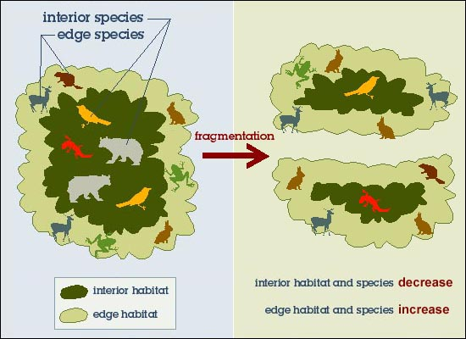
Habitat Fragmentation

Slide 25
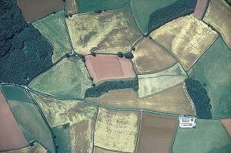
Habitat Loss
The greatest cause of habitat loss, degradation and fragmentation is agriculture

Slide 26
Unit 2 Exam FRQ Notes
Great job answering all parts of the FRQ!
Remember to label FRQ sections. It will make the grader happy ☺
A). i.
A) ii.
Describe more
Biodiversity FRQ:
Increased CO₂ in the ocean is causing increased acidification, NOT increased temperatures
Ecological vs. societal vs. economic benefits
Nature vs. People vs. Money $

Slide 27
FRQ Notes
Biogeochemical Cycles FRQ:

Slide 28
FRQ Notes:
Biogeochemical Cycles FRQ:
Biological process: Something that happens naturally
Burning fossil fuels is not a biological process
C). Deforestation increases the amount of CO₂ in the atmosphere BY:
Less trees→ less photosynthesis→ more CO₂ in the atmosphere
Decomposing trees → CO₂ released back to atmosphere
Slash and burn→ burning trees releases carbon back into atmosphere
FRQ Rockstars: Rimsha, Mahnoor and Mehrangiz

Slide 29
FRQ Re-Write
Quiz Grade
Due Friday!
Rewrite any section of the FRQ for which you missed points
Write one correct answer
Provide an explanation for WHY you missed the point(s)
Do NOT simple copy the entire rubric
Google APES FRQ
Biodiversity FRQ is question 4 from 2013
Biogeochemical cycles FRQ is question 4 from 2014

Slide 30
Interspecific vs. Intraspecific Competition
Write down how many seeds have germinated.
Write down in which cells they have grown the tallest.

Slide 31
NyT Education Course
http://nytedu.com/climate-change.html
3 hours on Saturday
4 Saturdays
School will pay for it!!

Slide 32
Homework
Read Ch. 18 through page 507 (finish climate change section)
Start working on invasive species article!
Research one endangered species in new york and one endangered species in the world
List which biome it belongs to
Explain the causes of why it is endangered
Explain the impact on the ecosystem if this species goes extinct

