Slide 1
SWBAT determine how mercury can bioaccumulate in fish.
APES Unit 10 3/15/16

Slide 2
Part 1– The Problem

Slide 3
Part II- Why should some fish be restricted?
Read the text
Answer the questions in complete sentences with group members

Slide 4
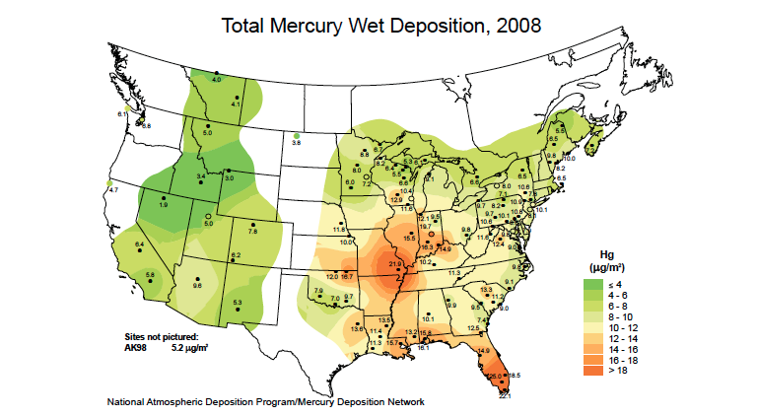
Part III- How does mercury get into fish?
Read the text
Answer the questions in complete sentences and consult with your group members (skip #2)

Slide 5
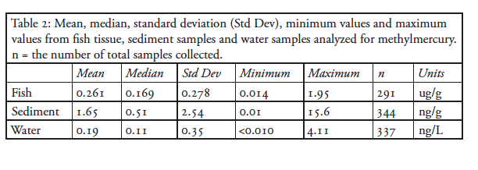
Part III

Slide 6
Homework
Study for the exam tomorrow!

