Slide 1
SWBAT explain the factors that go into risk analysis.
APES Unit 10 3/15/16

Slide 2
Agenda
Lecture
Current Events Presentations

Slide 3
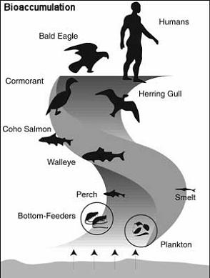
Bioaccumulation
The accumulation of a substance, such as a toxic chemical, in various tissues of a living organism.
Oil soluble chemicals found in soil and stored in fat tissue of animals
Over time the toxin can accumulate

Slide 4
Biomagnification
Increase in chemical concentration in animal tissues as the chemical moves up the food chain
Chemical must be persistent (cannot be broken down by environmental processes)
No or low rate of excretion because they are not soluble in water
Must be concentrated in producers
Ex: DDT
High concentration in birds caused them to produce thin-shelled eggs that often broke

Slide 5
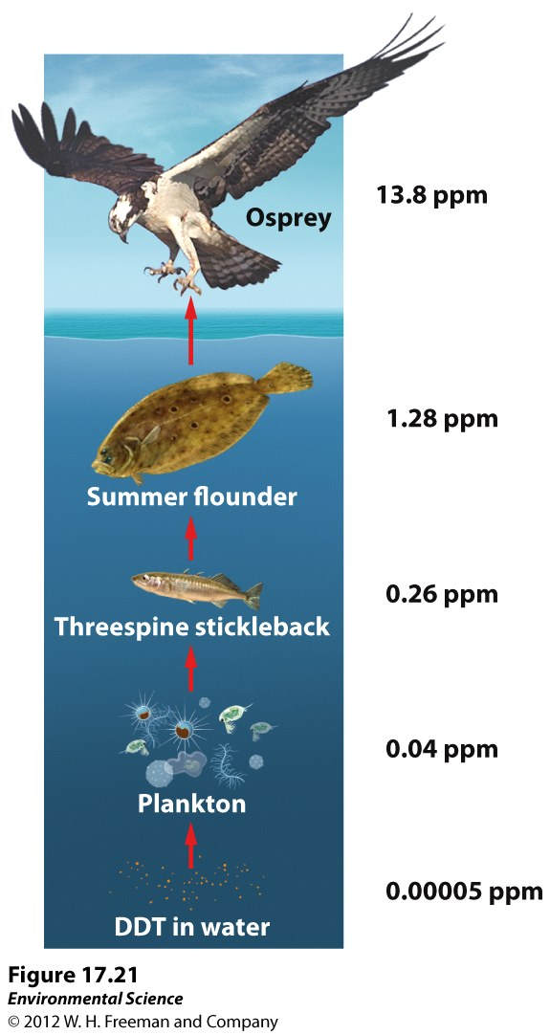
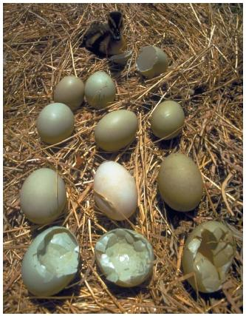
Biomagnification

Slide 6
Persistence
How long a chemical remains in the environment.
Dependent upon:
pH
Location of chemical (water or soil)
If it can be degraded by sunlight or chemicals
Half life of DDT: 30 years

Slide 7
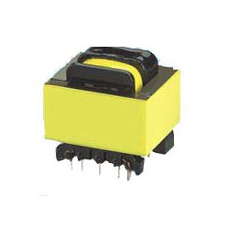
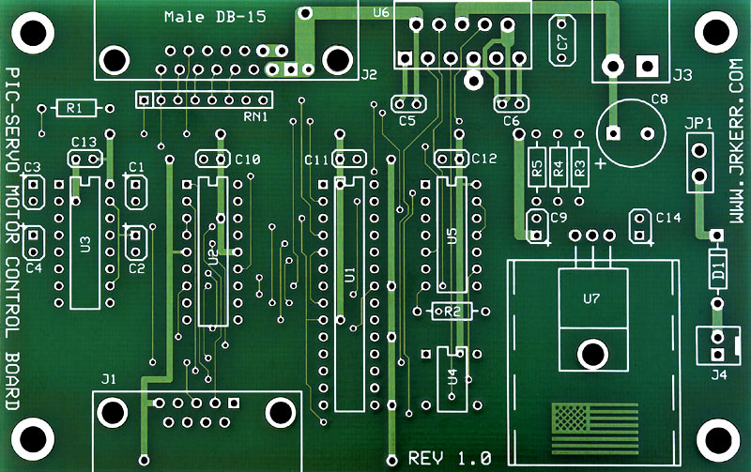
Common Toxic Pollutants
PCBs (Polychlorinated biphenyl) can be found in:
Transformers
Miscellaneous electronics
Paint
Pesticides
Waste oil
PCBs Can enter the body through drinking contaminated water, absorption through skin
Human health effects:
Birth defects
Brain damage
cancer

Slide 8
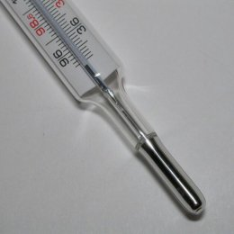
Common Toxic Pollutants
Sources of mercury:
Burning coal plants
Thermometers
Batteries
Appliances
How the pollutant enters the body:
Ingesting seafood contaminated with mercury
Absorption through skin
Medical and dental procedures
Human health effects:
Birth defects
Hearing loss
Damage to the neurological system
Kidney damage

Slide 9
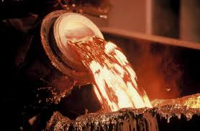
Common Toxic Pollutants
Sources of lead:
Paint
Water pipes
Electronic
Smelting
How lead enters the human body:
Ingesting lead-based paint
Inhaling dust or vapors contaminated with lead
Drinking water contaminated with lead
Human health effects:
Birth defects
Nervous system damage

Slide 10
Risk Assessment
Environmental Hazard: anything in the environment that can potentially cause harm
Risk assessment:
Identify the potential hazard
Determine the magnitude of the potential harm
Qualitative risk assessment: Not based on data
Based on personal judgments

Slide 11
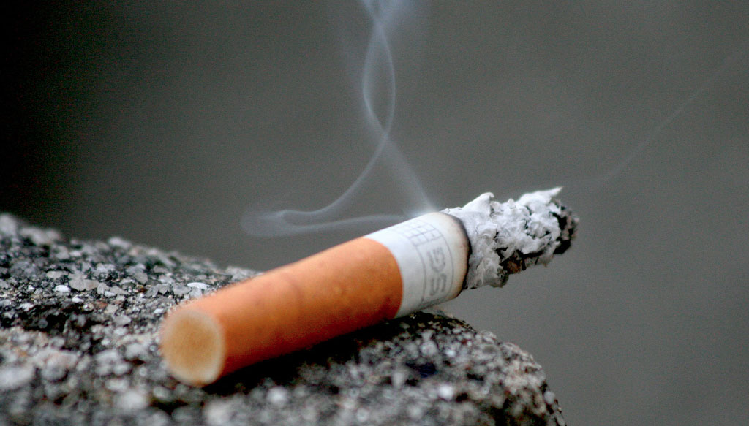
Risk Assessment
Perceived Risk vs. Actual Risk: perception doesn’t always match reality

Slide 12
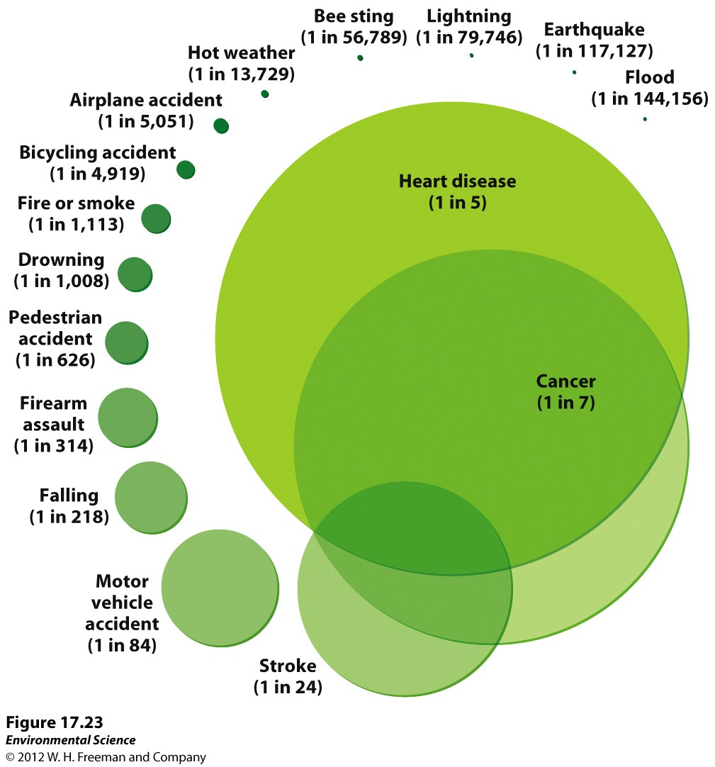
Risk Assessment

Slide 13
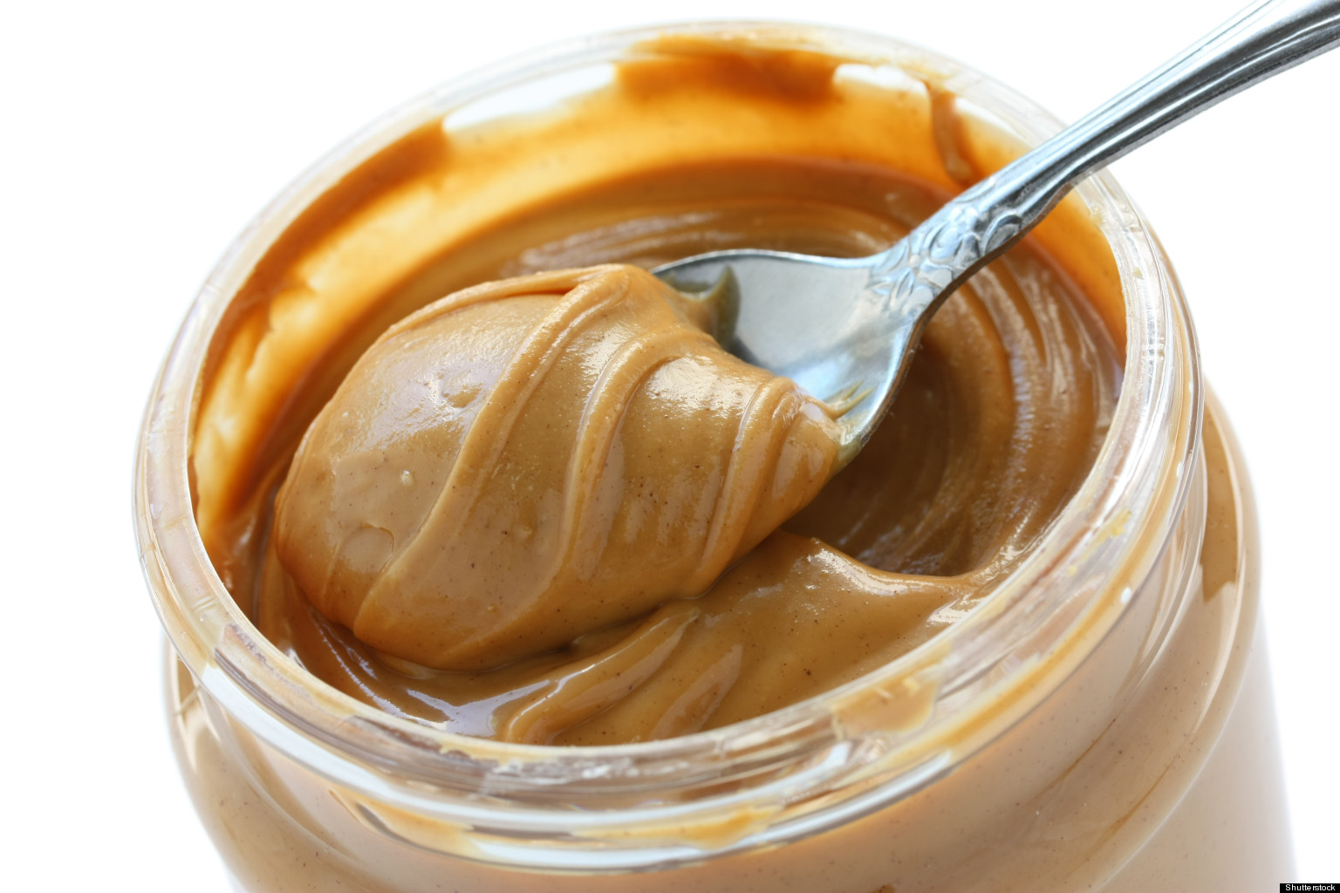
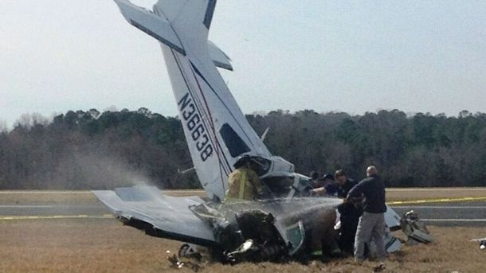
Quantitative Risk Assessment
Risk = (probability of being exposed to a hazard) x (probability of being harmed if exposed)

Slide 14
Risk Acceptance
Level of risk that can be tolerated
EPA: 1 in 1 million risk acceptable for most environmental hazards
Risk analysts might proclaim a risk acceptable based on
People agree to the risks
The risk is not greater than those created by natural hazard
The risk is not greater than those currently tolerated

Slide 15
Risk Management
Regulatory activity carried out by government agencies
Innocent until proven guilty principle: potential hazard should not be considered a hazard until the scientific data can definitively demonstrate that is causes harm
Precautionary Principle: When a hazard is plausible but not yet certain, actions should be taken to reduce or remove the hazard.

Slide 16
Turn and Talk
Which is method do you think is better: innocent until proven guilty or precautionary principle?

Slide 17
Stockholm Convention (2001)
127 nations gathered to reach an agreement on restricting the global use of some chemicals
Produced a list of 12 chemicals to be banned, phased out, or reduced.
Included: DDT, PCB
9 additional chemicals added to the list in 2009

Slide 18
Stockholm Convention (2001)

Slide 19
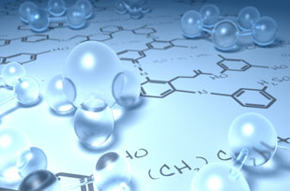
REACh
Agreement put into effect by the European Union
Registration, Evaluation, Authorization and restriction of Chemicals.
Embraces the precautionary principle

Slide 20
Check for Understanding
What is the difference between bioaccumulation and biomagnification?

Slide 21
Cosmetics
Do you think most people are aware of the chemicals in their cosmetics? Why or why not?
Do you think the U.S. should switch to a precautionary principle to approve chemicals in cosmetics? Why or why not?

Slide 22
Homework
Read the lab background info and summarize the lab in a paragraph
Summarize the current event presentations in your current event notebook

