Slide 1
SWBAT: name the five major types of toxic chemicals Distinguish between dose-response studies, retrospective studies, and prospective studies.
APES Unit 10 3/10/16

Slide 2
Agenda
Lecture
Ebola Video
Announcements:
Exam on Thursday
Superintendent on Monday

Slide 3
Ebola Hemorrhagic Fever

Slide 4
Mad Cow Disease
Mad Cow Disease (BVE): a pathogen slowly damages the cows nervous system and dies
Prions: proteins that can mutate into deadly proteins and act as pathogens
Cannot be destroyed by heat
Can be transmitted to humans in the form of Creutzfeldt-Jakob disease (CJD)
Transmission:
Another cow (or human) consumes infected cow

Slide 5
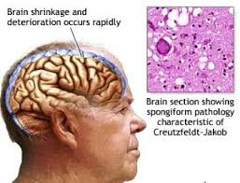
Mad Cow Disease

Slide 6
Bird Flu (Avian flu)
Bird flu: caused by H5N1 virus and infects birds
Can be deadly to domesticated birds
H5N1 strain jumped from birds to humans
Not easily passed among humans

Slide 7
Avian Flu

Slide 8
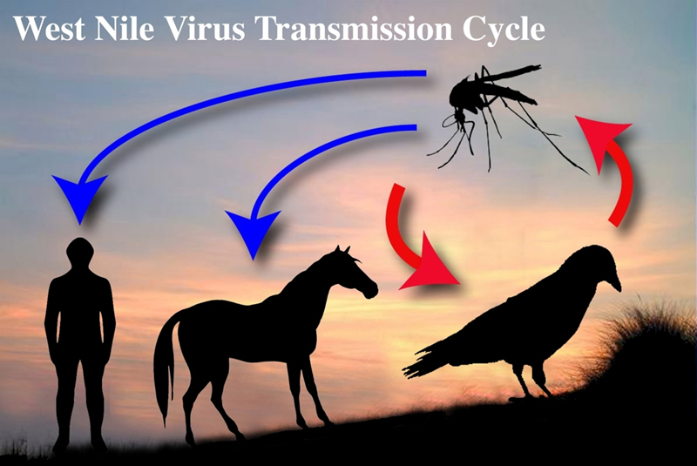
West Nile Virus
Lives in hundreds of species of birds and is transmitted among birds by mosquitos
Symptoms:
Inflammation of the brain
Can lead to death

Slide 9
West Nile Virus

Slide 10
Severe Acute Respiratory Syndrome (SARS)
Caused by a virus
2003 outbreak: more than 8,000 people infected
Transmission: human to human contact
Respiratory droplets when the person coughs or sneezes
Symptoms: high fever, body chills, headache

Slide 11
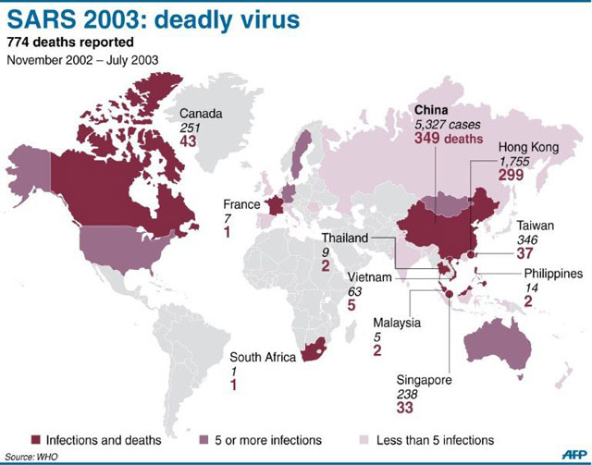
SARS

Slide 12
Types of Harmful Chemicals
Neurotoxins
Carcinogens
Teratogens
Allergens
Endocrine disruptors

Slide 13
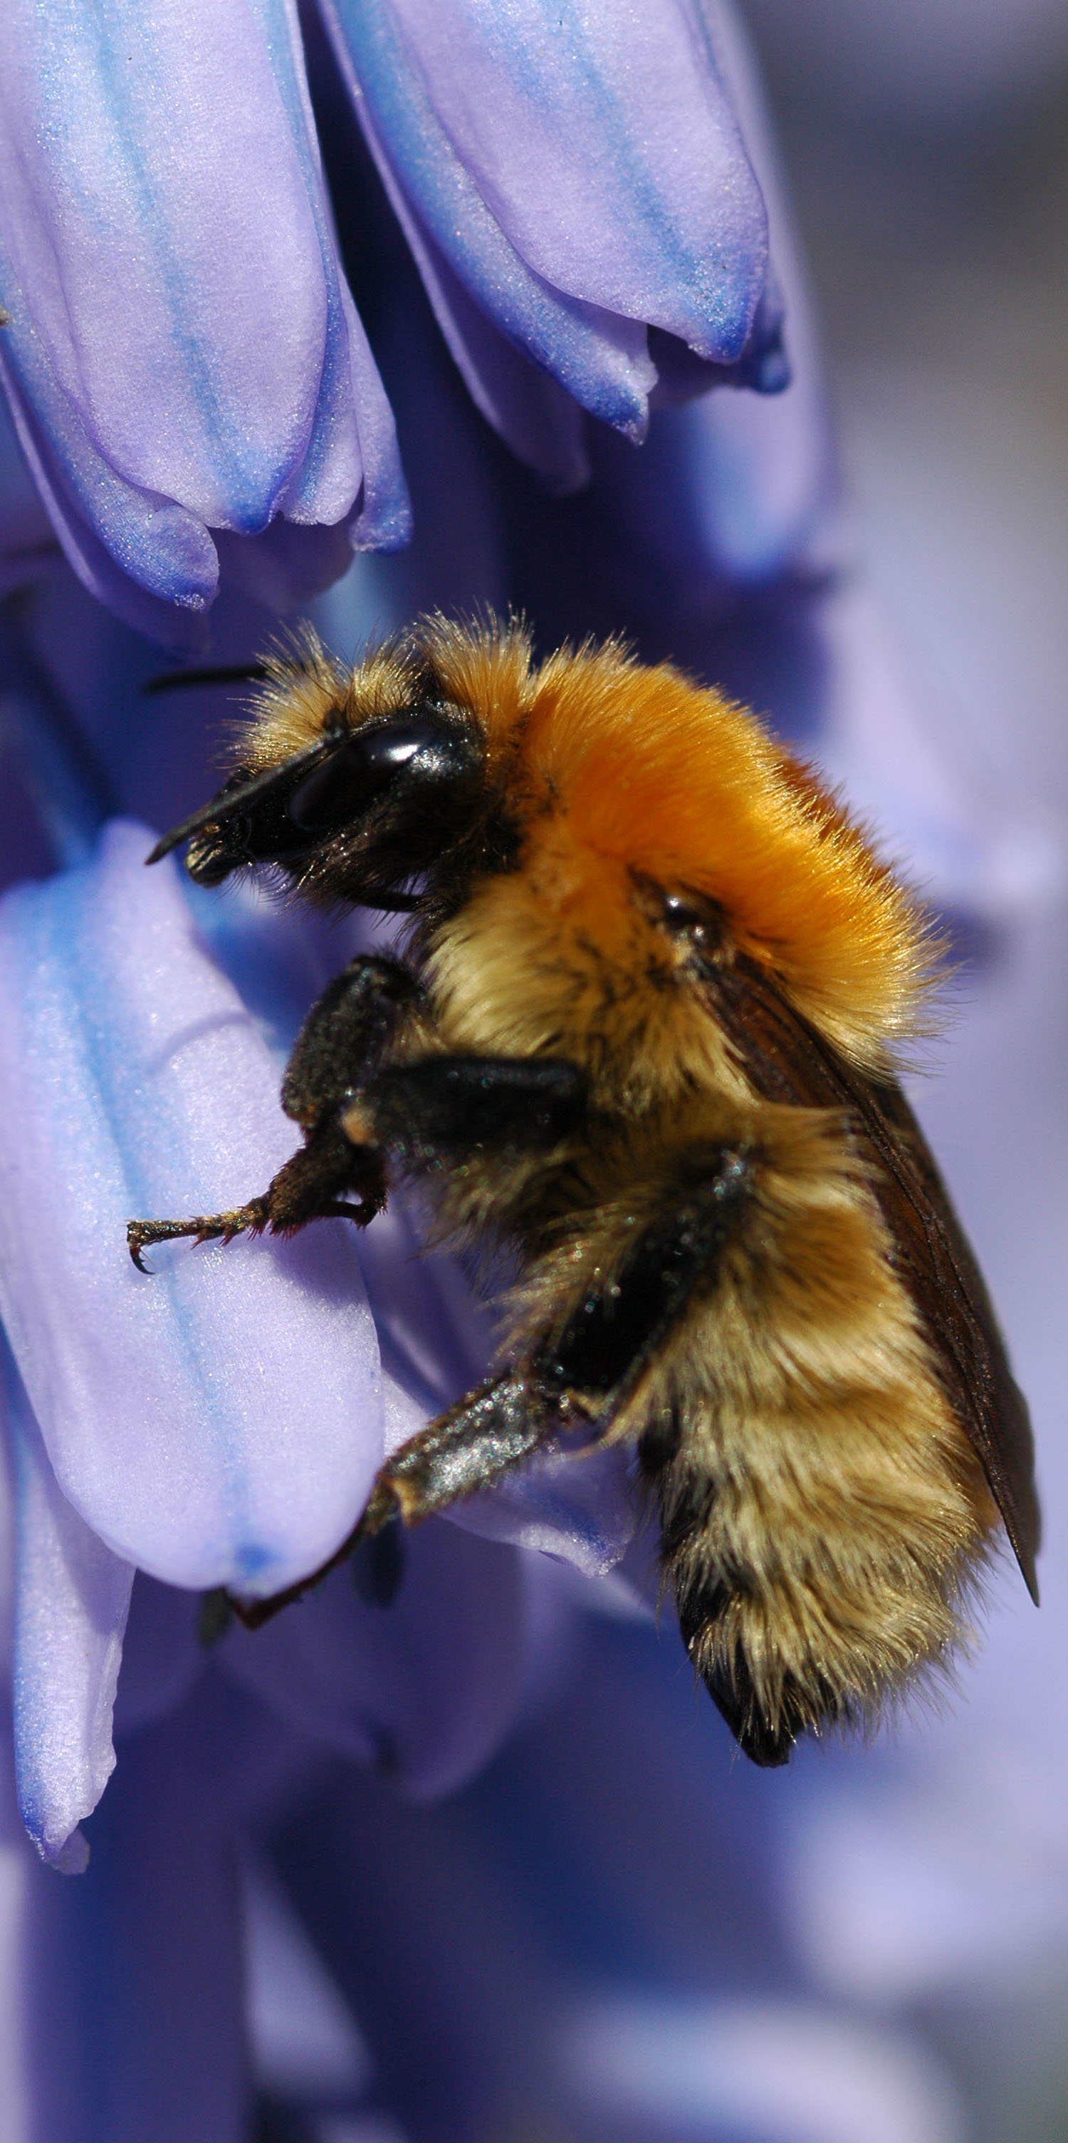
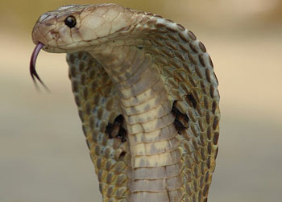
Neurotoxins
Disrupt the nervous system of animals
Many insecticides are neurotoxins
Examples:
Lead and mercury

Slide 14
Carcinogens
Cancer-causing chemicals that damage cells
Mutagens: carcinogens that cause damage to the genetic material of a cell
Examples:
Asbestos, arsenic, PCBs, radon, UV rays, chemicals in tobacco

Slide 15
Teratogens
Interfere with the normal development of embryos or fetuses and causes birth defects
Examples:
Alcohol causes fetal alcohol syndrome
Thalidomide: Morning sickness drug that was available in UK and Australia

Slide 16
Allergens
Chemical that cause allergic reactions
Elicit a high response from the immune system
Common allergens: chemicals found naturally in peanuts, milk, and penicillin

Slide 17
Endocrine Disrupters
Chemicals that interfere with the normal functioning of hormones in an animal’s body.
Wastewater may contain hormones from
CAFOs, pesticides that mimic animal hormones and birth control pills

Slide 18
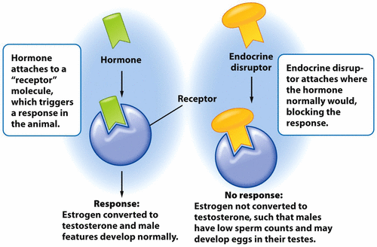
Endocrine Disruptors

Slide 19
Toxicity
Toxin: any substance that is inhaled, ingested or absorbed at sufficient dosages that it damages a living organism
Toxicity: the degree to which a toxin is biologically harmful
Toxicity of a substance dependent upon:
Dosage amount over a period of time
Number of times of exposure
Size and or/age of the organism that is exposed
Ability of the body to detoxify that substance
Organisms sensitivity to the substance
Synergistic effect: more than one substance combined

Slide 20
Dose-Response Analysis
Method to test toxicity of substances
Organisms exposed to a toxin at different concentrations
Record the dosage that kills the organism
LD50 or LC50: Amount of toxin it takes to kill 50% of the test animals

Slide 21
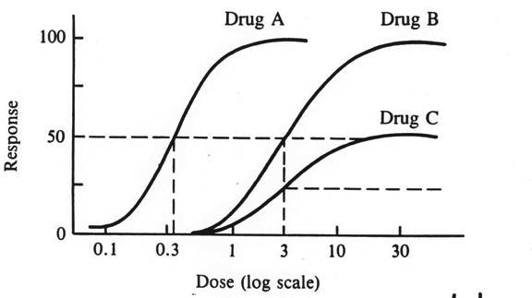
Dose Response Studies

Slide 22
Dose Response Studies
Poison: any substance that has an LD50 of 50 mg or less per kg of body weight
ED50: point at which 50% of the test organisms show a negative effect from the toxin.
Threshold dose: Dosage at which the negative (nonlethal) effects occur

Slide 23
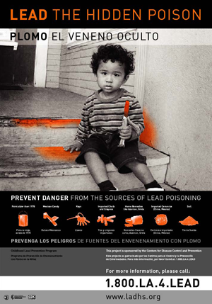
Chronic vs. Acute effects
Acute Effect: results from short term exposure to a high level of toxin
Ex: Snakebite
Chronic effect: results form long-term exposure to low levels of toxin
Ex: lead paint in a house

Slide 24
Testing Standards
Toxic Substance Control Act (1976): EPA has the authority to regulate chemicals--- excludes food, cosmetics and pesticides.
Scientists test the most sensitive species from a variety of different groups (bird, mammal, fish, invertebrate)
Safe dosage for animals: LD50 or ED50 divided by 10
Safe dosage for humans: LD50 or ED50 divided by 1,000

Slide 25
Chronic Studies
Chronic studies: Long-term studies
May last from when an organism is very young to when it is old enough to reproduce.

Slide 26
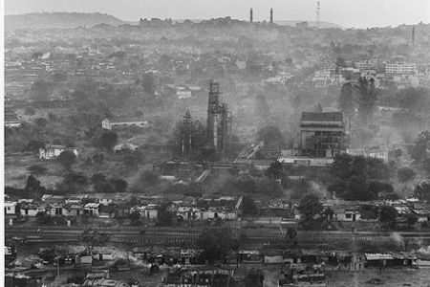
Retrospective Studies
Epidemiology: The study of the causes of illness and disease in the populations of humans and other organisms
Retrospective studies: Monitors people who have been exposed to a chemical at some point in the past
Ex: chemical disaster in Bhopal India
Hazardous gas spread in the city
100,000 people still suffering from the accident

Slide 27
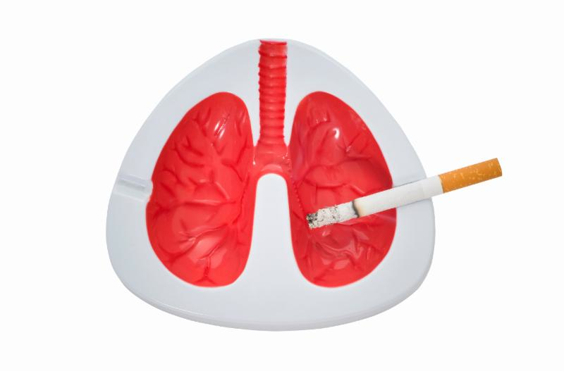
Prospective Studies
Monitor people who might become exposed to harmful chemicals in the future.
Synergistic interactions: two risks together cause more harm than one would expect based on their individual risks
Ex: asbestos + smoking = greater impact of carcinogen

Slide 28
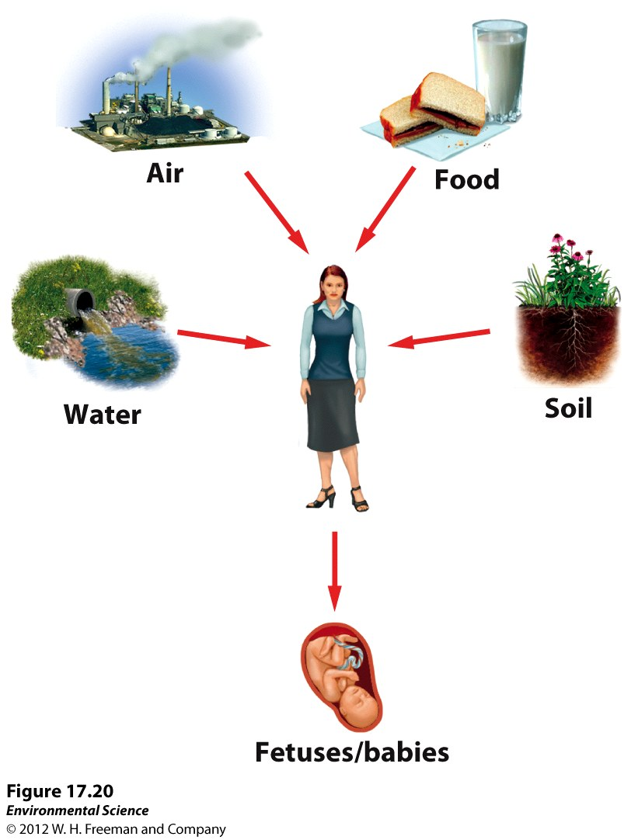
Routes of Exposure
Ways in which an individual may come into contact with a chemical

Slide 29
Ebola
http://edition.cnn.com/videos/health/2014/10/09/this-is-the-messy-truth-about-ebola-miguel-marquez-graphic-orig.cnn

Slide 30
Frontline Ebola
http://www.pbs.org/wgbh/frontline/film/ebola-outbreak/

Slide 31
Homework
Read and summarize an article about Zika virus
Read Barron’s book through pgs. 385-389 and 403-415
Make flash cards!

