Slide 1
SWBAT: Identify the three major risks categories of human health risk. List the major historical and emerging infectious diseases.
APES Unit 10 3/10/16

Slide 2
Categories of Human Health Risk
Physical
Biological
Chemical
Pathogen: bacteria, viruses, or other microorganisms that can cause disease
Vector: when a pathogen attacks via a carrier organism
Infection: result of a pathogen invading the body
Disease: infection causes a change in the state of health
Ex: HIV is a virus that causes the disease, AIDS

Slide 3
Main Categories of Pathogens
Viruses (and particles such as prions)
Bacteria
Fungi
Protozoa
Parasitic worms

Slide 4
Types of Disease
Chronic disease: slowly impair the functioning of a person’s body
Ex: heart disease and most cancers
Acute diseases: rapidly impair the functioning of a person’s body
Ex: Ebola

Slide 5
Risk Factors
Risk: likelihood that a person will become ill after exposed to a pathogen
Top 10 risk factors associated with chronic disease can be attributed to poverty
Malnutrition
Poor sanitation
Unsafe drinking water
No health insurance
Risk assessment (risk management): using strategies to reduce the amount of risk

Slide 6
Infectious Diseases
Epidemic: when a pathogen causes a rapid increase in disease
Pandemic: When an epidemic occurs over a large geographic region such as an entire continent.

Slide 7
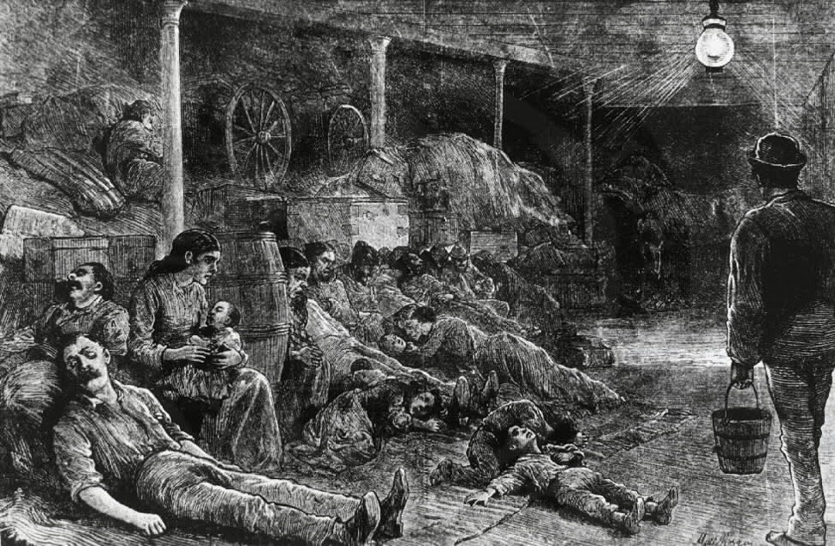
Important Infectious Diseases
Plague (bubonic plague and death plague): bacterial infection carried by a tick
Symptoms: swollen glands, black skin spots and extreme pain
Killed ¼ of the population of Europe in 1300

Slide 8
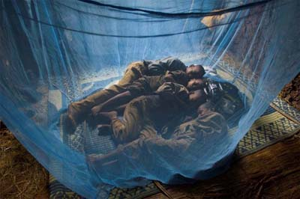
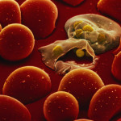
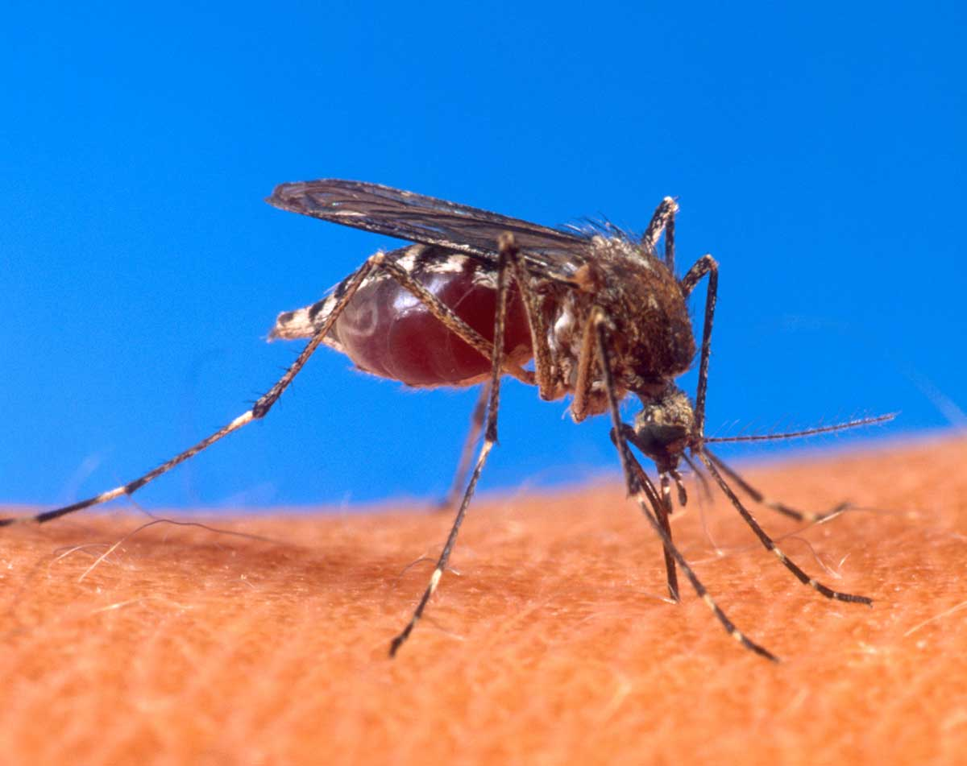
Malaria
Disease caused by infection of the protist plasmodium
350 to 500 million people worldwide contract the disease
About 1 million people die
Malaria parasite eradicated from U.S. in 1951
Can be treated with antibiotics
Methods to control malaria:
DDT, mosquito nets

Slide 9
Malaria

Slide 10
Tuberculosis (TB)
Highly contagious disease caused by a bacteria
Spread by cough
Symptoms: weakness, coughing up blood, night sweats
1/3 of the world’s population is infected with TB
2 million people die from it worldwide
Treatment: antibiotics
Not finishing antibiotics→ promote antibiotic resistant TB

Slide 11
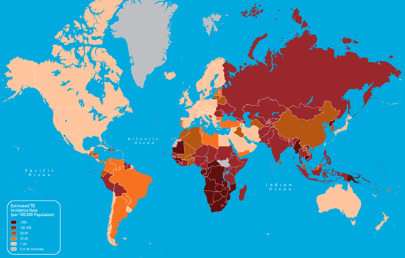
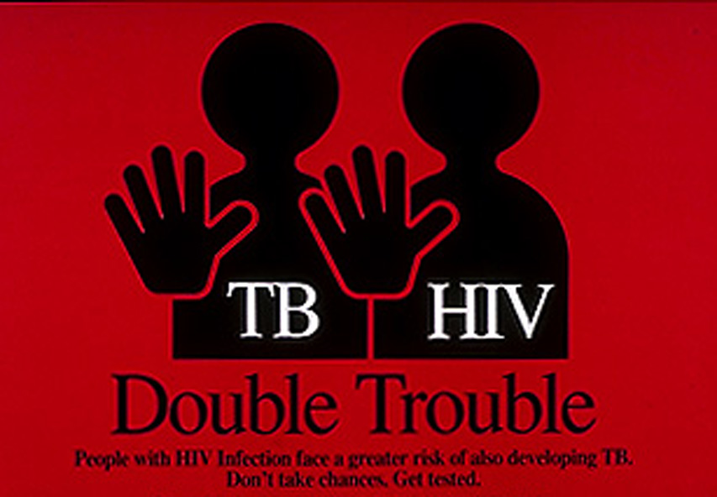
Tuberculosis

Slide 12
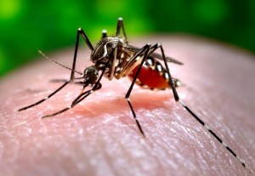
Yellow Fever
Single-stranded RNA virus transmitted by mosquito
Location: South American and Sub-Saharan Africa
Symptoms: flu-like symptoms
Can progress to toxic form of the disease and cause death
There is a vaccine!

Slide 13
Emergent Infectious Diseases
Previously not described or have not been common for at least the prior 20 years
One new emergent disease each year since the 70s
Many are zoonotic pathogens

Slide 14
HIV/AIDS
AIDS (Acquired Immune Deficiency Syndrome)
Human Immunodeficiency Virus (HIV)
Spread through: vaginal secretions, breast milk, blood, semen
Origin of virus: chimpanzees in Cameroon
33 million people infected worldwide
Has caused 25 million deaths
No cure or vaccine
Antiviral drugs can extend life

Slide 15
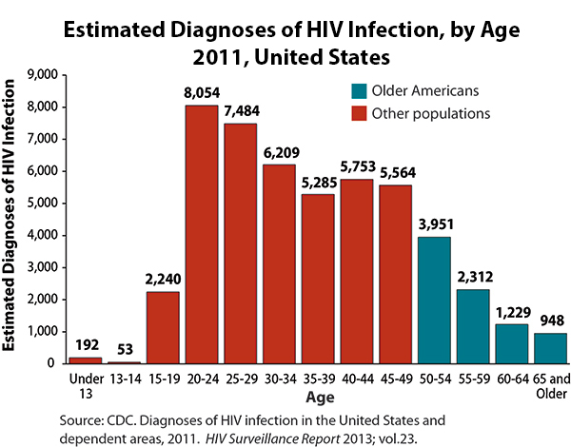
HIV/AIDS

Slide 16
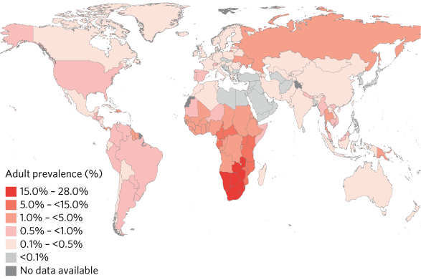
HIV/AIDS

Slide 17
Ebola Hemorrhagic Fever
Discovered in 1976, caused by Ebola virus
Death rate of 50 to 89% if infected
Transmitted through bodily fluids
Symptoms: fever, vomiting, internal and external bleeding

Slide 18
Ebola Hemorrhagic Fever

Slide 19
Mad Cow Disease
Mad Cow Disease (BVE): a pathogen slowly damages the cows nervous system and dies
Prions: proteins that can mutate into deadly proteins and act as pathogens
Cannot be destroyed by heat
Can be transmitted to humans in the form of Creutzfeldt-Jakob disease (CJD)
Transmission:
Another cow (or human) consumes infected cow

Slide 20
Mad Cow Disease

Slide 21
Bird Flu (Avian flu)
Bird flu: caused by H5N1 virus and infects birds
Can be deadly to domesticated birds
H5N1 strain jumped from birds to humans
Not easily passed among humans

Slide 22
Avian Flu

Slide 23
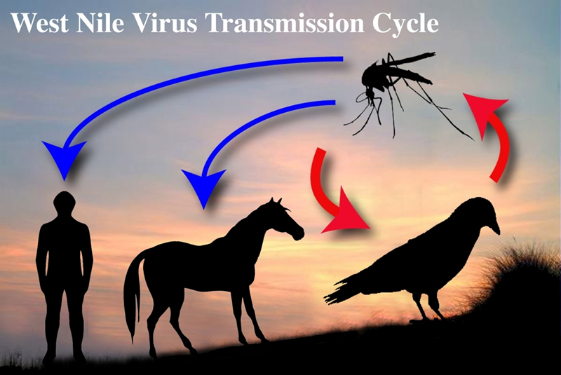
West Nile Virus
Lives in hundreds of species of birds and is transmitted among birds by mosquitos
Symptoms:
Inflammation of the brain
Can lead to death

Slide 24
West Nile Virus

Slide 25
Severe Acute Respiratory Syndrome (SARS)
Caused by a virus
2003 outbreak: more than 8,000 people infected
Transmission: human to human contact
Respiratory droplets when the person coughs or sneezes
Symptoms: high fever, body chills, headache

Slide 26
SARS

Slide 27
Ebola
http://edition.cnn.com/videos/health/2014/10/09/this-is-the-messy-truth-about-ebola-miguel-marquez-graphic-orig.cnn

Slide 28
Homework
Read the textbook through page 479 (stop right before risk assessment)
Unit 8 Test corrections due tomorrow!

