Slide 1
SWBAT identify the problems associated with the generation and disposal of hazardous waste. Do Now: What is the difference between superfund sites and brownfields? Who is Lois Gibbs and why is she famous?
APES Unit 10 3/9/16

Slide 2
Agenda
Lecture
Math!

Slide 3
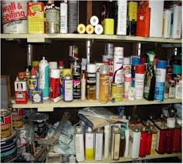
Hazardous Waste
Any waste that poses a danger to human health or ecosystems (liquid solid, gas, or sludge)
Examples: batteries, paints, solvents, pesticides, lawn fertilizers, radioactive waste
Only 5% is recycled

Slide 4
Types of hazardous Waste
Corrosive waste: Waste that corrodes (eats away at) metal
Ignitable waste: substances that can easily catch fire (alcohol or gasoline)
Reactive waste: chemically unstable or reacts readily with other compounds, may result in explosions
Toxic waste: creates health risks when inhaled or ingested, or when it comes into contact with skin

Slide 5
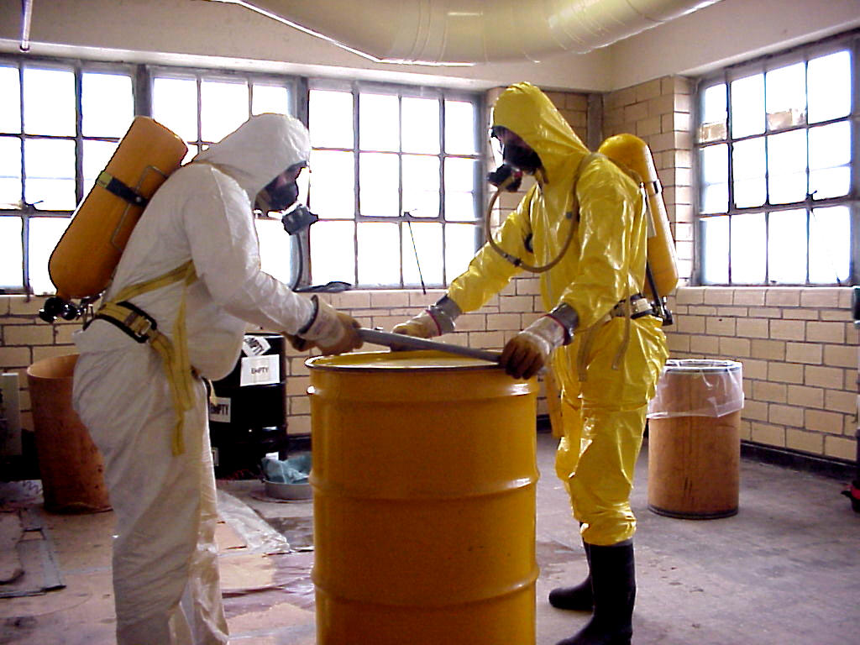
Handling of hazardous waste
Most municipalities don’t have regular collection sites
Treatment and exposure more expensive than MSW
Treatment: making hazardous waste more environmentally friendly

Slide 6
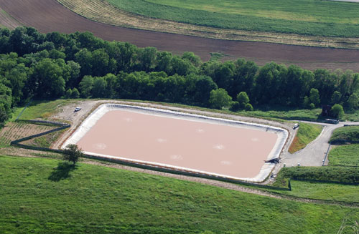
Disposing of hazardous waste
Disposing of hazardous waste: injection wells, surface impoundment, or landfills
Deep well injection: drilling a hole in the ground that’s below the water table (injected into porous rock)
Surface impoundment: shallow, lined pools where the hazardous waste evaporates (used for liquid waste)
Landfills: designated spots for hazardous waste
Best option: reduce the amount of hazardous waste produced in the first place!

Slide 7
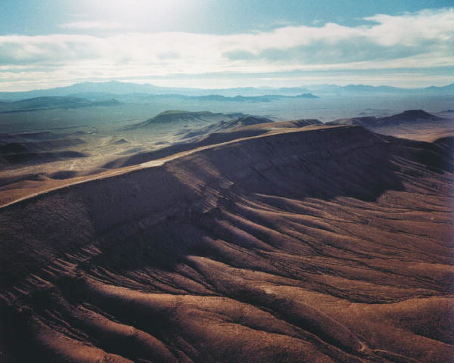
Radioactive Waste
Yucca Mountain: potential site of disposal for nuclear waste
Controversial due to NIMBY and the fact that Nevada has no nuclear power plants
Low-level radioactive waste: produce low levels of ionizing radiation
High-level radioactive waste: produce high levels of ionizing radiation

Slide 8
Legislative Response
U.S. Resource Conservation and Recovery Act (RCRA, 1976):
Encouraged states to develop comprehensive plans to manage nonhazardous industrial solid waste and MSW
Sets criteria for municipal solid waste landfills and other solid waste disposal
Established program for controlling hazardous waste from creation to disposal (cradle to grave)

Slide 9
Legislative Response
Comprehensive Environmental Response, Compensation and Liability Act (CERCLA or Superfund Act):
Tax on chemical and petroleum industries
Revenue from tax funds used to clean up abandoned, non-operating hazardous waste sites
Authorizes federal government to respond directly to release of chemicals that may pose a threat to human health or the environment
NPL: list of contaminated sites that are eligible for cleanup

Slide 10
Superfund Sites

Slide 11
Love Canal
Hazardous Waste landfill where they built a school and housing-development
Carcinogenic chemicals found in basements
Listed as superfund site and residents evacuated
Lois Gibbs: spokeswoman for the community

Slide 12
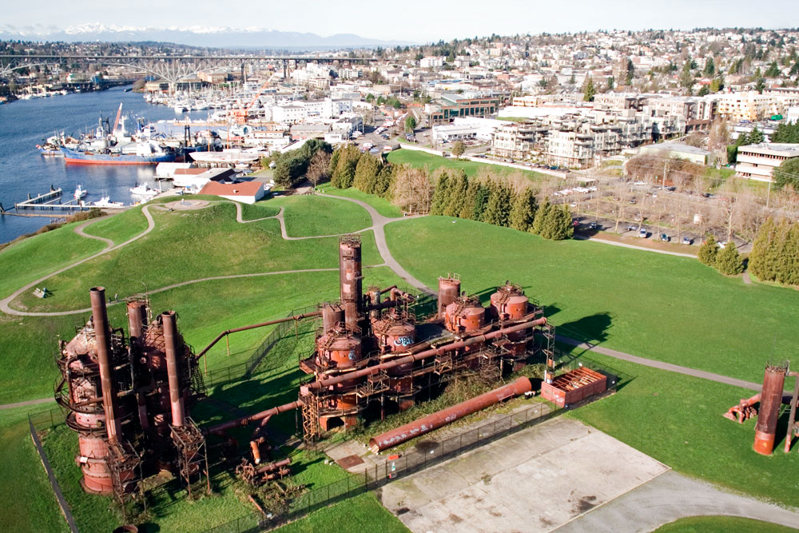
Brownfields
Assisted state and local governments in cleaning up contaminated industrial and commercial land that is not in the superfund category
Examples:
Dry cleaners, gas, stations, landfills, waterfront

Slide 13
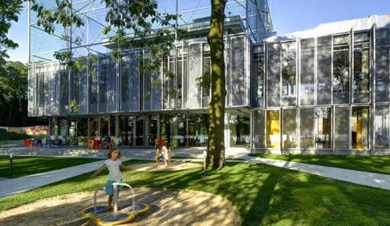
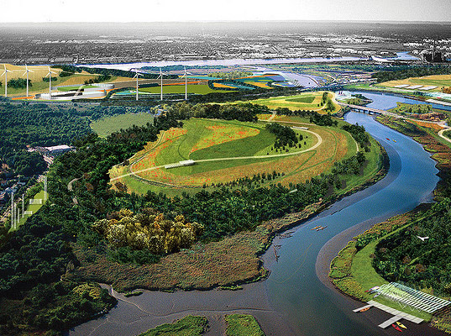
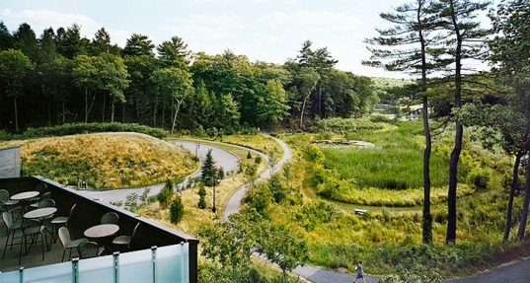
Brownfield Reclamation

Slide 14
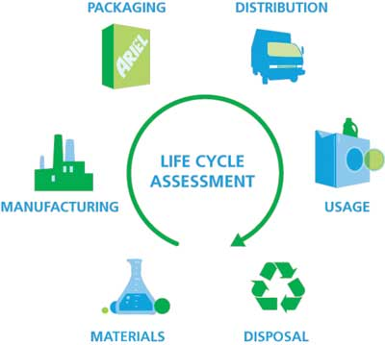
Life-Cycle Analysis
Examining the materials used and released throughout the lifetime of a product
Consider energy in producing the product
Pollution from trucking material to each destination
Always a cost to waste disposal (direct or indirect)

Slide 15
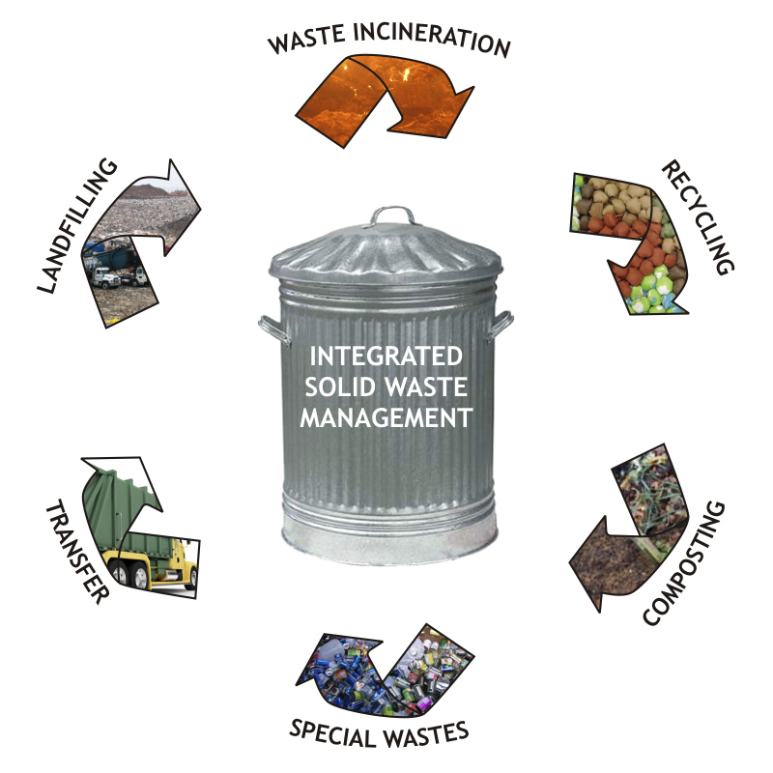
Integrated Waste Management
Strategies:
Source reduction
Recycling
Composting
Landfills and incinerators

Slide 16
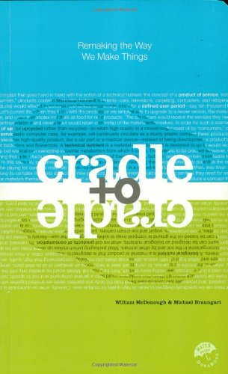
Cradle to Cradle Theory
Minimize waste generation before, after and during manufacturing

Slide 17
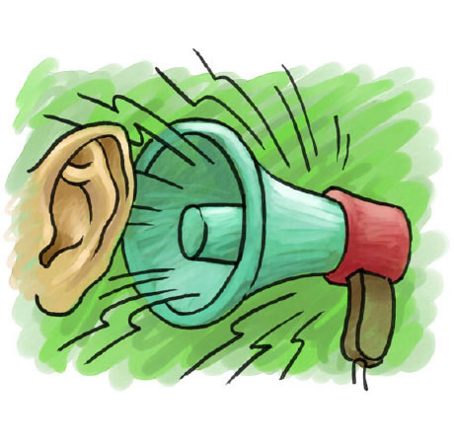
Noise Pollution
Noise pollution: any noise that causes stress or has the potential to damage human health
U.S. Noise Control Act of 1972 gave the EPA power to set emission standards for major sources of noise, including transportation, machinery, and construction.
Occupational Safety and Health Association (OSHA): set limits on the amount of noise that people can be exposed to in the workplace
More noise→ damage to hearing
Cells that are involved in hearing do not regenerate→ loss of hearing is permanent

Slide 18
Turn and Talk
How is hazardous waste different than MSW?
How can we reduce the production of hazardous waste?

Slide 19
Math Groups!
Group 1: Rimsha, Monica, Ramlah
Group 2: Cynthia, Wyllana, Amrat
Group 3: Harmanpreet, Uzma, Rahila
Group 4: Shayna, Mahnoor, Hamna, Mehrangiz
Group 5: Desire, Bukurie, Attia, Wendy, Saliha,

Slide 20
Math Group Rules
Skip to the math portion of the FRQ (c-d)
ALWAYS start with the end
Ask two people before me
Show ALL your work and units

Slide 21
Homework
Study for the quiz
Start Reading Ch. 17 through page 470 (stop before toxicology)

