Slide 1
SWBAT explain the implications of landfills and incineration.
APES Unit 10 3/8/16

Slide 2
Announcements
Ch. 16 Quiz on Thurs!!

Slide 3
PAYT programs
Pay-As-You-Throw: charge municipal customers for the amount of household garbage they throw away
Incentive programs: bottle redemption bill
Ex: Michigan: every bottle can be redeemed for 10 cents

Slide 4
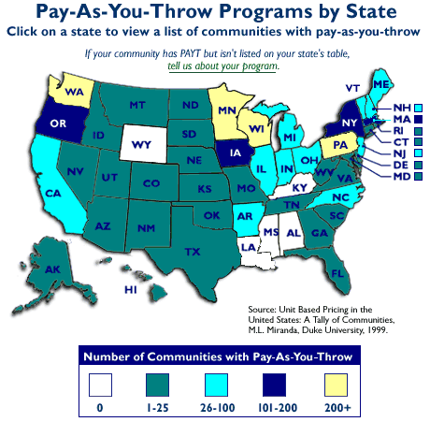

Slide 5
Compost
Organic materials: food and yard waste
In landfill: Anaerobic conditions→ organic matter decomposes and produces methane
Compost: organic matter that has decomposed under controlled conditions to produce organic-rich material that enhances soil structure, cation exchange capacity, and fertility

Slide 6
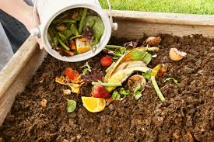
Compost
Compostable items:
Vegetable scraps
Eggshells
Coffee grounds
Sawdust
Yard clippings
NO meat, fish, cheese etc.

Slide 7
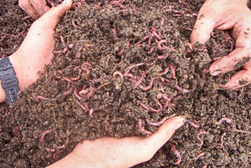
Compost
Important components:
Ratio of 30:1 for Carbon: Nitrogen is best for microbial activity
Frequent turning
Appropriate moisture levels
Respiration activity of microbes generates enough heat to kill pathogenic bacteria
Advantages:
enhances soil quality
Diverts waste from landfills
Reduces methane emissions
Disadvantages:
Takes time and space
Sorting organic material prior to composting can attract flies or vermin

Slide 8
Disposal of Solid Waste
Open Dumps: attracts pests and pollutes the air
Harmful components of MSW:
Runoff
Leachate: Water that leaches through the solid waste and removes various chemical compounds
Solution for preventing groundwater contamination by leachate:
Applying clean water continuously
collecting the resulting flow of leachate
processing this leachate

Slide 9
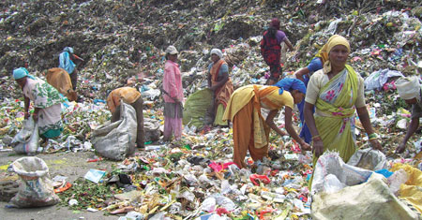
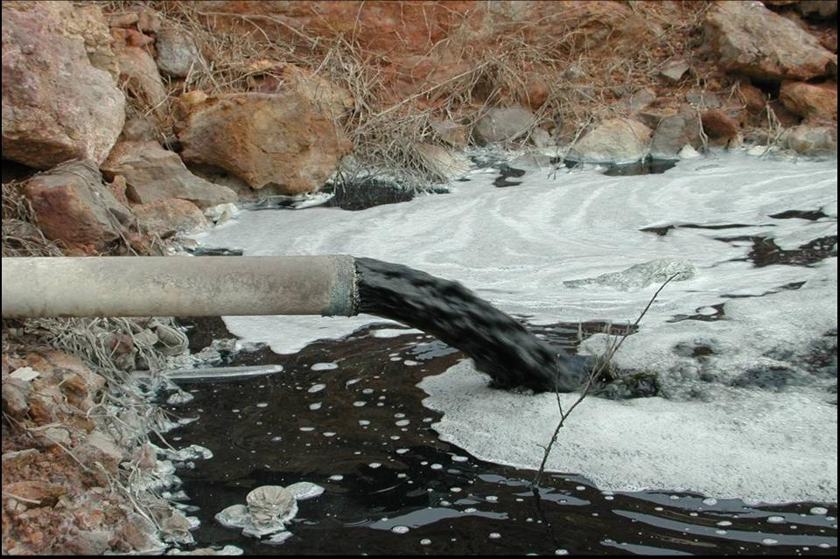
Disposal of Solid Waste

Slide 10
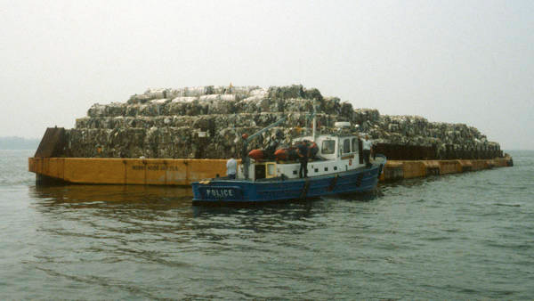
Landfills
About 60% of solid waste in the U.S. is sent to landfills
1987: Discovered that landfills on Long Island were contaminating ground water
Mabro barge left New York with 3,186 tons of garbage in search of a dumping grounds
Not In My Backyard (NIMBY): we need landfills but no one wants it in their backyard
Examples of environmental justice

Slide 11
Sanitary Landfills
Hold waste with little contamination of the surrounding environment as possible
Federal law prohibits landfills located near geologic faults, wetlands, floodplains or airports.
Double layered lining constructed with clay or plastic lining at the bottom
Systems of pipes collects leachate
When it reaches capacity, covered with a cap of soil and clay
Leachate regularly collected and tested for toxicity

Slide 12
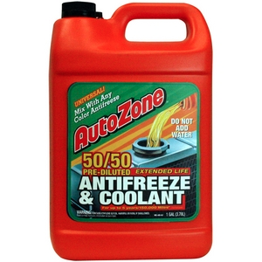
Sanitary Landfills
Monitoring the contents: Material least likely to contaminate the environment through leachate or generate methane in put into landfills
Incentives to recycle aluminum, metals, batteries, motor oil, antifreeze

Slide 13
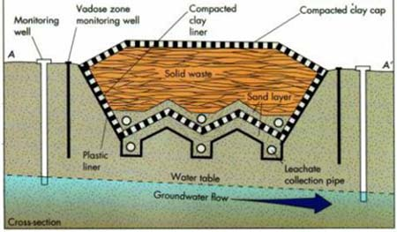
Sanitary landfills

Slide 14
Landfill Costs
Very expensive to construct a landfill
Tipping fee: trucks weighed before they are tipped into the landfill
Average 35$ per ton in the US
Benefits:
Encourages recycling
Minimize waste
Disadvantages:
May encourage illegal dumping

Slide 15
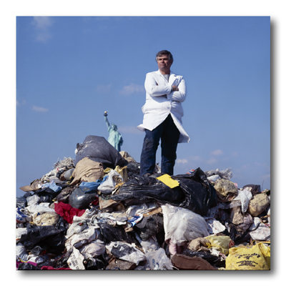
Landfills
Disadvantages:
Located near populations that do not have the resources to object
Fear of leachate contaminating underground waterways (before and after it is closed)
Methane can create an explosion hazard
Due to anaerobic conditions, solid waste doesn’t really decompose

Slide 16
Incineration
Burning waste materials to reduce their volume and mass
Process:
MSW is sorted and cleaned
Heat converts waste into CO₂ and H₂O→ released to atmosphere
Ash: particulates that do not combust
Bottom ash: collected beneath the furnace
Fly ash: collected beyond the furnace
Ash is tested for toxicity using weak acid
Low amount of contaminants→ landfills, can fill in road construction, used in cement
High amount of contaminants: special ash landfill
Waste to energy systems: heat generated by incineration is used rather than released to the atmosphere

Slide 17
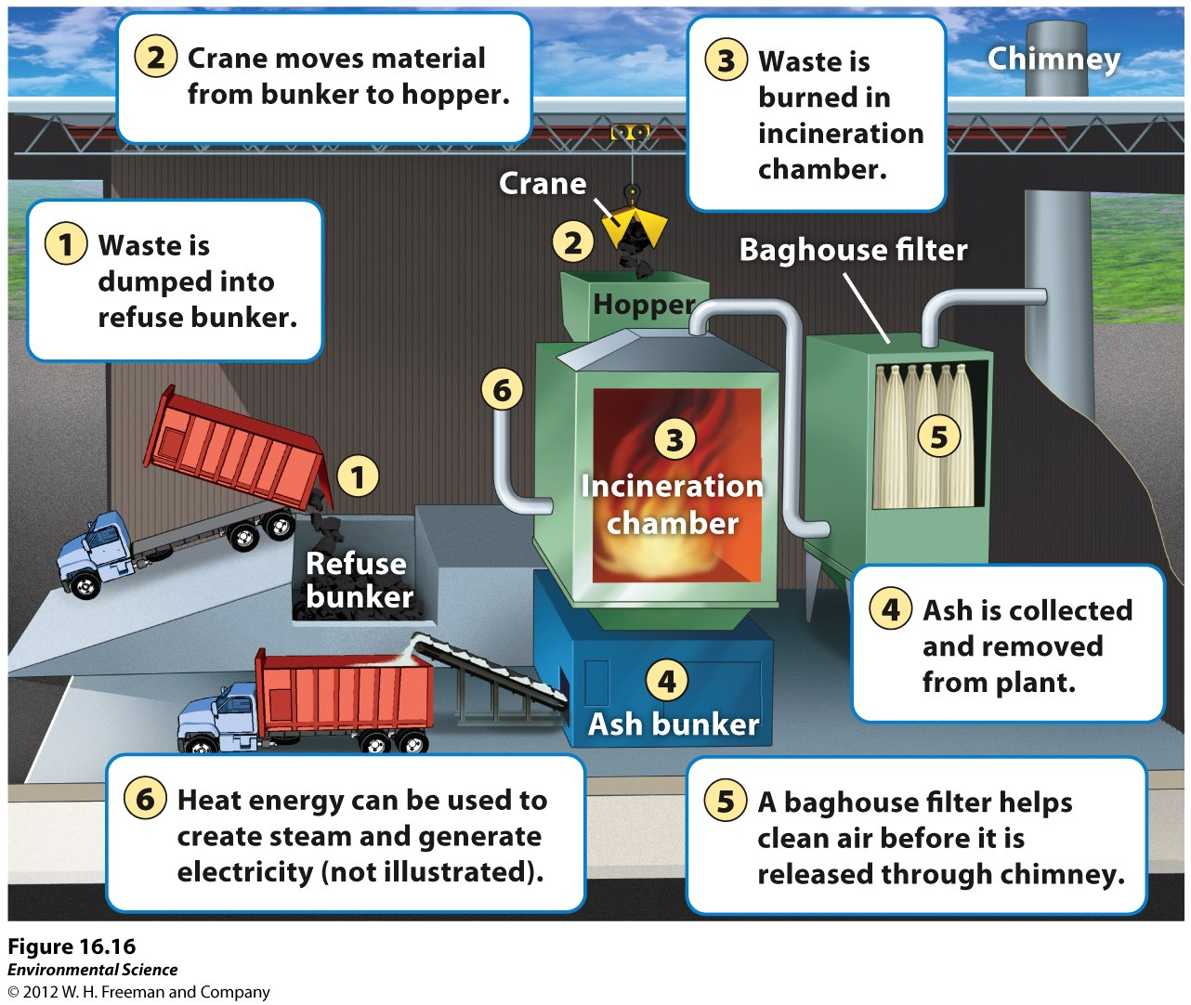

Slide 18
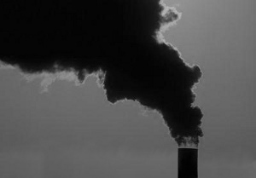
Incineration
Disadvantages:
Tipping fees are higher ($70 per U.S. ton)
Incineration releases air pollutants
Ash more toxic than the original MSW
Incinerators may not burn all the waste

Slide 19
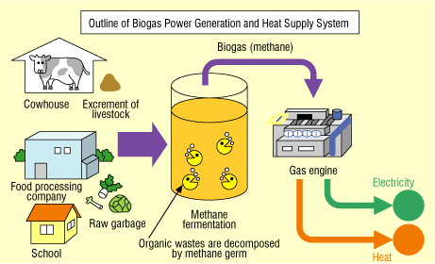
Methane Digester:
Methane produced in closed cells can be burned to generate electricity
Can produce steam to turn a turbine (rotates coils in a magnetic field)

Slide 20
Homework
Finish Reading Ch. 16
Research
What is cadmium
How cadmium can end up as a pollutant in landfills

