Slide 1
SWBAT describe the effects of acid deposition.
APES Unit 9 2/29/16

Slide 2
Announcements
Exam on Thursday!

Slide 3
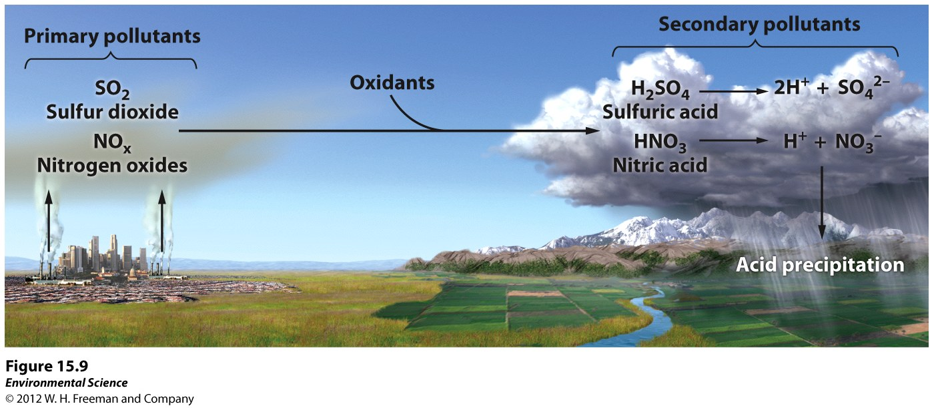
Acid Deposition
Acid deposition= acid precipitation in the form of acid rain, acid snow, acid hail, etc.
Acid deposition = deposition with a pH lower than 5.6
Pollutants responsible for acid deposition: SO₂ and NO_{x}

Slide 4
Acid Deposition
The highest concentration of acid deposition can be found in China
Dry acid particle deposition occurs two to three days after emission into the atmosphere
Occurs in arid climates
Wet deposition is delayed for 4 to 14 days after emissions
Can travel in air currents to locations that are miles downwind from the emission source

Slide 5
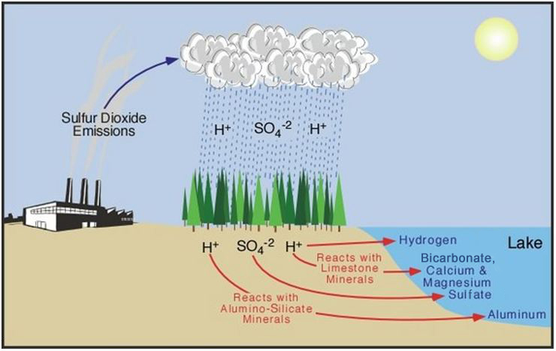
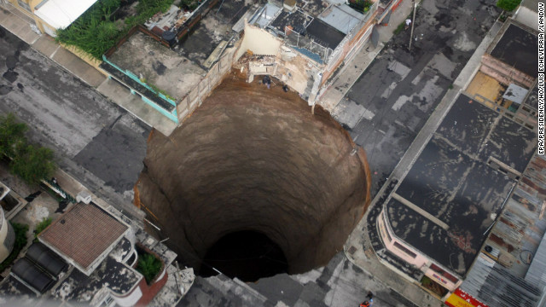
Acid Deposition
Effects on Soil:
Leaching of minerals from soil (alters soil chemistry)
Creates a buildup of sulfur and nitrogen ions in the soil
Increasing aluminum concentration in soil to levels that are toxic for plants

Slide 6
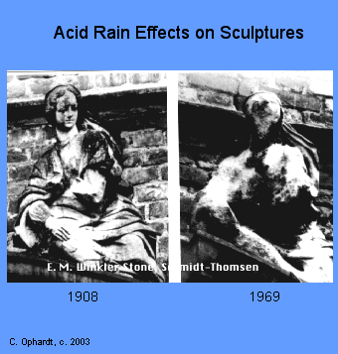
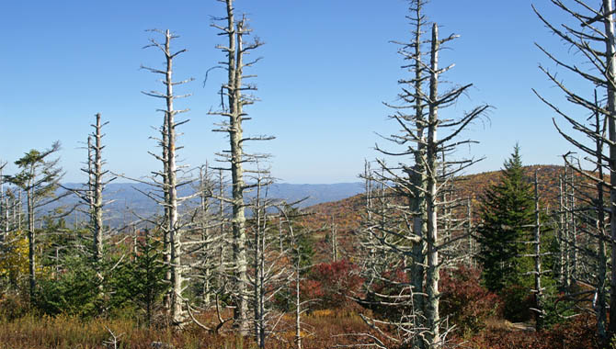
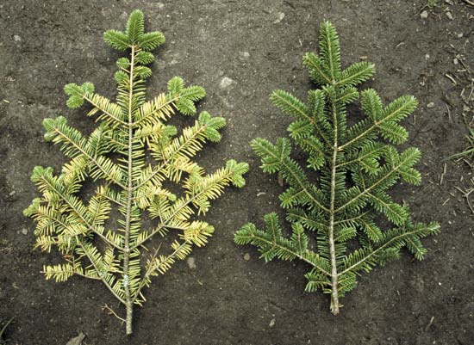
Acid Deposition
Effects:
Leaching of calcium ions from the needles of conifers
Elevating the aluminum concentration to levels that are toxic to fish
Lowering the pH of streams, rivers, ponds, and lakes→ may lead to fish kills
Damaging rocks and buildings (especially limestone and marble)

Slide 7
Acid Deposition Regulation
1990 amendment to the Clean Air Act led to significant reductions in in the amount of SO₂ and NO_{x} emitted from industrial plants
BUT damage still being done to soils and lakes

Slide 8
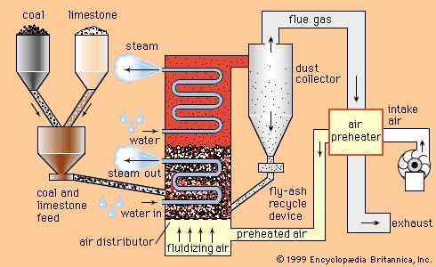
Pollution Control
Control of sulfur emissions
Fluidized bed combustion: coal burned in close proximity to calcium carbonate→ heated calcium carbonate absorbs sulfur dioxide

Slide 9
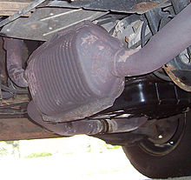
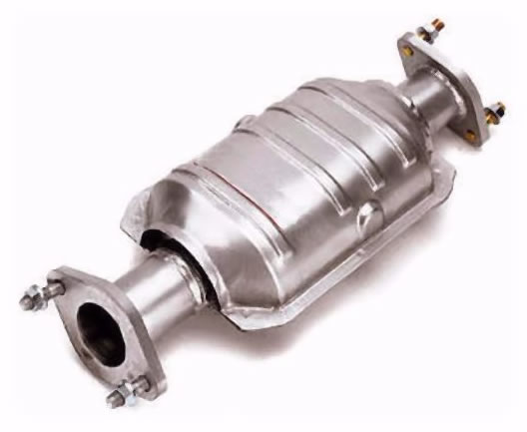
Pollution Control
Control of nitrogen oxide emissions:
Catalytic converters: reduces CO and NO emissions from cars

Slide 10
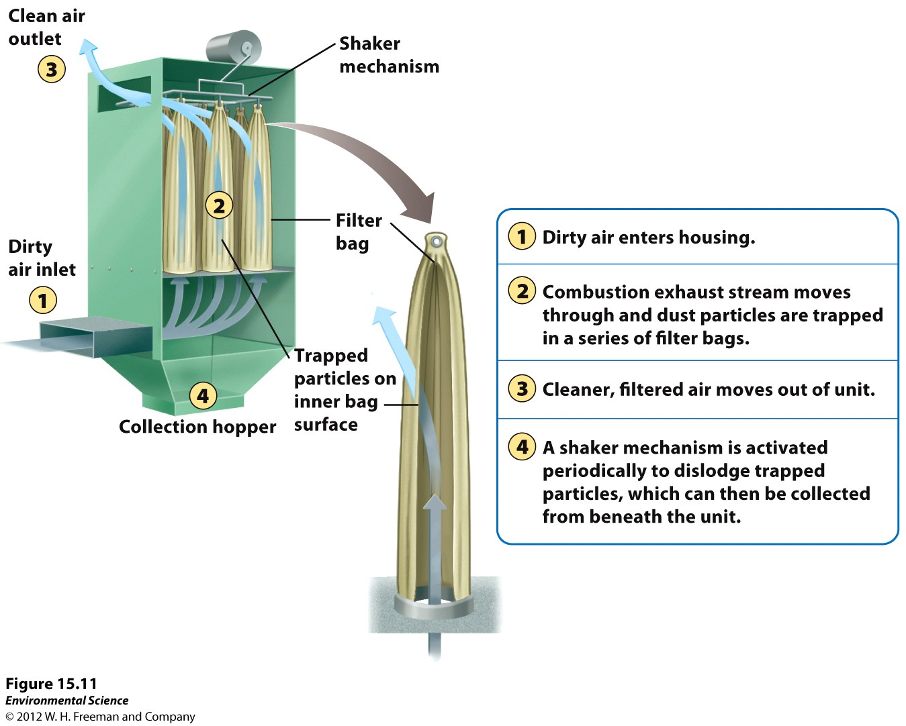
Pollution Control
Control of Particulate Matter
Gravitational settling
Fabric filters: gases can pass through but particle are removed

Slide 11
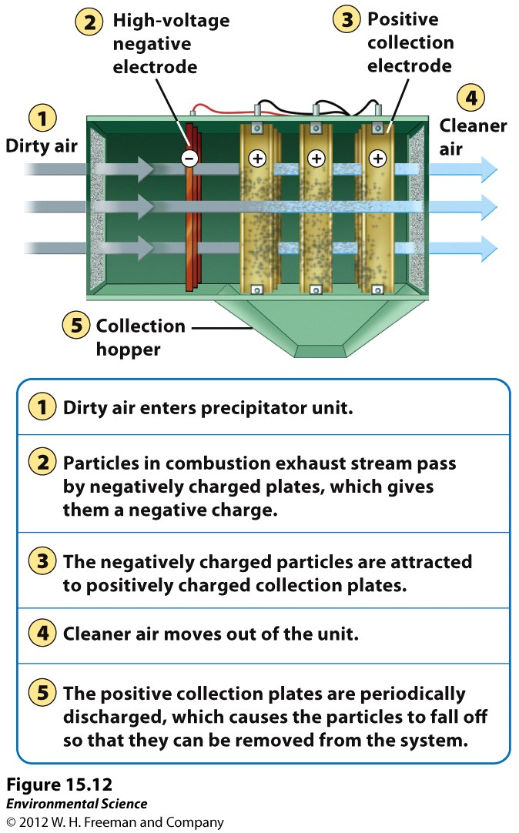
Pollution Control
Control of Particulate Matter:
Electrostatic Precipitator: use an electrical charge to make particles coalesce (clump together)

Slide 12
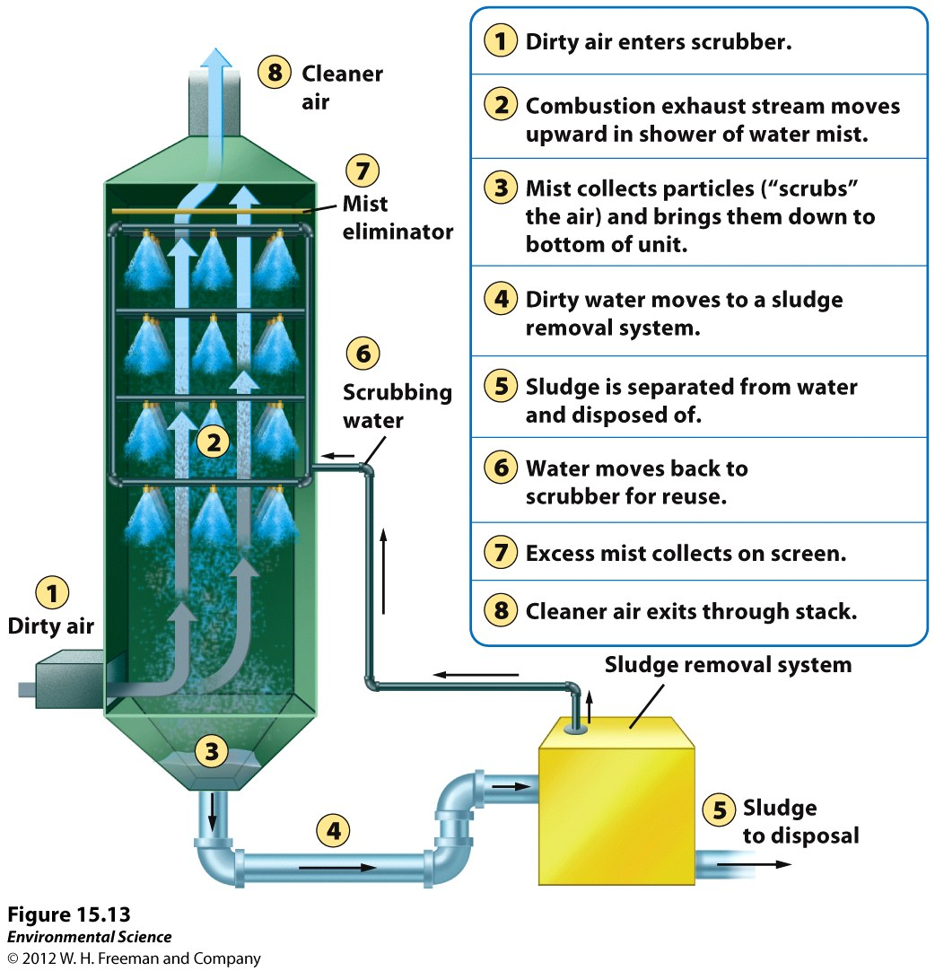
Pollution Control
Reducing emissions of particulate matter and SO₂
Scrubbers use a combination of water and air that separates and removes particles

Slide 13
Pollution control
Smog reduction
Difficult to control smog since ozone is a secondary pollutant
Efforts to reduce:
VOCs
Nitrogen oxides
Innovative Pollution Control
Mexico City: automobiles driven every other day
Carpool lanes
Amendments to the clean air act:
Buying and selling allowances that permit the owner to release a certain quantity of sulfur
Number of sulfur allowances has been reduced over time

Slide 14
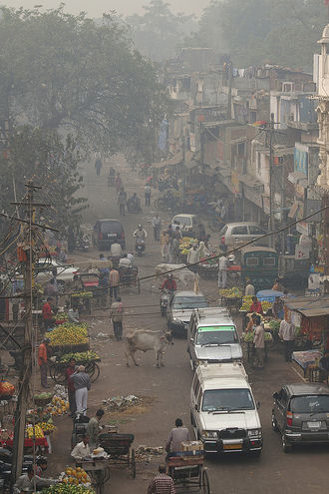
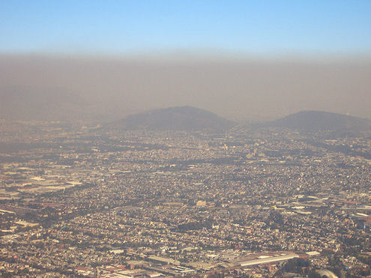

Slide 15
Homework
Read the procedure for the Vehicle Exhaust Lab Part 2

