Slide 1
SWBAT distinguish between natural emissions and anthropogenic emissions. SWBAT describe thermal inversions.
APES Unit 9 12/26/14

Slide 2
Agenda
Lecture
Work Time

Slide 3
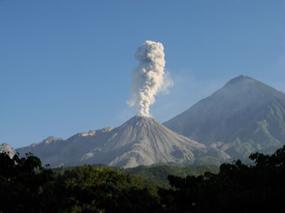
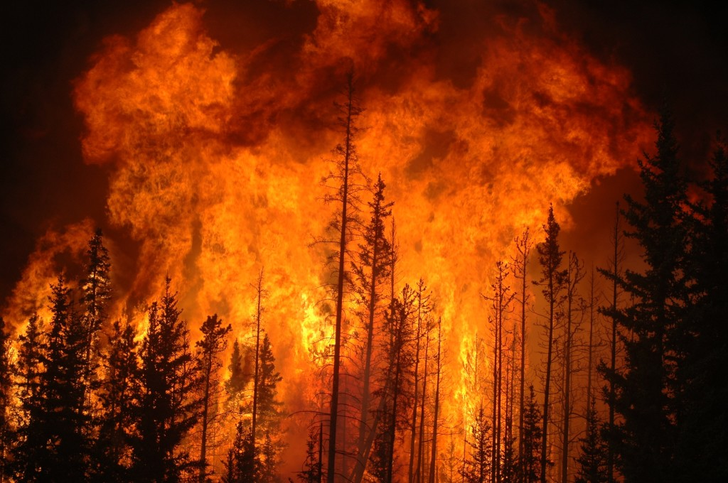
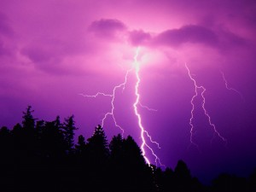
Natural Emissions
Volcanoes → SO₂, carbon monoxide, nitrogen oxides and particulate matter
Lightning→ nitrogen oxides
Forest fires → particulate matter, nitrogen oxides and carbon monoxide
Living plants → VOCs

Slide 4
Anthropogenic Emissions
Monitored by the EPA
Clean Air Act:
Specifies concentration limit for 6 outdoor air pollutants
Addresses acid rain, toxic emissions, ozone depletion, automobile exhaust
Improvements to the Clean Air Act
Focusing more on prevention than pollution cleanup
Increasing fuel efficiency standards for cars and light trucks
Further reduction of greenhouse gas emissions

Slide 5
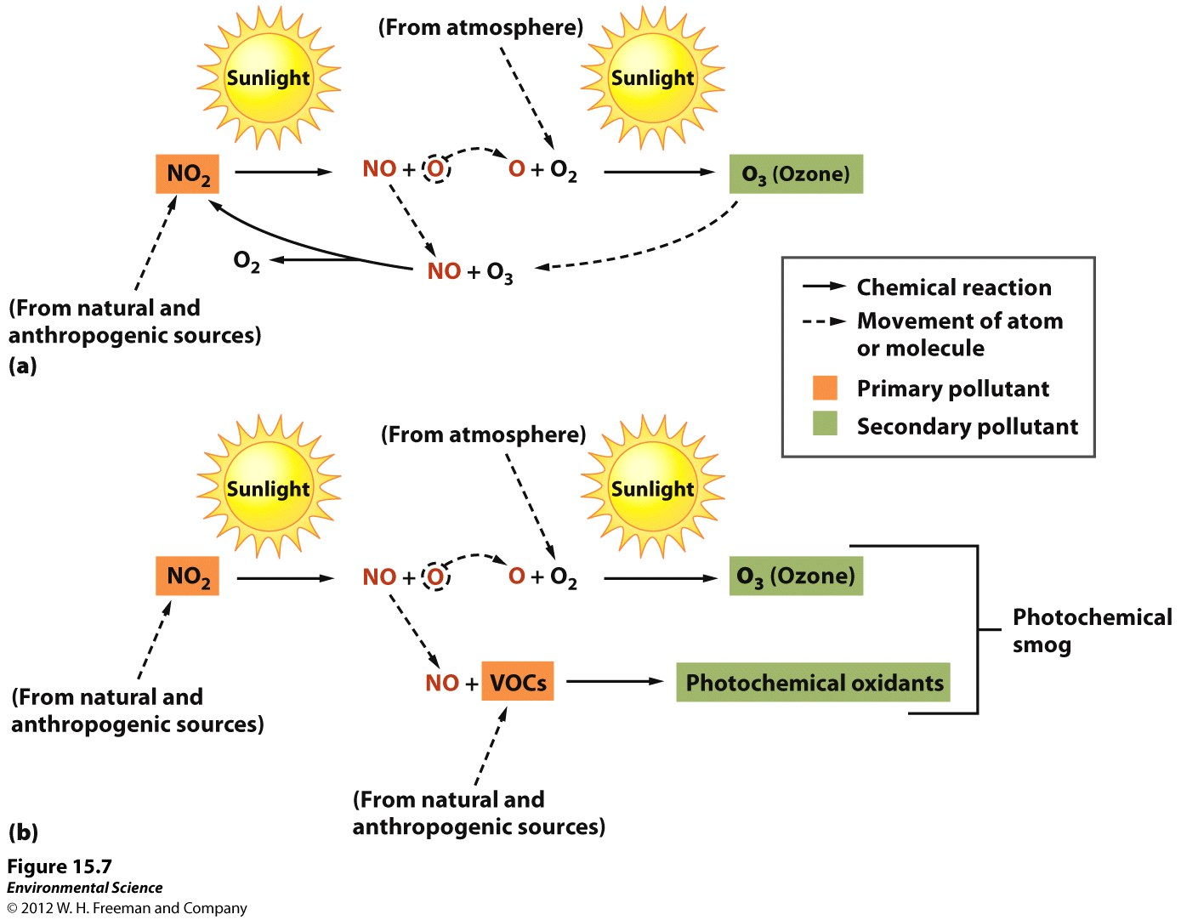
Smog Formation

Slide 6
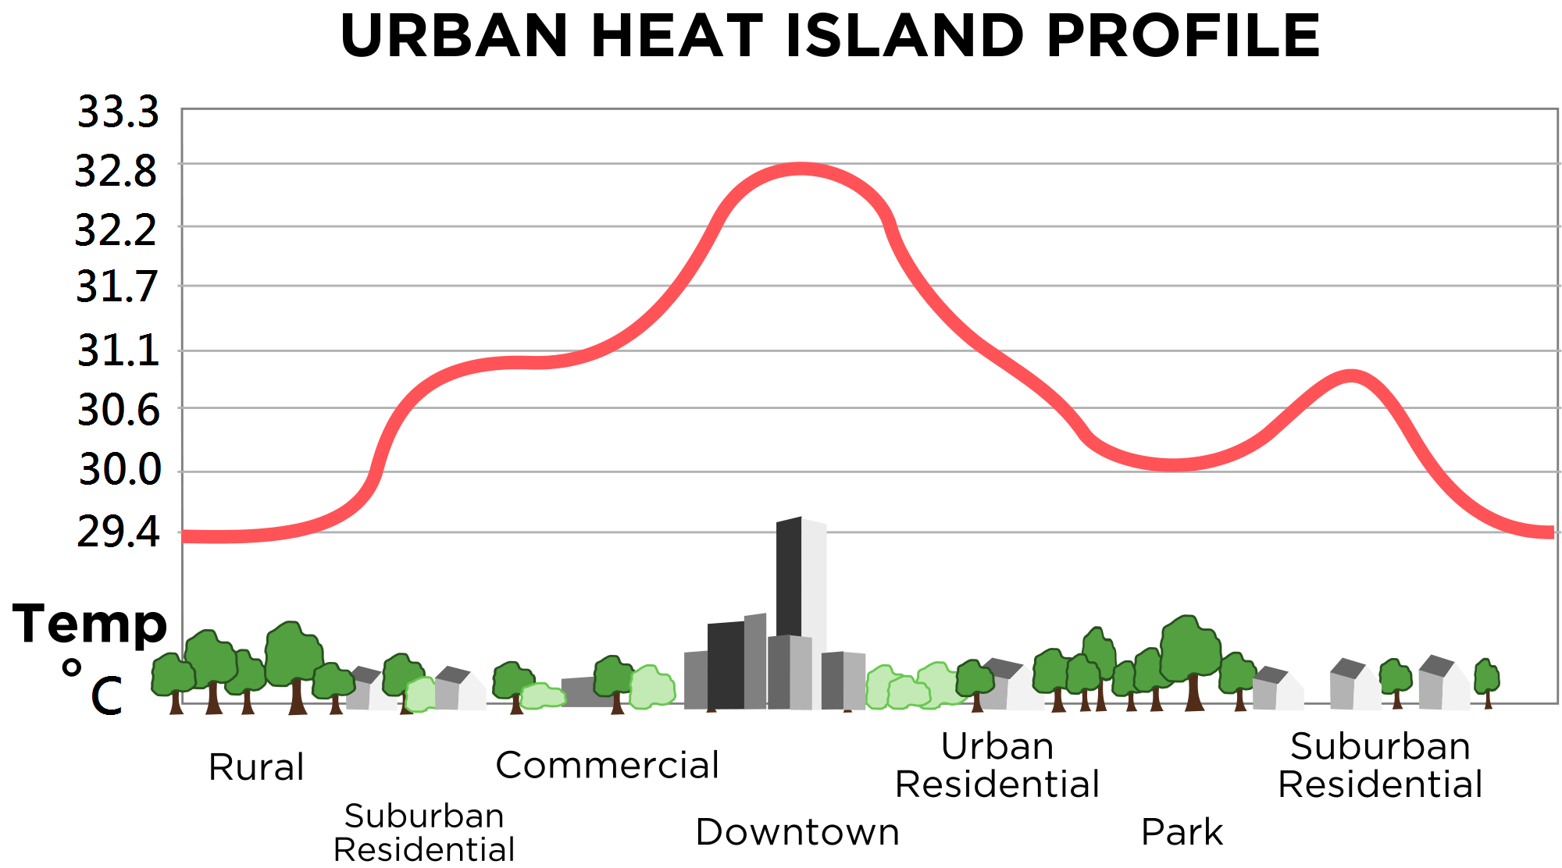
Urban Heat Island Profile

Slide 7
Urban Heat Island
Urban environments are about 20 degrees warmer than the countryside
Due to heat-absorbing capacity of buildings
Heat island effect is larger during the nighttime hours
High temperature in cities→ increase rate of photochemical reactions→ photochemical smog
Ways to combat urban heat island effect: build green roofs!

Slide 8
Urban Heat Island Effect

Slide 9
Urban Heat Island
Factors that contribute to a temperature difference:
More asphalt, concrete and buildings leads to
Lower albedo which causes more heat to be absorbed
More energy emitted by surfaces
Fewer trees and vegetation:
Reduces natural cooling effects of shading and evaporation of water form soil and leaves
More cars/factories and industry
Heat is a byproduct of combustion

Slide 10
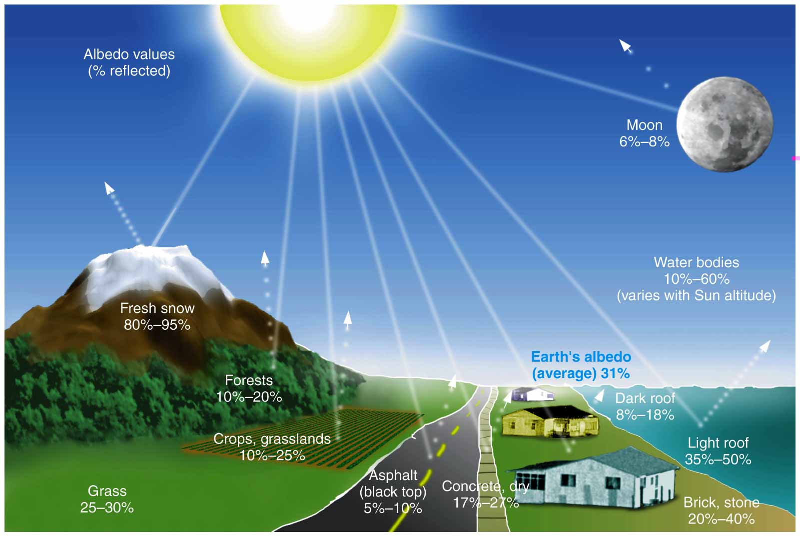
Albedo of different surfaces

Slide 11
Thermal (Temperature) Inversions
As altitude increases→ temperature decreases
Thermal inversions: warm layer of air at mid-altitude covers a layer of cold, dense air below.
Inversion layer: traps emissions that accumulate beneath it→ causes pollution
Often occur in cities surrounded by mountains or bordered by mountains on one side and ocean on the other

Slide 12
Thermal Inversions

Slide 13
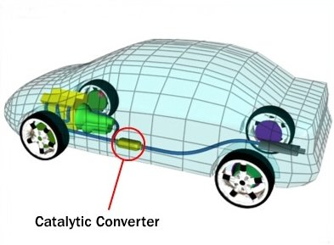
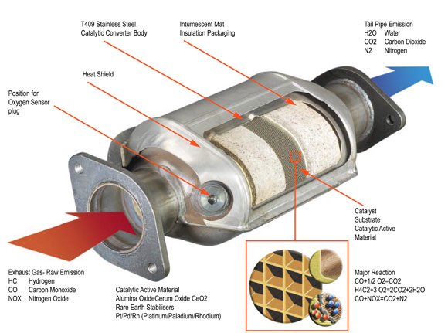
Motor Vehicles and Air Pollution
All new vehicles sold in the U.S. must meet EPA standards
Must emit 75% fewer pollutants than cars made before 1970
Catalytic converter: controls emissions by oxidizing most of the VOCs and some of the CO→ converts it into CO₂

Slide 14
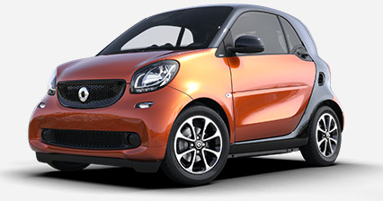
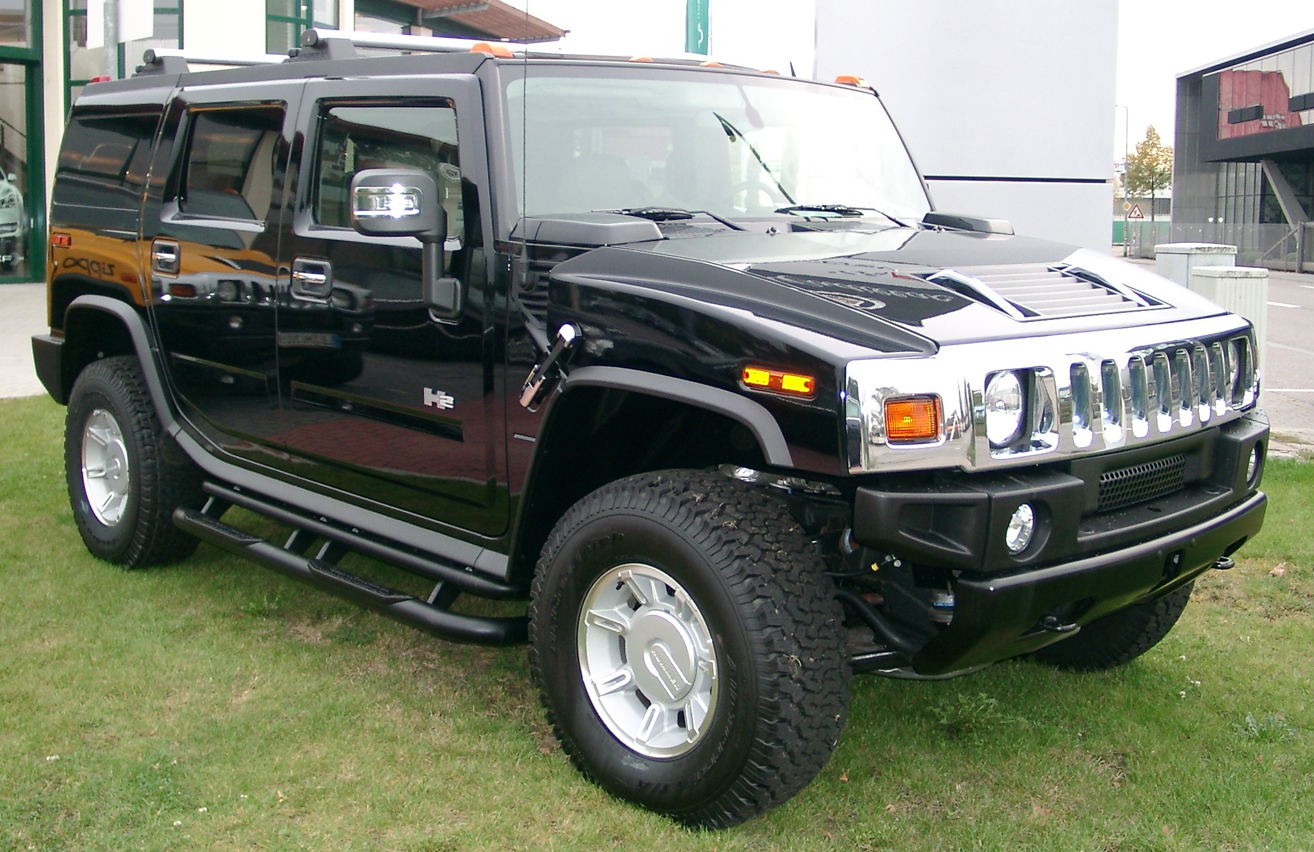
Motor Vehicles and Air Pollution
Corporate average fuel economy (CAFE): intended to reduce fuel consumption and emissions by setting a standard mpg
Average fuel efficiency of 27.5 mpg for all vehicles
Average fuel efficiency of 22.5 mpg for trucks, SUVs, and minivans

Slide 15
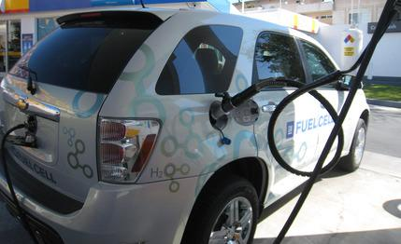
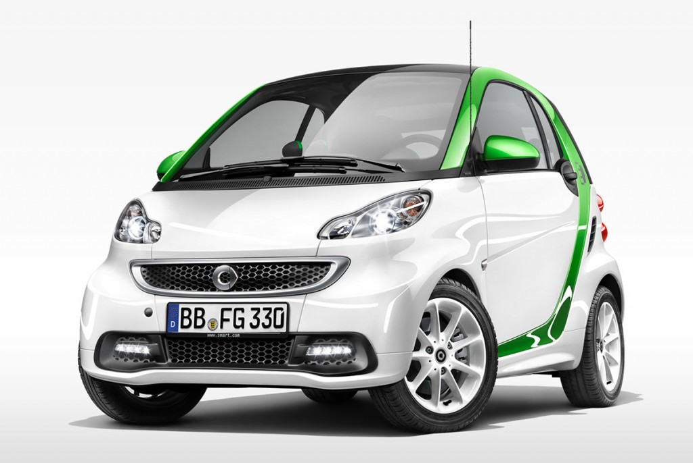
Vehicles of the Future
California has stricter air pollution laws than any other state
Passed a No-pollution Vehicle Law: by 2003, 10% of the cars sold in the state would be pollution free
Possible advancements:
Electric cars
Hybrid vehicles
Hydrogen fuel cell vehicle (very expensive)

Slide 16
Let’s Review!
How does photochemical smog form?
How does an inversion layer influence air pollution events?
How does the Clean Air Act regulate anthropogenic emissions?

Slide 17
Homework
Read Vehicle Exhaust Pre-lab background info, read the procedure and answer Pre-lab Questions
Lab tomorrow will be outside– come to school ON TIME!

