Slide 1
SWBAT identify the major air pollutants and where they come from.
APES Unit 9 2/24/16

Slide 2
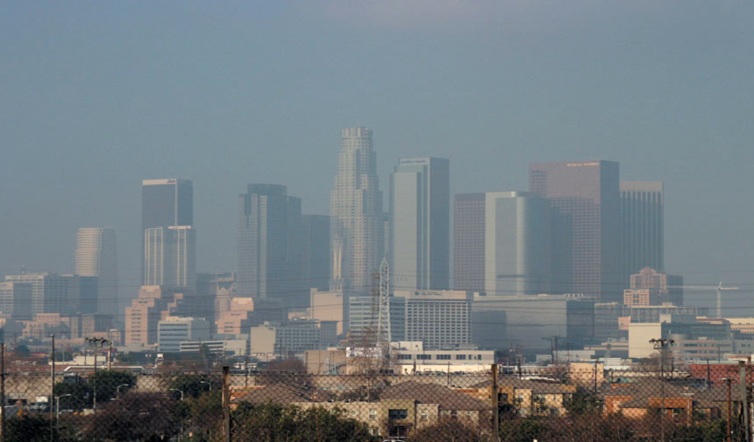
Unit 9: Air
Ch. 15: Air Pollution and Stratospheric Ozone Pollution
1 week
Vehicle Exhaust emissions lab
EQs:
How does air quality affect our lives?
What are humans doing to change the air quality for better or for worse?
Current Event Presentation: Attia on Mar. 4th

Slide 3
Agenda
Lecture
Article
Videos

Slide 4
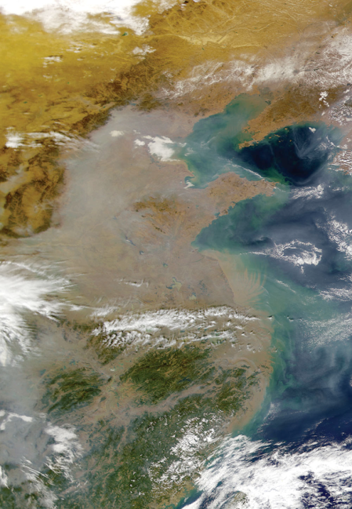
Air Pollution
Pollution is in the troposphere (ground-level pollution)
Pollution in the atmosphere that can harm:
Animals
Buildings
Alter ecosystems
Air pollution is global!
Ex: South Asian Brown Cloud

Slide 5
Primary vs. Secondary Air Pollutants
Primary air pollutants: released directly into the atmosphere and are toxic
Ex: CO, SO₂, NO_{x}, many VOCs
Secondary air pollutants: formed by the combination of primary pollutants in the atmosphere.
Ex: Ozone, SO₄²- and NO₃-

Slide 6
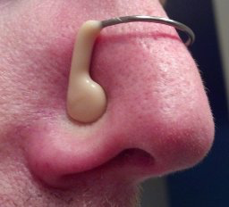
The Major Culprits (Criteria Pollutants) Remember: NOS CLP
Nitrogen Dioxide (NO₂)
Ozone (O₃)
Sulfur Dioxide (SO₂)
Carbon Monoxide (CO)
Lead (Pb)
Particulates

Slide 7
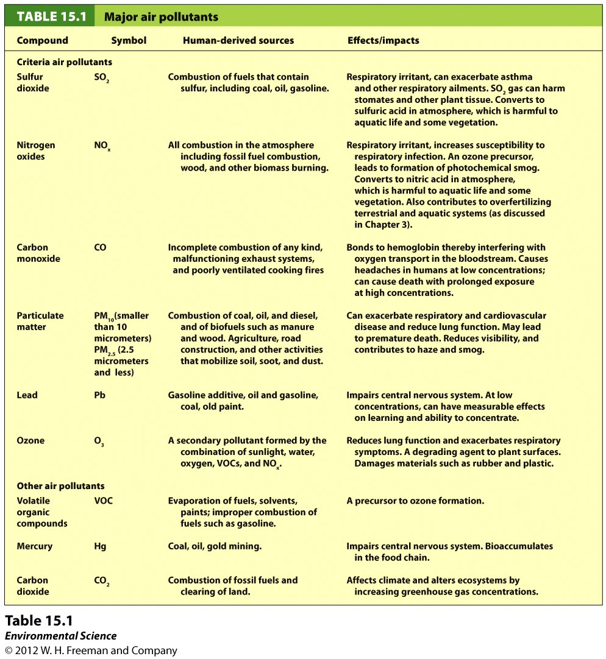

Slide 8
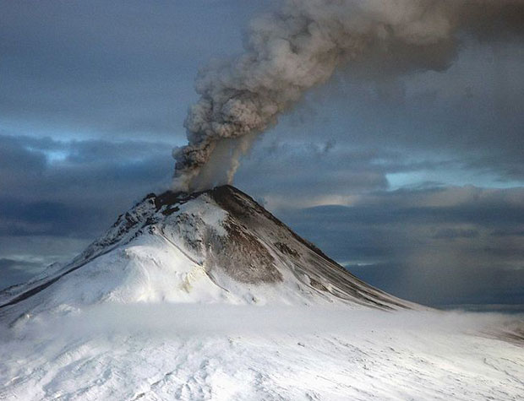
SO₂ (sulfur dioxide)
Colorless gas with a strong odor
Respiratory irritant and can damage plant tissue
Primary source: combustion of fossil fuels (coal and oil)
Other sources:
Metal smelting, paper pulping, volcanic eruptions, forest fires

Slide 9
Nitrogen Oxides (NO_{x})
Nitrogen and oxygen react as a result of exposure to high temperatures:
NO
Colorless, odorless gas
N₂ + O₂→ 2NO
NO₂
Pungent, reddish brown gas
2NO + O₂→ 2NO₂
Health effects: respiratory irritant, increases susceptibility to respiratory infection
Produced by combustion engines burning fossil fuels
Natural sources: forest fires, lightning, microbial action in soils

Slide 10
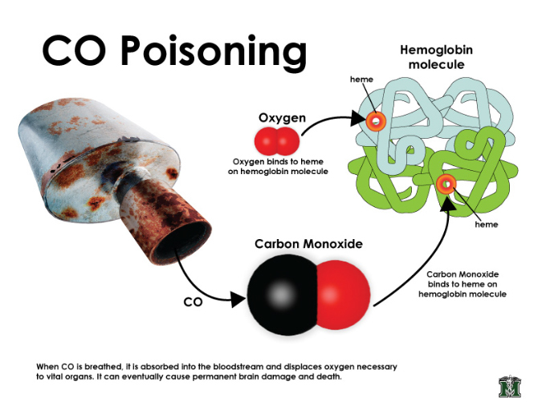
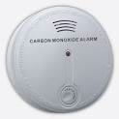
Carbon Oxides (CO and CO₂)
Carbon Monoxide (CO)
Odorless, colorless gas
Main sources: byproduct of incompletely burned organic material, such as fossil fuels
Can be indoor air pollutant when exhaust systems on natural gas systems malfunction
Effect on human health:
Binds to hemoglobin and displaces oxygen
In high concentrations, CO can be deadly

Slide 11
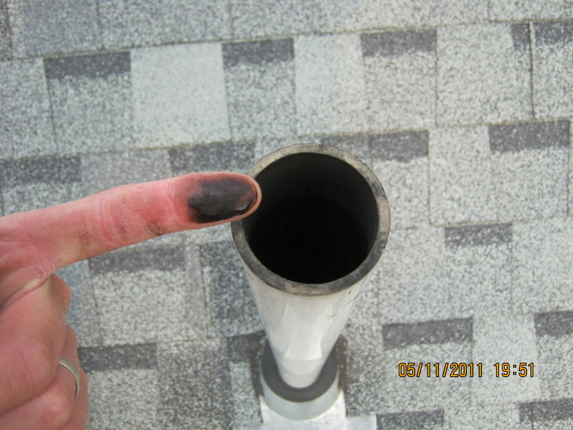
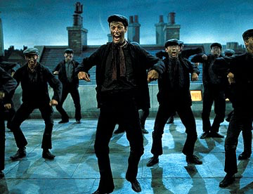
Particulate Matter (PM)

Slide 12
Particulate Matter (PM)
Small solid or liquid particles suspended in the air
Sources: combustion of wood, animal manure, biofuels and fossil fuels, volcanoes, unpaved roads
Mainly diesel fuel engines
Health effects: exacerbate respiratory and cardiovascular diseases and reduce lung function
Ex: soot and sulfate aerosols
Particulate matter less than 2.5 um is most dangerous to human health
Composed of more toxic substances
Deposited more deeply within the respiratory tract
Haze: particulate matter from air pollution scatters light

Slide 13
Photochemical Oxidants
Oxides: oxidize (remove electrons) from other substances
Formed as a result of sunlight acting on compounds such as nitrogen oxides and sulfur dioxide
NO_{x}, O₃ and PANs
Tropospheric Ozone (O₃) is most abundant and photochemical oxidant
VOC + NO_{x} + O₂ + sunlight→ O₃ + photochemical oxidants
Harmful to plants and animals
Can cause emphysema (damages air sacs in lungs, causes you to be out of breath)

Slide 14
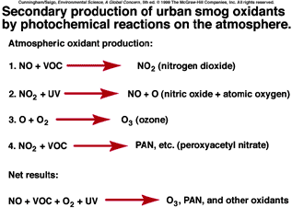
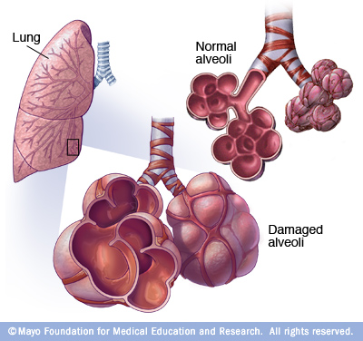
Photochemical Oxidants

Slide 15
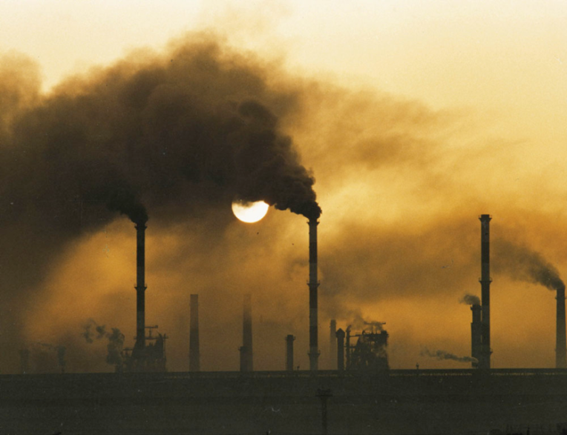
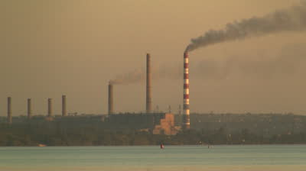
Smog
Smoke + fog = smog
Industrial smog (gray smog or London-type smog)
Result of burning oil or coal
CO and CO₂ are released and combine with particulate matter to produce smog
SO₂ + H₂O → H₂SO₄
Tiny particles such as salt and the carbon in soot give smog its gray color
Accounts for 750,000 deaths each year in China

Slide 16
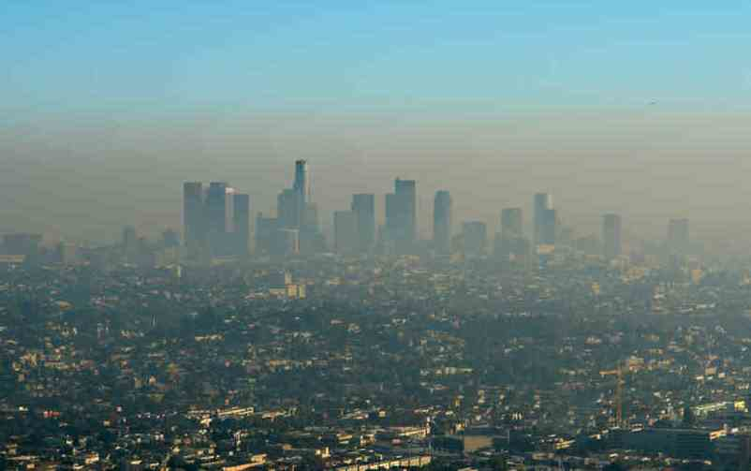
Photochemical Smog (Brown Smog)
Dominated by oxidants (O₃)
Common cities with high brown smog: L.A. and Athens
Commuter traffic!
Secondary pollutants that are a component of photochemical smog: O₃, PANs, NO₂, HNO₃, H₂SO₄

Slide 17
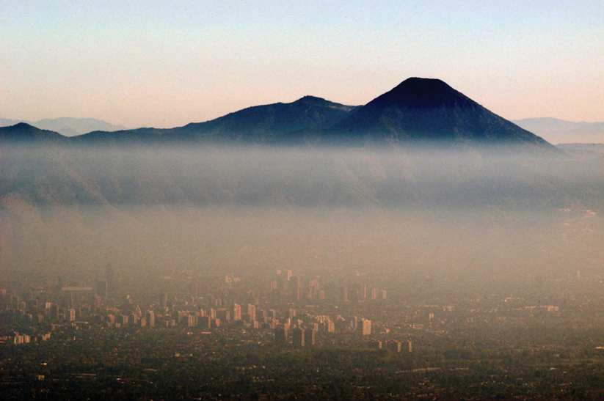
Photochemical Smog

Slide 18
Lead (Pb) and other Metals
Lead present in small quantities in fossil fuels
Added to gas to improve vehicle performance
Phased out in U.S.
Human health effects: nervous system disorders
Mercury (Hg)
Released into atmosphere from burning of coal
Human health effects: nervous system disorders

Slide 19
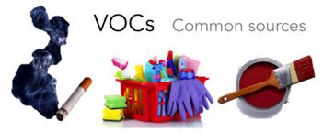
Volatile Organic Compounds (VOCs)
Organic compounds that become vapors at typical atmospheric temperatures
Hydrocarbons, terpenes and methane
Source: Natural gas wells, cow belches, landfills, cleaning compounds, dry cleaning
Play important role in the formation of ozone

Slide 20
Let’s review!
What are the major air pollutants?
What is the difference between a primary and a secondary air pollutant?
Describe the difference between industrial smog and photochemical smog

Slide 21
Homework
Read in textbook through page 419
Study Figure 15.7 in the textbook for formation of tropospheric ozone and photochemical smog
Make a flash card for one of the secondary pollutants involved in photochemical smog and list (look at table 15.1):
How it is formed
One effect on human health
One environmental effect

