Slide 1
SWBAT perform an experiment to analyze the effectiveness of secondary treatment of wastewater.
APES Unit 4 11/25/15

Slide 2
Lab Notes
pH of acidic solution is
While the reaction is running, you can:
Complete MC questions

Slide 3
Roles
Timer: Announce when it is time to take a reading (Rimsha)
Glucose tester (7 people)
0 min. (Uzma)
5 min. (Shayna)
10 min. (Desire)
15 min. (Hamna)
20 min. (Rahila)
30 min. (Monica)
40 min. (Ramlah)

Slide 4
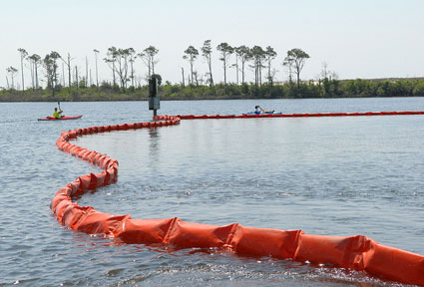
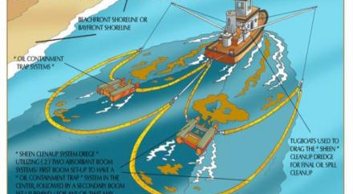
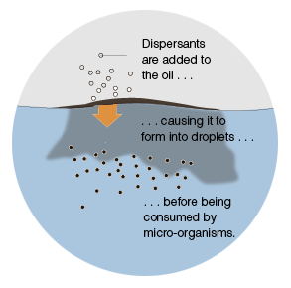
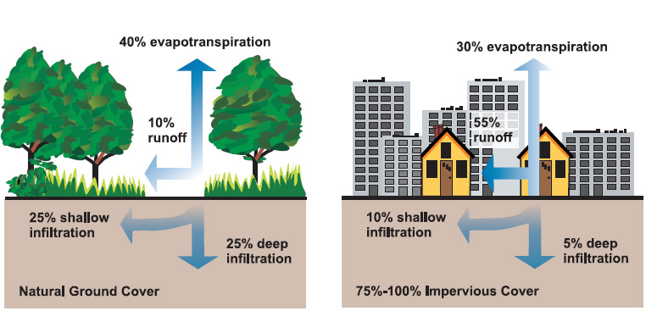
B.P. Oil Spill Article

Slide 5
Break Homework
MC questions
Lab report!
Start reading Ch. 8 (Earth Systems) through page 217
Have a great Thanksgiving ☺

