Slide 1
SWBAT design a lab to test the effectiveness of the wastewater treatment process
APES Unit 4 11/20/15

Slide 2
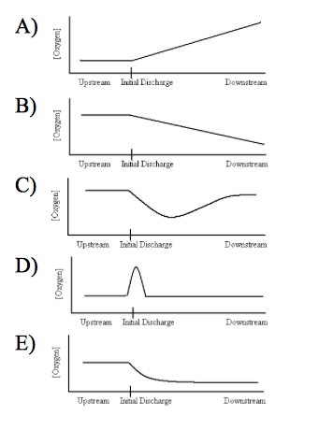

Slide 3
Agenda:
Review Hw
Current Event Presentations
Pass Back Work
Design Inquiry Lab

Slide 4
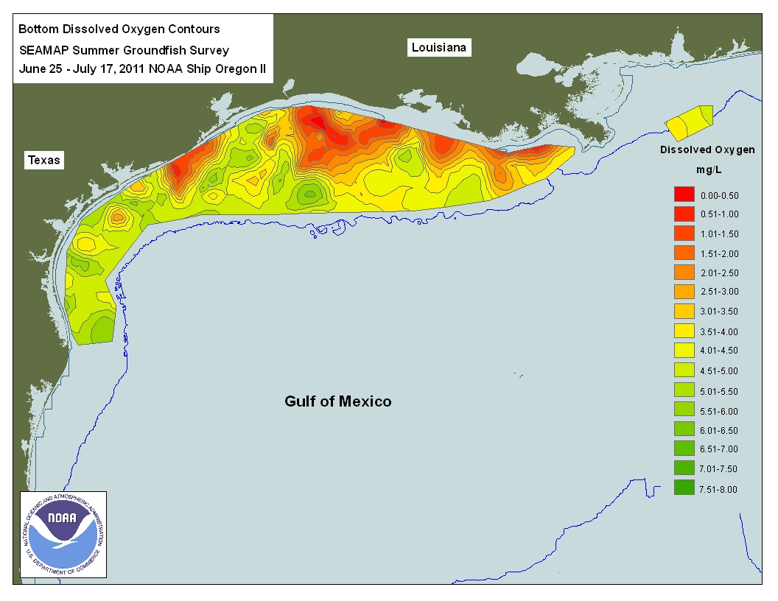
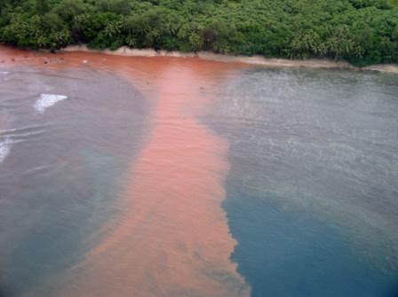
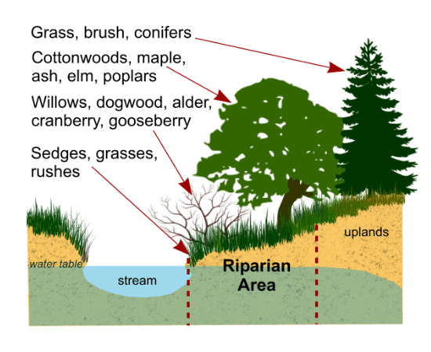
Gulf of Mexico
Harmful Algal Blooms (HABs)

Slide 5
Sample Inquiry Questions:
How does the amount of pollution affect the wastewater treatment process?
How does an acidic or basic pH affect the wastewater treatment process?
How does the temperature of the water affect the rate of the wastewater treatment process?

Slide 6
Experimental Design:
What is your testable question?
What is your IV and DV?
STOP and call over Ms. McDaniel
Hypothesis?
What is your control?
What materials will you need?
STOP and call over Ms. McDaniel
Look at the procedure on the class website in order to write your procedure

Slide 7
Homework
B.P. Oil Spill Article and questions
Start studying for the exam!
Write summaries of the current event presentations and bring in your current event notebook on Monday!

