Slide 1
SWBAT evaluate methods for regulating water pollution.
APES Unit 4 11/18/15
SWBAT determine the water quality of a pond by measuring dissolved oxygen.

Slide 2
Agenda
Lecture
Lab!
Video (if time)

Slide 3
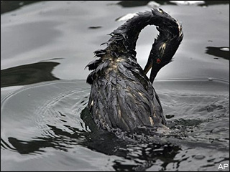
Oil Pollution
Highly toxic to marine life
Sources of oil in water:
Offshore platforms that drill for oil undersea
The majority of oil pollution in the ocean comes from land activities (runoff)

Slide 4
Exxon Valdez Oil Spill (1989)
Oil tanker Exxon Valdez ran aground off the coast of Alaska
Spilled 11 million gallons of crude oil
About 14,500 gallons still remain
Consequences:
Widespread shoreline contamination
Decline in bird populations
Passage of the Oil Pollution Act
Disruption of salmon migration

Slide 5
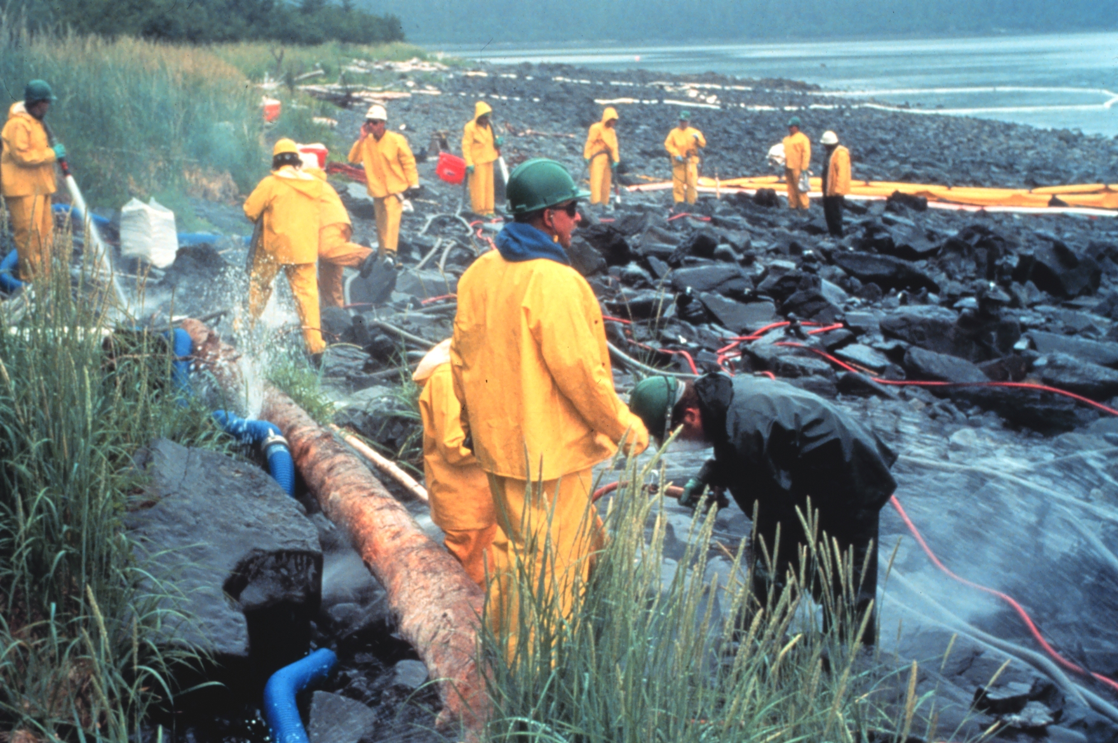
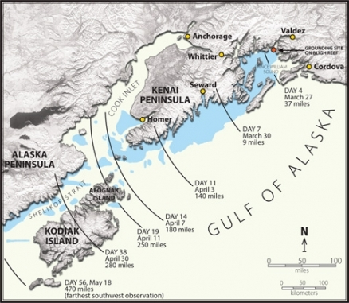
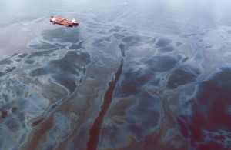
Exxon Valdez Oil Spill

Slide 6
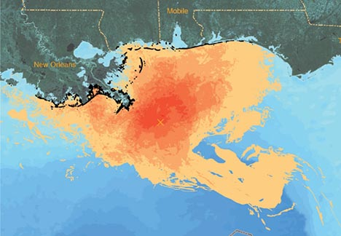
B.P. Oil Spill (2010)
Explosion on an offshore platform caused pipe to break on ocean floor
206 million gallons of oil leaked
Contamination of beaches, wildlife, and estuaries

Slide 7
Oil Spill Cleanup
Use coagulating agents that causes floating oil to clump together
Burn the oil
Use absorbing pads or large mesh pillows to soak up oil
Use dispersing agents to break up oil slicks
Con: can be toxic to marine animals
Plastic barriers laid out to contain oil
Genetically engineered bacteria to eat oil
Animals must be cleaned by hand

Slide 8
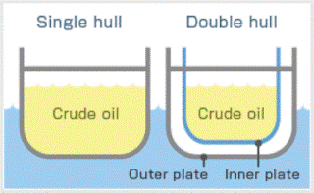
Oil Spill Prevention
The Oil Pollution Act
MARPOL
International convention for prevention of pollution of marine environment by oil spills
The Clean Water Act (1972)
Catamaran hull tankers
Fit oil tankers with double hulls

Slide 9
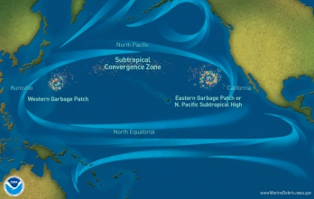
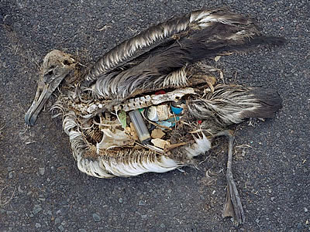
Solid Waste Pollution
Garbage dumped in bodies of water
Great Pacific Garbage Patch
Size of Texas
Coal ash: waste product from burning coal
Contains mercury, arsenic and lead
EPA does not classify it as a hazardous waste

Slide 10
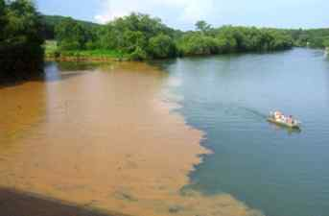
Sediment Pollution
Sediment: particles of sand, silt and clay carried by moving water
Human activities that increase sediments:
Construction of houses and buildings
Plowed agricultural fields→ susceptible to erosion
Effects of increased sediment
Water more cloudy→ less light penetration
Less light penetration→ less photosynthesis

Slide 11
Thermal pollution
Thermal pollution: human activities cause a significant change the temperature of the water
Most common form: cold water removed to absorb heat for industrial process and then returned back to source
Major cause: nuclear power
Thermal shock: dramatic temperature change can kill many species

Slide 12
Thermal Pollution
Makes aquatic organisms more vulnerable to parasites and toxic chemicals
Decreases the amount of dissolved oxygen in water
Primary causes:
Soil erosion
Soil particles absorb more sunlight→ warmer water
Deforestation of shore lines
Less shade→ more sunlight→ warmer water
Coolant use in nuclear reactors
Run-off from paved surfaces

Slide 13
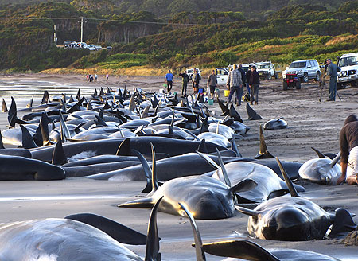
Noise Pollution
Sounds from ships and submarines can interfere with animal communication

Slide 14
Water Quality Legislation
Clean Water Act (1972): Protects all surface waters in the U.S.
Reduced direct pollutant discharge into waterways
Financed municipal wastewater treatment facilities
Restoring and maintaining chemical, physical, and biological integrity of the nation’s water
Supported protection and propagation of fish, wildlife and recreation

Slide 15
Water Quality Legislation
Ocean Dumping Act (1972): Unlawful for any person to dump sewage sludge or industrial waste into ocean waters
Safe Drinking Water Act (1974):
Sets standards for safe drinking water
EPA established maximum contaminant levels (MCLs) for 77 different elements
Includes wells that supply at least 25 people

Slide 16
Water Quality Legislation
Improvements to clean water drinking act:
Expanding the rights of citizens to bring lawsuits to uphold water pollution laws
Strengthening programs to prevent and control toxic water pollution
Permitting states with good environmental records to take over the clean water program
Increased monitoring of state programs to make sure permits don’t expire

Slide 17
Water Quality Legislation
Ocean Dumping Act (1972): Unlawful for any person to dump sewage sludge or industrial waste into ocean waters
Safe Drinking Water Act (1974):
Sets standards for safe drinking water
EPA established maximum contaminant levels (MCLs) for 77 different elements
Includes wells that supply at least 25 people

Slide 18
Water Quality Legislation
Oil Pollution Act (1990)
Strengthened EPA’s ability to prevent and respond to catastrophic oil spills
Established a trust fund (financed by tax on oil) that is used to clean up oil spills.

Slide 19
D.O. Lab Safety
We will be handling STRONG acid!
Wear goggles and latex gloves AT ALL TIMES!!!!
If your gloves tear, get another pair!

Slide 20
Calculations:
Temperature for all 3 sites: 15 degrees C

Slide 21
Homework
Water Quality Analysis Questions
Wastewater treatment reading and pre-lab
Watch for my email and look on the class website for information on data analysis

