Slide 1
SWBT identify the effect of chemical pollutants on the water supply and human health.
APES Unit 4 11/17/15

Slide 2
Agenda
Lecture
Videos
Announcement: Unit 4 Exam on Tues. Nov. 24th

Slide 3
Animal feedlots and manure lagoons
Animal waste can contaminate water
Waste from CAFOs contains hormones and antibiotics
Manure lagoons: human-made ponds lined with rubber to prevent the manure from leaking into the groundwater

Slide 4
Heavy Metals: Lead
Lead may contaminate water by passing through pipes of older homes that contain lead.
Lead poisoning:
Can damage brain, nervous system and kidneys
Symptoms: anemia, headaches, vomiting and increased blood pressure
affects 5% of the population
Is a greater risk for lower income families.

Slide 5
Heavy Metals: Arsenic
Arsenic occurs naturally in Earth’s crust and can dissolve into groundwater.
Can be removed from drinking water with fine membrane filtration, distillation and reverse osmosis.
Arsenic poisoning associated with cancers of skin, lungs, kidneys, and bladder.
Most common in west and midwest in U.S.

Slide 6
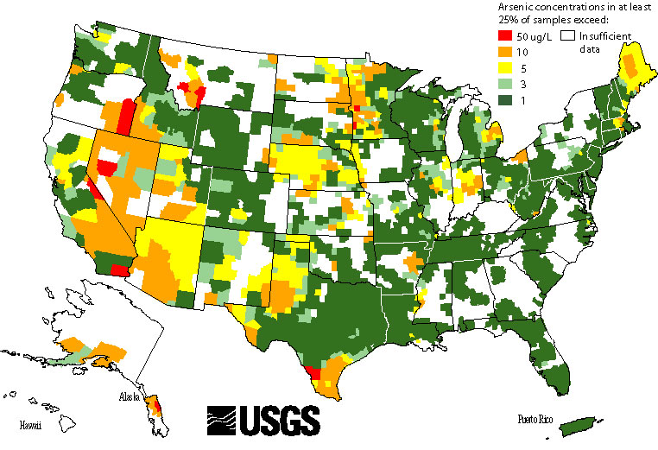
Arsenic in the U.S.

Slide 7
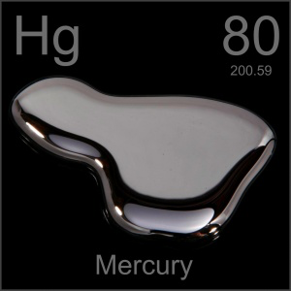
Heavy Metals: Mercury
2/3 of mercury from human activities is from burning fossil fuels
Specifically coal
Mercury poisoning: nervous system damage, kidney damage, eye damage and congenital defects

Slide 8
Heavy Metals: Methylmercury (CH₃Hg⁺)
Bacteria in wetland and lakes convert inorganic mercury to methylmercury
Can damage the nervous system
Human exposure occurs mostly through eating fish and shellfish
Tuna
Limit mercury pollution:
EPA proposed cement factories reduce mercury emissions by 81%
Reduce mercury pollution from coal-burning power plants

Slide 9
Mercury and Lead Poisoning

Slide 10
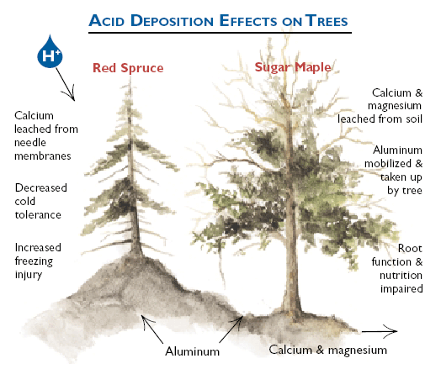
Acid Deposition
Wet-acid deposition: rain and snow
Dry-acid deposition: gases and particles that attach to the surfaces of plants, soil and water
Reduces the pH below 5
Can cause aquatic animal populations to decrease significantly

Slide 11
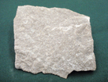
Acid Deposition
A lake or pond can be protected from acid deposition by natural buffers from limestone
Reason: limestone is basic
Increased amounts of acid mobilize aluminum ions
Aluminum ions cause stunting of root growth
Can reduce populations of soil microorganisms

Slide 12
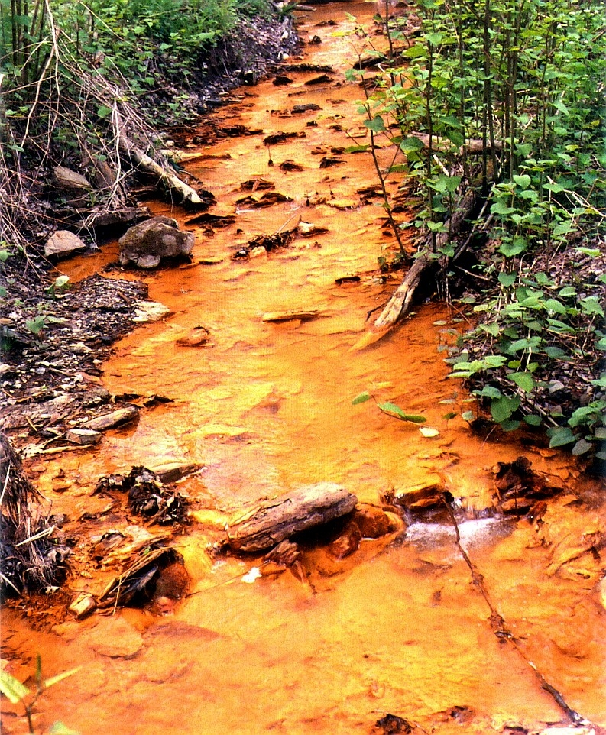
Acid mine drainage
Underground mines flood with groundwater→
Water + air allows pyrite rock to break down→
Produces iron and hydrogen ions→ acidic pH
Water comes to the surface and pollutes streams

Slide 13
Synthetic Organic (carbon containing) Compounds
Chlorinated hydrocarbons are the most persistent pesticide in the environment
Example: DDT
Responsible for the deaths of many birds
Known to cause human neurological damage
Subject of Rachel Carson’s Silent Spring

Slide 14
DDT
U.S. stopped spraying DDT in 1972
In the U.S., DDT has been replaced with organophosphates which are highly toxic to humans but less persistent
Still produced in many developing countries to combat malaria

Slide 15
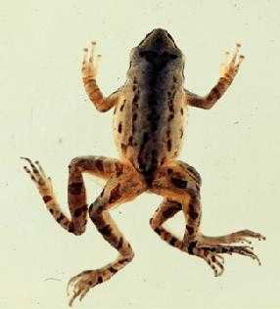
Pesticides
Inert ingredients: make a pesticide more effective
Can be harmful
Example: Roundup contains inert ingredient that is highly toxic to amphibians
Example: Atrazine can change the sex of adult frogs and lower their fertility.

Slide 16
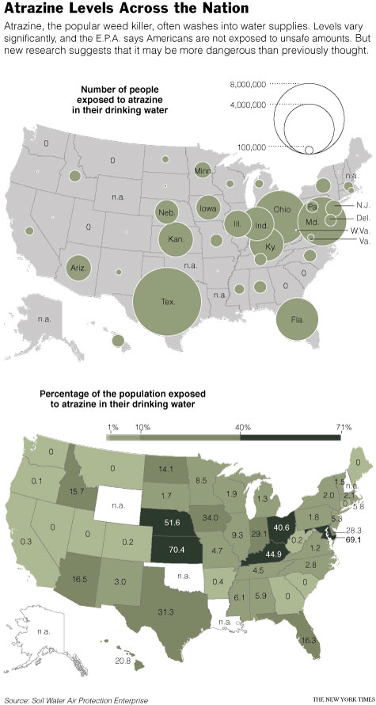

Slide 17
Synthetic Organic Compounds
Pharmaceuticals and Hormones:
In the U.S. 50% of streams contained antibiotics
80% contained nonprescription drugs
90% contained steroids
Drugs that mimic estrogen are connected to male fish growing female eggs in testes
Military Compounds:
Perchlorates used for rocket fuel
Can leach from contaminated soil into groundwater

Slide 18
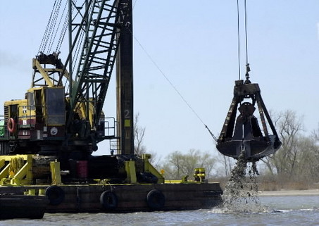
Industrial Compounds: PCBs
Used in manufacturing plastics and insulate electrical transformers
Health effects: lethal and carcinogenic if ingested
Case Study: Hudson River
General electric manufacturing plant dumped 590,000 kg of PCBs
2009 – General Electric forced to dredge the river

Slide 19
Industrial Compounds: PBDEs
Make buildings and contents less flammable
Have been detected in fish, aquatic birds, and human breast milk
Exposure can lead to brain damage

Slide 20
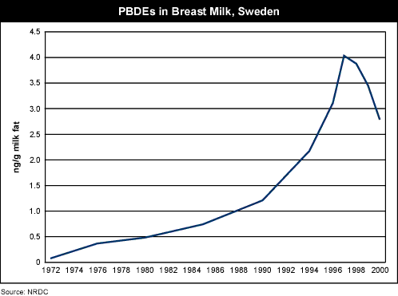

Slide 21
Checkpoint
Describe the dangers associated with heavy metals in water
Explain the role of acid deposition in water pollution
Name examples of synthetic compounds that have been found in our water supply and explain why they are a concern.

Slide 22
Homework
Finish reading Ch. 14- all the way to the end!
Read Quality of Water Pre-lab and Answer Questions
Collect Water Samples pretty please ☺

