Slide 1
SWBAT perform unit conversions to solve FRQ problems
APES Unit 4 11/16/15
SWBAT identify ways in water can be polluted.

Slide 2
Agenda:
Math FRQ
Lecture
Pass Back Exams/Invasive Species Articles
People who live near bodies of water!

Slide 3
Math Groups!
Group 1: Rimsha, Ramlah, Monica
Group 2: Cynthia, Wyllana, Rahila, Uzma
Group 3: Hamna, Shayna, Amrat, Mahnoor
Group 4: Attia, Wendy, Bukurie, Saliha
Group 5: Mehrangiz, Desire, Kaylah, Harmanpreet

Slide 4
Group Rules
Start with the end!
Ask 3 before me!
Check answers with each other!
Then check answers with me before moving on the the next section!

Slide 5
Household Water Use FRQ
C) Two practical measures that the family could take to reduce their overall water use at home
Reduce the length of daily showers
Shower less frequently
Install low flow shower heads/and or toilets
Turn off water when brushing teeth
Use a water-efficient appliance
Use gray water to water plants

Slide 6
Household Water Use FRQ
(D) Describe two conservation methods that they family could use to lower the amount of energy
Turn off electronic appliances when no one is in the room
Replace incandescent light bulbs with fluorescent light bulbs
Turn off lights during daylight hours
Open windows or turn on fans rather than running the a/c
Use sweaters/blankets rather than running the heater

Slide 7
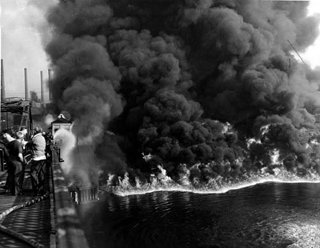
Water Pollution
Contamination of streams, rivers, lakes, oceans or groundwater with substances produced thorough human activities that negatively affect organisms
Cuyahoga river fire in Cleveland, Ohio (1969)
Symbol of polluted America

Slide 8
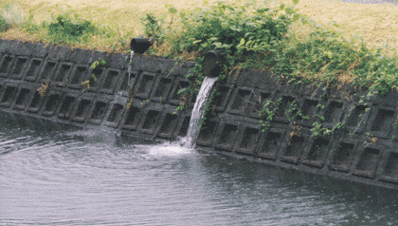
Water Pollution
Point sources: Distinct sources of water pollution
Oil tankers
Factory
Sewage treatment plant

Slide 9
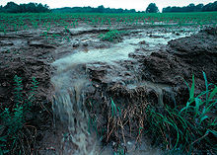
Water Pollution
Non-point sources: Pollution does not have a definitive source
Mining wastes
Construction sediments
Agricultural runoffs
Soil erosion
Largest non-point source of water pollution in the U.S. is agriculture

Slide 10
Human Wastewater
Wastewater: Any water that has been used by humans
Sources:
Sewage
Showers/tubs
Sinks
Dishwashers
Challenge: How do we keep human wastewater from contaminating human drinking water?

Slide 11
Wastewater
Effects of wastewater pollution:
Naturally undergoes decomposition by bacteria→ creates large demand for oxygen in the water
Nutrients released from decomposition make the water more fertile
Carry a wide-variety of disease-causing organisms

Slide 12
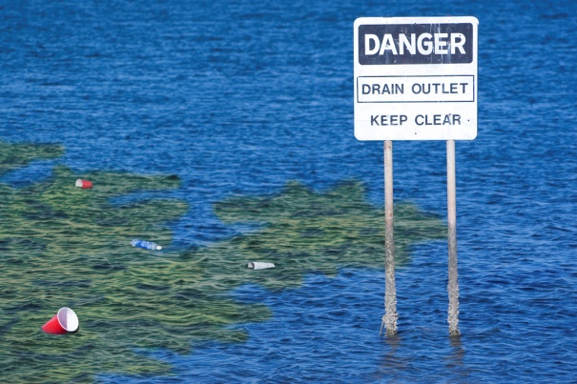
Oxygen Demand
Oxygen demanding waste: organic matter that enters a body of water and feeds the growth of the microbes
Biochemical oxygen demand (BOD): the amount of oxygen a quantity of water uses over a period of time at a specific time

Slide 13
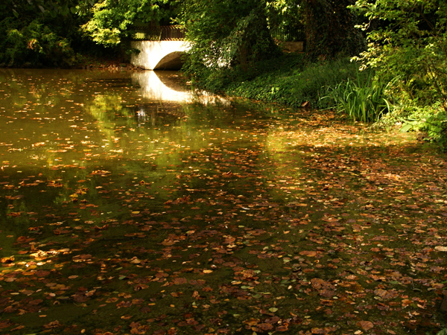
BOD
Low BOD= less pollution
High BOD= more pollution
A high level of biological oxygen demand= large amount of detritus (fragments of dead organisms and fecal material) in the water.

Slide 14
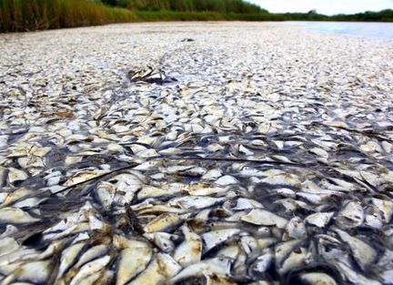
Eutrophication
Runoff from land carries excess nutrients and pollutants from streams
Dead zones: Areas with little oxygen
Fish kill: marine animals die off as a result of no oxygen

Slide 15
Eutrophication
Eutrophication: abundance of fertility due to nutrients (phosphate and nitrogen)
More nutrients → more phytoplankton and zooplankton
Phytoplankton and zooplankton die and sink to the bottom→ bacteria use all available oxygen as they decompose
Lack of oxygen → creates hypoxic (anoxic) zone (dead zones)

Slide 16
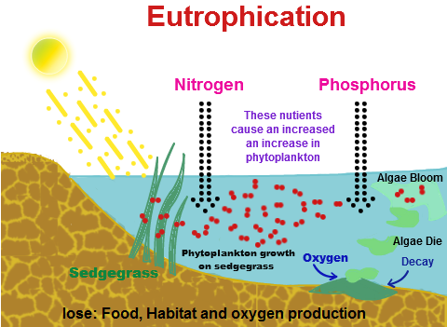
Eutrophication
Cultural eutrophication: Process by which eutrophication is accelerated by human beings
Artificial eutrophication can be caused by fertilizer runoff

Slide 17
Eutrophication
Can be controlled by:
Controlling runoff
Planting vegetation along streambeds
Controlling fertilizer application
Development of natural biological controls
Suffered major eutrophication but made major improvements
Chesapeake Bay
Great Lakes

Slide 18
Disease-Causing Organisms
Water borne pathogens: viruses, bacteria and parasites
Cause diseases: cholera, typhoid fever, various types of stomach flu, diarrhea
Fecal coliform bacteria: live in the intestines of humans
Example: E. coli
Indicate potentially harmful water
High amount of fecal coliform bacteria in black water

Slide 19
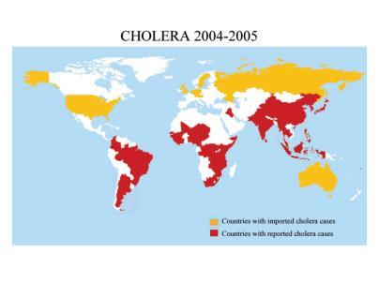
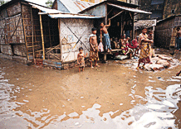
Water-borne pathogens

Slide 20
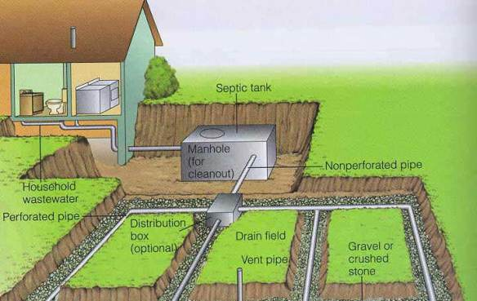
Waste-Water Treatment
Septic system: Houses that have their own sewage treatment system
Rural areas of low population density
Septic tank: large container that receives wastewater from the house

Slide 21
Sewage Treatment Plants
1) Underground pipes carry waste to treatment plant
2) Physical treatment: waste is filtered through screens to remove debris (stones, sticks, rags, toys)
3) Primary treatment: Solid waste (sludge) settles to the bottom of tanks
Removes 60% of suspended solids and 30% of organic wastes that need oxygen in order to decompose

Slide 22
Sewage Treatment Plants
4) Secondary treatment: Biological treatment of wastewater in order to continue to remove biodegradable waste
Sludge processor: Tank with aerobic bacteria
Converts 85 to 90 percent of organic matter to CO₂ and nutrients (nitrogen and phosphorous)
5) Sludge thickened by removing water
6) Majority of sludge produced by sewage treatment is disposed of in conventional landfills.
7) Wastewater exposed to chemicals (chlorine) or UV light to kill pathogens
8) Treated wastewater released into rivers or lakes

Slide 23
Sewage Treatment Plants
Tertiary treatment: Water passes through sand and carbon filters and receives further chlorination.
Example: San Jose Creek in L.A. where water goes to nurseries, golf courses, irrigation, etc.

Slide 24
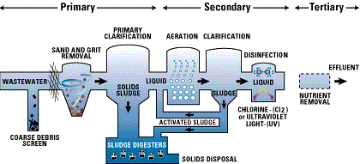
Sewage Treatment Plants

Slide 25
Checkpoint
What is the role of bacteria in the treatment of human and animal waste?
Describe the advantages and disadvantages of both septic systems and sewage plants.

Slide 26
A.P. FRQ Tips
HUGE improvement on FRQ!
Answer usually not found in the text!
Economic consequences:
Higher prices
Decreased revenue
inflation
Gain/loss of jobs
FRQ Rewrite due by Friday!
Come to me if you’re confused about missing points!

Slide 27
Homework
Read Ch. 14 pgs. 389-396

