Slide 1
SWBAT explain the benefits and drawbacks of using geothermal, wind power and hydrogen fuel cells as energy sources. Do Now: What is the energy source of geothermal energy? Why is hydrogen useful as an alternative to fossil fuels?
APES Unit 11 3/30/16

Slide 2
Agenda
Lecture
Videos
Discussion

Slide 3
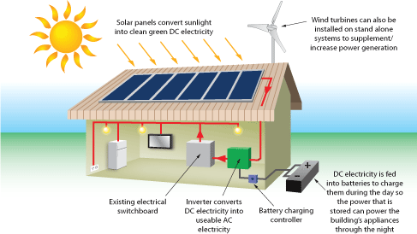
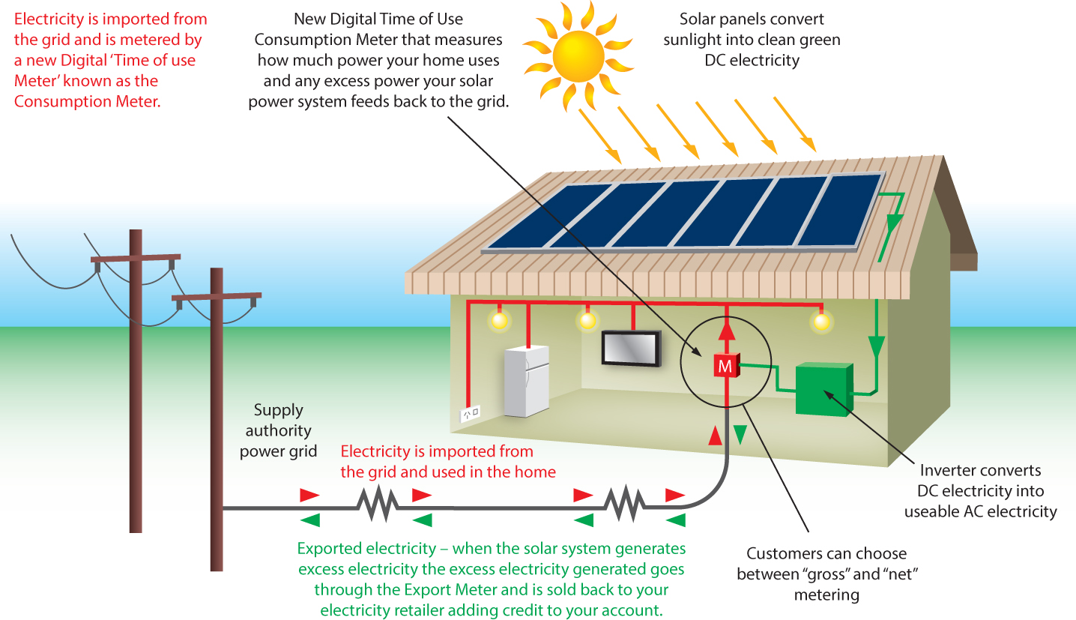
Stand alone vs. connected solar panels

Slide 4
Geothermal Energy
Heat that comes from the natural radioactive decay of elements deep within the earth.
Elevated temperatures within earth results in a buildup of pressure → some heat escapes through cracks
Ex: geysers, hydrothermal vents, and hot springs
Form of renewable energy that does not come from the sun.
Largest producers of geothermal energy:
U.S, China, and Iceland

Slide 5
Geothermal Energy
Hot groundwater can be piped directly to household radiators for heating a home
Iceland heats 87% of its homes this way
Naturally heated water and steam from the earth’s interior turn turbines→ generate electricity
Need to return water to the ground in order for it to be sustainable

Slide 6
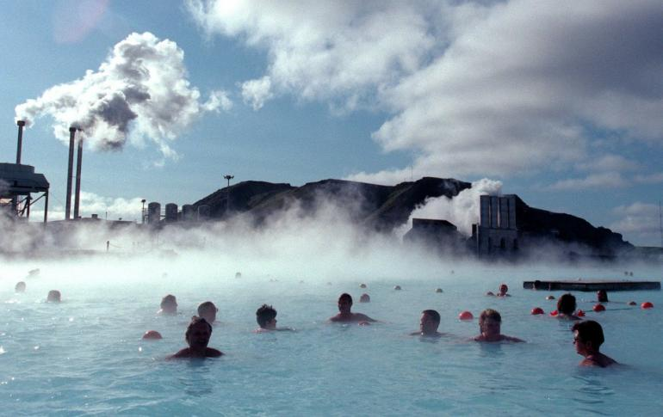
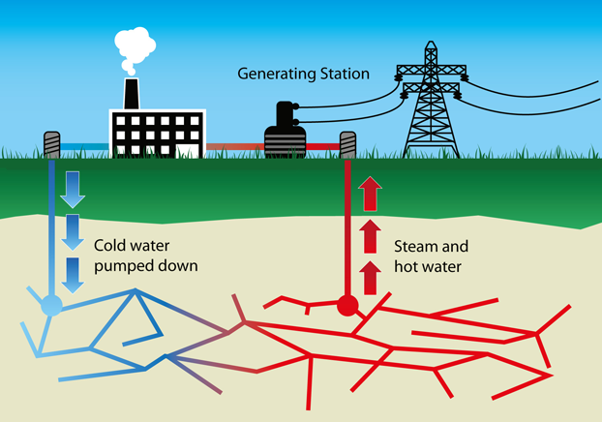
Geothermal Energy

Slide 7
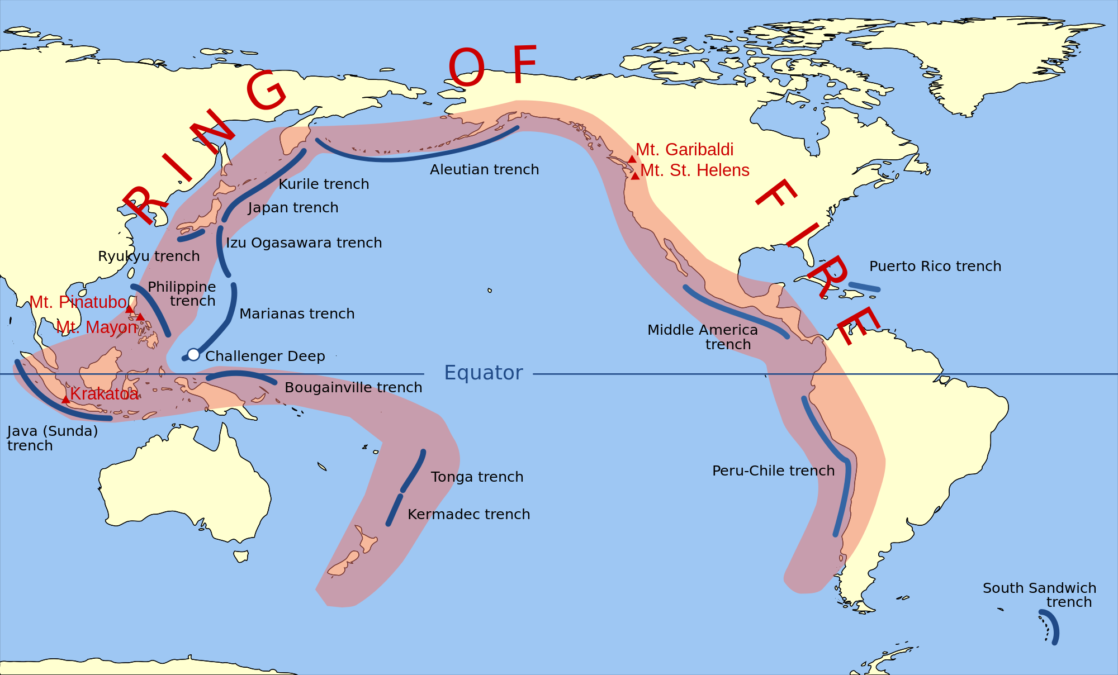
Geothermal Energy

Slide 8
Geothermal Pros and Cons
Pros | Cons
Renewable source of energy | Geographically limited
After initial investment, no cost to harness energy | Salts dissolved in the water can corrode machinery parts
 | Some gases (methane, ammonia, hydrogen sulfide, carbon dioxide) may be trapped in the water and can be released as the water is utilized.

Slide 9
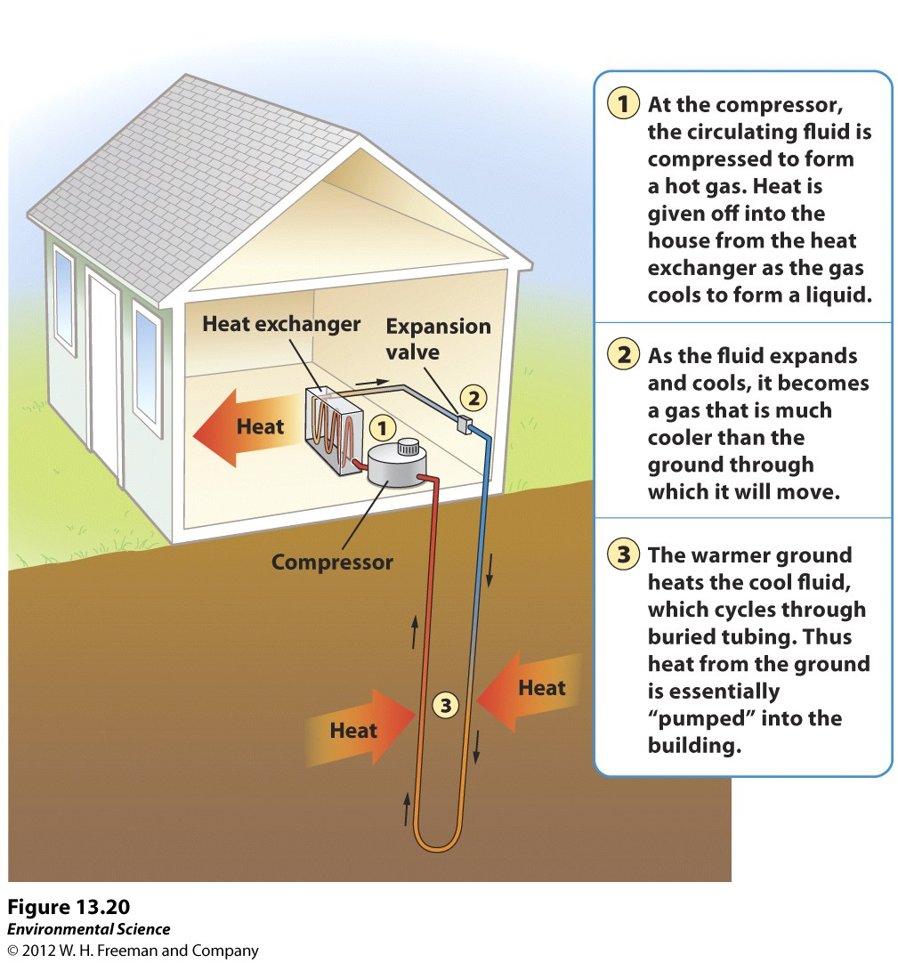
Ground Source Heat Pumps
Ground has high thermal inertia→ retains heat form the sun
Source is solar energy
Can be installed anywhere

Slide 10
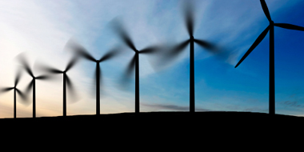
Wind Energy
Most rapidly growing source of energy with a huge untapped potential
Wind results from the unequal heating of the earth’s surface by the sun.
U.S. has largest source of wind energy generating capacity in the world

Slide 11
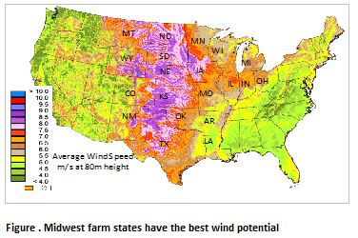
Wind Energy

Slide 12
Generating Electricity from Wind
Wind turbine converts kinetic energy of moving air into electricity.
Average wind conditions→ produces electricity 25% of the time
Typically installed in rural locations on land
Need to be close to electrical transmission lines
Offshore wind parks are rapidly growing
Turbines can be made larger and produce more electricity

Slide 13
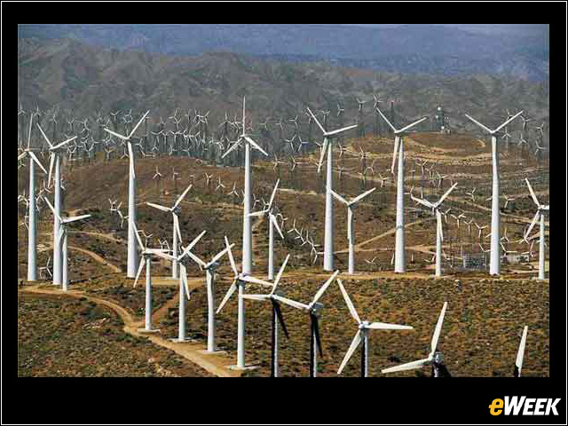
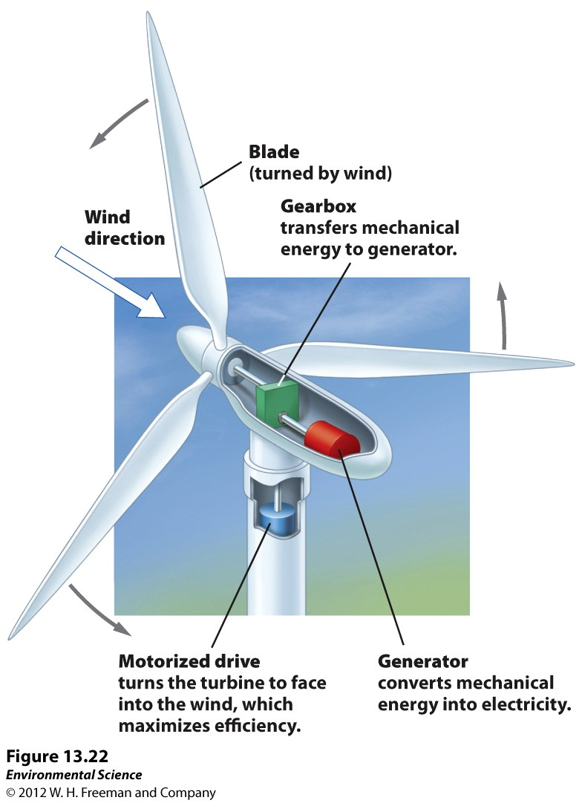
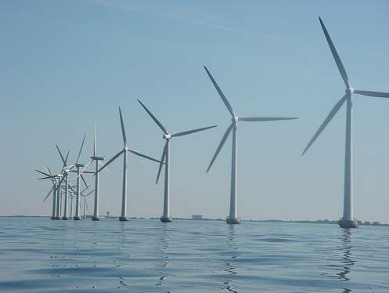
Wind Energy

Slide 14
Wind Energy Pros and Cons
Pros | Cons
Nondepletable, clean energy source | Rely on batteries to store electricity→ expensive to produce and hard to dispose of
No pollution or greenhouse gases produced | Turbine noise
Can share land with other uses (i.e. cattle grazing) | Deaths of birds and bats
 | Geographically limited to windy areas
 | Aesthetically displeasing to some

Slide 15
Hydrogen Fuel Cells
Fuel cell: reactants are added continuously to the cell → produces energy for longer
2H₂ + O₂ → energy + H₂O
Movement of protons in one direction and electrons in the other direction generates electricity

Slide 16
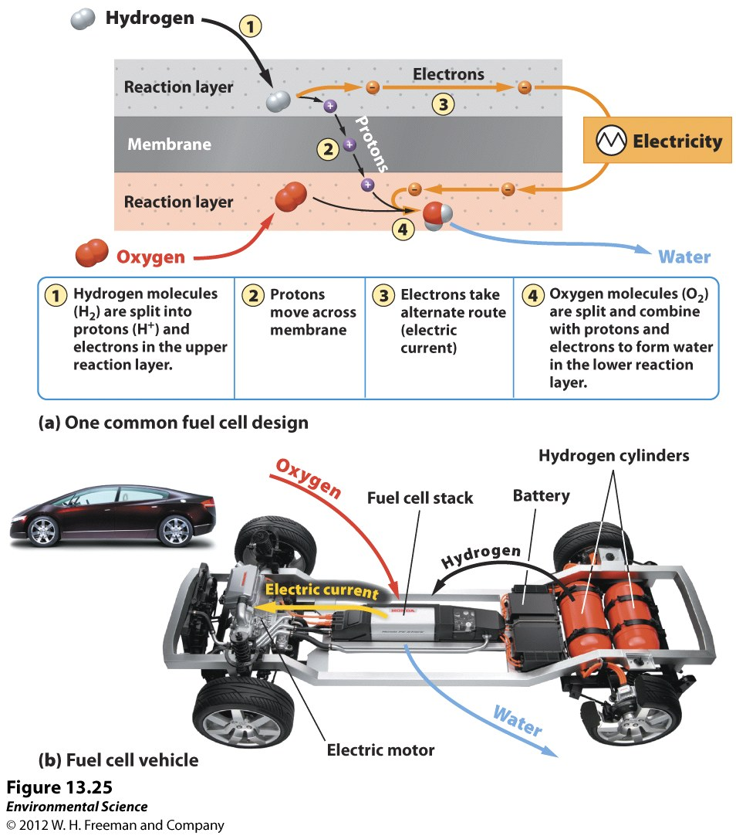
Hydrogen Fuel Cells

Slide 17
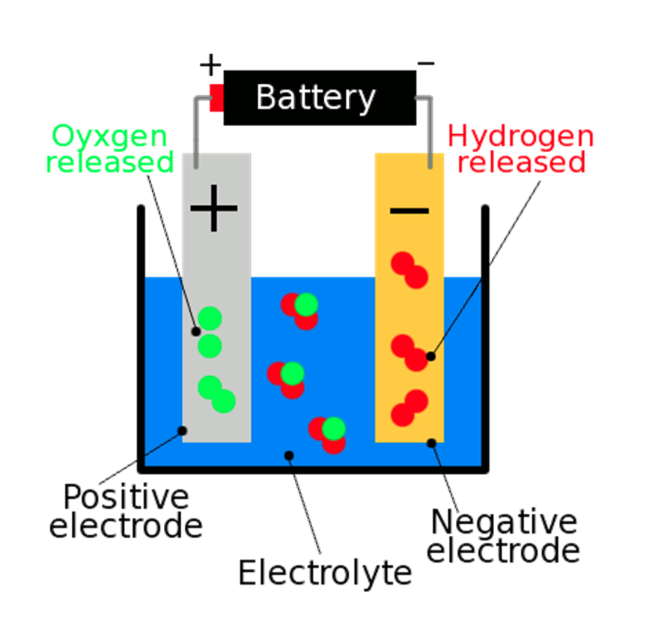
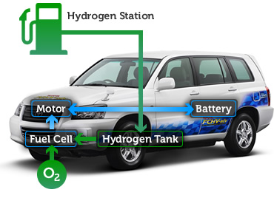
Hydrogen Fuel Cells
Hydrogen gas is rare in nature (highly explosive)
Electrolysis: method to produce hydrogen gas by applying an electrical current to water to split it into hydrogen and oxygen
Hydrogen fuel cells can be a sustainable carrier if renewable resources are used during electrolysis

Slide 18
Pros and Cons of Hydrogen Fuel Cells
Pros | Cons
No pollution | Challenge to store hydrogen
80% efficient in converting potential energy into electricity | Lack of distribution network
Hydrogen cells cars would need less energy than internal combustion engines | Producing hydrogen is an energy intensive process

Slide 19
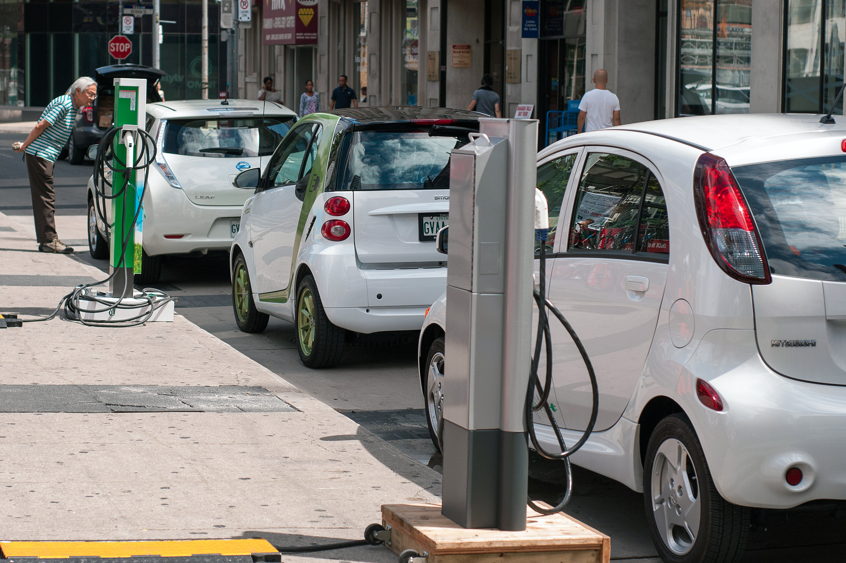
BEV (Battery Electric Vehicles)
Run entirely on electricity
Must be plugged into a charging station to refuel

Slide 20
Renewable Energy Strategy
Government funding is needed to support research to overcome limitations of renewable energy resources
U.S. needs to upgrade existing electrical grid
Outages and overloads cost the U.S. $100 billion per year
Need cost-effective, reliable source of storing energy
Smart grid: self-regulating electricity network that accepts any source of electricity and distributes it automatically to end users.
Decentralized energy parks with a mix of renewable and nonrenewable energy sources

Slide 21
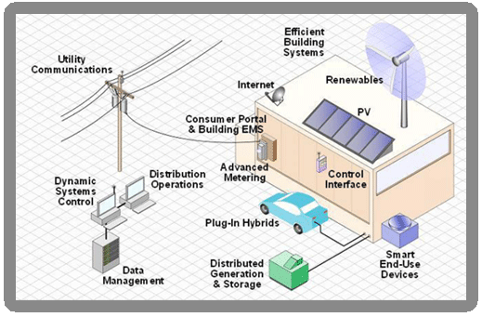
Smart Grid

Slide 22
Turn and Talk
Which vehicle do you think should replace the combustion engine: hydrogen fuel cells or BEVs? Why?
Which type of renewable energy do you think we should rely on the most in the future? Why?
What do you think is the most compelling piece of evidence for switching to renewable energy? Why?

Slide 23
Discussion
What do you think the government can do to incentivize a switch to renewable energy?
Do you think the U.S. should use natural gas a crutch to transition to renewable energy or should we simply transition straight to renewable energy?

Slide 24
Homework
Read the rest of the scientific american article.
Answer the following question in two paragraphs using evidence from the article: “what do you think is holding us back from fully developing renewable energy sources to replace fossil fuels?”

