Slide 1
SWBAT explain the advantages and disadvantages of hydroelectricity and solar energy.
APES Unit 11 3/29/16

Slide 2
Agenda
Lecture
Video
Review!

Slide 3
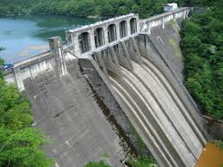
Hydroelectricity
Electricity generated by the kinetic energy of moving water
Accounts for 7% of electricity generated in the U.S.
Top states in producing hydroelectric power:
Washington, California and Oregon
Top countries:
China, Brazil, and the U.S.

Slide 4
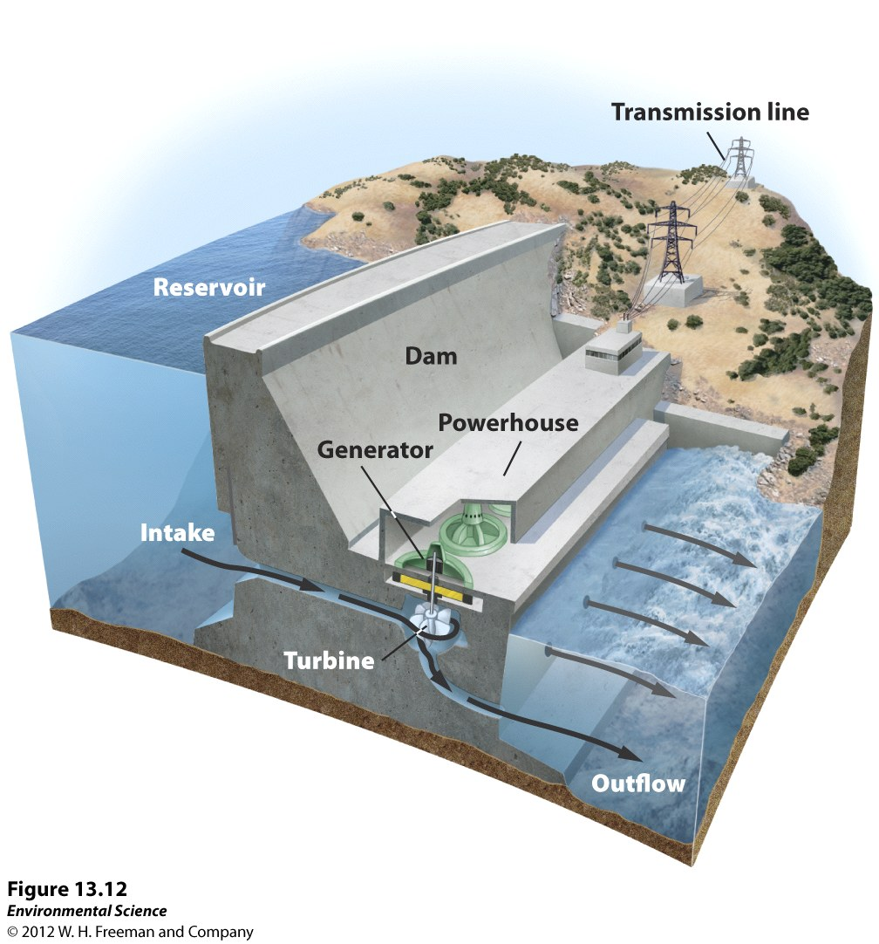
Generating Electricity
Falling water turns turbine→ produces electricity through a generator

Slide 5
Hydroelectricity
Amount of electricity dependent upon:
Vertical distance as the water falls
Flow rate
Run of the river systems: water retained behind a low dam and runs through a channel before returning to the river.
Don’t store water in a reservoir
Pros: little flooding, doesn’t disrupt flow in rivers
Cons: doesn’t generate much energy

Slide 6
Water Impoundment Systems
Storing water in a reservoir behind a dam
Control flow rate of water by opening and closing the gates

Slide 7
Tidal Systems
Tidal energy: movement of water from the gravitational pull of the moon
Cons:
does not have the potential to become a major supply of energy
Needs to be near coastline or estuary
Disruptive to the environment

Slide 8
Hydroelectricity: Pros and Cons
Cons | Pros
Expensive to build | Large amount of energy without creating air pollution, CO₂ emission or waste products.
Reservoir may flood land→ can force people to relocate | Flood control for downstream areas
No free flowing river→ alters ecosystems and disrupts life cycles of certain fish | Provides Recreational areas
CO₂ emission released during creation of the Dam (cement)
Dead plants and organisms in flooded soils release methane Siltation occurs– build up of sediment→ life span of dam reduces

Slide 9
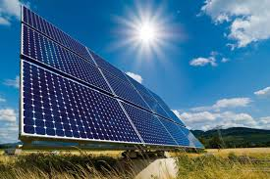
Solar Energy
Solar energy available depends upon:
Cloudiness
Time of day
Season

Slide 10
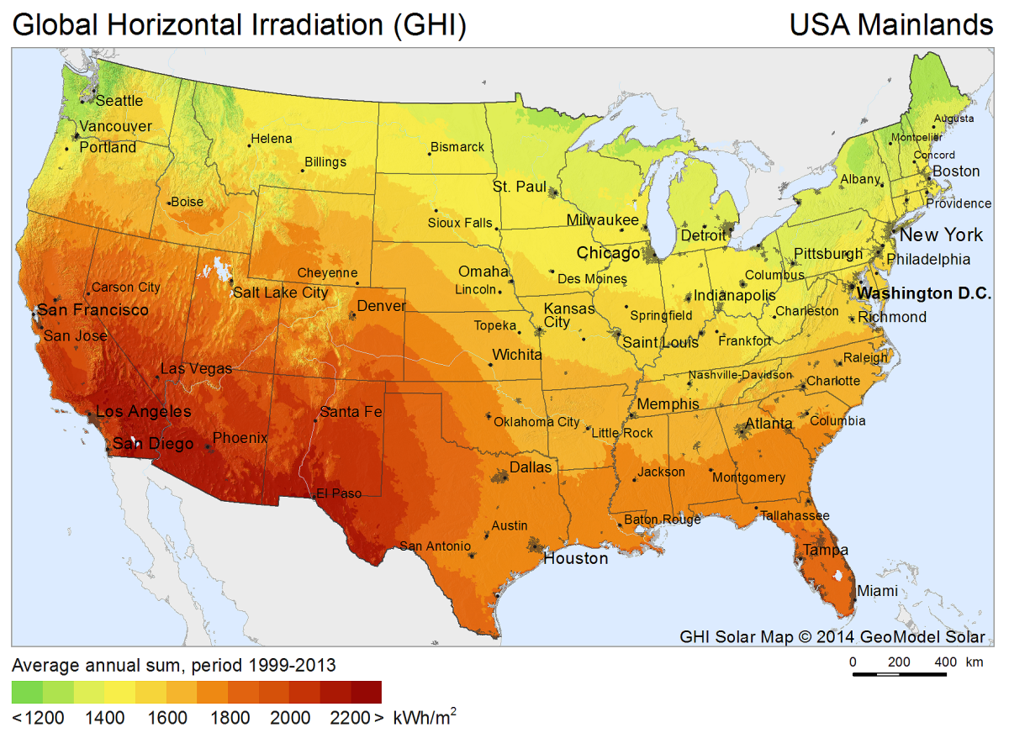
Solar Energy in the U.S.

Slide 11
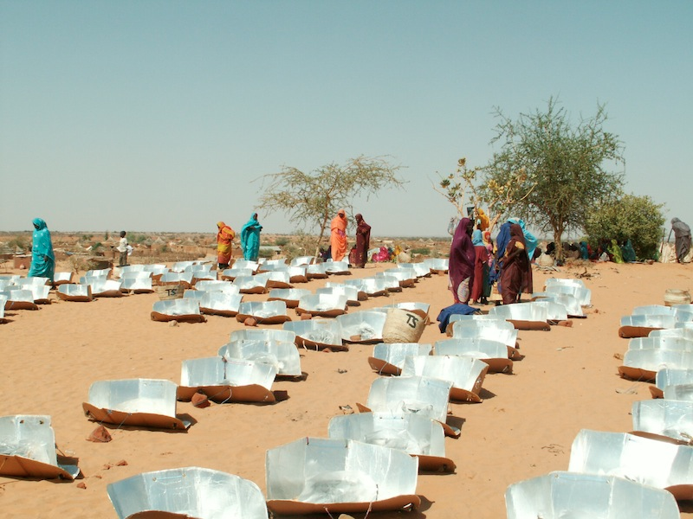
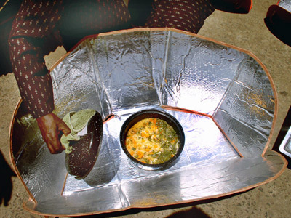
Passive Solar Heating
Windows and skylights
Solar ovens
Reduces the need of firewood→ prevents deforestation

Slide 12
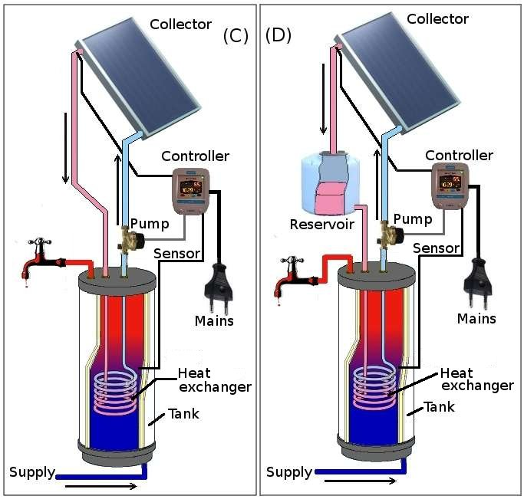
Active Solar Energy
Capture sunlight with the use of technology, such as solar panels
Higher cost than passive solar heating
Solar water heating systems: allows heat to be transferred directly to water or another liquid
Used to heat swimming pools and provide domestic hot water

Slide 13
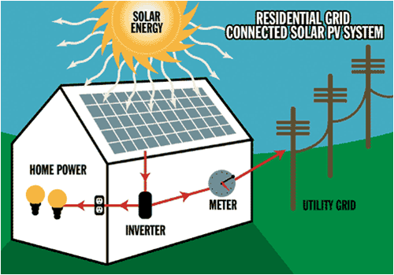
Photovoltaic Systems
Photovoltaic Solar Cells: capture energy from the sun as light→ converted into electricity
Solar energy hits PV cells-> mobilize electrons→ produces electric current

Slide 14
Solar Energy
Concentrating Solar Thermal Electricity Generation (CST): large scale application of solar energy
Use lenses or mirrors and a tracking system to focus the the sunlight falling on a large area into a small area
Heat of concentrated beam evaporates water→ produces steam→ turns turbine→ produces electricity
Con: Can have a negative impact on the desert ecosystem

Slide 15
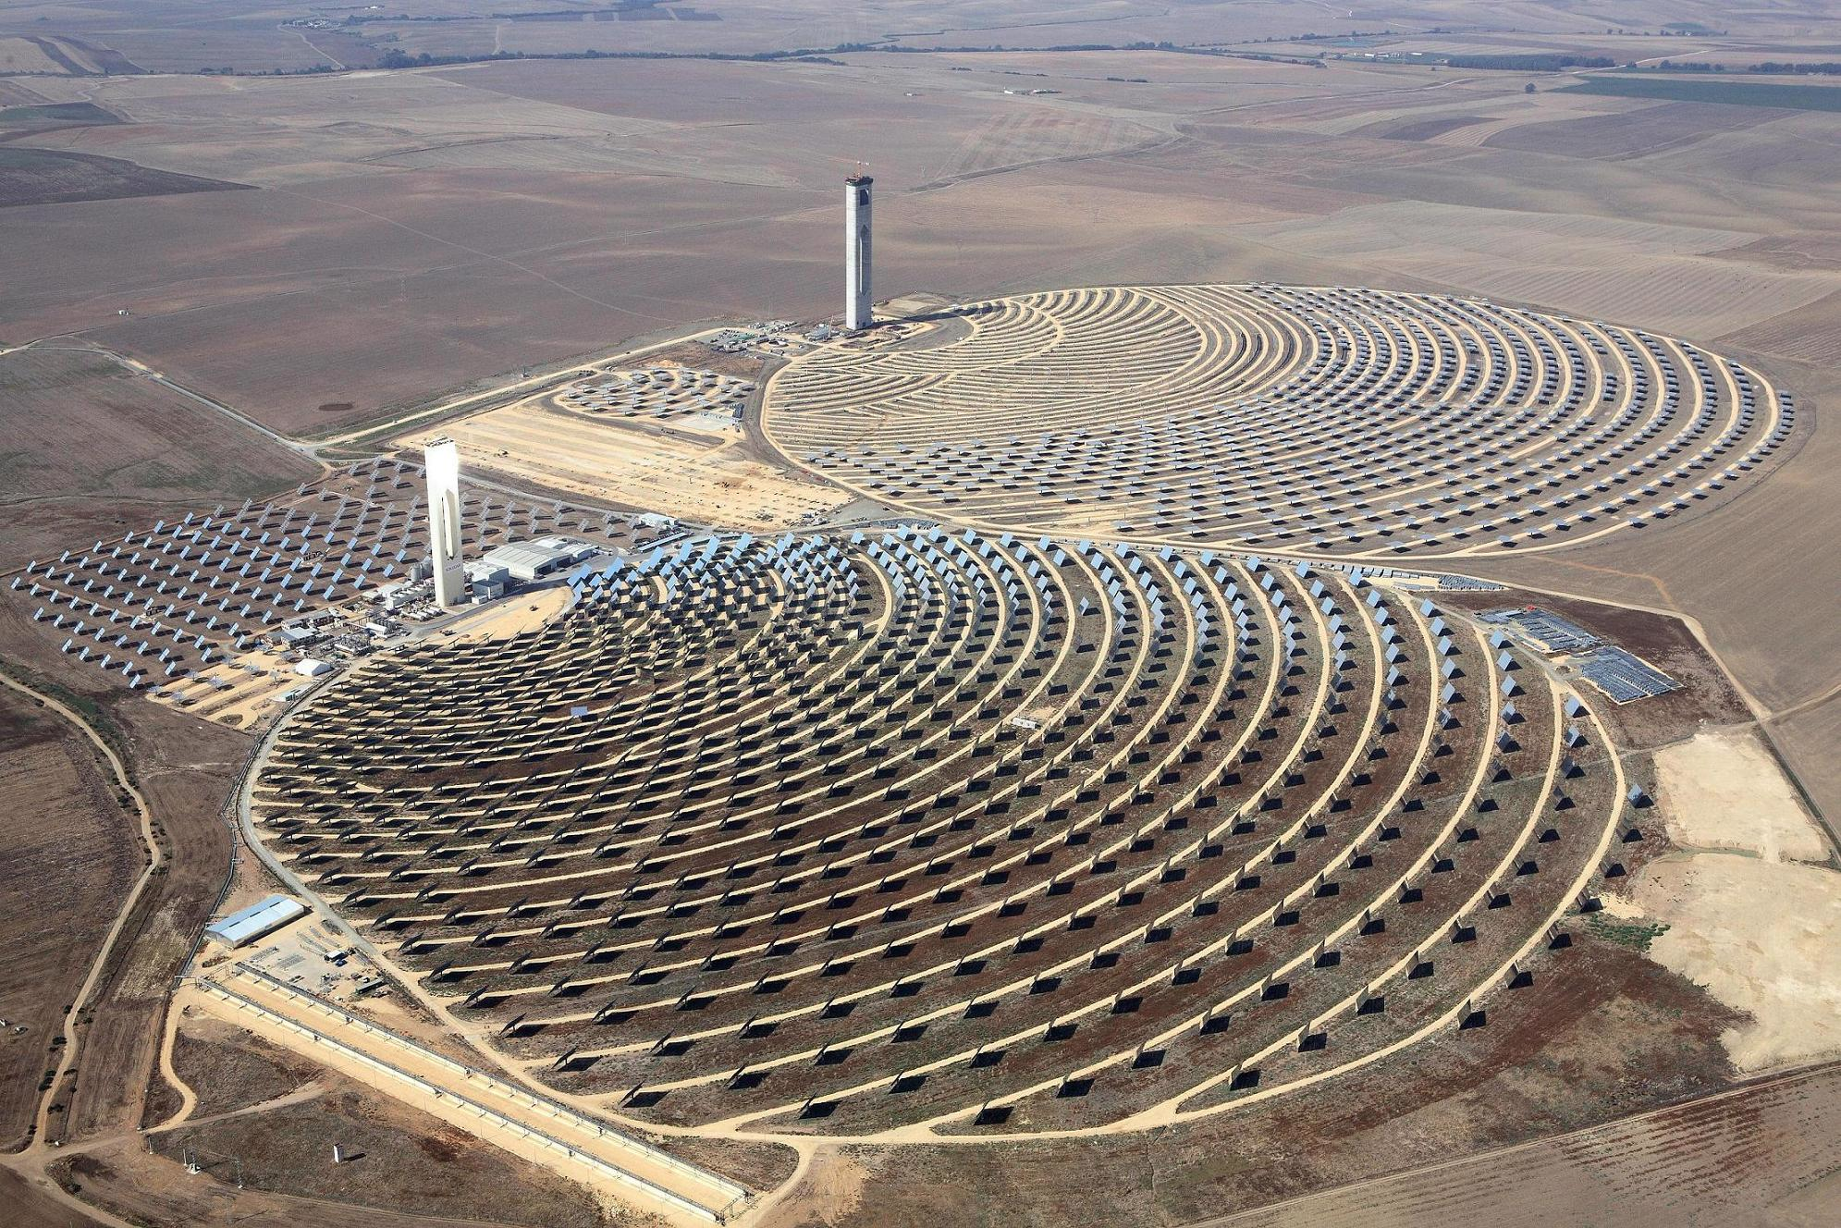
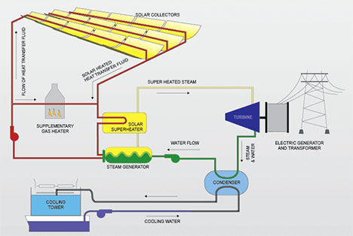

Slide 16
Pros and Cons of Solar Energy
Con | Pro
PV cells are expensive to manufacture and install | Don’t produce air pollution, water pollution or CO₂
Manufacturing PV cells requires energy (fossil fuels), water and toxic metals Some toxic waste is produced | Produce electricity when it is needed most (hot, sunny days)
Not every location receives enough sunlight to to make them worthwhile | Land disturbance is minimal since most solar panels are on top of houses

Slide 17
Government/ Industry Incentives for Solar Power
Government incentives:
Give tax credits to homeowners who install PV systems
Subsidize the cost of PV panels so they are cheaper
Industry Incentives:
Provide education
Lower the cost of PV panels

Slide 18
Checkpoint
What are the trade-offs associated with using hydroelectricity compared with biomass?
In what ways do humans capture solar energy for their use?
Why are active solar energy systems on feasible everywhere?
How do active and passive solar systems work? What are the advantages of each?

Slide 19
Homework
Finish Reading Ch. 13 and take detailed notes
What is the difference between grid and stand alone systems of solar energy? What is one drawback and one advantage of using both?

