Slide 1
SWBAT: Define renewable energy Compare and contrast the various forms of biomass energy.
APES Unit 11 3/28/16

Slide 2
Agenda
Lecture
Biofuels from Microalgae video
Math practice!
Reminder: Unit exam on Friday!

Slide 3
Turn and Talk
What are some of the drawbacks of relying on biofuels as a fuel source?

Slide 4
Renewable Energy
Potentially renewable: (biomass) renewable as long as we don’t consume them faster than they’re depleted
Nondepletable: Will never be depleted
Wind, solar, hydroelectric, geothermal
Renewable Energy: Potentially and nondepletable energy sources
Accounts for approximately 10% of the energy used in the U.S.

Slide 5
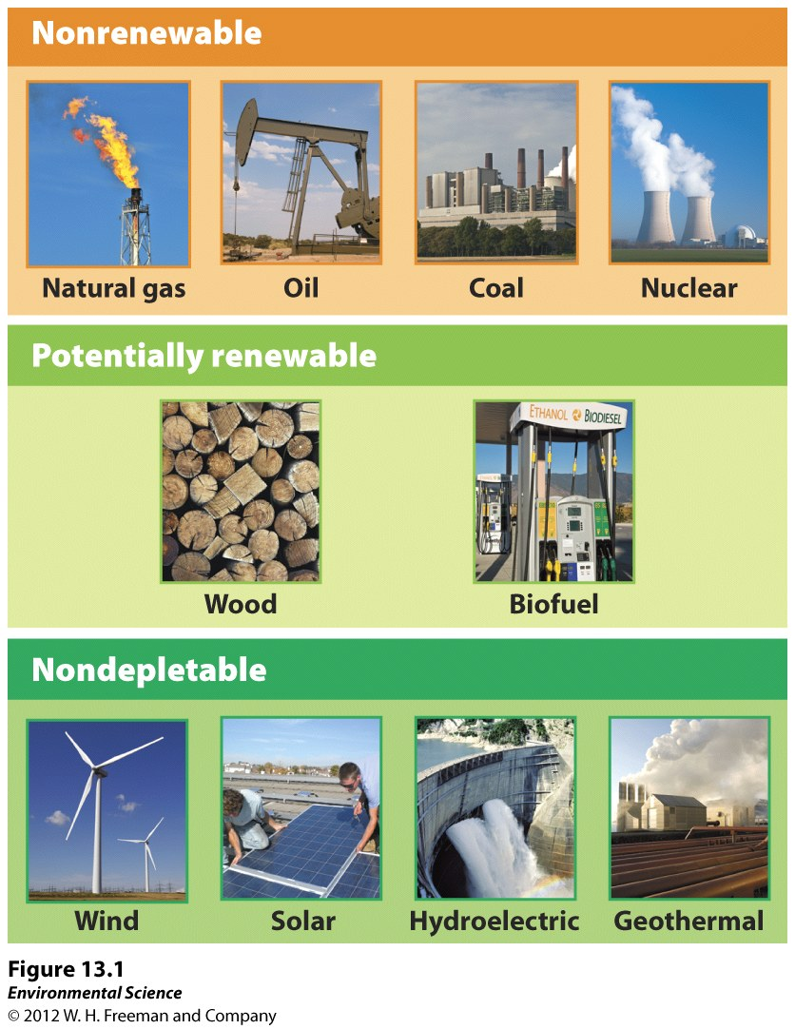

Slide 6
Renewable Energy Use in the U.S.

Slide 7
How can we use less energy?
Energy conservation: Finding ways to use less energy
Within a household:
Lower thermostat during cold months (less heating)
Turn off/ unplug computer, lights, TV
Replacing incandescent light bulbs with energy efficient light bulbs
Government incentives:
Tax electricity and natural gas, increase tax on oil
Rebates or tax credits to retrofit (adding new technology to older systems) a home or business to operate on less energy

Slide 8
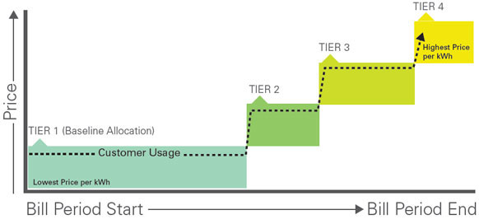
How can we use less energy?
Tiered rate system: Customers pay a low rate for the first increment of electricity they use and pay higher rates as their use goes up.

Slide 9
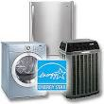
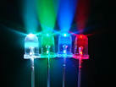
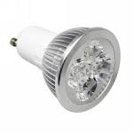
How can we use less energy?

Slide 10
Benefits of Energy Conservation
Peak demand: the greatest quantity of energy used at any one time
To meet peak demand, energy companies often need to keep back up sources of energy (generators)
Reduce peak demand-→ conserve more energy

Slide 11
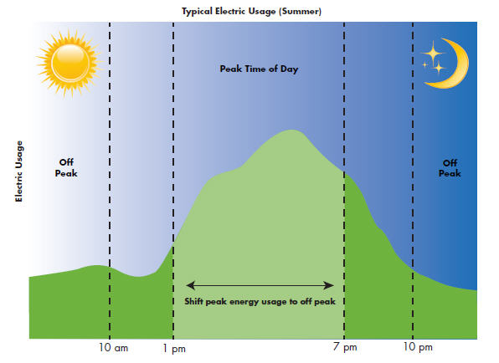

Slide 12
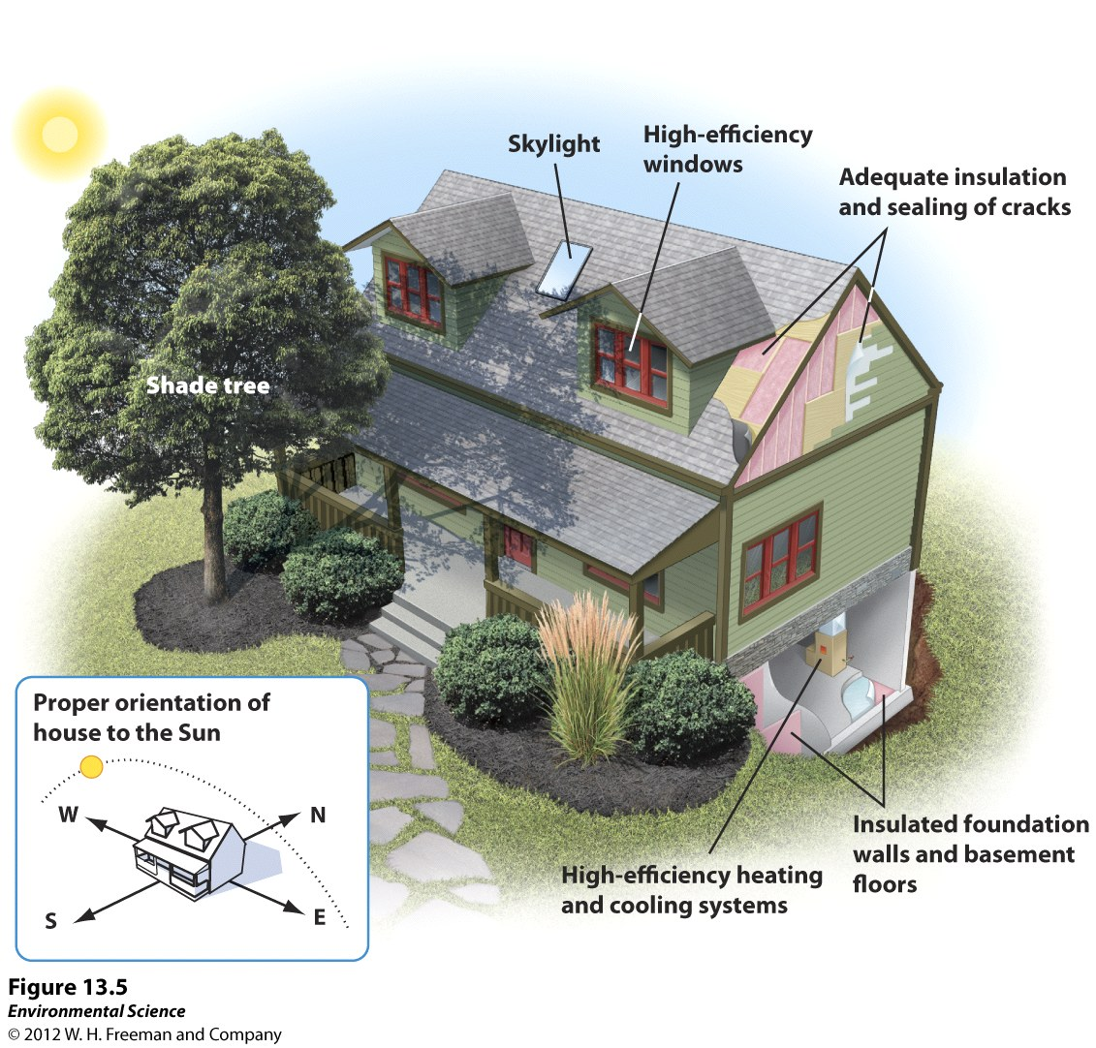
Sustainable Design
Buildings consume energy for cooling, heating and lighting

Slide 13
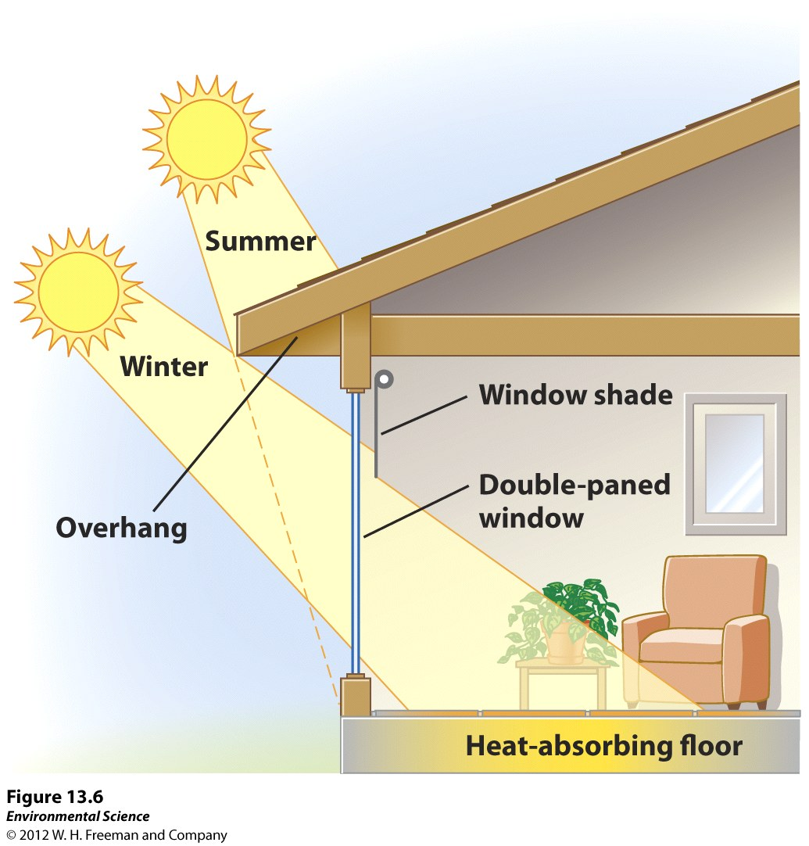
Sustainable Design
Passive solar design: takes advantage of solar radiation to maintain a comfortable temperature in the building
Natural sunlight warms a room
Natural light reduces the need for electricity
Overhanging roof helps block sun during the summer

Slide 14
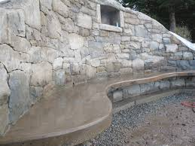
Sustainable Design
Thermal Inertia: the ability of a material to retain heat or cold.
Stay hot once heated
Stay cool once they have been cooled
Ex: stone and concrete

Slide 15
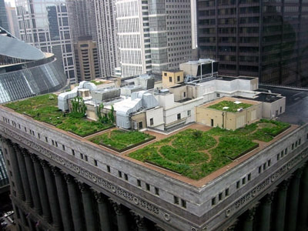
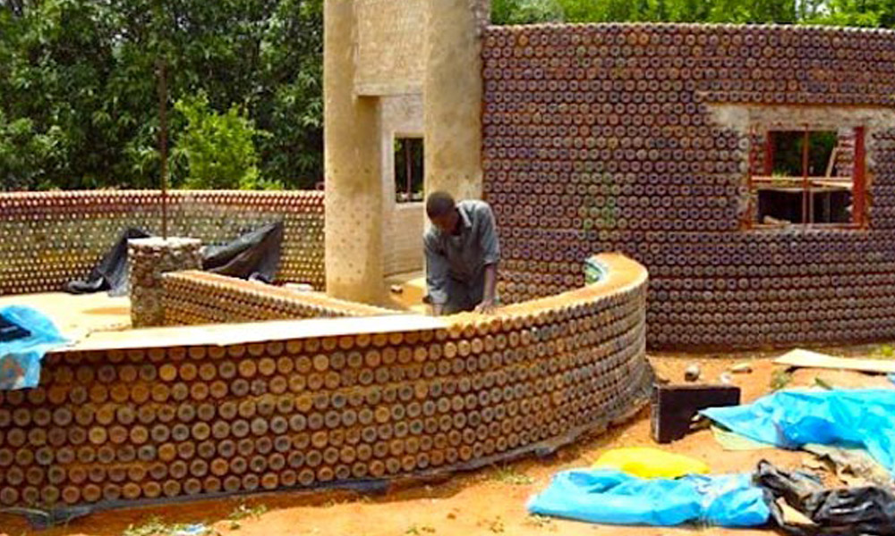
Sustainable Design
Building Greenroofs
Reduces heating and cooling costs and runoff
Use of recycled building materials
Ex: denim to insulate walls

Slide 16
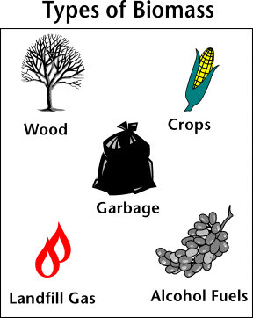
Biomass
Wood, charcoal, animal products and manure, plant remains and MSW.
Biofuels: biomass that is processed or refined into liquid fuels (ethanol and biodiesel)
Modern carbon: carbon in biomass
Fossil carbon: carbon in fossil fuels

Slide 17
Biomass and CO₂
Low net energy yield
Net increase in CO₂ when fossil fuels are burned
Releasing stored carbon
Biomass is a carbon neutral fuel source
Returning carbon back the atmosphere when it was there recently
Plant more crops to take up carbon

Slide 18
Solid Biomass
Net removal of forest + burning of woods = net increase in atmospheric CO₂
Dried manure is used in regions where wood is scarce
Downside: indoor air pollution

Slide 19
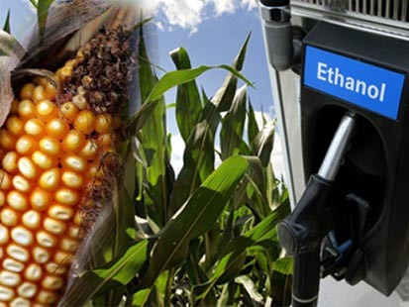
Ethanol
Made from converting starches and sugars from plant material into alcohol and CO₂
More than 90% in the U.S. comes from corn
U.S. invests in ethanol as a way to lessen dependence on foreign oil
Brazil is investing in ethanol from sugarcane
Doesn’t need to be replanted as often as corn

Slide 20
Gasohol
Fuel that is 10% ethanol and 90% gasoline
Designed to reduce smog in urban areas
Advantages: burns more slowly, completely, and coolly→ reduced emission of some pollutants
Disadvantages:
can aggravate ozone pollution in the troposphere
Expensive to produce
Energy-intensive
Reduces gas mileage

Slide 21
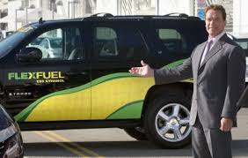
E-85
85% ethanol and 15% gasoline
Produced in some parts of the midwestern U.S.
Flex-fuel vehicles: can run on E-85 or gasoline

Slide 22
Biodiesel
Made from vegetable waste oils
B-20: 80% regular diesel and 20% biodiesel
Works only in modified engines
Benefits of increased reliance on biofuels:
Renewable resource→ less likely to be exhausted
Decreased disposal of used cooking oil→ less waste disposal
Increased jobs→ more labor needed in the agricultural sector

Slide 23
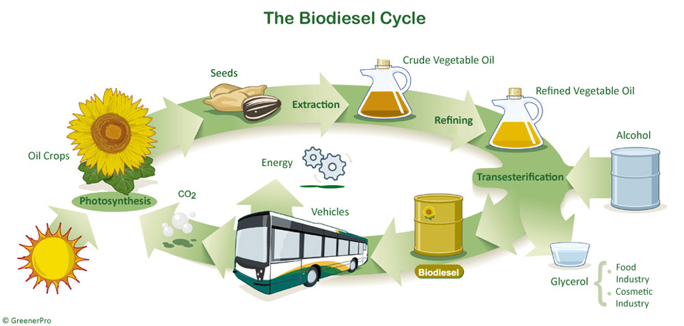

Slide 24
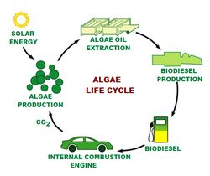
Biodiesel from microalgae!

Slide 25
Turn and Talk
Why do you think biodiesel from algae would be more environmentally friendly than biodiesel from crops?

Slide 26
Math Groups
Same as usual!

Slide 27
Math Group Norms
Start with the math (part C)
If you have time, go back and finish parts A and B in a group
Ask two before me
Start with the end unit!
Show ALL your work!

Slide 28
Homework
Read Ch. 13 through page 361 (stop before geothermal energy)

