Slide 1
SWBAT discuss the consequences of using nuclear fuels.
APES Unit 11 3/23/16

Slide 2
Agenda
Lecture
Math!!
ANWR video if time

Slide 3
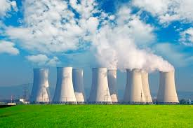
Nuclear Energy
World’s primary non-fossil fuel nonrenewable energy
20% of electrical energy is provided by nuclear power plants in the U.S.
China and India: leading the world in creating new nuclear facilities

Slide 4
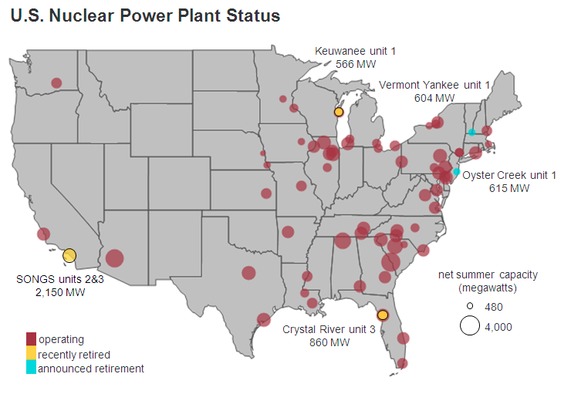
U.S. Nuclear Power Plants

Slide 5
Nuclear Fission
Fuel source: uranium-235
Radioactive
Fission: Neutron strikes a large atomic nucleus, splits into two or more parts
Release energy in the form of heat
Heat is used to produce steam
1 gram of uranium produces way more energy than 1 gram of coal

Slide 6
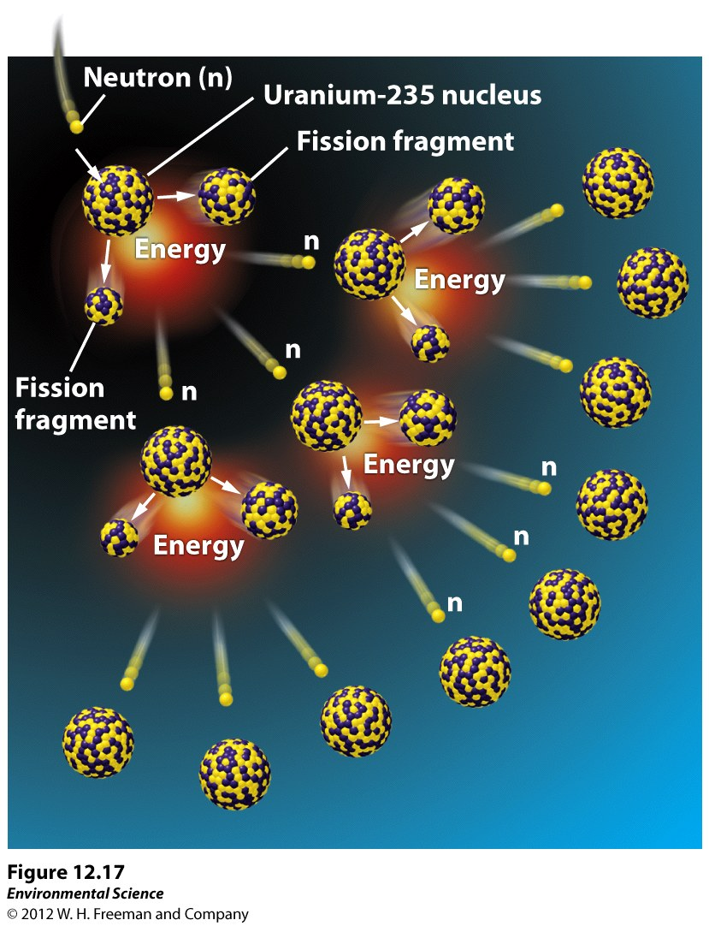
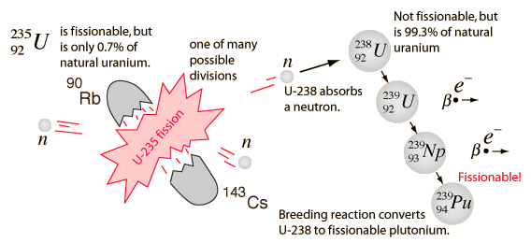
Nuclear Fission

Slide 7
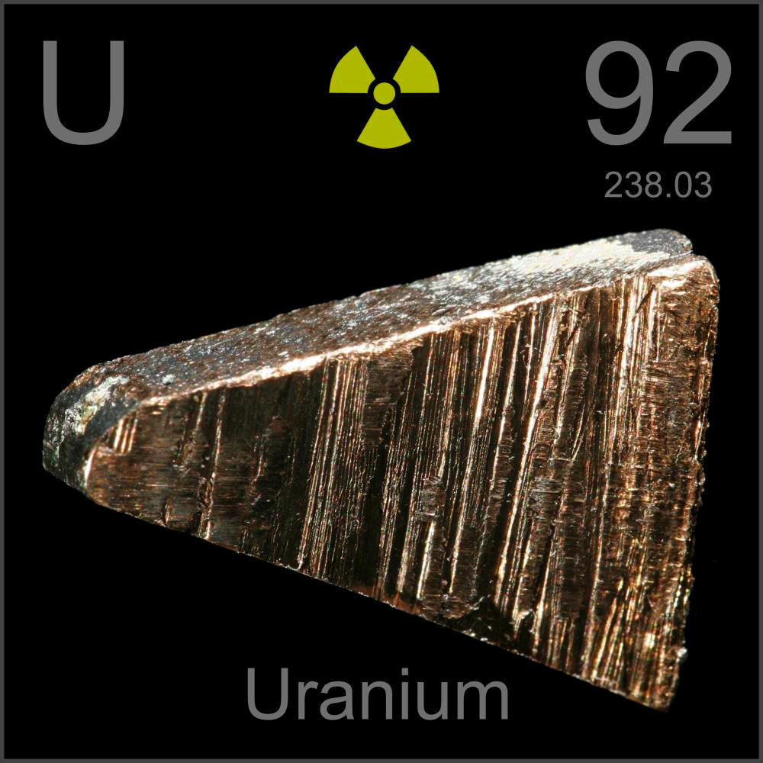
Nuclear Fission
Breeder reactors generate new fissionable material (from waste or lower grade uranium) faster than they consume such material

Slide 8
Nuclear Energy
Fuel rods: contain nuclear fuel (Uranium in the form of pellets)
Nuclear fission produces heat→ heats water→ water circulates in a loop→
produces stream→ turns turbine
Moderator (often water): slows down neutrons to effectively trigger the next fission reaction

Slide 9
Nuclear Energy
Control rods: cylindrical devices that can be inserted between the fuel rods to absorb excess neutrons, slowing or stopping the reaction
Meltdown: when nuclear fuel rods become too hot and melt

Slide 10
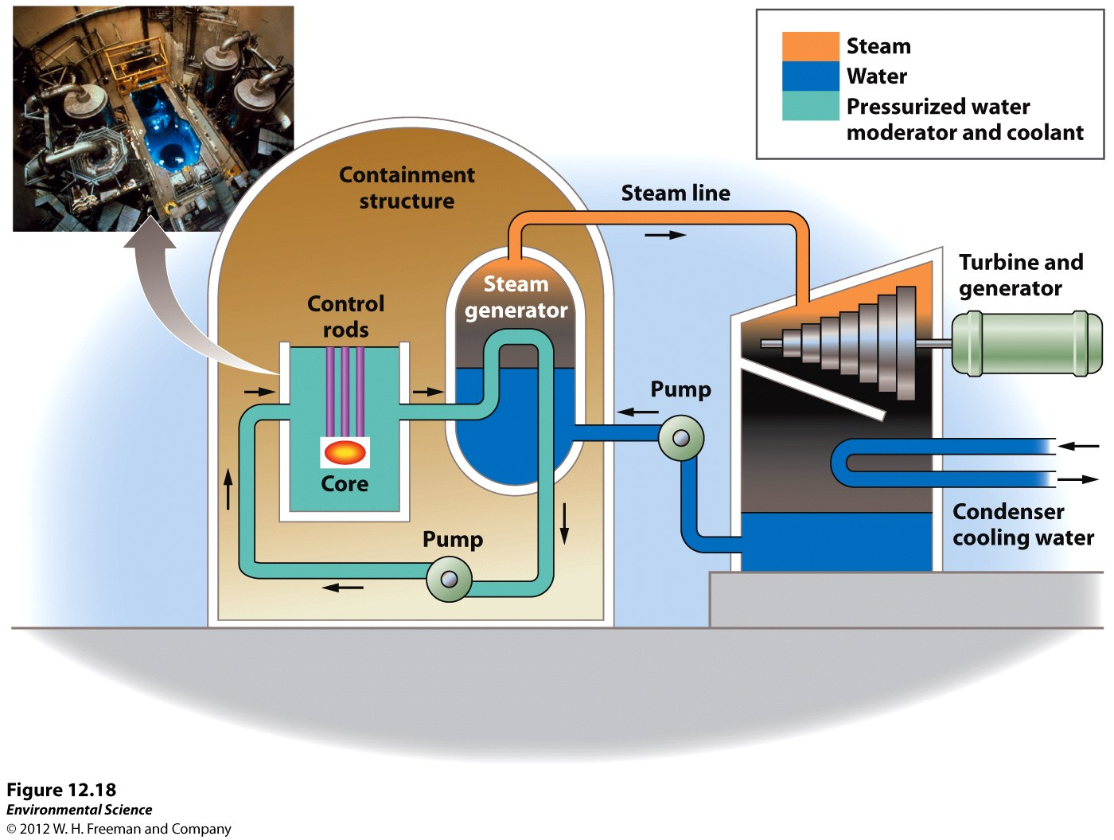

Slide 11
Nuclear Reactors

Slide 12
Environmental costs of Nuclear Energy
Construction of Nuclear power plant:
Habitat destruction or fragmentation at the construction site
Noise pollution from the machinery
Water pollution/stormwater runoff
Thermal pollution of water
Thermal shock in organisms
Increased bacteria growth

Slide 13
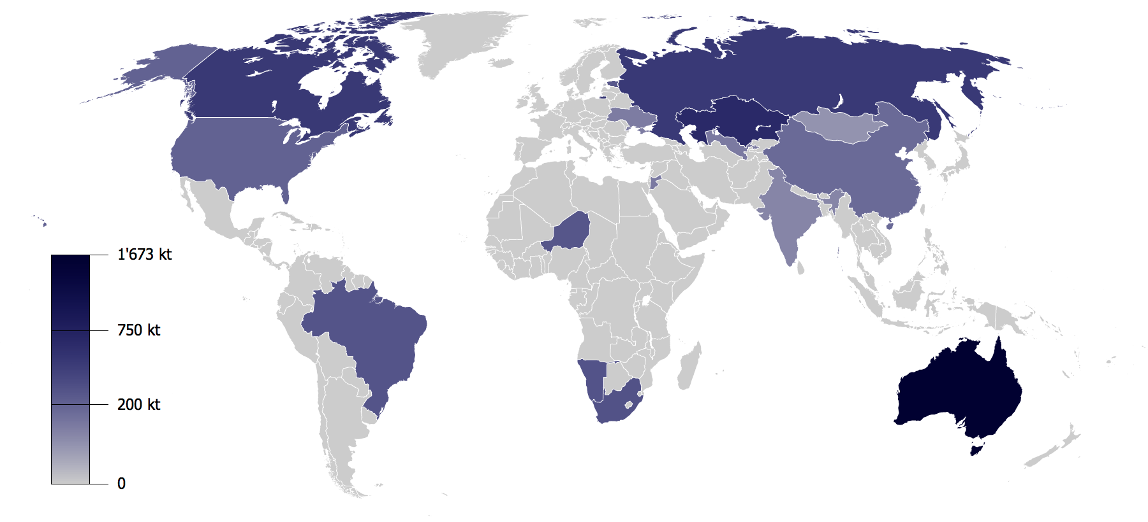
Uranium Mining

Slide 14
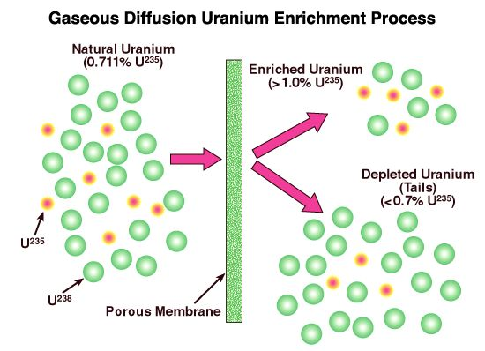
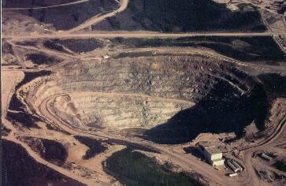
Uranium Mining
Most uranium found as ²³⁸U
Needs to be chemically enriched in ²³⁵U

Slide 15
Nuclear Energy: Pros and Cons
Advantages | Disadvantages
No air pollution is produced | Possibility of accidents
Countries can limit their need for imported oil | Disposal of the radioactive waste

Slide 16
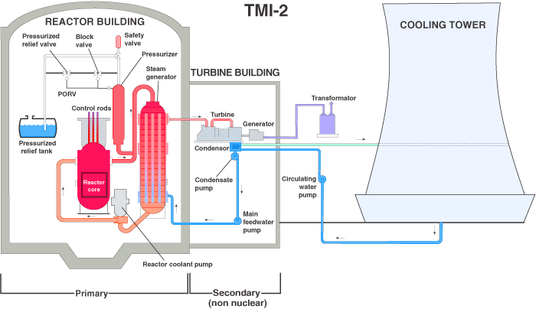
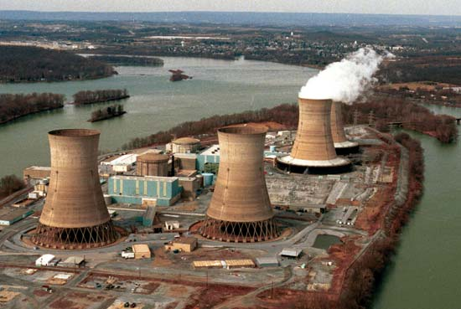
Nuclear Accidents
Three Mile Island (1979, PA): cooling water valve closed→ lack of cooling water→ reactor core overheated
Evacuated school children and pregnant women
Unknown amount of radiation released to the environment
No deaths

Slide 17
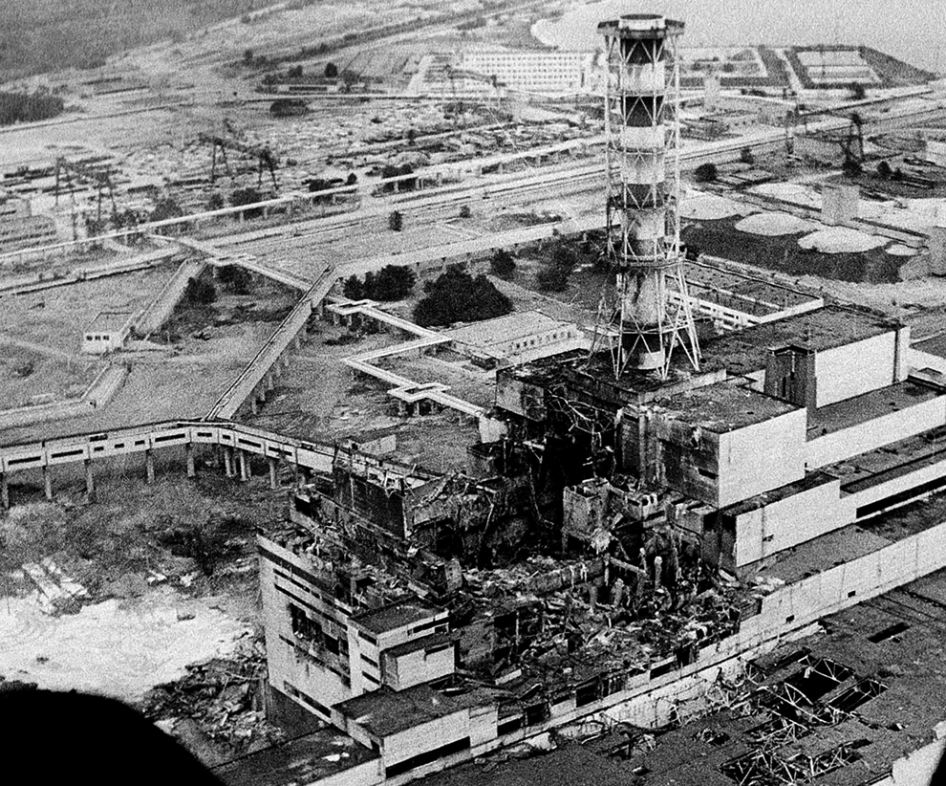
Nuclear Accidents
Chernobyl (1986, Ukraine): operators disconnected emergency cooling systems and removed the control rods→ plant overheated
Workers at a nuclear power plant in Sweden noticed elevated radiation levels that were not coming from their facility
Resulted in explosion and fire
31 plant workers and firefighters died from acute radiation exposure

Slide 18
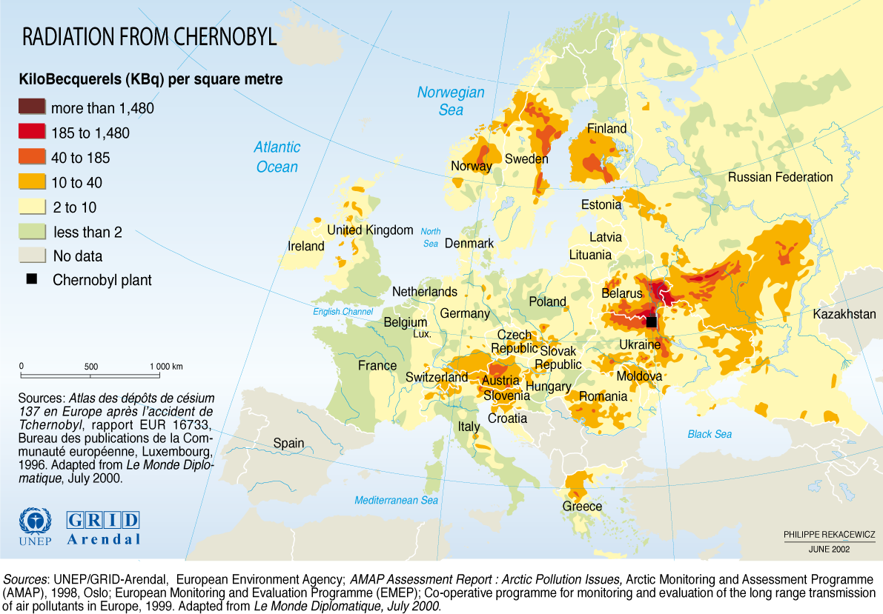
Nuclear Accidents: Chernobyl
100,000 people evacuated
Radiation blew all over Europe→ contaminated crops and cows
Increased cancer rates in humans and animals
Death of plants and animals

Slide 19
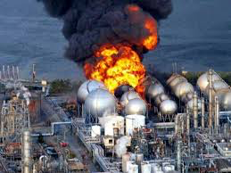
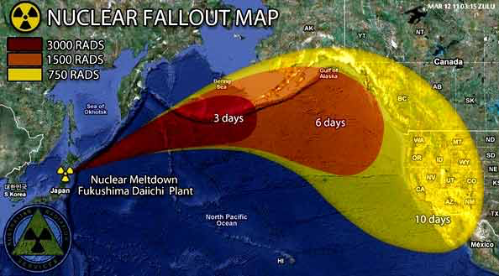
Fukushima
Tsunami disabled power supply and cooling of nuclear reactors in Japan (2011)
No deaths
100,000 people evacuated

Slide 20
Radioactive Waste
Nuclear fuel continues to emit radioactivity even after it is done producing heat
Half life of ²³⁵U is 704 million years
High-level waste: used (spent) fuel rods
Threat to human health for 10 or more half-lives
Low-level waste: contaminated protective clothing, tools, rags, etc.
Uranium mine tailings: residue after uranium ore is mined and enriched

Slide 21
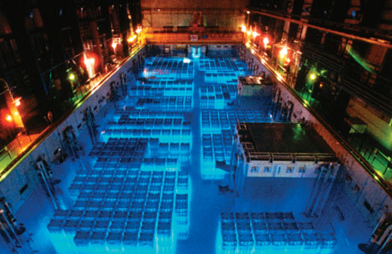
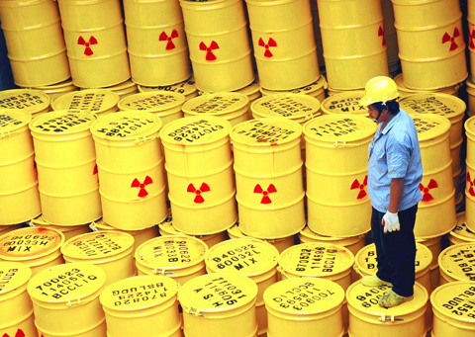
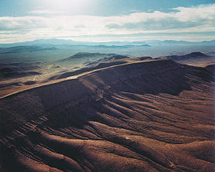
Storing Radioactive Waste
Stored in pools of water at least 6 m deep
Stored in lead-lined dry containers on land
Yucca Mountain in Nevada is a potential option

Slide 22
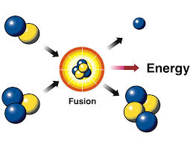
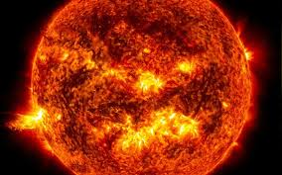
Fusion power
Nuclear Fusion: lighter nuclei are forced together to produce heavier nuclei
Generates a lot of heat
Liberates a ton of energy (more than fission)
Still produces radioactive waste
Not possible on earth (yet)

Slide 23
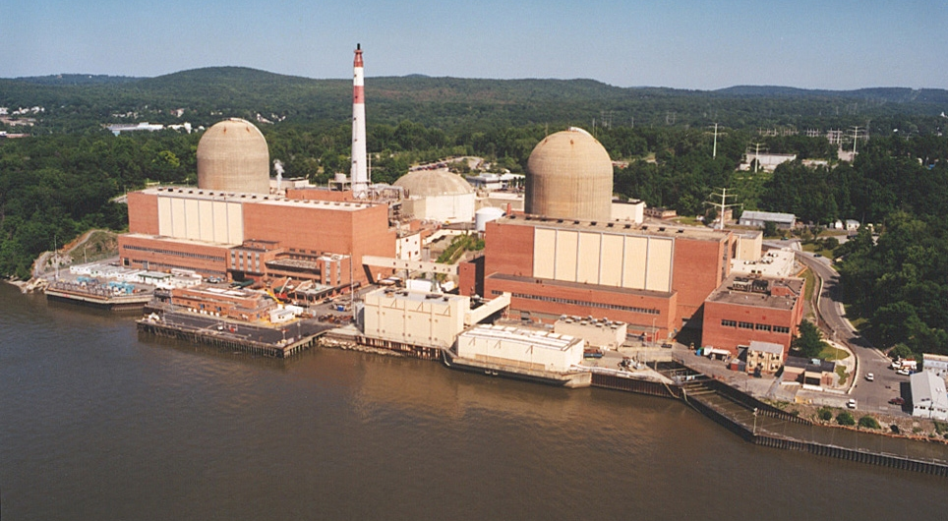
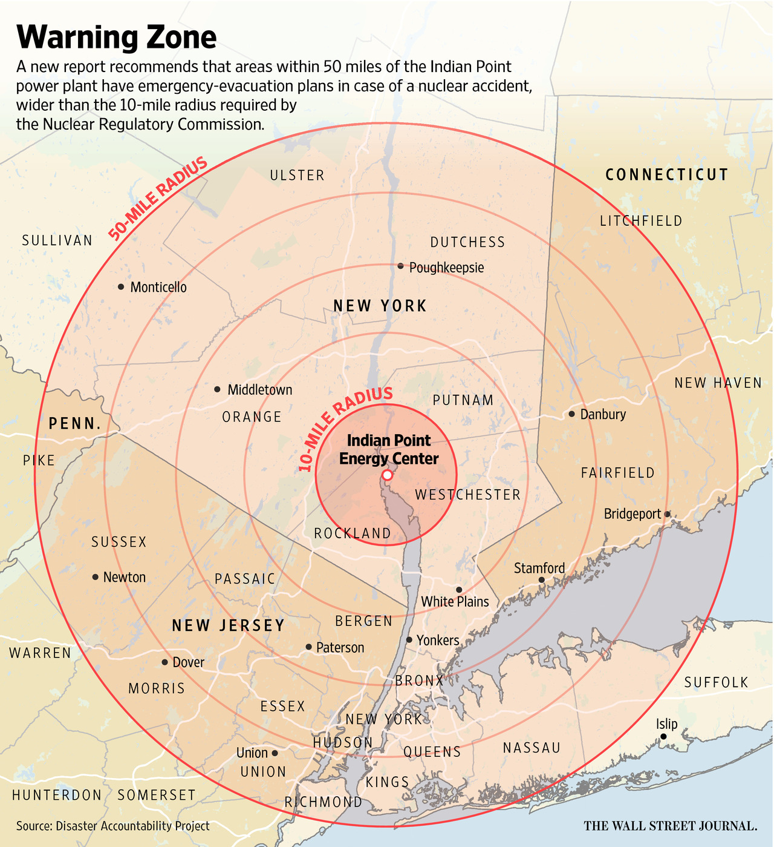
Is there a nuclear power plant close to New York?

Slide 24
Discussion
Do you believe nuclear energy is a viable alternative to fossil fuels? Why or why not?

Slide 25
BTU
The British thermal unit is the amount of work needed to raise the temperature of one pound of water by one degree Fahrenheit

Slide 26
Math Groups!
Group 1: Rimsha, Monica, Ramlah
Group 2: Cynthia, Wyllana, Amrat
Group 3: Harmanpreet, Uzma, Rahila
Group 4: Shayna, Mahnoor, Hamna, Mehrangiz
Group 5: Desire, Bukurie, Attia, Wendy, Saliha,

Slide 27
Math group rules
Ask two before me
No calculators
Use scientific notation- it will help you!!

Slide 28
Homework
Study for quiz!!
Watch the ANWR video and take notes
Research an article about Yucca Mountain from a reputable news source and write a one paragraph summary in your current events journal

