Slide 1
SWBAT discuss the uses and consequences of using coal, oil, natural gas and nuclear fuels. Do Now: Name three substances crude oil can be refined into. Describe the Hubbert Curve and its significance.
APES Unit 12 3/22/16

Slide 2
Agenda
Lecture
Videos

Slide 3
Coal: solid fossil fuel
Coal is plentiful but a dirty fuel
Generates 42% of the world’s electricity
Top 3 coal users:
China
United States
India

Slide 4
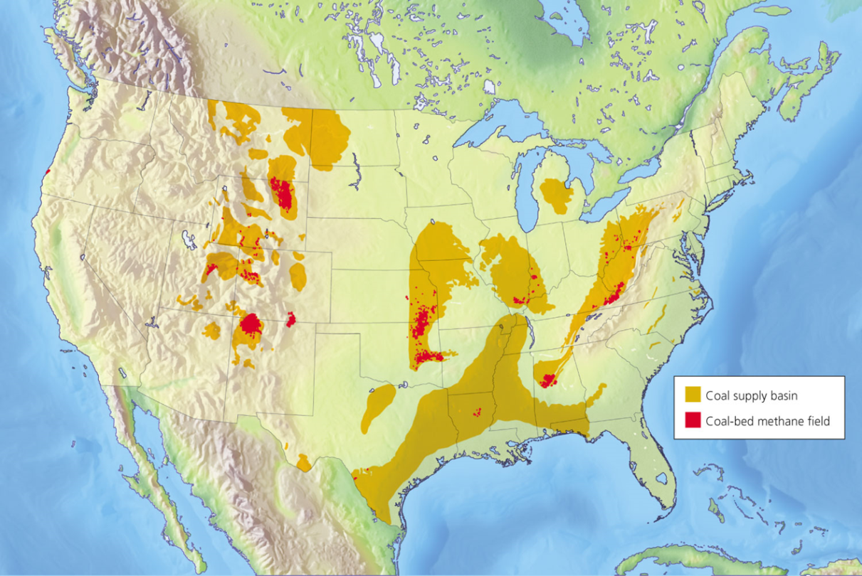
Coal Deposits in the U.S.

Slide 5
Stages in Coal Formation over Millions of Years
Increasing moisture content
Increasing heat and carbon content
Peat
(not a coal)
Lignite
(brown coal)
Bituminous
(soft coal)
Anthracite
(hard coal)
Heat
Heat
Heat
Pressure
Pressure
Pressure
Partially decayed plant matter in swamps and bogs; low heat content
Low heat content; low sulfur content; limited supplies in most areas
Extensively used as a fuel because of its high heat content and large supplies; normally has a high sulfur content
Highly desirable fuel because of its high heat content and low sulfur content; supplies are limited in most areas

Slide 6
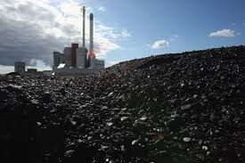
Advantages of Coal
World’s most abundant fossil fuel
U.S. has 28% of proven reserves
Energy-dense and plentiful
Easy to exploit by surface mining
Inexpensive fossil fuel
Easy to Handle and Transport

Slide 7
Disadvantages of Coal
Environmental costs of burning coal
Severe air pollution
Sulfur released as SO₂
Nitrogen oxides
Large amount of soot
Produces more CO₂ per unit energy than oil or natural gas
Trace amounts of Hg (mercury), lead, arsenic and radioactive materials
3 to 20% of burned coal remains behind as ash (highly toxic)
Land reclamation needed with types of coal mining

Slide 8
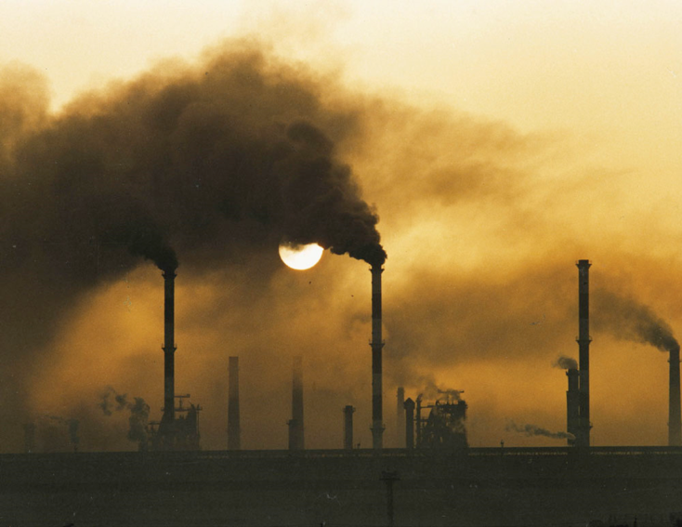
Disadvantages of Coal

Slide 9
We Can Convert Coal into Gaseous and Liquid Fuels
Conversion of solid coal to
Synthetic natural gas (SNG) by coal gasification
Methanol or synthetic gasoline by coal liquefaction
“Synfuels” for vehicles
Lower # of air pollutants
CONS:
More coal required
Low net energy
Higher CO₂ emissions than coal

Slide 10
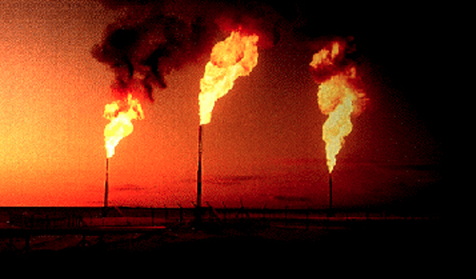
Petroleum (Oil)
Mix of hydrocarbons, water and sulfur
Formed from remains of phytoplankton
Contains some natural gas
Crude oil: liquid petroleum that is fresh from a reserve

Slide 11
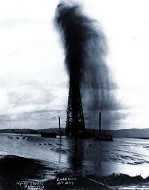
Extracting Oil
Primary extraction: oil pumped to the surface
Gusher: large amount of oil and gas released when oil wells are tapped for the first time
Pressure extraction: Requires mud, saltwater and CO₂ to push oil out
Thick crude oil extracted by steam, hot water or hot gases
Shale oil (found in rock)
tar sands (found in surface sands)

Slide 12
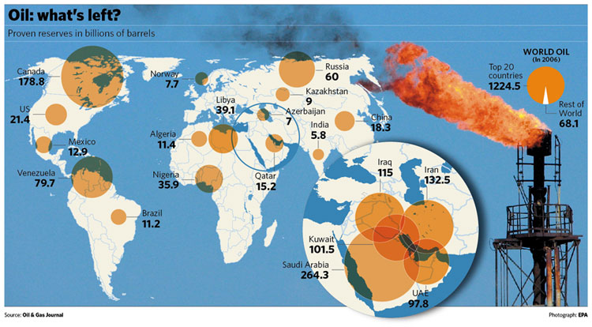
Oil Reserves

Slide 13
Oil Pros/Cons
Advantages of oil
Very easy to transport
Cleaner-burning than coal
Ideal fuel for mobile combustion engines
Disadvantages of Oil
Releases CO₂ when burned
Contains sulfur and trace amounts of mercury, lead and arsenic
Oil spills can greatly harm the environment
Large tankers and deep-water oil wells
Runoff from land, rivers and airplanes

Slide 14
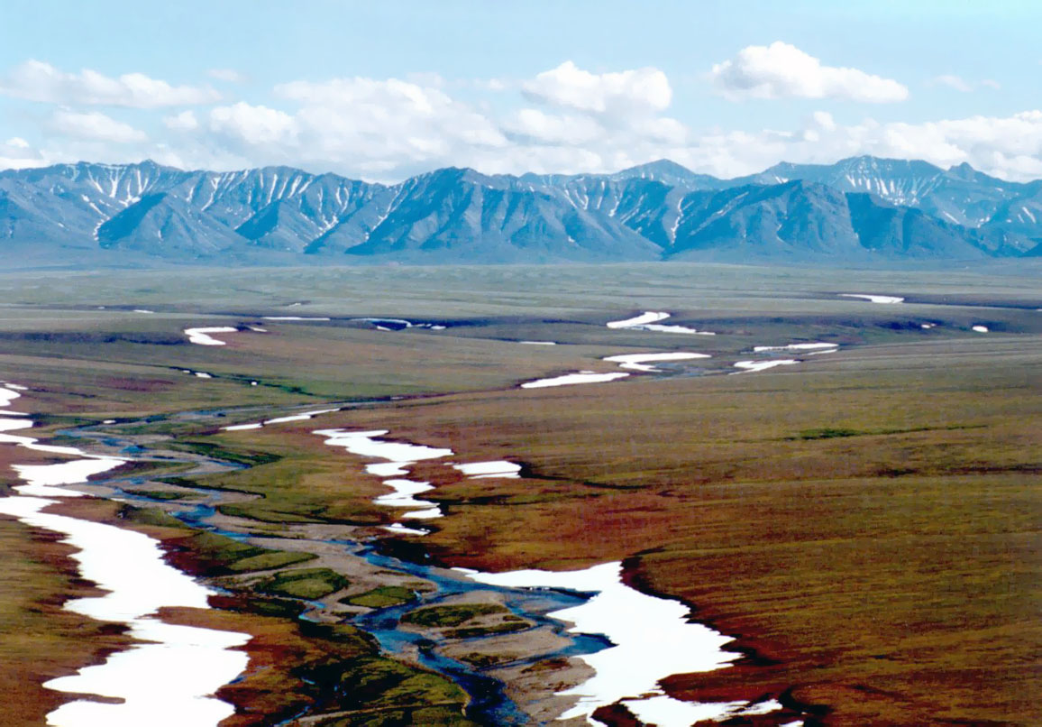
ANWR

Slide 15
Drilling in the ANWR
Geologists estimate that there are billions of economically recoverable oil beneath the frozen tundra
Drilling Activities:
Construction and use of drilling sites
Construction and use of roadways
Environmental impact:
Disruption of migration routes for birds
Loss and reduction of food resources

Slide 16
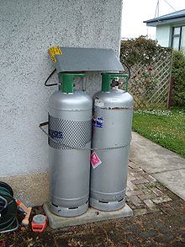
Natural Gas
80 to 95% methane (CH₄)
Usually extracted in association with petroleum
Normally transported by pipelines
LPG (liquefied petroleum gas or propane): used in BBQ grills and heaters
Largest uses in the U.S.
Electricity generation and industrial processes

Slide 17
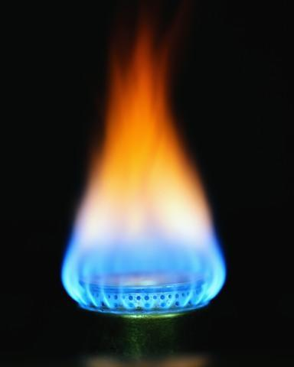
Natural Gas
Advantages | Disadvantages
Contains fewer impurities and therefore emits almost no sulfur dioxide or particulates | When unburned, methane escapes into the atmosphere
Emits only 60% as much carbon dioxide as coal | Exploration of natural gas has the potential of contaminating groundwater

Slide 18
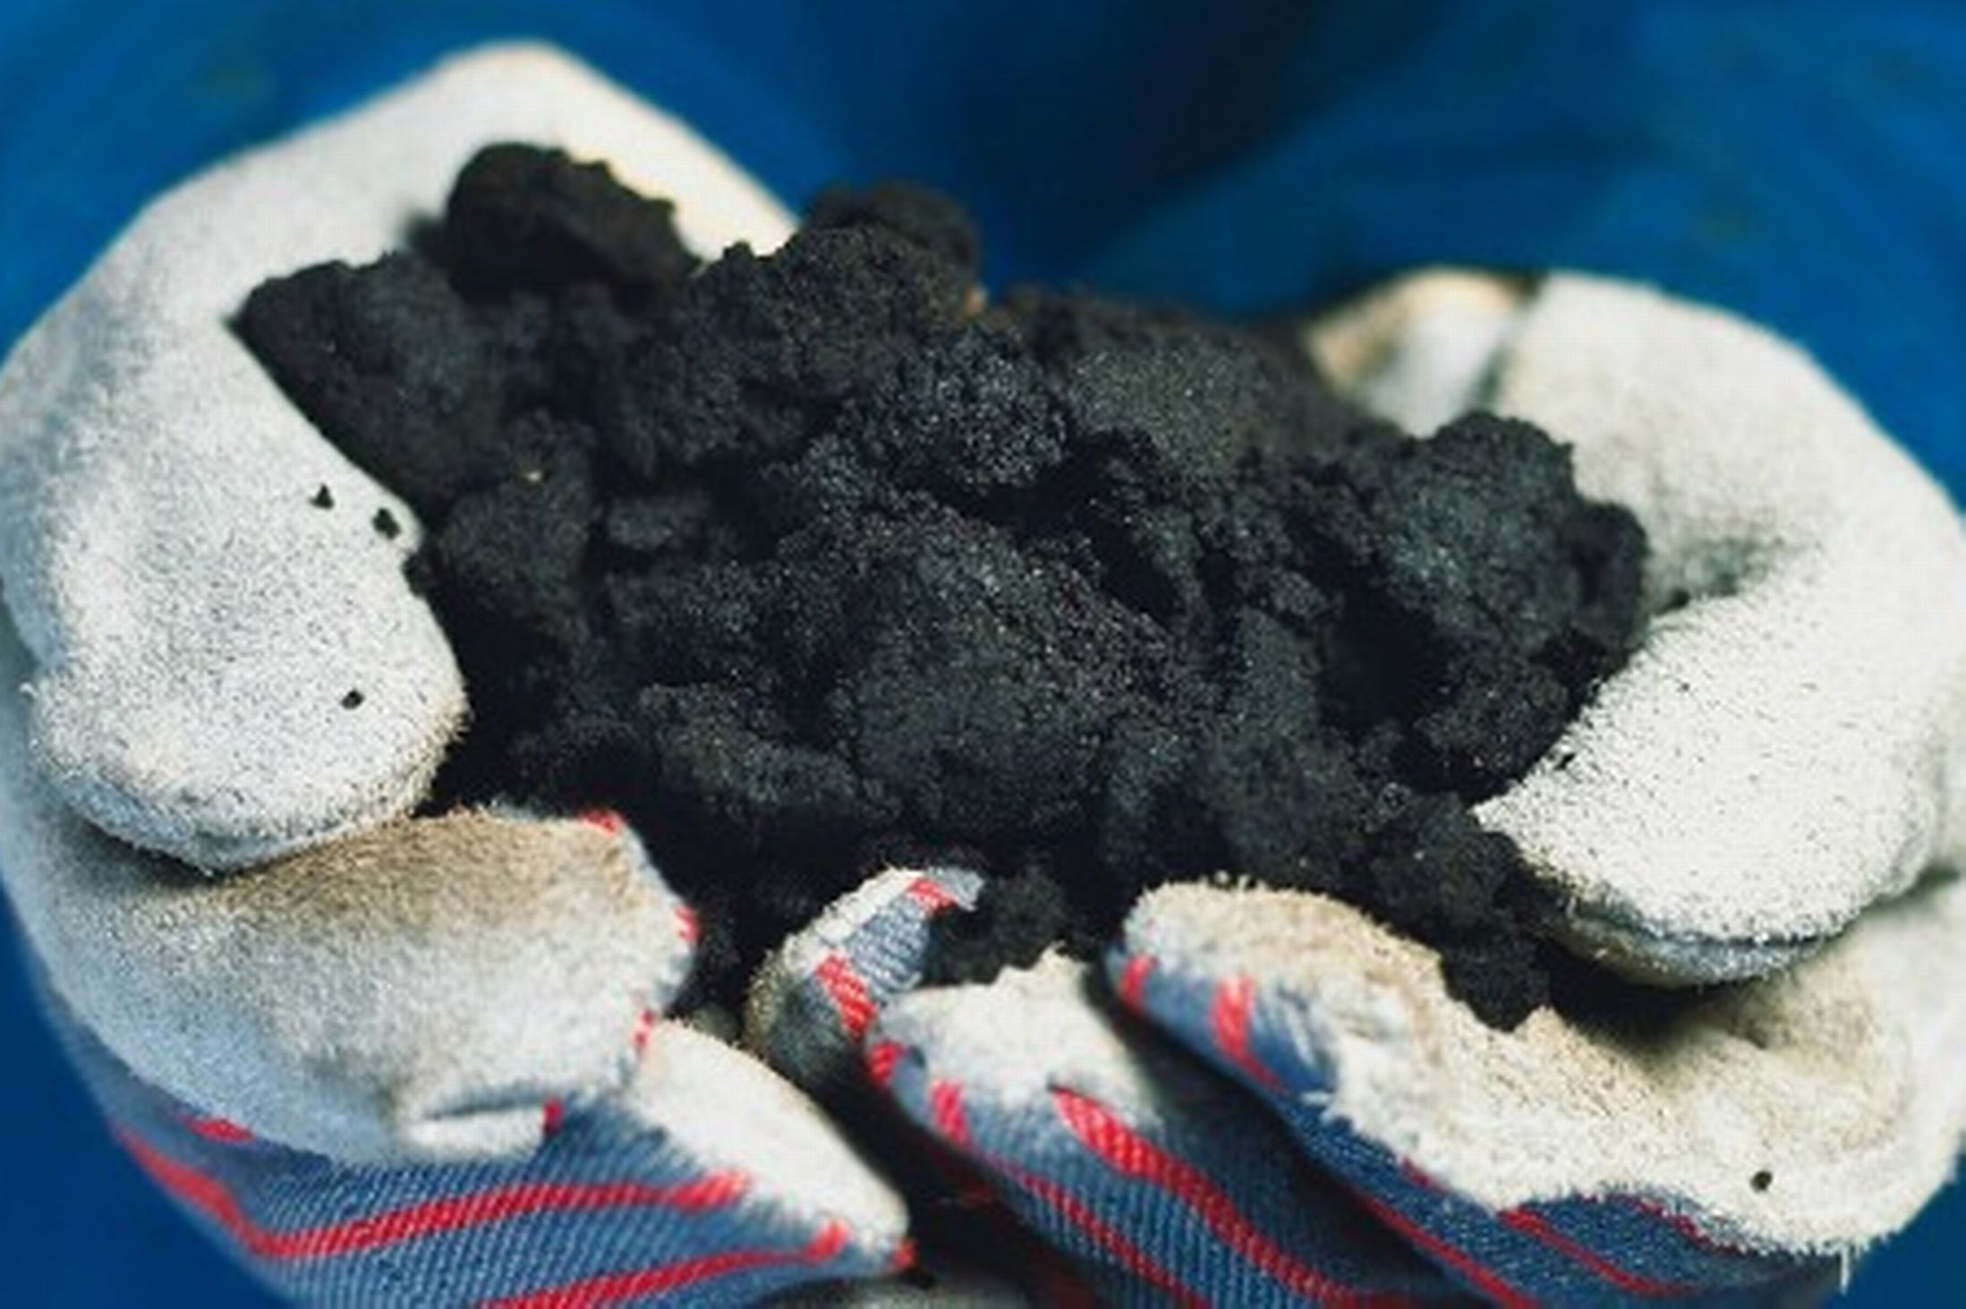
Other Fossil Fuels
Bitumen (tar or pitch): degraded type of petroleum
Oil Sands: slow-flowing, viscous deposits of bitumen mixed with sand, water and clay
Cons:
Mining is much more energy intensive
Uses lots of water
Require energy to process
CTL: converting solid coal to liquid form

Slide 19
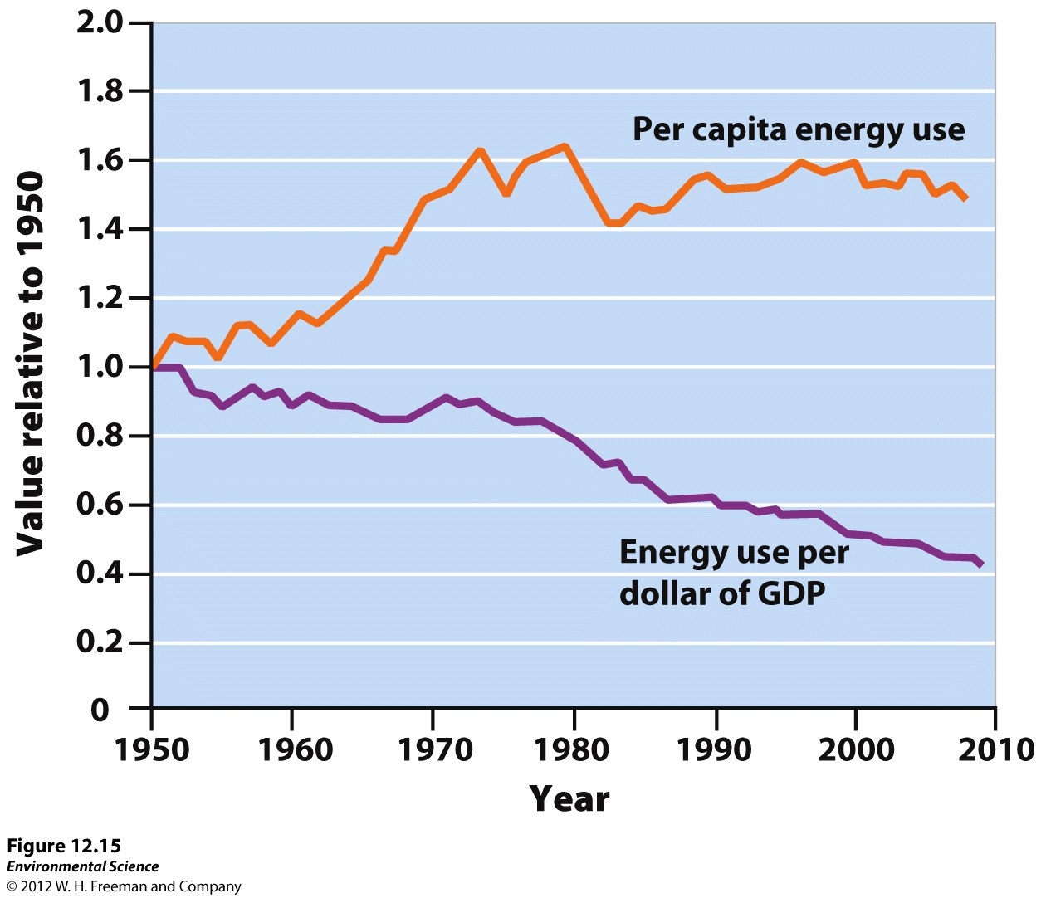
Fossil Fuels are a Finite Resource
Energy intensity (energy use per unit of GDP) is decreasing
Using energy more efficiently

Slide 20
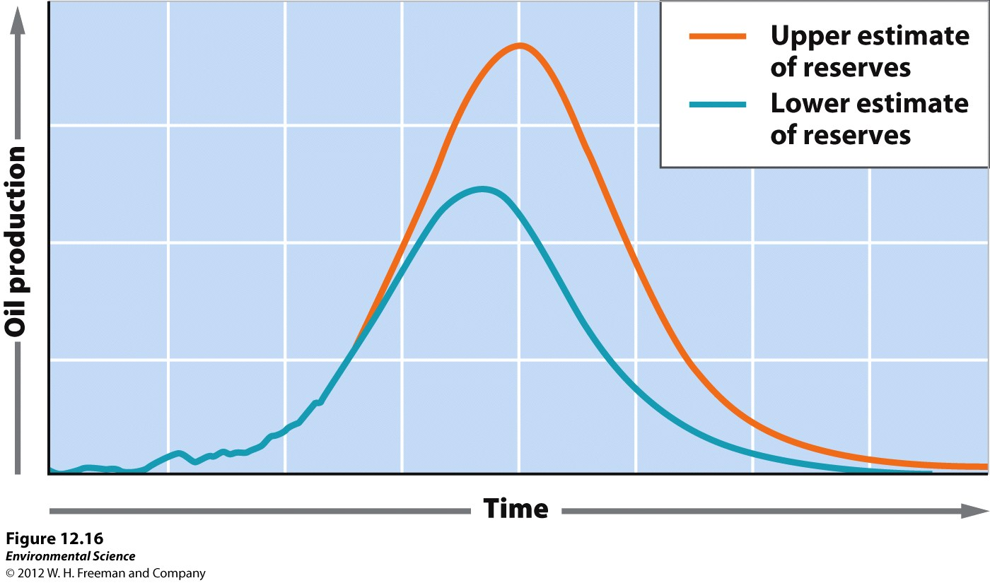
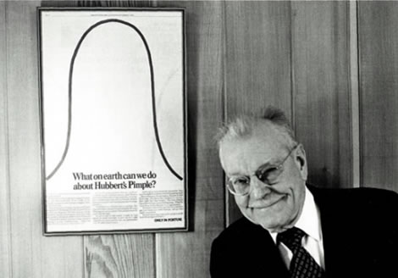
The Hubbert Curve
Graph that predicted:
point at which world oil production will reach a maximum
Point at which we will run out of oil
Oil extraction and use will increase until half the supply had been used up (peak oil)

Slide 21
The Future of Fossil Fuel Use
Oil supplies: ~40 years
Natural gas: ~100 years
Coal: ~ 200 years

Slide 22
Homework
Finish Reading Ch. 12
Research two environmental impacts of drilling in the ANWR
Watch the Tar Sands Video on the APES website and take notes

