Slide 1
SWBAT describe how energy use and energy resources have varied over time, both in the U.S. and worldwide.
APES Unit 11 3/20/16

Slide 2
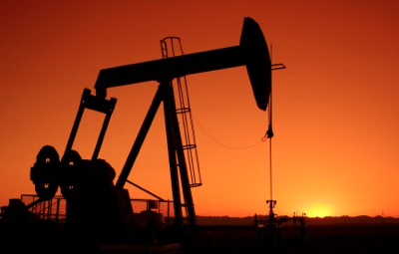
Unit 11: Energy
2 weeks
Lots of math!
Ch. 12: Nonrenewable Energy Resources
Ch. 13: Achieving Energy Sustainability
Current event presenter: Ramlah on 3/31
Ch. 12 Quiz on Thursday; Unit exam next Friday (4/1)
EQs:
How are fossil fuels contributing to the increase of greenhouse gases in the atmosphere?
Can we live without fossil fuels?
Could alternative energy sources replace fossil fuels?

Slide 3
Agenda
Lecture
Crash Course History Video
Pass back work!
Quick poll:
Mock AP exam will be the first week of April
Mock FRQ exam after school or during lunch?

Slide 4
Nonrenewable Energy
Fossil fuels: biological material that has been exposed to heat and pressure → fossilized millions of years ago
Provide 80% of the worlds energy
Coal, oil and natural gas
Oil and natural gas generally found in the same area: deep under land and ocean floor
Stored in pores between rocks
Coal found in long continuous deposits called seams
Nuclear fuels: radioactive material that gives off energy

Slide 5
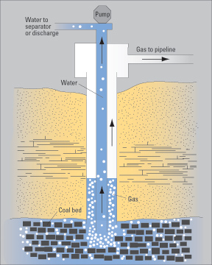
Fossil Fuels: Extraction
Geologists locate fossil fuel reserves
Exploratory wells used to drill and sample a certain area
Proven reserve: if an exploratory well is a fossil fuel reserve, can provide an estimate of the amount of fuel that can be obtained from the area

Slide 6
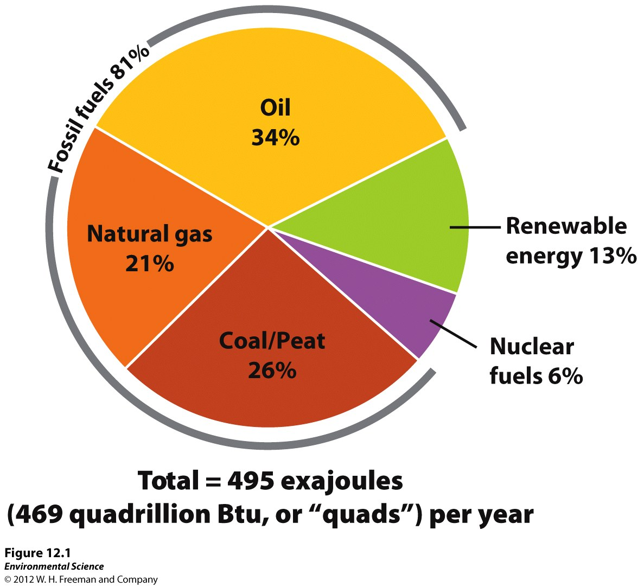
Worldwide Patterns of Energy Use
Not evenly distributed throughout the world
Average energy consumption in the U.S. was 5 times greater than the world average

Slide 7
Worldwide Patterns of Energy Use
Commercial energy sources: bought and sold
Coal, oil, and natural gas
Sometimes wood, charcoal and animal waste
Subsistence energy sources: gathered by individuals for their own immediate need
Used in developing countries in rural areas

Slide 8
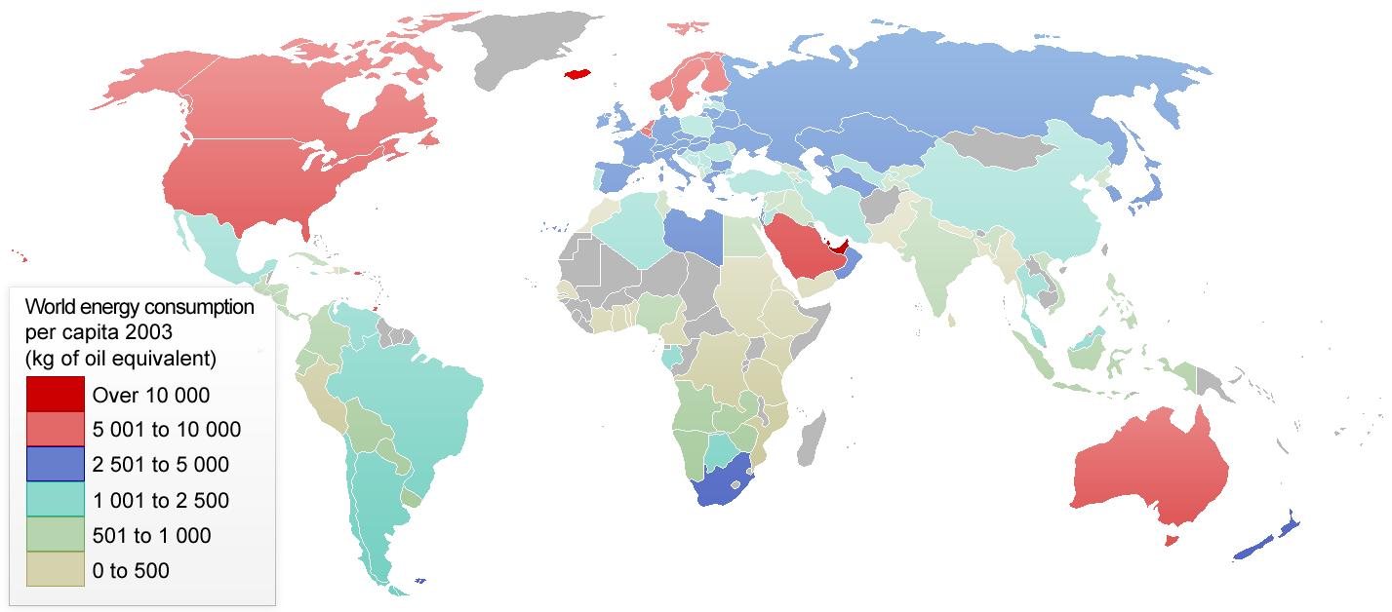
Worldwide Energy Consumption

Slide 9
Patterns of Energy Use in the U.S.
Major suppliers of energy:
1) oil
2) coal
3) natural gas
Work: end use of energy
Waste: heat, CO₂, other pollutants released
We Produce 70% of the energy we need

Slide 10
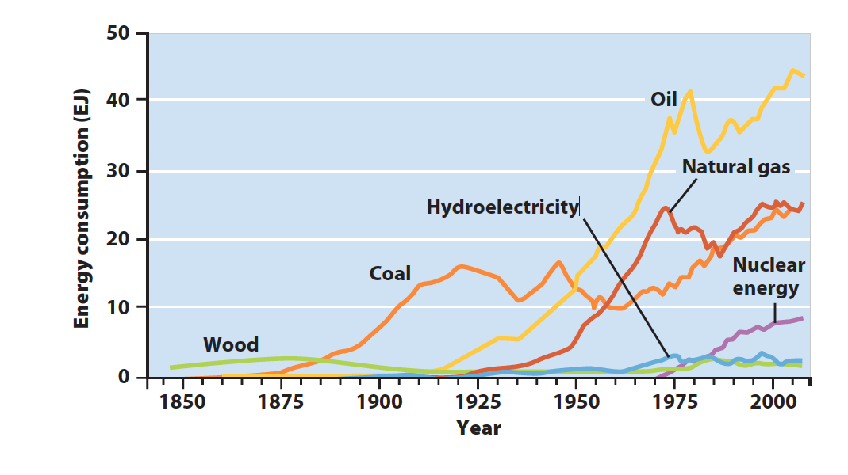
Patterns of Energy Use in the U.S.

Slide 11
Energy Types and Quality
Liquid fuels (oil and biodiesel)
Pros: high energy to mass ratio, compact
Cons: air pollution and energy input for refining
Energy efficiency: how easily stored energy can be converted to useful work
2nd law of thermodynamics: As ability to do work decreases→ energy lost in each conversion

Slide 12
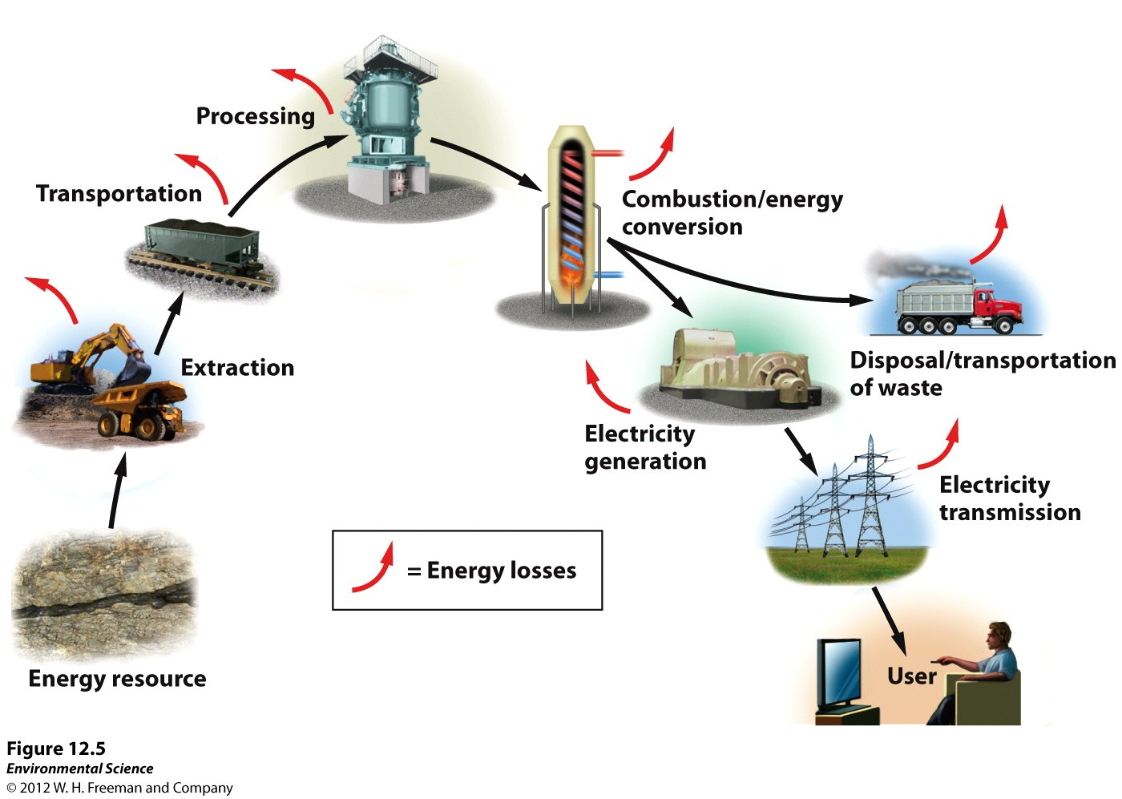
Energy Types and Quality
Energy return on energy investment (EROEI): energy obtained from the fuel / energy invested to obtain the fuel

Slide 13
Energy Efficiency
Public transportation: Most efficient

Slide 14
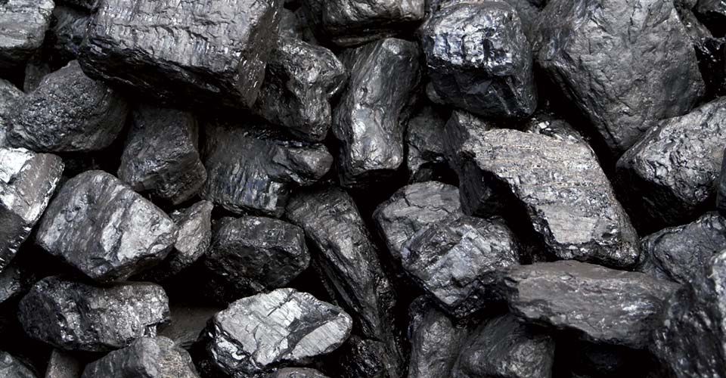
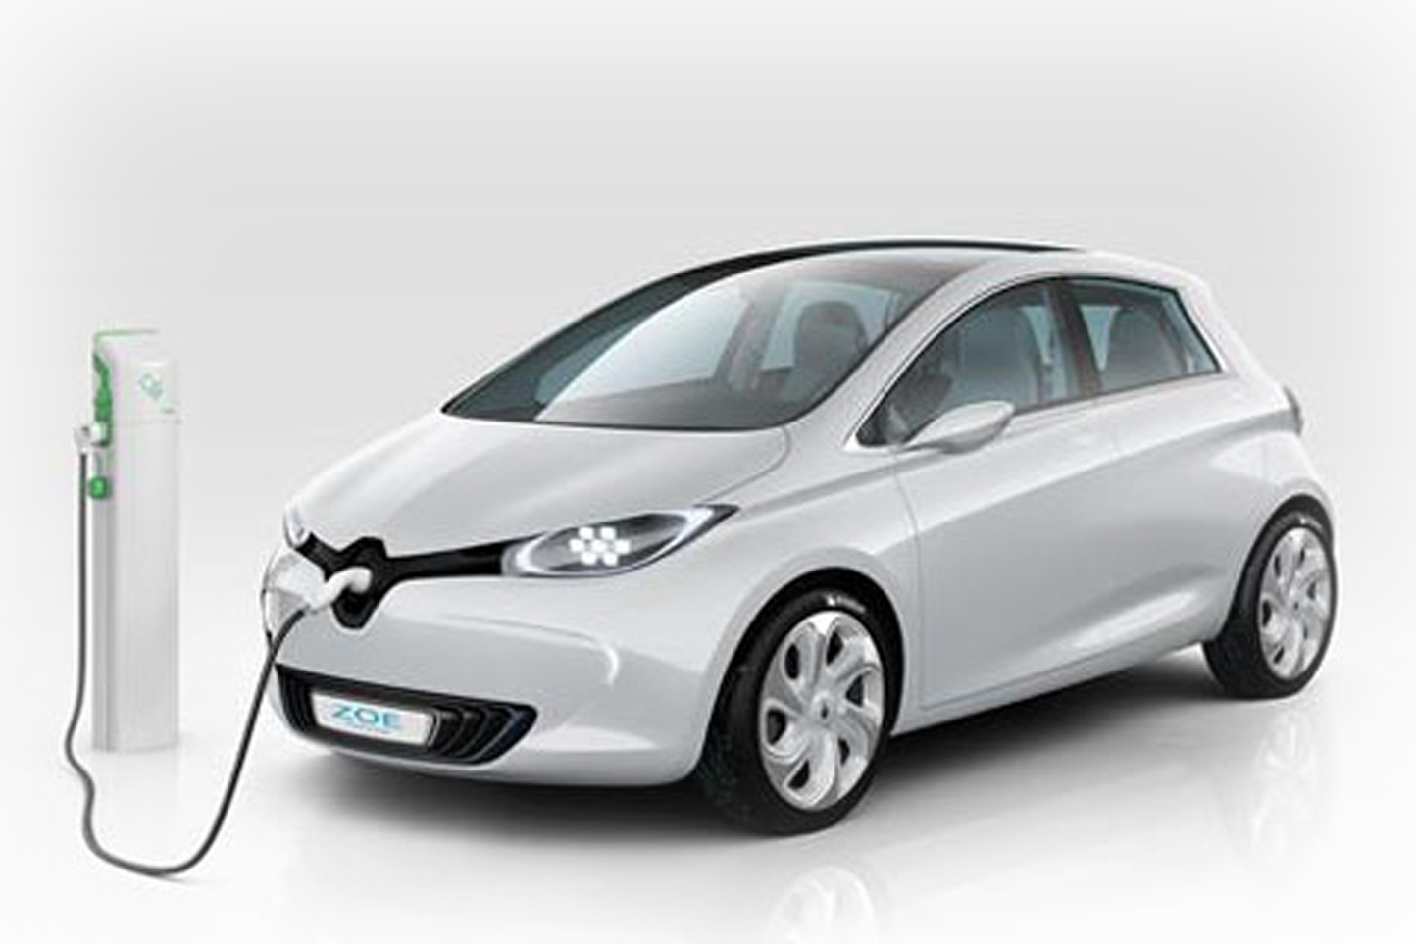
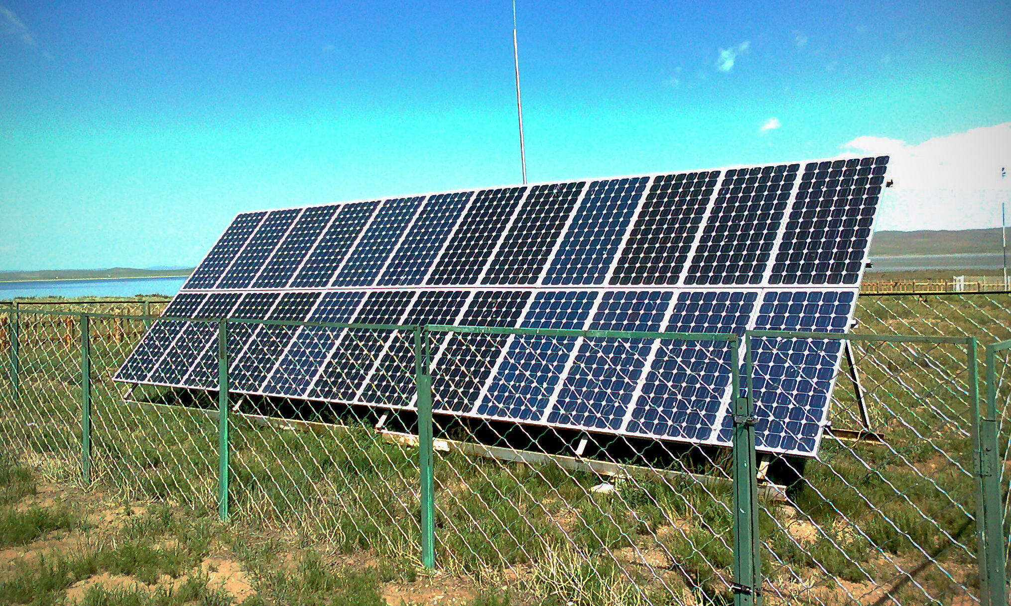
Electricity
Secondary source of energy
Primary sources used to generate electricity:
Fossil fuels, nuclear energy, renewable energy
Energy carrier: something that can move and deliver energy in a convenient, usable form
Transfer of energy from fuel to electricity is 35% efficient

Slide 15
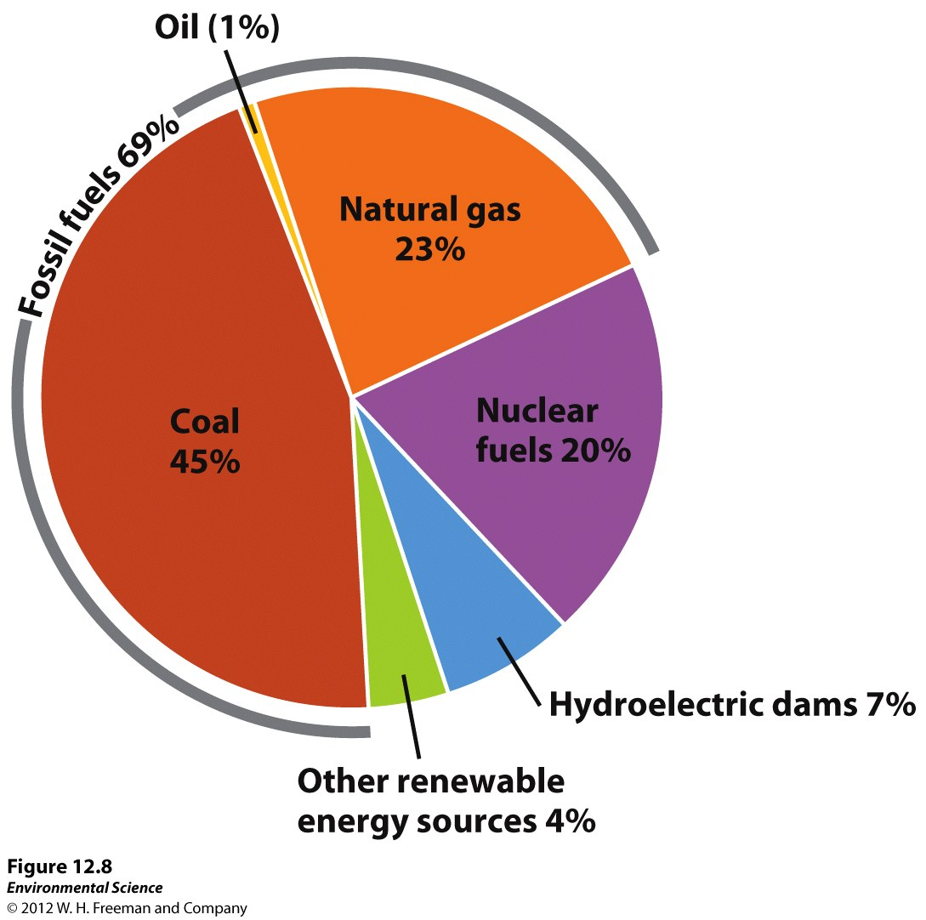
Primary energy sources used to generate electricity

Slide 16
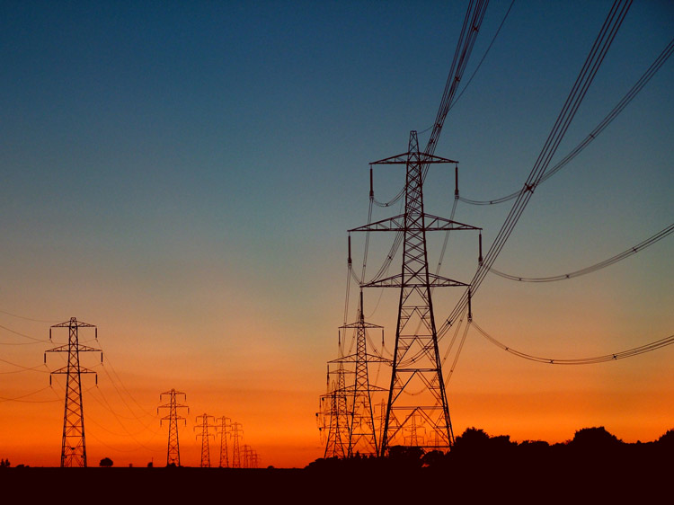
Electricity Generation
Fuel burned→ heats water and makes steam→ steam turns the blade of a turbine→ shaft in the turbine turns the generator→ electricity produced
Electrical grid: power plants are connected together and links them with end users of electricity (homes, businesses, etc.)

Slide 17
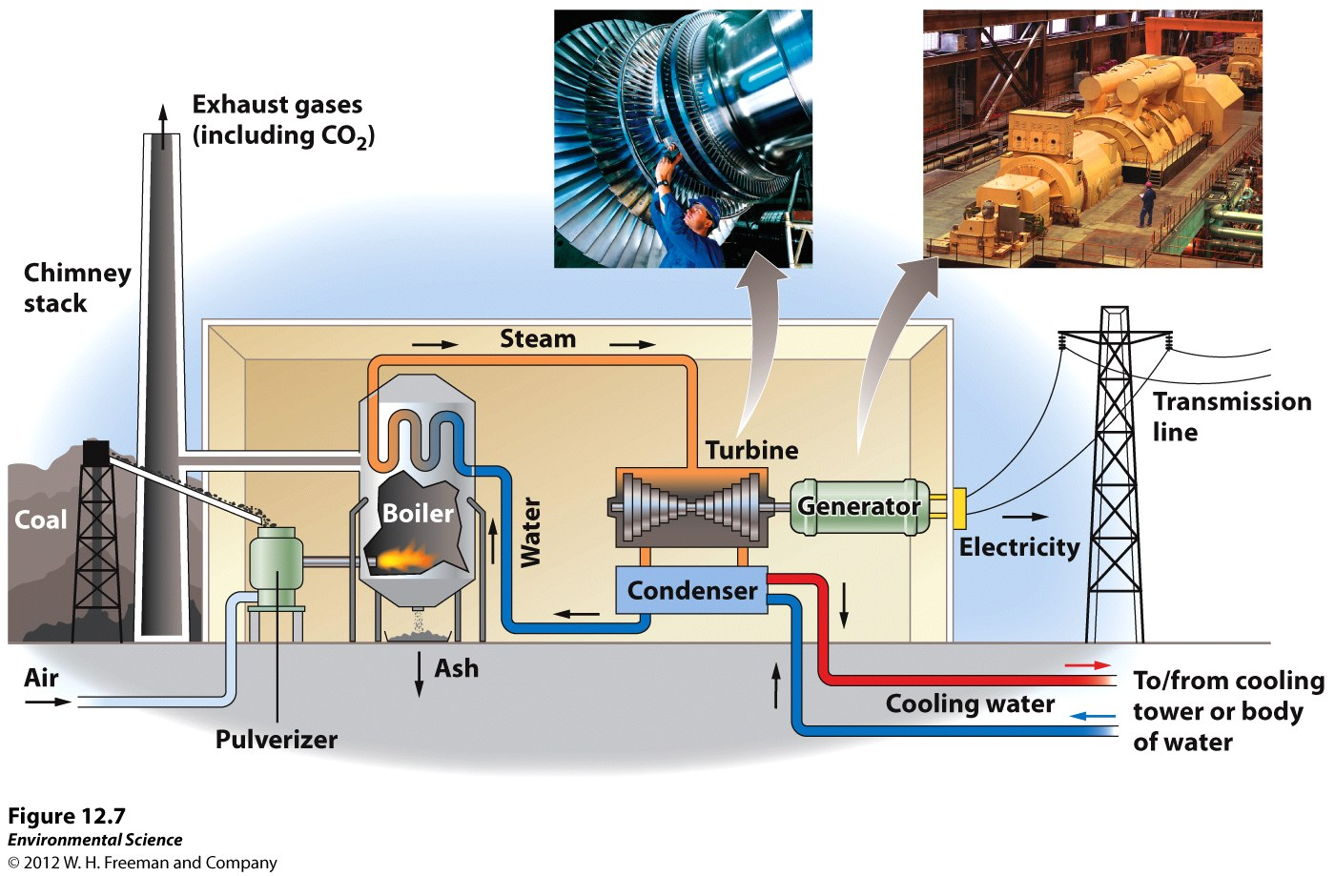
Electricity Generator

Slide 18
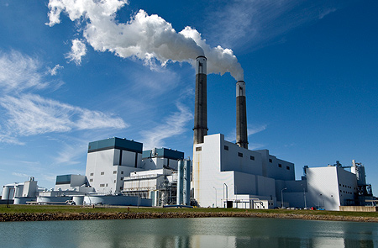
Efficiency of Electricity Generation
Combined Cycle natural gas fired plant: contains two turbines and two generators
Efficiency of 60%
Capacity: maximum electrical output
500 MW in the U.S. for a typical power plant
Capacity factor: the fraction of the time a plant is operating

Slide 19
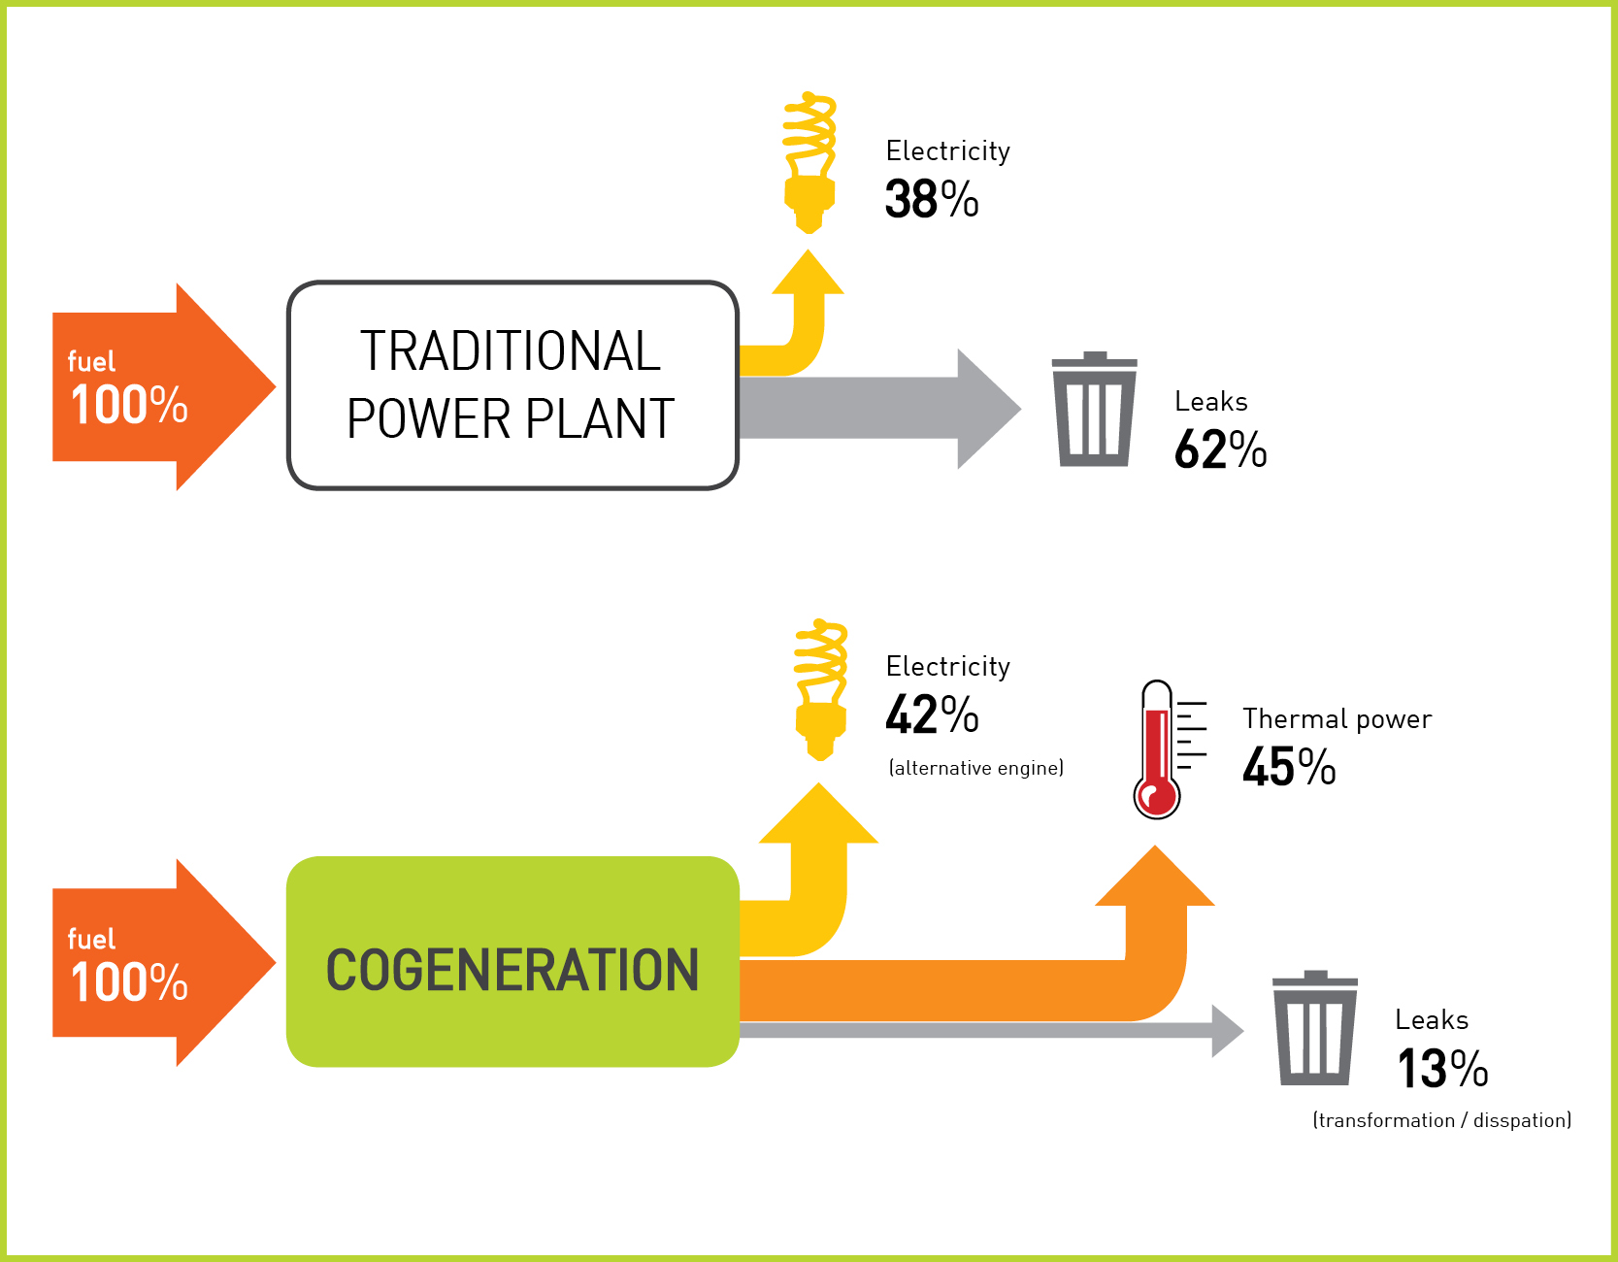
Cogeneration
Using fuel to generate electricity and produce heat
Waste energy produced in electrical generation is pumped to homes

Slide 20
Stop and Think
How is water used to generate electricity?
How can electricity be a source of pollution?

Slide 21
Homework
Read Ch. 12 through page 332 (stop before nuclear energy)

