Slide 1
SWBAT explain the environmental impacts of various approaches to raising and harvesting meat and fish. Do Now: What is bycatch? What are some of the ways in which modern agribusiness produces meat and fish?
APES Unit 8 2/13/15

Slide 2
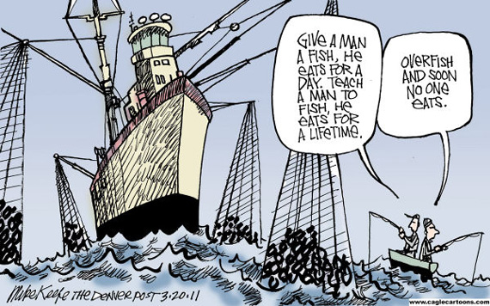
Overfishing….

Slide 3
Reminders
MC Exam on Monday (2/22)
Current event presentations on (2/23)
All late work for this unit due by Tuesday!
Agenda:
Lecture
Seeds/pass back work
Video

Slide 4
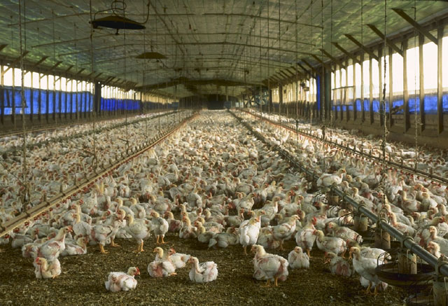
High Density Animal Farming
Concentrated Animal Feeding Operations (CAFOs) used for:
Beef cattle
Dairy cows
Pigs
Poultry
Benefits:
Less land use→ protection of biodiversity
Increased meat production → higher profits
Reduce soil erosion
Reduce
Improve feeding efficiency

Slide 5
High Density Animal Farming
Disadvantages of CAFOs:
Antibiotics regularly given to animals→ more antibiotic resistant bacteria
Waste disposal→ produces over 2,000 tons of manure a year
Can pollute water through runoff
Methane Emissions from cattle
Can contribute to the spread of spread zoonotic diseases
Mad cow disease
Swine flu
Bird flu

Slide 6
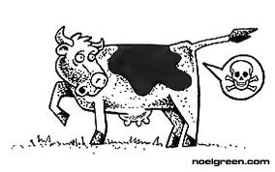
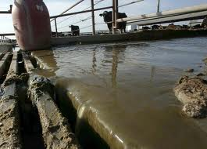
High Density Animal Farming

Slide 7
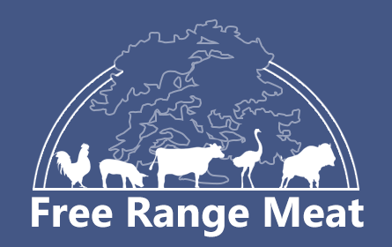
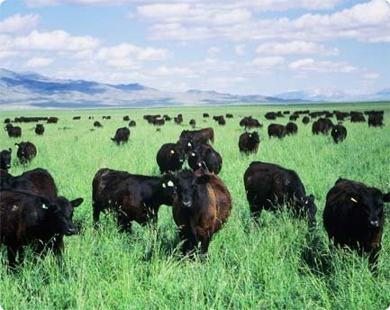
More Sustainable Animal Farming
Free Range Meat is more sustainable
Animals not kept in close quarters→ less need for antibiotics
Manure/urine spread out→ naturally broken down by decomposers
Less fossil fuel used for grain production
Disadvantage:
Use more land than CAFOs→ cost of meat is higher

Slide 8
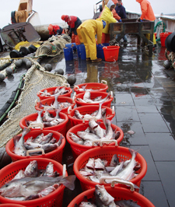
Ocean Resources
Fish is the third major source of food for humans
One billion people worldwide depend on fish as their main source of food
125 million tons of fish are harvested each year
Fishery: industry devoted to catching processing or selling fish or other aquatic organisms

Slide 9
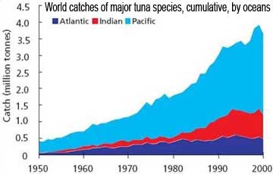
Ocean Resources: Overfishing
12-mile limit: limited the nations territorial waters to 12 miles from the shore
UN held a conference to address problems of fish scarcity (Tragedy of free access)
Nations were authorized to extend limits of jurisdiction to 200 miles offshore

Slide 10
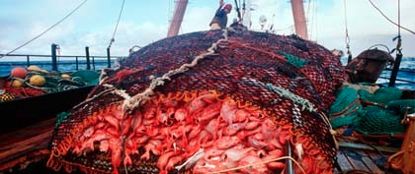
Overfishing
Capture fisheries: fish that are caught in the wild and not raised in captivity
Majority of fish harvested worldwide use this technique
Fishery collapse: decline in a fish population by 90% or more

Slide 11
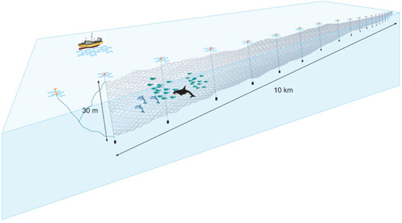
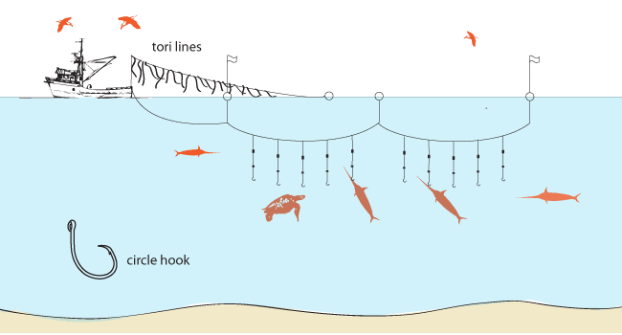
Fishing Methods
Driftnets: drift through the water and catch everything in their path
Long lining: Use of long lines that have many baited hooks that will lure numerous aquatic organisms and drift in the water

Slide 12
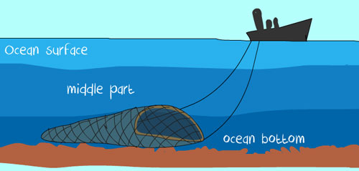
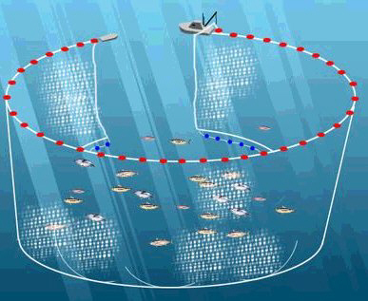
Fishing Methods
Bottom Trawling: Ocean floor is scraped by heavy nets that smash everything in its path
Destroys benthic habitat
Purse seines: large nets drawn up like a drawstring purse to capture fish in large schools near the ocean surface

Slide 13
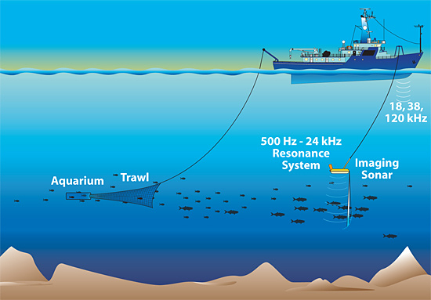
Fishing Methods
Sonar: sound waves used to locate fish or to “see” the bottom of the ocean
Allows ships to locate large quantities of fish quickly
Target specific species
Bycatch: unintentional catch of species of fish, mammals or birds that are not the target fish

Slide 14
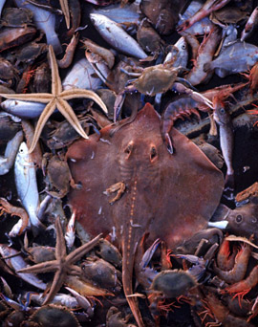
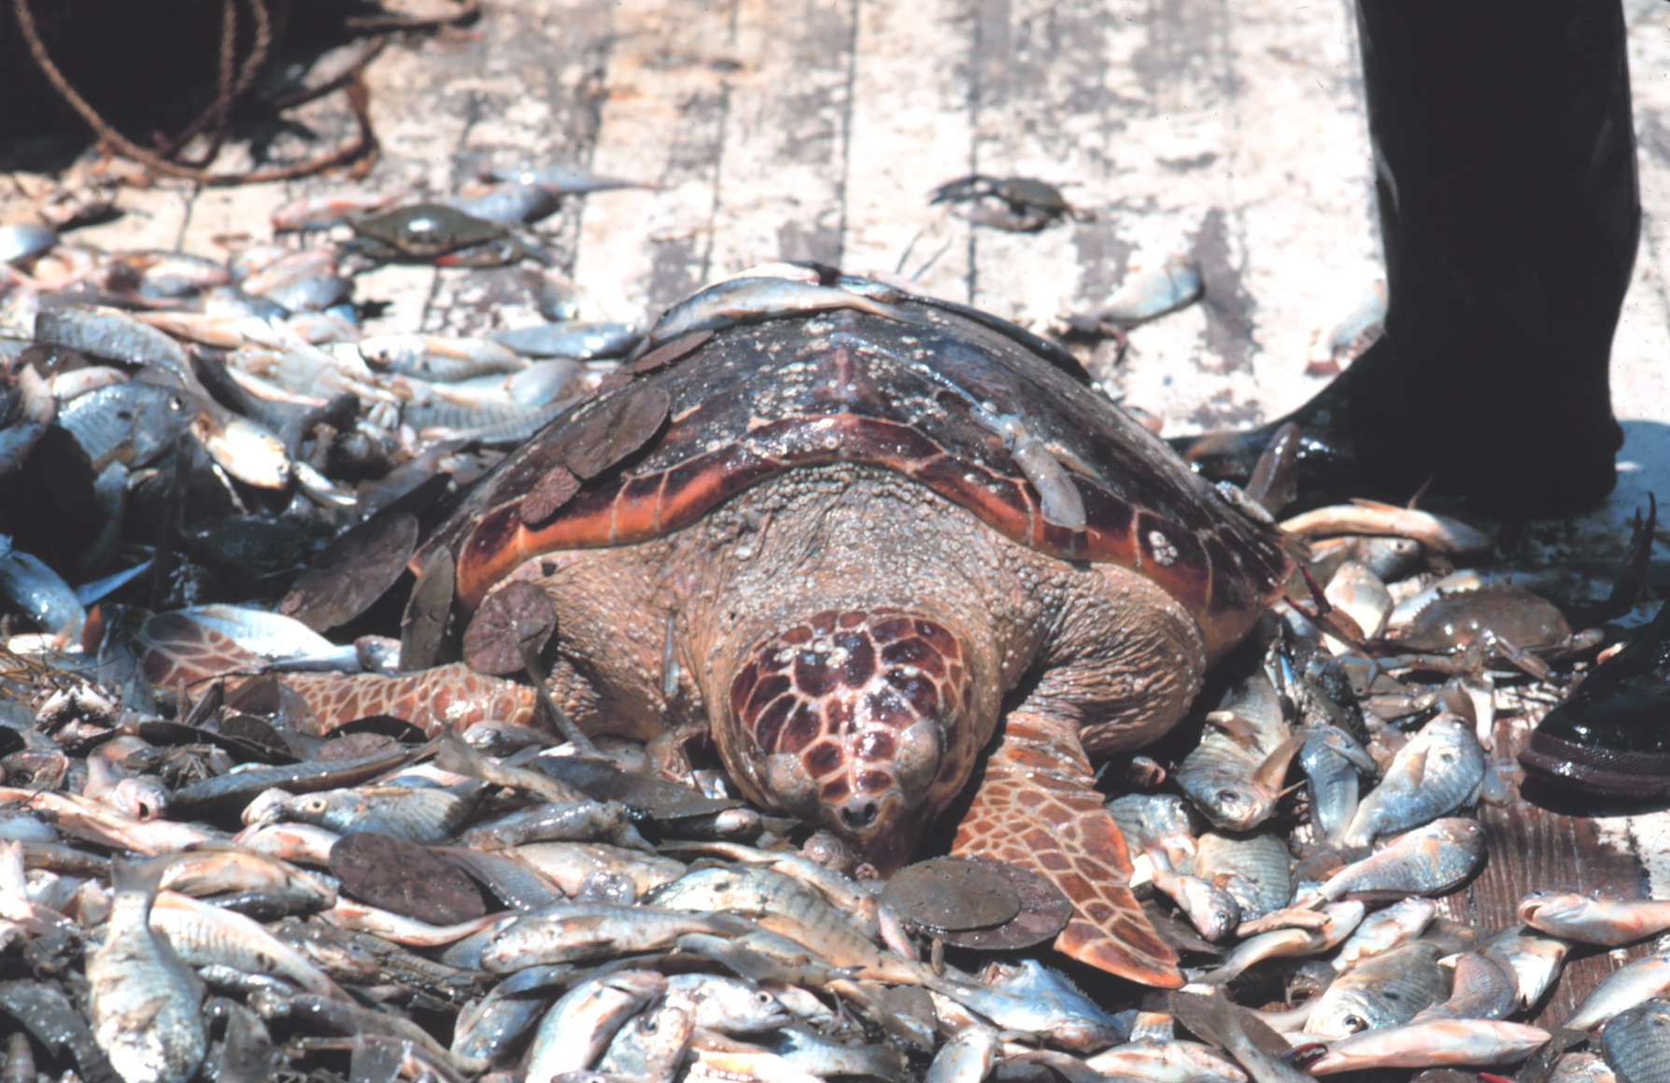
Bycatch
Fishing methods that contribute to bycatch:
Bottom-trawling
Long-line fishing
Purse seines
Has significantly reduced populations of sharks and turtles

Slide 15
More Sustainable Fishing
Need international cooperation!
Sustainable Fishery Act (1996): shift from economic sustainability to conservation/ sustainability approach.
Individual Transferable Quotas (ITQs):
Total allowable catch determined before the start of the fishing season
If fishers don’t catch enough fish→ can sell their quotas to other fishers
Success in Alaska for small family-run fisheries
Success in New Zealand with large fishing companies

Slide 16
Ocean Resource Legislation
Anadromous Fish Conservation Act: Protect fish that live in the sea but grow up and breed in fresh water
Magnuson fishery conservation and management act: governed conservation and management of ocean fishing
Established 200 mile fishing area
Marine Mammal Protection Act: established a federal responsibility to conserve marine mammals
United Nations Agreement for the Implementation of the Provisions of the United Nations Convention on the Law of the Sea: Established principles for conservation and management of certain types of fish
CITES: prevents trade of threatened or endangered marine species

Slide 17
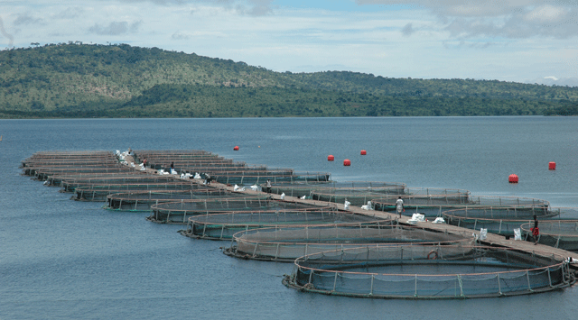
Aquaculture (fish farming)
Raising fish and other aquatic species in captivity for harvest
Methods:
Completely raised in captivity
Hatched in captivity→ release into wild→ captured (salmon)
Provide fish with food and antibiotics

Slide 18
Aquaculture (fish farming)
Advantages:
Helps meet worldwide demand for fish
Reduces bycatch
Disadvantages:
Accidental release of fish into the wild
Spread of new diseases and contamination of native gene pool
Carnivorous fish in captivity are fed other fish
Waste water containing feces and antibiotics is pumped back into rivers and streams

Slide 19
Check Seeds!
Pass back work!

Slide 20
Break Homework
Salinization Lab Report
Read in the Barrons book: 269-278 and 292-302
Make flash cards for terms you didn’t know and bring them to school
Do the practice questions and check your answers
Watch for email about videos
Have a great break!

