Slide 1
SWBAT identify the benefits and costs of using GMOs in agriculture.
APES Unit 8 2/11/16

Slide 2
Homework Share Out

Slide 3
Agenda
Lecture
Check Seeds
Pass Back Work
Math Practice
Announcement: Unit Exam on Monday Feb. 22nd

Slide 4
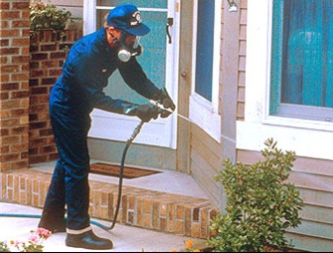
Pesticide legislation
Federal Insecticide, fungicide, and rodenticide Act (FIFRA) (1947): EPA must approve the use of all pesticides used in the U.S.

Slide 5
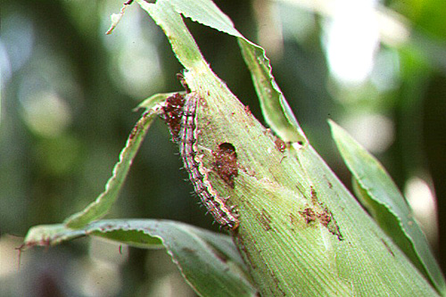
Benefits of GMOs
Increased crop yield and quality
Changes in pesticide use
Ex: Bt corn
Pests (corn borer, larvae of butterflies and moths feed on corn)
Bacterium produce toxin (Bt gene) that kills moths and butterflies
Bt gene can be inserted into corn→ produces natural insecticide in its leaves

Slide 6
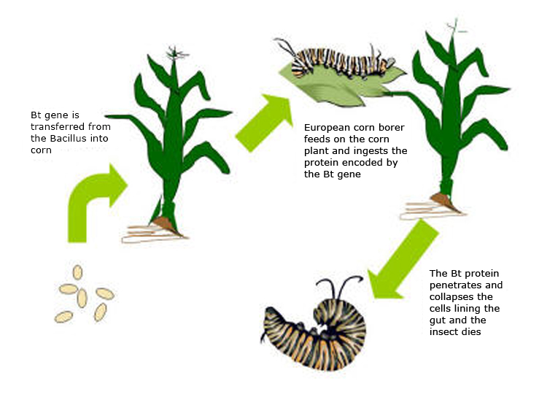

Slide 7
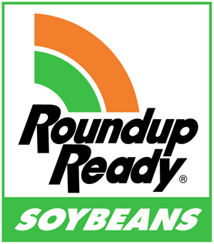
Benefits of GMOs
Potential changes in pesticide use:
Crops resistant to the herbicide roundup ready
Widely used in corn, soybean and cotton plants
Increased profit:
Farmers don’t need to buy as many pesticides→ increased profit
Greater yield→ more profit

Slide 8
Concerns about GMOs
75% of all crops grown in the US are genetically modified
Safety for human consumption:
Possibility of increased allergies
Effects on biodiversity:
Newly added genes can spread to old varieties of crops→ new genes spread to wild plants-→ wild varieties are lost
More GMOs→ loss of genetic diversity

Slide 9
Concerns about GMOs
Regulation of genetically modified organisms:
No regulations currently in the U.S.
Debate over labeling
Anti-labeling: suggest that something is wrong with GMOs
Organic food doesn’t contain any GMOs
EU has much stricter restrictions on labeling GMOs

Slide 10
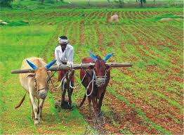
Alternatives to Industrial Farming
Traditional subsistence agriculture: families grew crops for themselves
Relied on human and animal labor
Conventional agriculture: industrial agriculture

Slide 11
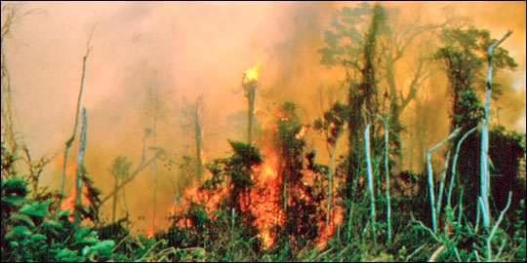
Alternatives to Industrial Farming
Shifting Agriculture: clearing land and using it for a few years until soil is depleted of nutrients
Slash and burn: vegetation cut down, burned and then planted with crops
Releases CO2 into the atmosphere

Slide 12
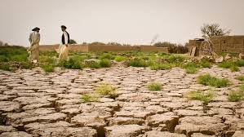
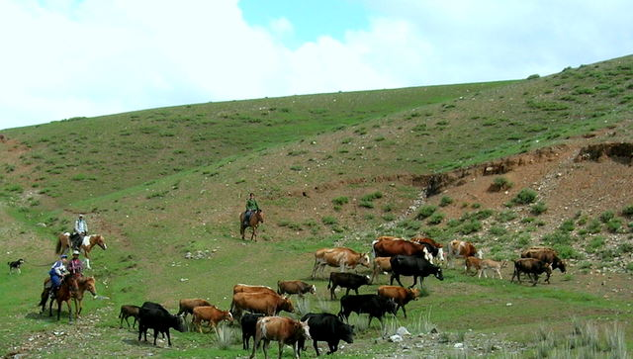
Alternatives to industrial farming
Desertification:
Irrigation leads to salinization
Topsoil is eroded
Nomadic grazing: move herds of animals over long distances to seasonally productive feeding grounds
Benefits:
Sustainable way to use soil with low productivity
Vegetation can regenerate

Slide 13
Desertification

Slide 14
Sustainable (low-input) Agriculture
Feed the world WHILE
Enhancing the quality of soil
Minimizing the use of nonrenewable resources
Economic viability for farmer
Often requires more labor
Relies on ecological interactions

Slide 15
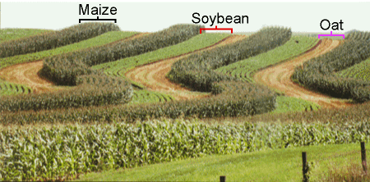
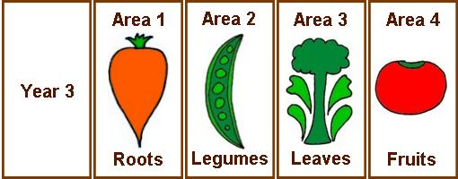
Sustainable Agriculture
Intercropping (strip-cropping): planting bands of different crops across a hillside
Prevents erosion
Ex: nitrogen fixing plants (peas) with a nitrogen intensive crop
Crop rotation: rotate the crop species in the field from season to season
Typical crop rotation: corn→ soybeans→ oats→ alfalfa

Slide 16
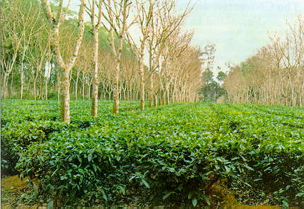
Sustainable Agriculture
Agroforestry: tress and crops grown together
Creates a symbiotic relationship
Trees provide habitats for animals that prey upon the pests that harm crops
Tree roots stabilize the soil→ reduce vegetation

Slide 17
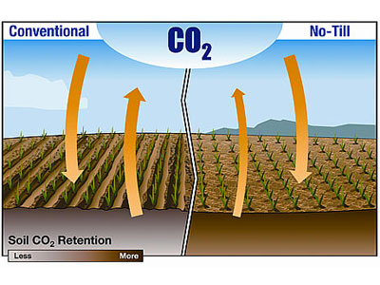
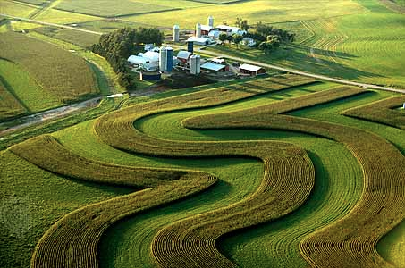
Sustainable Agriculture
Contour plowing: rows of crops are planted across the hillside
Prevents erosion
Plowing and tilling makes soil more susceptible to erosion
More oxygen→ oxidation of organic material→ increase in atmospheric CO₂ concentration
No-till agriculture: farmers plant seeds without using a plow to turn the soil
Crop residues left in the field between seasons
Intact roots hold the soil in place→ reduces wind and water erosion
Disadvantages: increase use of herbicides

Slide 18
Integrated Pest Management (IPM)
Uses a combination of biological, chemical and physical means to reduce pests
Used to reduce or eliminate the use of pesticides
Reduce pest populations to acceptable levels
Pest control strategies:
Crop rotation and intercropping
Specialized pests can’t establish themselves
Provide habitat for insects that prey on crops
Agroforesty encourages the presence of insect-eating birds

Slide 19
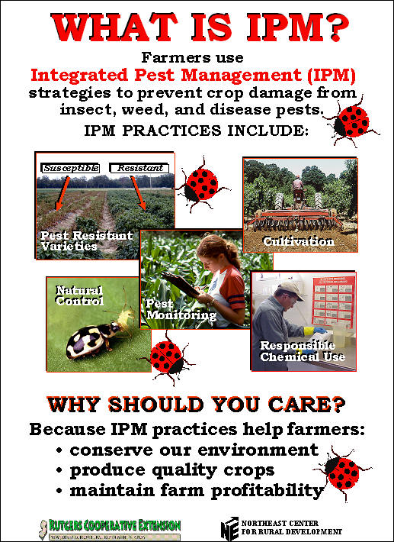
IPM vs. Pesticide use

Slide 20
Organic Agriculture
Production of crops without the use of synthetic pesticides or fertilizers.
Pros:
Carefully manage soil
Plant diverse crops
Avoid synthetic fertilizers and pesticides
Reduce environmental effects of agriculture
Cons:
No herbicide use→ less likely to use no till methods effectively
Organic Food Protection Act (OFPA): established uniform national standards for the production and handling of foods labeled organic

Slide 21
Check your seeds!

Slide 22
Math Practice!
Practice Problem: Monica has 10 starbursts candies on Monday. By the end of the week she has 70 starbursts candies. What is the increase in starburst candies that Monica accumulates? Express the answer as a percentage of the amount of starbursts she had on Monday.

Slide 23
Math Groups!
Group 1: Rimsha, Monica, Ramlah
Group 2: Cynthia, Wyllana, Amrat
Group 3: Harmanpreet, Uzma, Rahila
Group 4: Shayna, Mahnoor, Hamna, Mehrangiz
Group 5: Desire, Bukurie, Attia, Wendy, Saliha,

Slide 24
Math Practice
Rate = rise/run
Ask three before me
Check your answers with each other when you are done with each section and finally with me.

Slide 25
Homework:
Finish Reading Ch. 11
Read- Are engineered foods evil?
Write two paragraphs in response to the question: Do you believe the advantages of GMOs outweigh the disadvantages? Why or why not?

