Slide 1
SWBAT identify the pros and cons of industrialized agriculture. Do Now: What are the pros and cons of pesticide use?
APES Unit 8 2/10/16

Slide 2
The Green Revolution
Farming is mechanized
Crop yields in industrialized nations boomed
1st green revolution: use of selective breeding to increase crop yield
Pioneer: Norman Borlaug
2nd Green Revolution: GMOs
Fast growing strains of rice and wheat introduced into developing countries to improve crop yield
Most greatly affected India

Slide 3
2nd green revolution
Cons:
Decreased genetic diversity and increased use of hybrid species

Slide 4
If the world continues expanding the green revolution….
Populations of pests will develop genetic immunities to widely used pesticides
There might be a loss in genetic raw material in which to draw if biodiversity continues plummeting
Grain yields per hectare will still increase but will slow down in growth rate
Genetically engineered crop strains and their required maintenance costs will be too much for developing countries

Slide 5
Mechanization
Fields must be plowed, planted, weeded, irrigated, etc.
If labor costs are high, machines are used
Economies of scale: output increases→ average costs of production falls
Big farms do better than small farms

Slide 6
Irrigation
Pros:
More efficient use of water in places where it is scare
Can transform former deserts into productive farmland

Slide 7
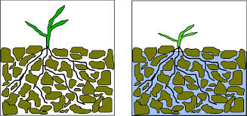
Irrigation
Cons: Contributes to soil degradation
Waterlogging: when soil remains under water for a long period of time→ roots are impaired because they don’t get oxygen
Salinization: small amounts of salts in irrigation water become highly concentrated on soil surface through evaporation

Slide 8
Fertilizers
Agriculture removes organic matter and nutrients from soil
These nutrients must be replenished
Fertilizer contains nitrogen, phosphorous and potassium
Organic fertilizers: composed of organic matter from plants and animals
Inorganic (synthetic) fertilizers: produced commercially
Combusting natural gas: allows nitrogen in the air to become fixed in fertilizer

Slide 9
Synthetic fertilizers
Pros:
Targeted to needs of particular crops
Easily absorbed by plants
Easy application
Estimated that world output of crops would reduce by 40% if no chemical fertilizers were used!
Cons:
Uses fossil fuels to manufacture them
Can be carried off by runoff→ creates hypoxic conditions
Reduction of organic matter and oxygen in the soil

Slide 10
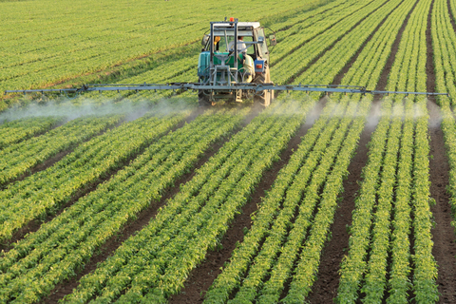
Monocropping (Monoculture)
One type of plant is planted in a large area
Pros
Improve agricultural productivity
Large expanses of land can be planted and harvested at the same time
Cons:
All plants harvested at once→ soil exposed→ soil erosion
Land more vulnerable to pests
Decreases biodiversity

Slide 11
Monoculture
Plantation farming: type of industrialized agriculture practiced in tropical developing nations
Monoculture cash crop is grown and then exported to developing nations
Ex: bananas, coffee, pineapple
Polyculture: using multiple crops in the same space

Slide 12
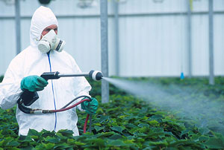
Pesticides
Pesticides: substances that kill organisms that people consider to be pests
Insecticides: target species of insects and other invertebrates the consume crops
Herbicides: target plant species that compete with crops

Slide 13
Pesticide Facts
DDT is still used in developing countries for mosquito control
Pests develop genetic resistance to pesticides very quickly
Because of overuse, many insecticides can no longer protect people from diseases such as malaria in some parts of the world
pesticides can kill natural predators, unleashing new pests

Slide 14
So many pesticides….
Broad spectrum pesticides: they kill many different types of pests
Selective: focus on a narrow range of organisms
Persistent pesticides: Remain in the environment for a long time
Ex: DDT
Chlorinated hydrocarbons are the most persistent hydrocarbon
Nonpersistent: pesticides break down relatively rapidly
Lower environmental impact
Ex: organophosphates

Slide 15
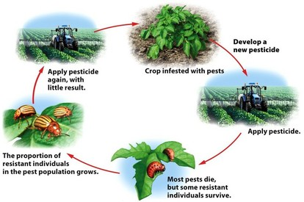
Pesticide Treadmill

Slide 16
Check Seeds!!

Slide 17
Homework
Read textbook through page 300
Research one environmental advantage and one environmental disadvantage of using monocultures
Research one economic advantage of using monocultures
Read the food waste article posted online and answer the question: How do you think we can reduce food waste in the U.S.?

