Slide 1
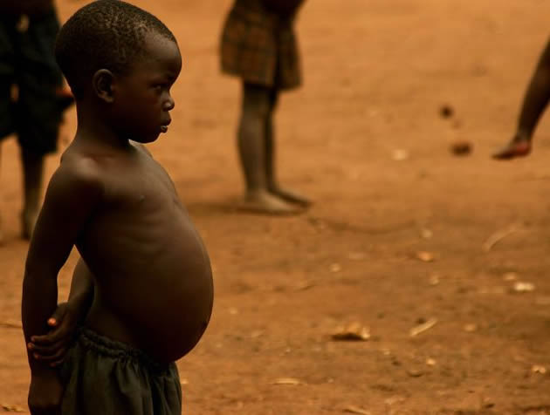
SWBAT describe human nutritional needs and the challenges of overcoming hunger and malnutrition.
APES Unit 8 2/9/16

Slide 2
Agenda
Video
Mini lecture
Salinization Lab
Famine Activity

Slide 3
Homework Share
Share out your research

Slide 4
Meat vs. Grain
Meat production in developed countries has all of the following effects:
Consumption of an large amount of US grain production
Consumption of half of the water withdrawn from rivers and aquifers every year
Emissions of a considerable amount of methane, a greenhouse gas, from belching cows
Increase NO₂ from inorganic fertilizers used to grow livestock feed

Slide 5
Meat vs. Grain
Why is it more environmentally friendly to produce grains over meat?
Land use:
Grain for human consumption- only need land for grain growth
If grain is used for meat production- land is needed for growing grain AND raising food animals
A hectare of land used for grain will feed more people than a hectare of land used for livestock
Larger amount of rangeland is used for free-range livestock than for grain production

Slide 6
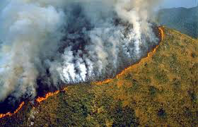
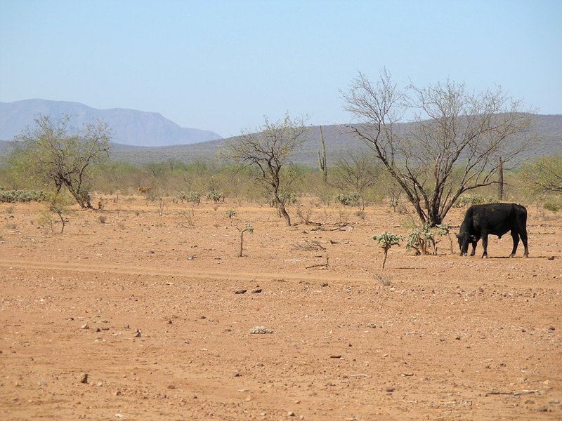
Stop and Think
What are some environmental consequences of the livestock industry?

Slide 7
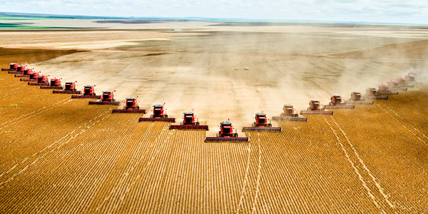
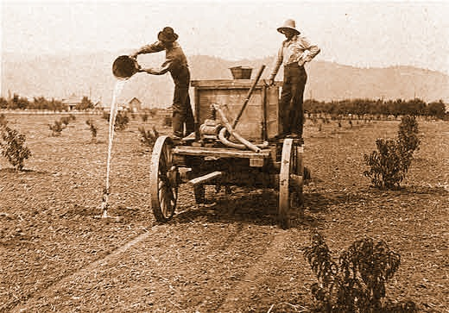
Industrial Agriculture
Industrial agriculture (agribusiness): applies techniques of the industrial revolution to the production of food

Slide 8
Energy Subsidy
Energy subsidy: energy input per calorie of food
20 kg of grain to feed a cow to produce 1 kg of beef
Why do energy subsidies exist?
Energy needed for tractors, irrigation, harvesting food
Transporting food

Slide 9
Salinization Lab
Materials:
10 mL 0% salt solution
10mL 0.5% salt solution
10mL of 3.5% salt solution
3 ziplock bags
3 napkins
Permanent marker
30 radish seeds

Slide 10
Salinization Lab
When you are done:
Clean up any spills
Make your data table (we will be making observations through Friday)

Slide 11
APES famine activity
Bring a calculator and the worksheet
Don’t eat the oreos!
Total amount of beans: 200 grams WITHOUT a calculator ☺

Slide 12
Homework
Read the ch. 11 through page 292

