Slide 1
SWBAT describe human nutritional needs and the challenges of overcoming hunger and malnutrition.
APES Unit 8 2/5/16

Slide 2
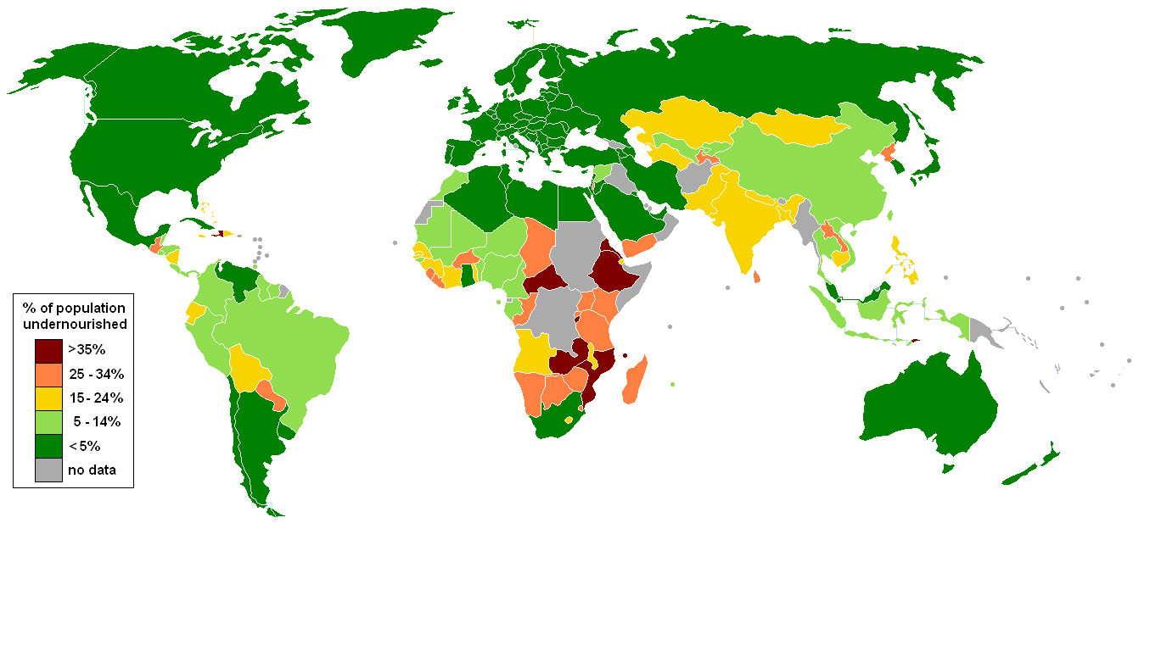
Nutritional Requirements
1 billion people worldwide lack access to access to adequate amounts of food

Slide 3
Nutritional Requirements
Our bodies need nutrients to survive!
Macronutrients: nutrients needed in large amount
Ex: proteins, carbs and fats
Micronutrients: needed in smaller amounts
Ex: vitamins (i.e. iron) and minerals (i.e. calcium)
Hunger: insufficient calories are taken in to replace those that are being expended
Under nutrition: not consuming enough calories to be healthy
In children- can lead to improper brain development and lower IQ

Slide 4
Nutritional Requirements
Malnutrition: poor nutrition that results from insufficient or poorly balanced diet
Not enough protein, carbs, vitamins and minerals
The principal cause of malnutrition and hunger is poverty
Food security: people have access to sufficient, safe and nutritious food

Slide 5
Food Insecurity and the U.S.
Personal Responsibility and Word Opportunity Reconciliation Act (PRWORA)
Welfare reform: people who work should be encouraged to find employment
Limited the number of people who qualified for food stamps
Second harvest: charity that makes use of food that would otherwise go to waste

Slide 6
Nutritional Requirements
Famine: food insecurity is so extreme that large numbers of deaths occur in a given area over a relatively short period.
Causes:
Crop failures
Droughts
Natural disasters
Political and economic instability
Population increases
Mismanagement of resources
The most successful method of reducing famine in underdeveloped countries is agricultural education

Slide 7
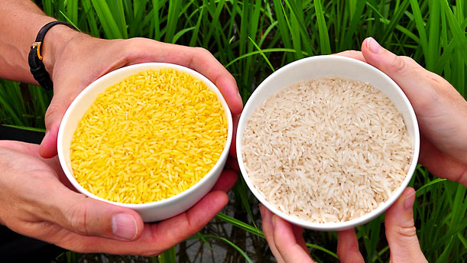
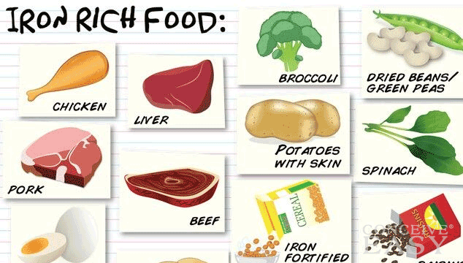
Nutritional Requirements
Deficits in essential vitamins:
Vitamin A deficiency can lead to blindness
Anemia: Deficiency in iron
Foods high in iron: spinach, red meat, pork, poultry
Kwashiorkor: deficiency in protein

Slide 8
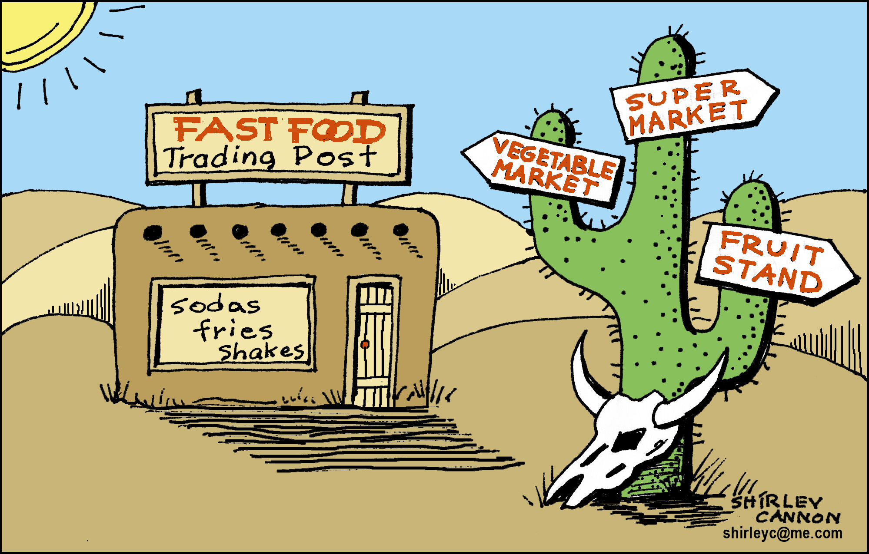
Nutritional Requirements
Overnutrition: ingestion of too many calories and improper foods which causes a person to become overweight
Result of the availability and affordability of certain kinds of food

Slide 9
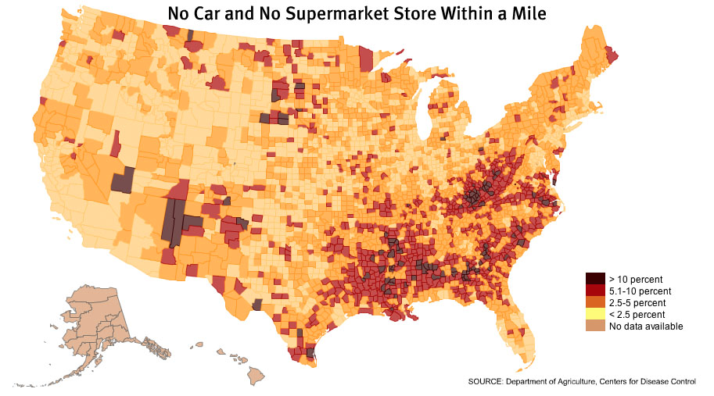
Food Deserts

Slide 10
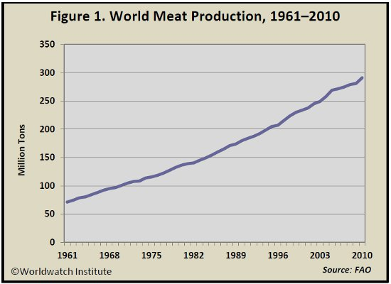
Human Diet
50,000 edible plants but just 3 make up 60% of human energy intake
Meat intake increases with economic growth

Slide 11
Meat vs. Grain
Meat production in developed countries has all of the following effects:
Consumption of an inordinate amount of US grain production
Consumption of half of the water withdrawn from rivers and aquifers every year
Emissions of a considerable amount of methane, a greenhouse gas, from belching cows
Increase NO₂ from inorganic fertilizers used to grow livestock feed

Slide 12
Meat vs. Grain
More efficient to produce grain than meat due to
Land use:
Grain for human consumption- only need land for grain growth
If grain is used for meat production- land is needed for growing grain AND raising food animals
A hectare of land used for grain will feed more people than a hectare of land used for livestock
Larger amount of rangeland is used for free-range livestock than for grain production

Slide 13
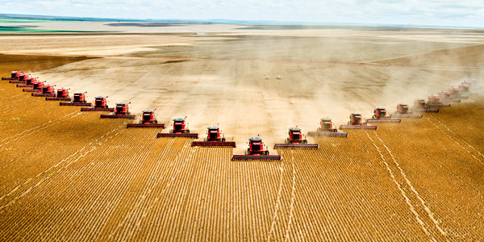
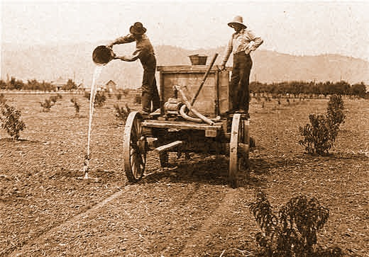
Industrial Agriculture
Industrial agriculture (agribusiness): applies techniques of the industrial revolution to the production of food

Slide 14
Energy Subsidy
Energy subsidy: energy input per calorie of food
20 kg of grain to feed a cow to produce 1 kg of beef
Why do energy subsidies exist?
Energy needed for tractors, irrigation, harvesting food
Transporting food

Slide 15
Homework
Read in the review book from page 279-293
Research:
Identify one potential advantage and one potential disadvantage for human health of a diet that contains very little meat
Identify why it is more energy efficient to eat a vegetarian diet rather than eat meat.

