Slide 1
SWBAT define how residential land use is expanding. Do Now: How can zoning help reduce urban sprawl?
APES Unit 8 2/4/16

Slide 2
Agenda:
Lecture
Reading/Group Work
TED Talk

Slide 3
Forestry FRQ Review
a) Identify TWO ecological services that forest ecosystems provide.
b) Explain how clear cutting is an example of a positive feedback loop for erosive processes.
c) Describe TWO environmental impacts deforestation practices have on the ecosystem.
d) Discuss how human activities are threatening the survival of available forested area.
e) Identify a potential economic impact of losing our forests.

Slide 4
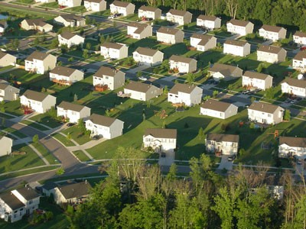
Residential Land Use is Expanding
Suburban areas: surround metropolitan areas
U.S. is undergoing a rapid increase in suburban development and population
Exurban areas: suburban areas that are not connected to any central city

Slide 5
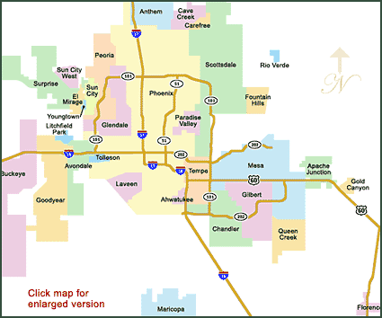
Urban Sprawl
Emigration of people out of the city and into the suburbs
Removes boundaries between urban rural areas

Slide 6
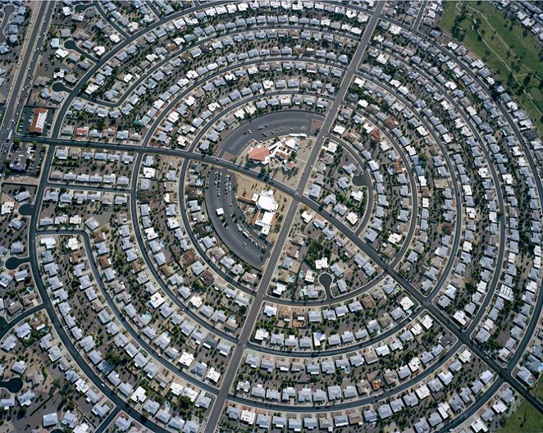
Urban Sprawl Causes
Automobile and highway construction:
People can work in the city but live in the suburbs
Main cause of the growth of suburbs and urban areas
Living Costs:
Get more land and a larger house for the same amount of money
Taxes can be lower

Slide 7
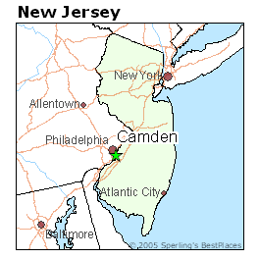
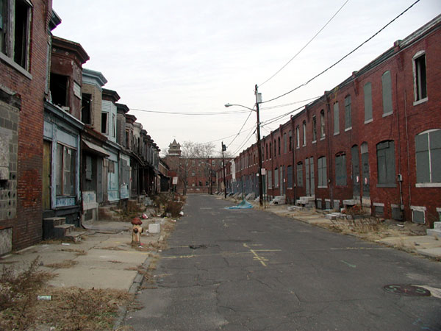
Urban Sprawl Causes
Urban Blight:
Population shifts to the suburbs → tax base shrinks→
Smaller tax base→ services decline→ increase in crime rates
Jobs and services follow population to the suburbs
Urban stores lose customers
People have fewer reasons to go to the city and shop

Slide 8
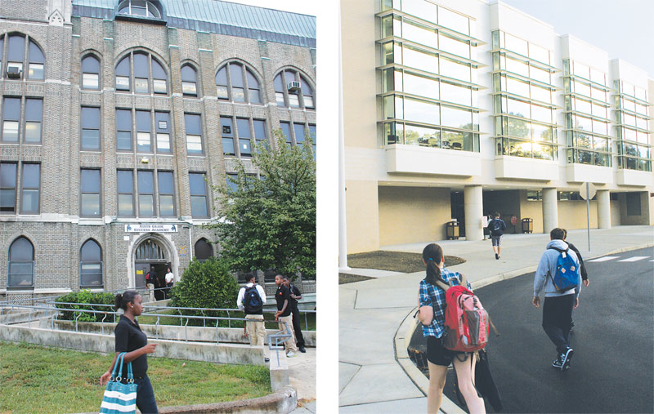
Urban Blight
“White flight” to suburbs
Minority populations remained in city
Higher suburban property taxes → better schools→ increased disparity

Slide 9
Urban Sprawl
Government policies that contributed to urban sprawl:
Highway trust fund: fund the construction and maintenance of roads and highways
Induced demand: increase gas tax revenues→ more highway construction→ suburbs expands→ increased traffic→ longer commutes→ more gas used

Slide 10
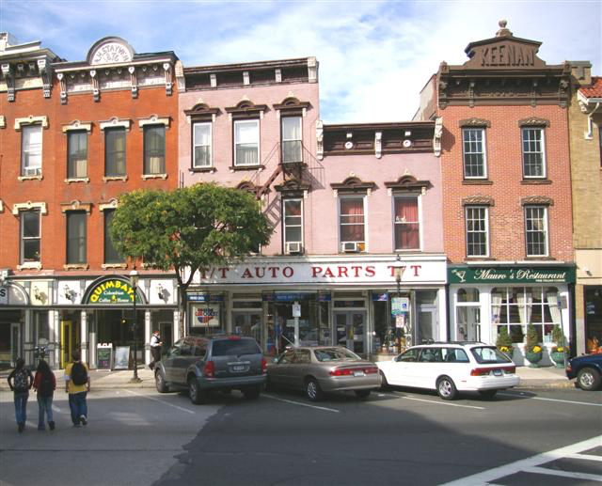
Urban Sprawl
Government Policies:
Zoning: Separate business/industry from residential neighborhoods
Multi-use zoning: allows retail and residential development to coexist in the same area
Federal Housing Administration: people could apply for federally subsidized mortgages in suburbs
GI Bill: credit to war veterans for mortgages

Slide 11
Smart Growth
Mixed land uses: residential, education, recreation, and business land use
Create a range of housing opportunities: provide housing for people of all income levels
Create walkable neighborhoods:
Less fossil fuel use
More interactions among neighbors
Encourage community and stakeholder collaboration: residents determine how their neighborhood will appear and be structured

Slide 12
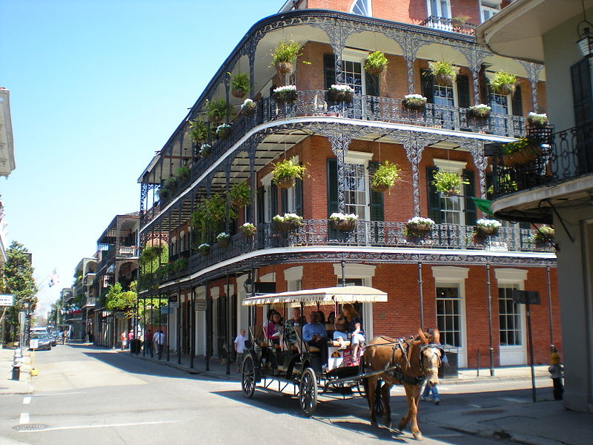
Smart Growth
Take advantage of compact building design: Less space→ reduce environmental footprint
Foster communities with a strong sense of place
Preserve open space, farmland and natural beauty

Slide 13
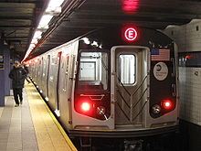
Smart Growth
Transit Oriented Development: focuses dense residential and retail development around stops for public transportation
Strengthen and direct development towards existing communities:
Infill: fill in existing lots rather than rather than expanding into new land outside the city
Make development decisions predictable, fair and cost-effective

Slide 14
Why does smart growth matter?
Less water pollution
Lower carbon footprint
Safer, better communities

Slide 15
Homework
Study for the quiz tomorrow!
Start reading Ch. 11 through page 288

