Slide 1
SWBAT evaluate the effectiveness of fire suppression policies.
APES Unit 8 2/3/16

Slide 2
Agenda
Lecture
Video

Slide 3
Announcements
Ch. 10 Quiz on Friday
Pick up review book!
Salinization lab design: Come up at lunch!

Slide 4
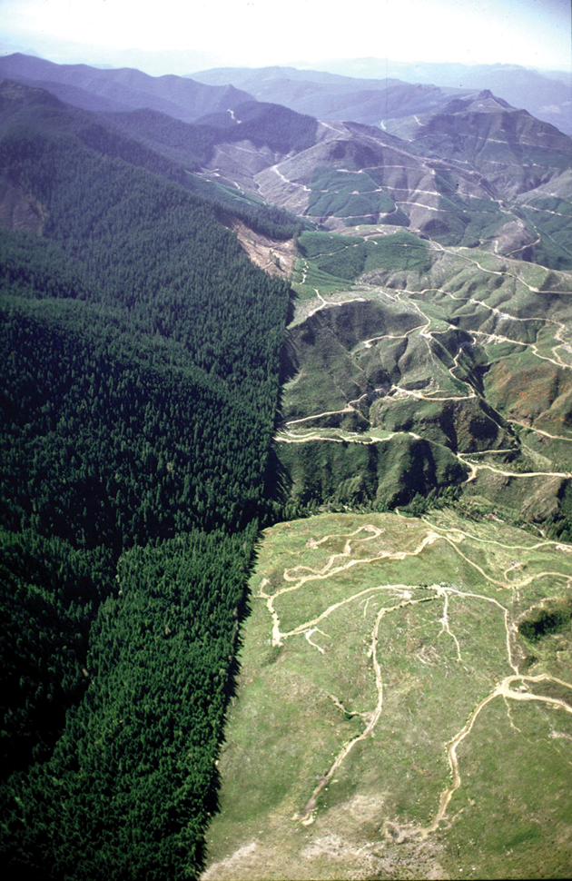
Unsustainable logging is a major threat to forest ecosystems
Silviculture: management of forest plantations for the purpose of harvesting timber
Humans should only harvest as many trees as they can replace through planting

Slide 5
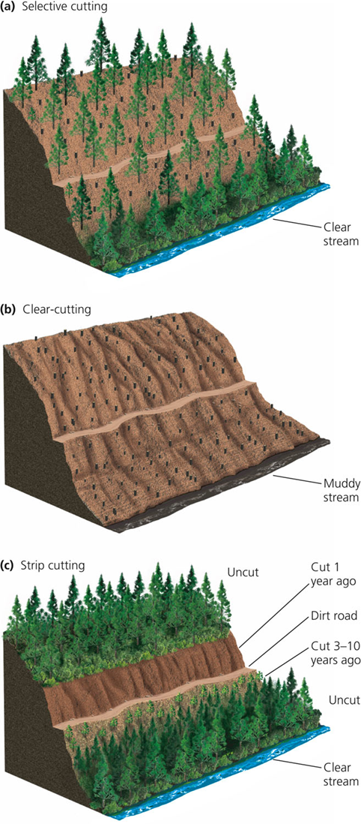
Types of logging
Selective cutting: cutting down only mature trees
Clear cutting: cutting down all trees
Tons of soil erosion
Strip cutting: designed to mimic natural regrowth of a forest
Most environmentally friendly

Slide 6
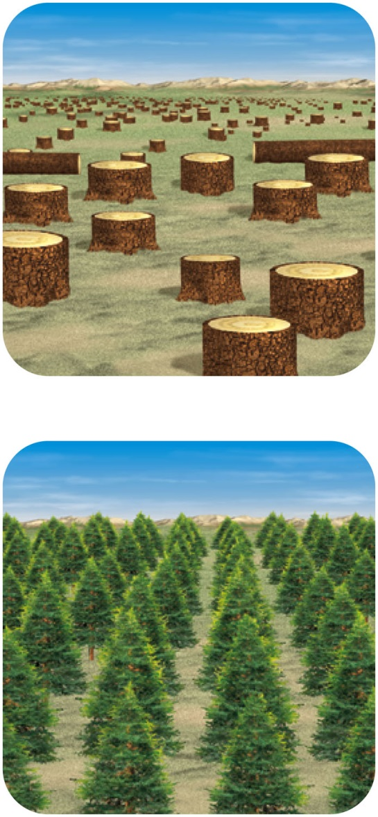
Trade-Offs: Clear-Cutting forests
Advantages:
Higher timber yields
Maximum profit in short time
Can reforest with fast-growing trees
Disadvantages:
Reduces biodiversity
Destroys fragments and habitats
Increases water pollution, flooding and erosion

Slide 7
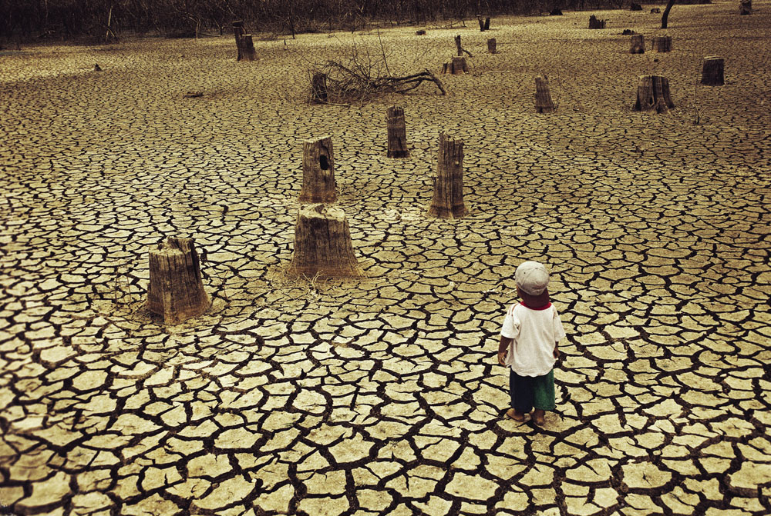
Causes of Tropical Deforestation Are Varied and Complex
Population growth
Poverty of subsistence farmers
Ranching
Lumber
Plantation farms: palm oil
Brazilian Amazon
Extreme Tropical Deforestation in Thailand

Slide 8
Logging, Deforestation and Reforestation
Tree plantation: large areas planted with a single rapidly growing tree species
Never develop into mature, ecologically diverse forests

Slide 9
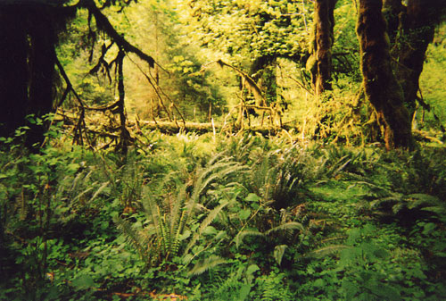
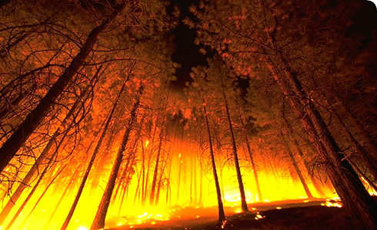
Fire Suppression Policies

Slide 10
Fire Management
Advantages of forest fires:
Liberate nutrients tied up in dead biomass
Provide openings for early successional species
Fire suppression policies lead to:
Accumulation of combustible materials (leaf litter, debris, etc.)
Increase in understory growth (grasses, shrubs, brush ladder)
Higher tree density

Slide 11
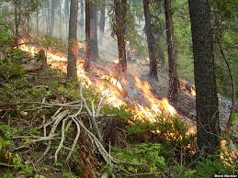
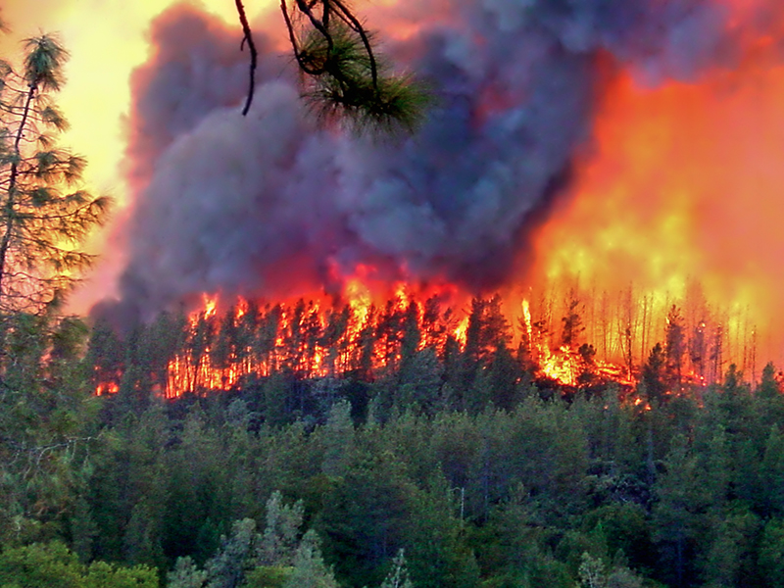
Natural Events in Forests
Surface fires: burn only underbrush and do little damage to the mature trees
Can protect forests from more harmful fires
Crown fires: May start on the ground or in the canopies of forests
Spread quickly and have high temperatures
Threat to wildlife, human life and property
Ground fires: take place in bogs or swamps and can burn underground for days or weeks

Slide 12
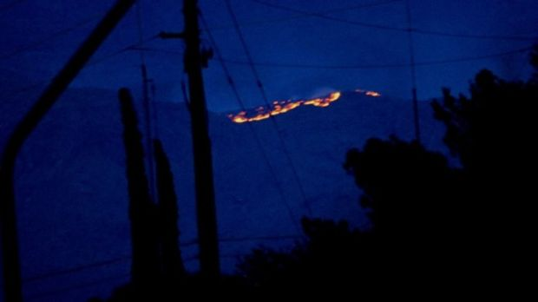
Fire Suppression Policies
Increased fire risk due to fire suppression policies:
Increased leaf litter and understory→ adds to amount of debris that can burn quickly
Increased density of trees → adds to spreading of fire

Slide 13
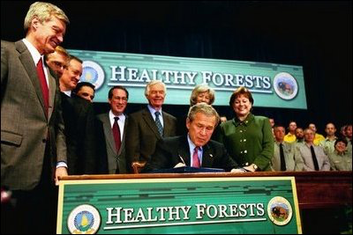
Case Study: Healthy Forests Initiative

Slide 14
Healthy Forests Initiative
Timber companies are encouraged to harvest medium and large size trees in federally owned forests
Aim: reduce forest fires
Positive effect:
lead to economic growth in the lumber industry
Negative effect:
Reduce available habitat
Reduce biodiversity
Increase soil erosion

Slide 15
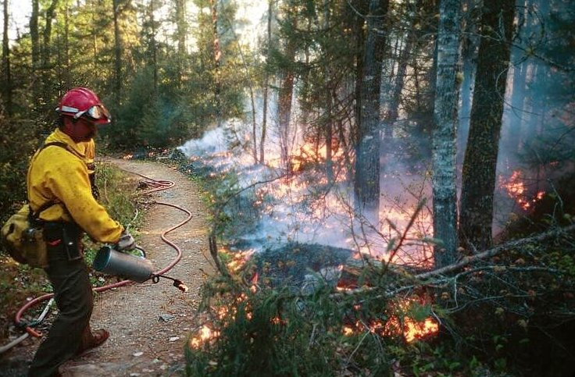
Fire Management
Prescribed burn: A fire is deliberately set under controlled conditions
Reduces the risk of uncontrolled natural fires

Slide 16
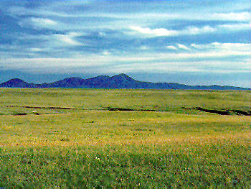
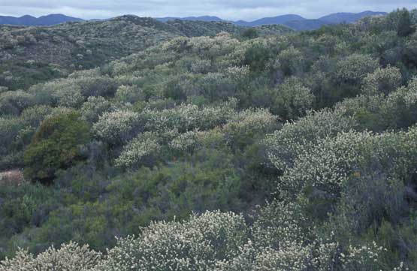
Fire Management
Biomes (besides forests) that are naturally maintained by fires
Grasslands
Fires can destroy invasive plant species
Fire enhances cycling of nutrients back into soil
Chaparral:
Fire removes brush, reduces competition for resources

Slide 17
Wildlife Refuges and Wilderness Areas
National wildlife refuges: The only federal public lands managed for the primary purpose of protecting wildlife
National wilderness areas: Large tracts of intact ecosystems or landscapes
Permit limited human use

Slide 18
Federal Regulation of Land Use
National Environmental Policy Act (NEPA): mandates environmental assessment of all projects involving federal money or permits
Environmental Impact Statement (EIS):
Summarizes environmental impact of a proposed project
Must take into account impact on endangered species

Slide 19
National Forest Policy
Wilderness Act (1964): established review of road-free areas of 5,000 acres or more within national wildlife refuges or the national park system for inclusion in the national preservation system
Wild and Scenic Rivers Act: Established a National Wild and Scenic Rivers System for the protection of rivers

Slide 20
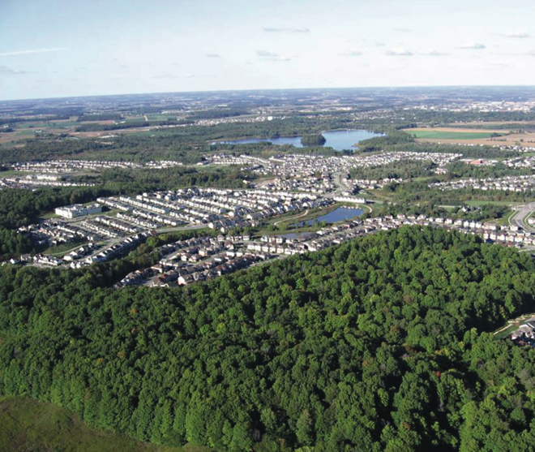
Greenbelts
Open or forested areas built at the outer edge of a city
Building not permitted
May increase quality of life for people living nearby
Can limit the growth of cities

Slide 21
Homework
Forestry FRQ
Finish reading Ch. 10

