Slide 1
SWBAT define waste generation from an ecological and waste systems perspective.
APES Unit 10 3/7/16

Slide 2
Unit 10: Waste and Toxicity
2 Weeks
Ch. 16 Waste Generation and Waste Disposal
Ch. 17 Human Health and Environmental Risks
Lab: LD ₅₀
EQs:
How does our culture embrace a throw-away society?
How can we reuse trash?
How does our way of life affect our health?
Current event presentations: Wendy and Saliha on Tues. the 15th (email me the topic by this Friday)

Slide 3
Agenda
Lecture
Pass back work
Videos:
E-waste
The Story of Stuff
Reminder: Make up Unit 9 exam today and tomorrow!

Slide 4
The Solid Waste System
Waste: a component of a human-dominated system in which products are manufactured, used, and eventually disposed.
Humans are the only organism that produce waste that others cannot use
The average person produces approximately 5 pounds of waste per day

Slide 5
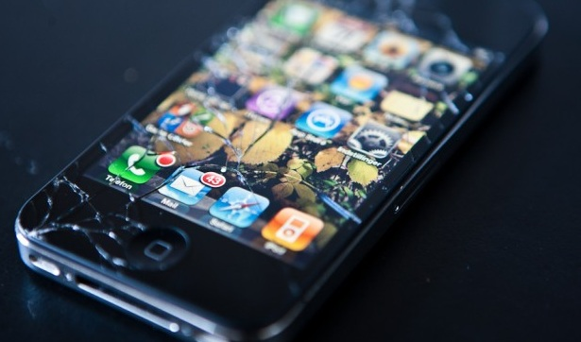
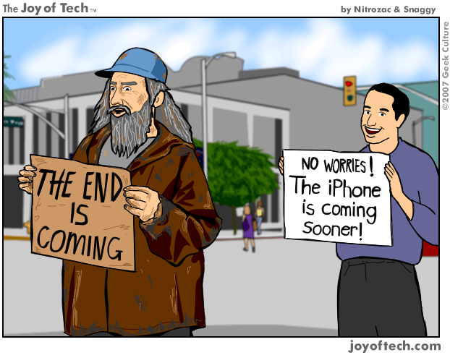
Throw-Away Society
Wealthier country→ more waste
Industrialization→ increased wealth→ items purchased can be thrown away
Planned obsolescence: designing a product so that it will need to be replaced in a few years

Slide 6
U.S. and the throw-away society
The US is home to approximately 5% of the world's population but produces 33% of the world's total waste
Municipal solid waste (MSW): trash collected by municipalities (town or city that has a local government) from households, small businesses, and institutions.
Majority is sent to sanitary landfills

Slide 7
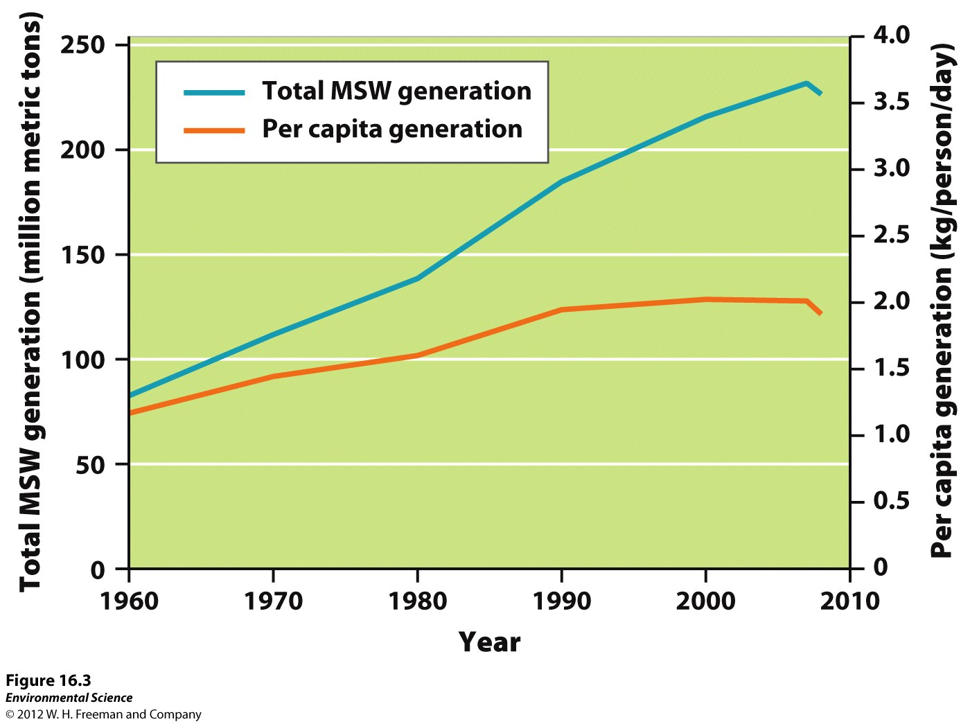
Municipal Waste

Slide 8
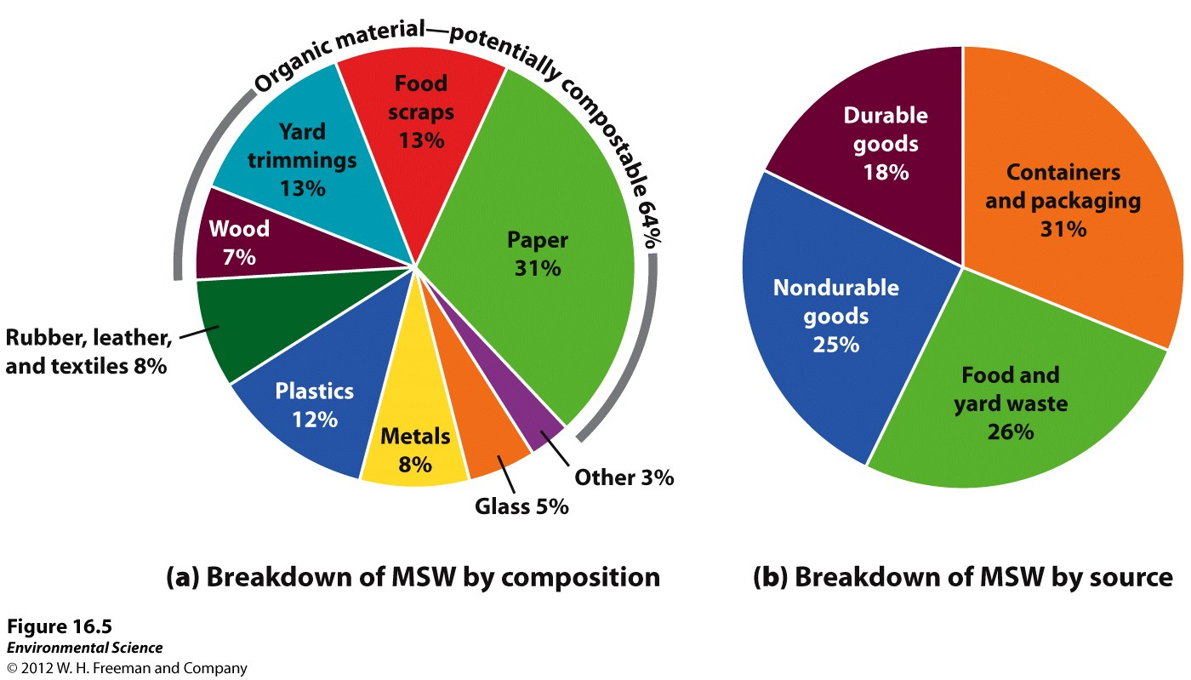
Waste types
Agricultural waste
Mining waste
Industrial waste
The largest portion of municipal solid waste produced in the U.S. is paper

Slide 9
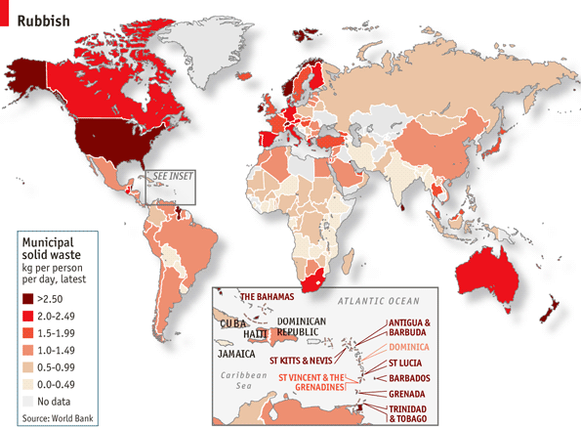

Slide 10
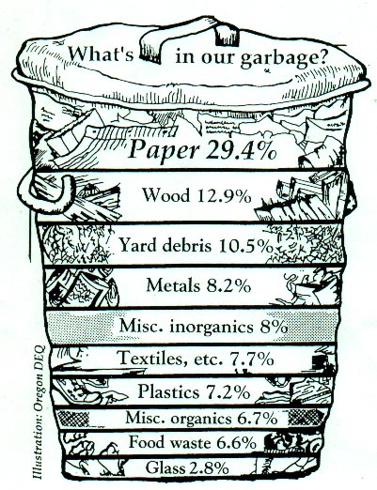
Content of the solid waste stream
Waste Stream: the flow of solid waste that is recycled, incinerated or placed in a solid waste landfill.
Nondurable goods: disposable (paper, plastic)
Durable goods: Last for years (appliances, tires)
Compostable goods: Made up of organics matter and can decompose

Slide 11
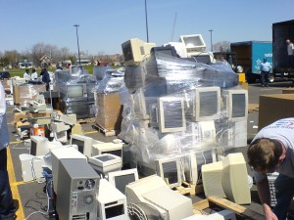
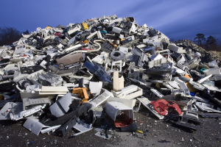
E-Waste
Only 2% of waste stream but HUGE environmental impact.
May contain heavy metals such as lead or mercury
Large amount of E-waste sent to china
Adults and children separate valuable metals with little protective gear

Slide 12
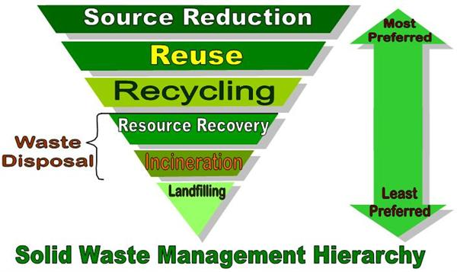
Reduce, Reuse, Recycle
Reduce (waste minimization or waste prevention)
Source reduction: reduce the use of materials that will become MSW
Examples: double-sided printing, electronically downloading songs instead of CDs
Most environmentally sound method of waste disposal

Slide 13
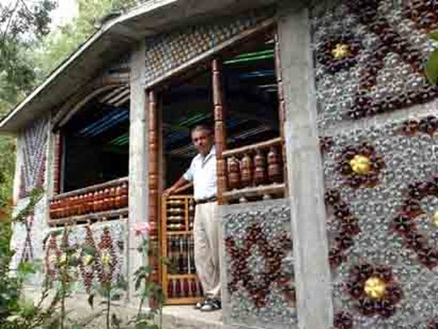
Reduce, Reuse, Recycle
Reuse: material cycles longer within a system before becoming an output
Some energy may need to be used

Slide 14
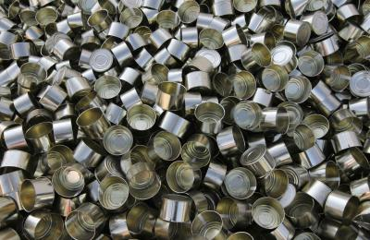
Reduce, Reuse, Recycle
Recycle: materials destined to become MSW are collected and converted into raw materials that are then used to produce new objects.
Close-loop (primary) recycling: recycling of a product into the same product.
Open-loop (secondary) recycling: materials are used to form new products that are usually lower quality
Reduces greenhouse gas emissions

Slide 15
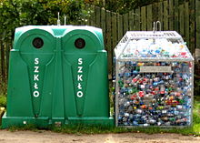
Recycling
Items that can be recycled:
Paper
Cardboard
Aluminum cans
Appliances
Electronics
Batteries
Plastic bottles
Glass

Slide 16
Checkpoint
What are the three Rs? What are the benefits and disadvantages of each?
What is the difference between open and closed-loop recycling?

Slide 17
E-Waste Video Recap
Why are we sending our E-Waste overseas?
How can it harm workers?

Slide 18
Homework
Read Ch. 16 through page 452 (stop right before hazardous waste)
Research two specific ways we can reduce the amount of E-waste
Unit 8 exam FRQ rewrite due on Friday

