Slide 1
SWBAT identify ways in which public lands are used.
APES Unit 8 2/2/16

Slide 2
Agenda:
Lecture
Pass Back Midterms and U.N. Reports
Reading
Reminders:
Come up at lunch TODAY if you were absent on Friday
Pick up Barron’s review book after school

Slide 3
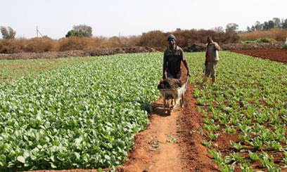
Unit 8: Land and Food
~ 2 weeks
Ch. 10 and 11
Soil Salinization Inquiry lab
EQs:
How does agriculture and our food choices impact the environment?
What role do GMOs play in feeding the world?
Current event presentations: Mahnoor and Wyllana on Feb. 23rd

Slide 4
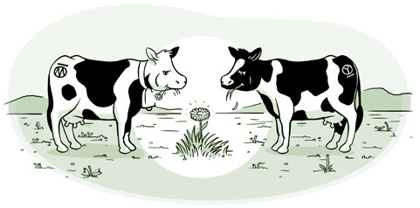
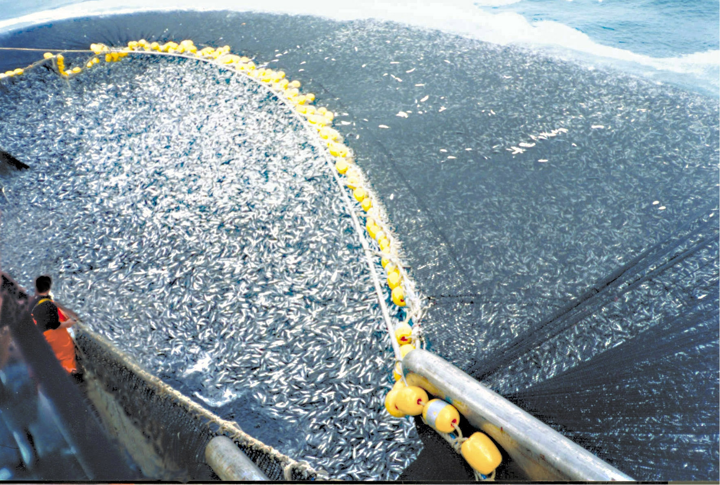
Tragedy of the Commons
Paper published by Garret Hardin in 1968
Shared, limited resource becomes depleted because people act from self-interest for short-term gain
Product of scarcity and ownership

Slide 5
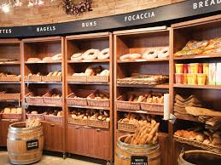
Externalities
Cost of benefit of a good not included in the price
Negative externalities→ serious environmental damage

Slide 6
Turn and Talk
How is the tragedy of the commons related to externalities?

Slide 7
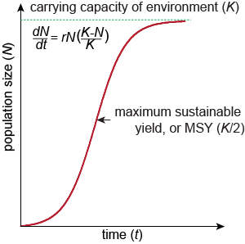
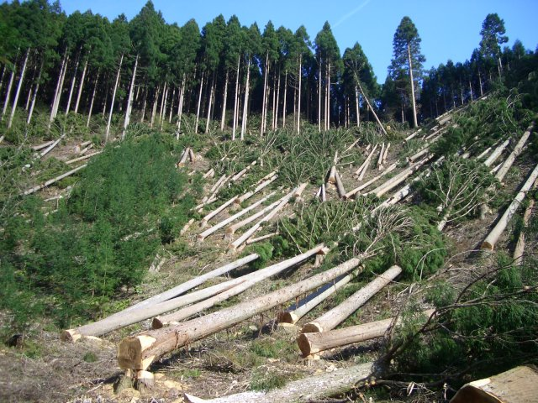
Maximum Sustainable Yield
Maximum amount of resource that can be harvested without compromising the future availability of the resource.
In theory, MSY should be about half of carrying capacity

Slide 8
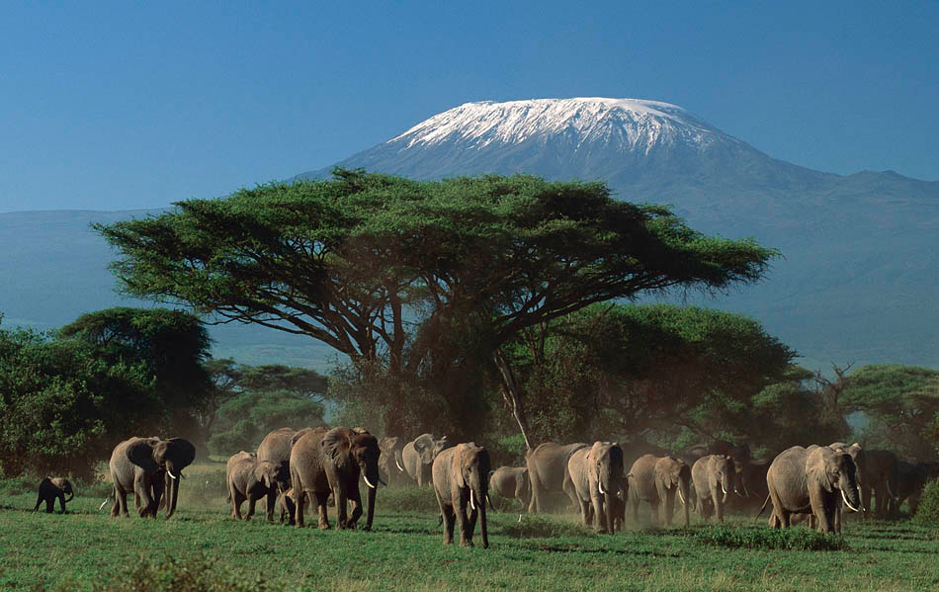
International Categories of Public Lands
National Parks:
Can be used for education, scientific or recreational use
Not used for extraction of natural resources
Managed Resource Protected Areas:
Use of biological mineral and recreational resources in a sustainable way

Slide 9
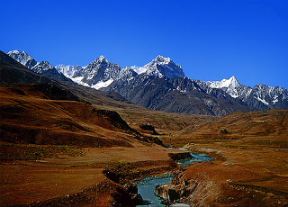
International Categories of Public Lands
Habitat/Species management areas:
Managed to maintain biological communities
Nature reserves and wilderness areas:
Established to protect species and ecosystems
Protected landscapes and seascapes
Orchards, villages and beaches
National monuments
Protect land of cultural interest

Slide 10
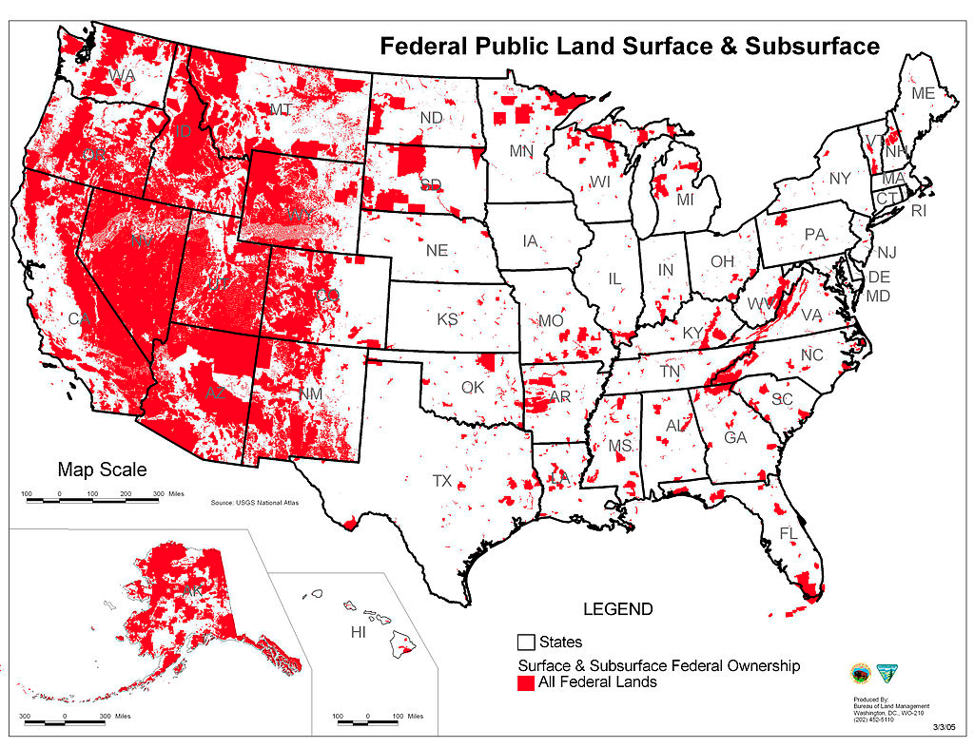
Public Lands in the U.S.
Federal government largest single land owner in the U.S.

Slide 11
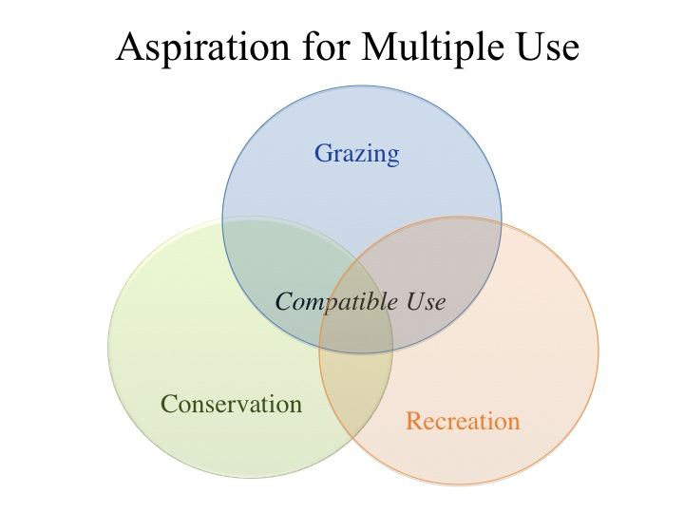
Public Lands in the U.S.
Resource Conservation Ethic: maximize resource use based on the greatest good for everyone
Multiple-use lands:
Can be used for grazing, timber, or mineral extraction

Slide 12
Federal Agencies
Bureau of Land Management (BLM):
Grazing, mining, timber harvesting and recreation
Administers areas of critical environmental concern and conservation areas
United States Forest Service:
Allow logging with a permit
Most jobs are associated with recreation
National park service
Recreation and conservation
Administers national parks, battlefields, monuments and seashores
Fish and Wildlife Service (FWS)
Wildlife conservation, hunting and recreation

Slide 13
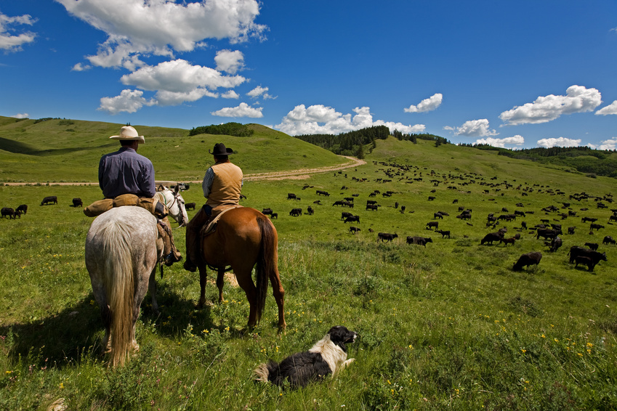
Rangelands
Dry, open grasslands
NOT plowed or planted
Benefits of rangelands
Less fossil fuel use than CAFOs
Cattle and sheep can be raised on lands that are too dry to farm
Disadvantages of rangelands:
Overgrazing can strip an area of vegetation

Slide 14
Rangelands
Ways to conserve rangelands from grassland overgrazing:
Fencing off damaged rangeland
Moving livestock
Protecting an area of land for 2 years before allowing grazing
Situating water holes at strategic locations
Taylor Grazing Act of 1934: permit-based system to limit the number of animals grazing in a particular area

Slide 15
Forests
Natural Capital
Ecological Services:
Reduce soil erosion
Nutrient cycling
Absorb, release, and purify water and air
Influence climate by storing carbon
Provide Habitats
Economic Services:
Fuelwood
Lumber
Pulp to make paper
Recreation
Jobs

Slide 16
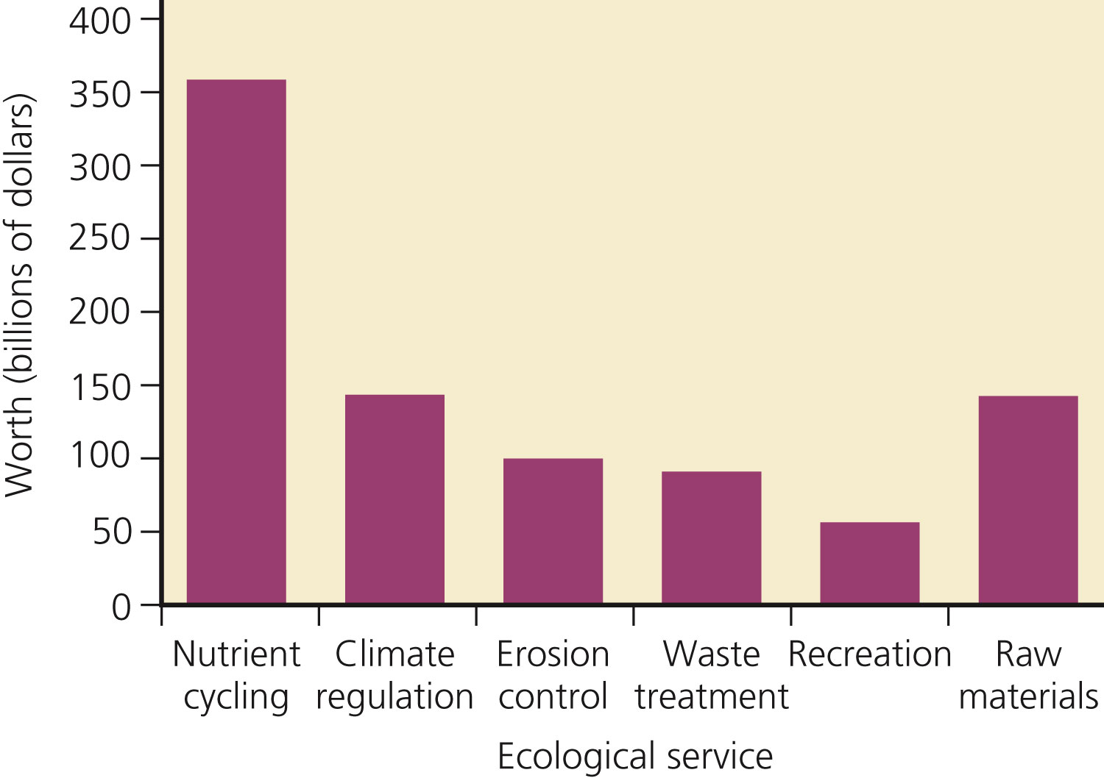
Estimated Annual Global Economic Values of Ecological Services Provided by Forests
Fig. 10-A, p. 221
Notes:
Figure 10.A: This chart shows estimates of the annual global economic values of some ecological services provided by forests compared to the raw materials they produce (in billions of dollars). (Data from Robert Costanza)

Slide 17
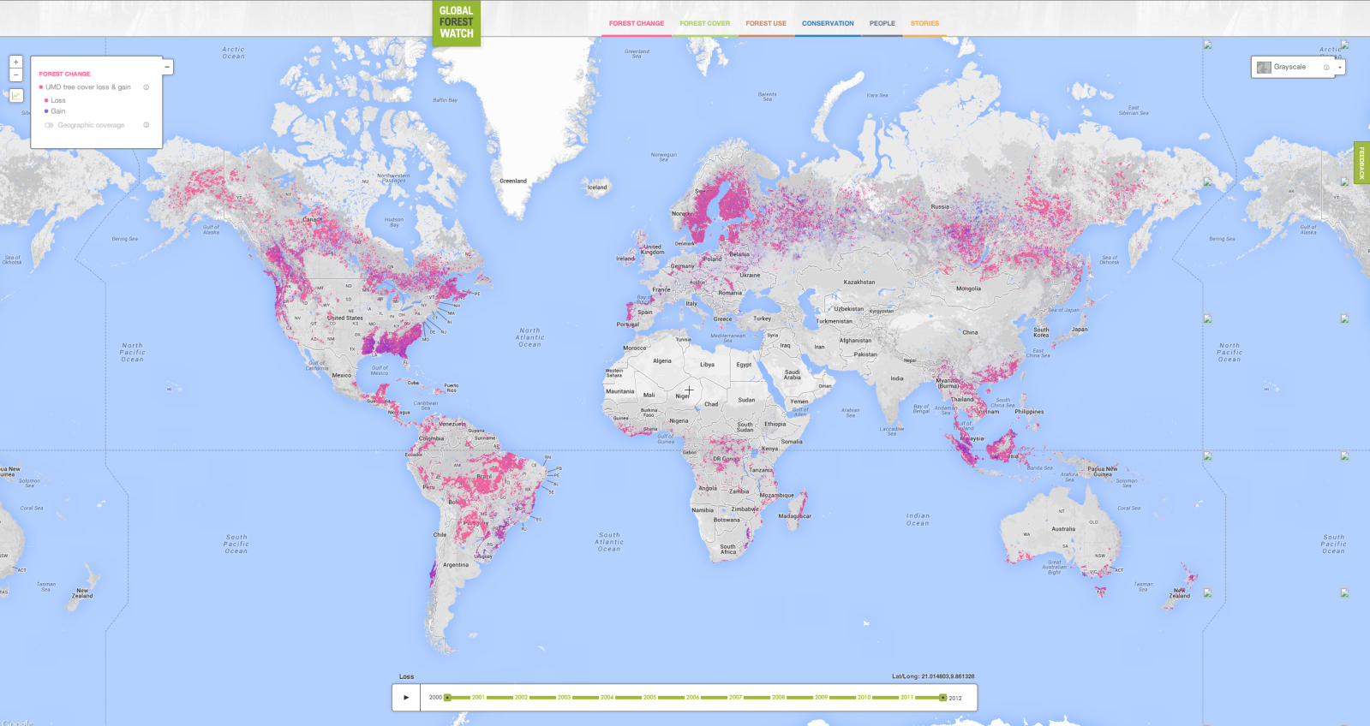
Global Forest Watch
230 million hectares of trees lost between 2000 and 2012 alone!
Hectare: a metric unit, equal to 100 square acres
Greatest rate of deforestation currently in Asia

Slide 18
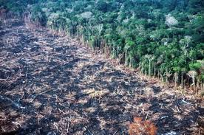
How does deforestation lead to enhanced climate change?
Less Photosynthesis = less CO2 absorbed
More leaf litter= more CO2 released during decay

Slide 19
Checkpoint
What are the main uses of public lands in the US?

Slide 20
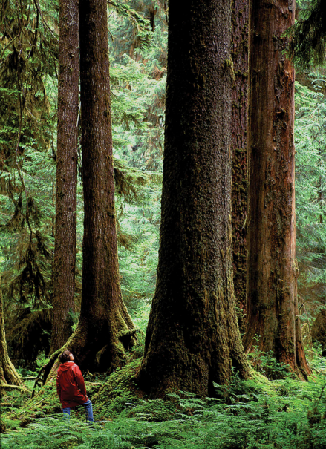
Forests Vary in Their Make-Up, Age, and Origins
Old-growth, virgin forests, or primary forest (36%)
Undisturbed for 100s of years
Large numbers of standing trees and fallen logs
Reservoirs of biodiversity
Second-growth forest (60%)
Secondary ecological succession
Tree plantation, (tree farm, commercial forest) (4%)
May supply most industrial wood in the future

Slide 21
Population U.N. Growth reports
Glows:
Reading the rubric and following specific format of report
In text citations
Variety of sources
Grows:
Organization
Shout outs:
Innovative solution: Rahila
Organization: Mahnoor
Quantity and quality of research: Rimsha and Ramlah

Slide 22
Homework
Read until page 273 in the textbook (stop right before “residential land use is expanding”)

