Slide 1
SWBAT review air pollution.
APES 4/20/16

Slide 2
Agenda
Carousel: Air Pollution
Reminder: Lunch review!
You guys were great yesterday ☺

Slide 3
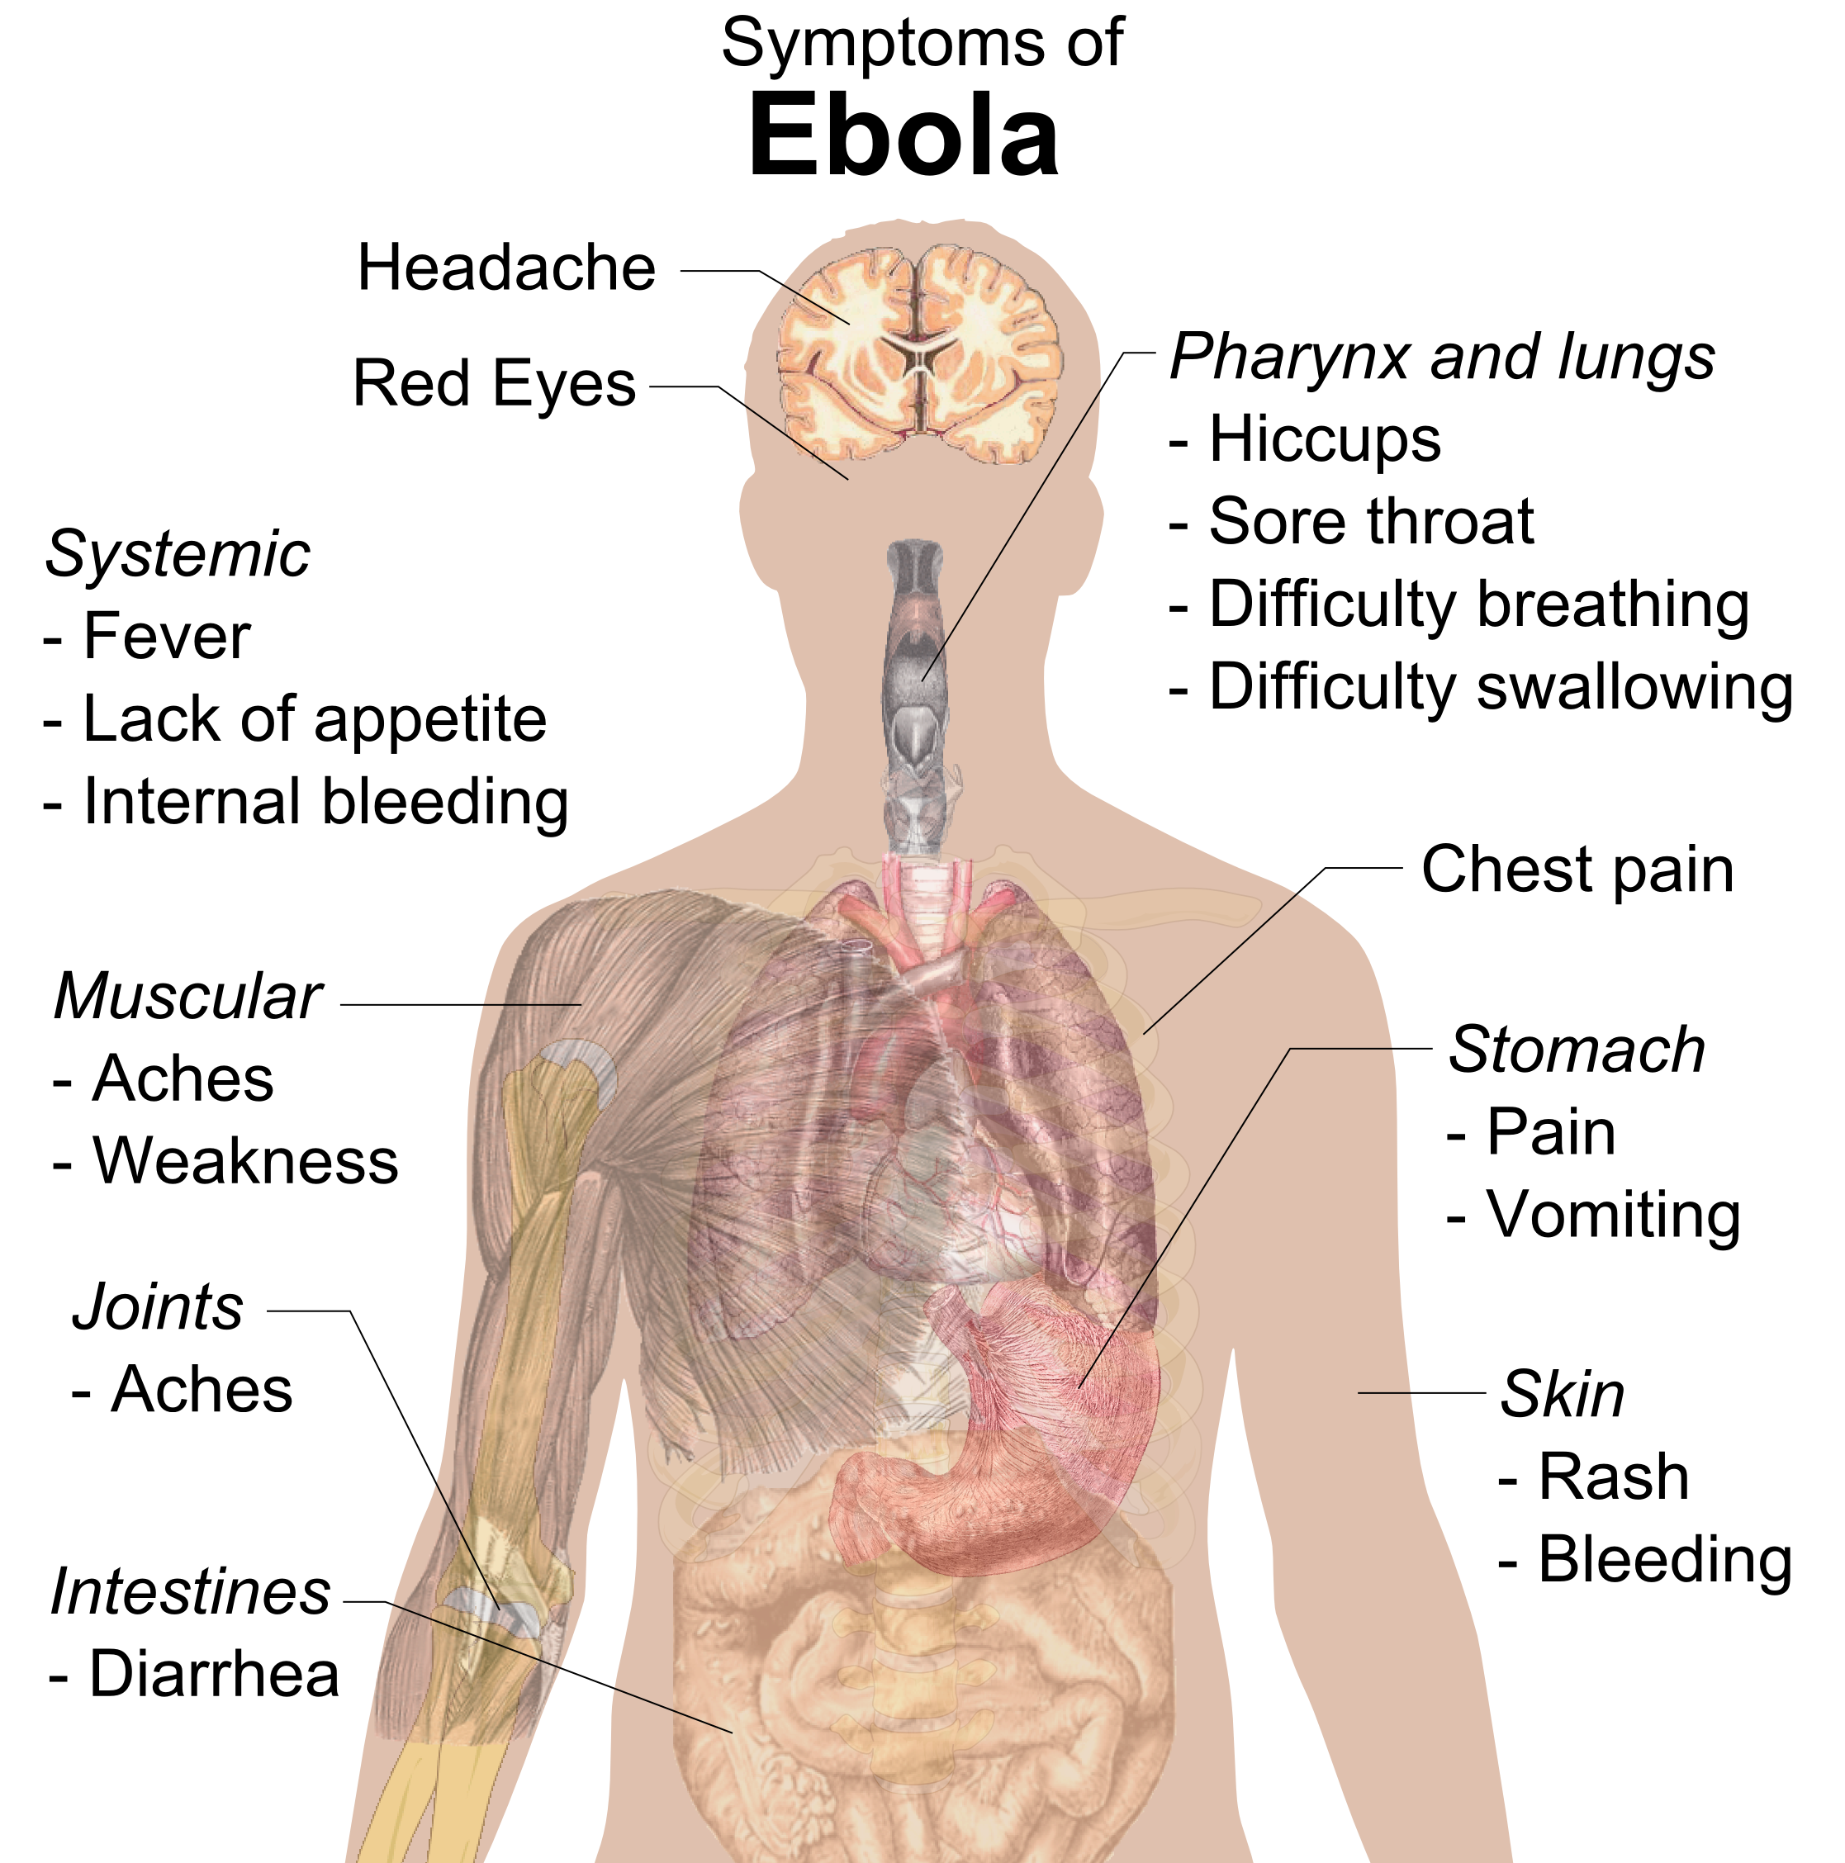
Diseases FRQ

Slide 4
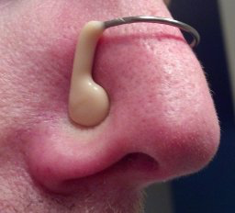
The Major Culprits (Criteria Pollutants) Remember: NOS CLP
Nitrogen Dioxide (NO₂)
Ozone (O₃)
Sulfur Dioxide (SO₂)
Carbon Monoxide (CO)
Lead (Pb)
Particulate Matter (PM)

Slide 5
Carousel
What are the causes? What are the effects?
Acid Deposition
Brown and Gray Smog
Lead, Particulate matter, and mercury
Indoor Air Pollution
Natural Sources of Air Pollution
Urban Heat Island and Thermal Inversion

Slide 6
Sulfate Aerosols

Slide 7
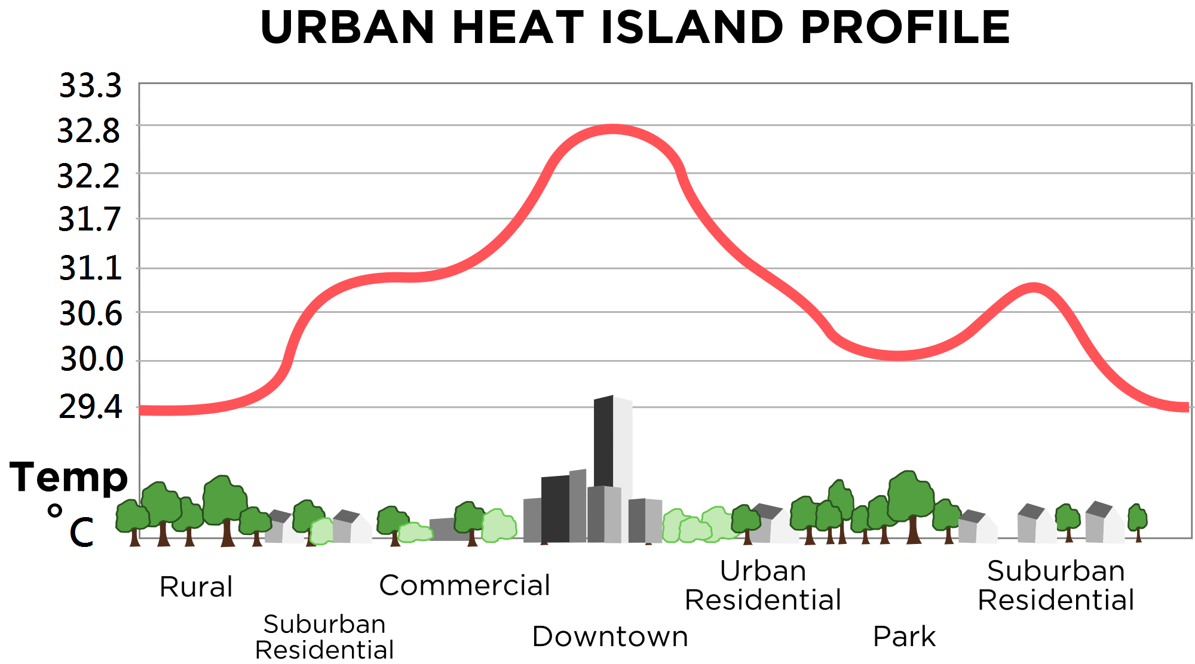
Urban Heat Island Profile

Slide 8
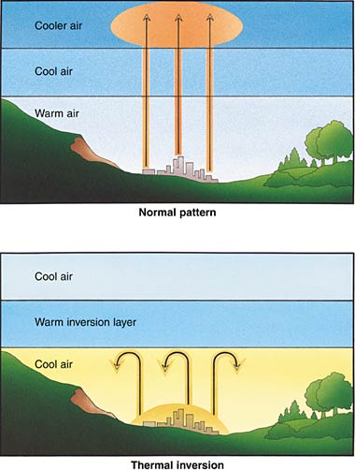

Slide 9
SWBAT review the what causes the ozone hole.
Agenda:
Dry Run
MC practice

Slide 10
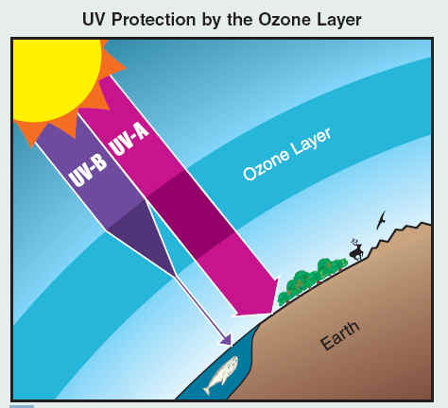
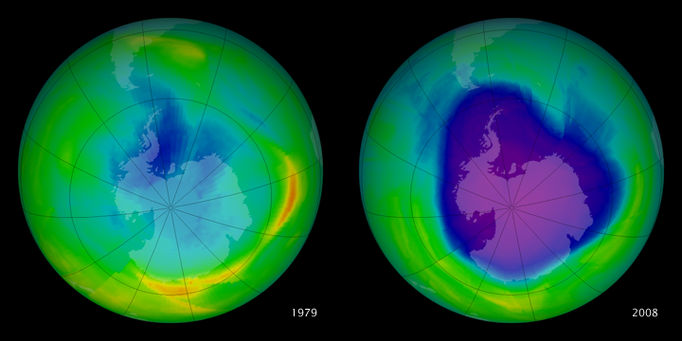
Dry Run: Ozone Hole
CFCs
Montreal Protocol
UV light
Ecosystem effects
Health effects

Slide 11
Studying Over Spring Break
Take out your planner!
Plan in when you are going to study
Plan in when you will do FRQ reflections #10-16
2 hours each day
Ways to review:
APES in a box videos
Flashcards
Barron’s MC
Practice dry runs on your own

