Slide 1
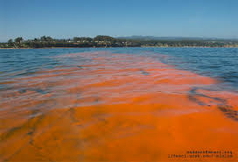
SWBAT review water pollution.
APES 4/18/16

Slide 2
Agenda:
Review Unit 11 FRQ answers
Dry Runs
Reminders:
Bubbling after school today!
Lunch review today and Wed!
You will have to carry around your binders tomorrow

Slide 3
Unit 11 Exams
Glows:
HUGE improvement on the math!!
Grows:
Remember to always include units!
Make sure you’re reading the question carefully ( i.e. if it asks for two examples give two examples)
The difference between modern and ancient carbon

Slide 4
What can Uncle Sam do?
Things the government can ALWAYS do:
Provide or increase/decrease taxes
Subsidize something
Run educational campaigns through commercials/ads or Public service announcements (PSAs)
Things the government can’t do:
Increase or decrease the price of BEV

Slide 5
More Practice
Discuss one environmental advantage of using biodiesel from microalgae rather than from crops:
Less land use
Less pesticide/fertilizer use
Discuss one advantage of increased use of biodiesel
Less reliance on fossil fuels of foreign countries

Slide 6
Dry Run: Water Pollution
Agriculture biggest source of water pollution (sediments + excess nutrients)
Toxic waste
Eutrophication
Algae blooms/red tides
Hypoxia→ fish kills
(fecal) Coliform bacteria
Standing bodies of water and ground water struggle to recover from water pollution
Thermal pollution: from electricity plants and nuclear power plants

Slide 7
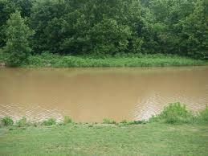
Water Quality Tests
Chemical:
pH
Hardness (measure calcium and magnesium)
Dissolved Oxygen
BOD (rate at which bacteria absorbs oxygen from the water)
High = lots of pollution
Low = little pollution
Physical:
Turbidity: density of suspended particles in the water
Biological:
Macoinvertebrates
Fecal coliform bacteria

Slide 8
Dry Run: Waste Water Treatment Plants
Primary Treatment:
Suspended solids, debris (sticks, leaves, etc.), solid human or animal waste
Fats and oil
Secondary Treatment:
Dissolved organic material
Sugar
Phosphates and nitrate
Uses bacteria
Disinfection:
Pathogens
Uses chlorine, UV or ozone

Slide 9
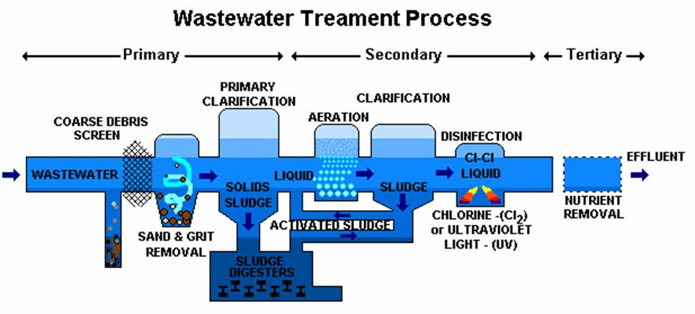

Slide 10
SWBAT review solid waste pollution and Toxicology.
APES 4/18/16

Slide 11
Agenda
Carousel activity
MC

Slide 12
Carousel Activity
Directions: Provide concrete examples and specific definitions– no drawings!
Types of Solid Waste
Organic
Radioactive waste
Recyclable
toxic
Landfills and Incinerators
MSW
NIMBY
Leachate
methane
Hazardous Waste, Superfund Sites, Brownfields
Phytoremedation
The Superfund Act
Reduce, reuse, recycle
Cradle to cradle and cradle to grave
Integrated waste management
Diseases
Hazardous Chemicals
Mutagens, teratogens, endocrine disruptors, neurotoxins, allergens
Innocent until proven guilty theory

