Slide 1
SWBAT review Biogeochemical Cycles.
APES 4/20/15

Slide 2
Agenda
Review California drought FRQ
Dry Runs: biogeochemical cycles
Pass Back Unit 8 Exams
Take home your binders today!

Slide 3
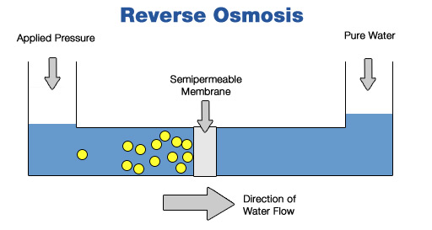
Desalination

Slide 4
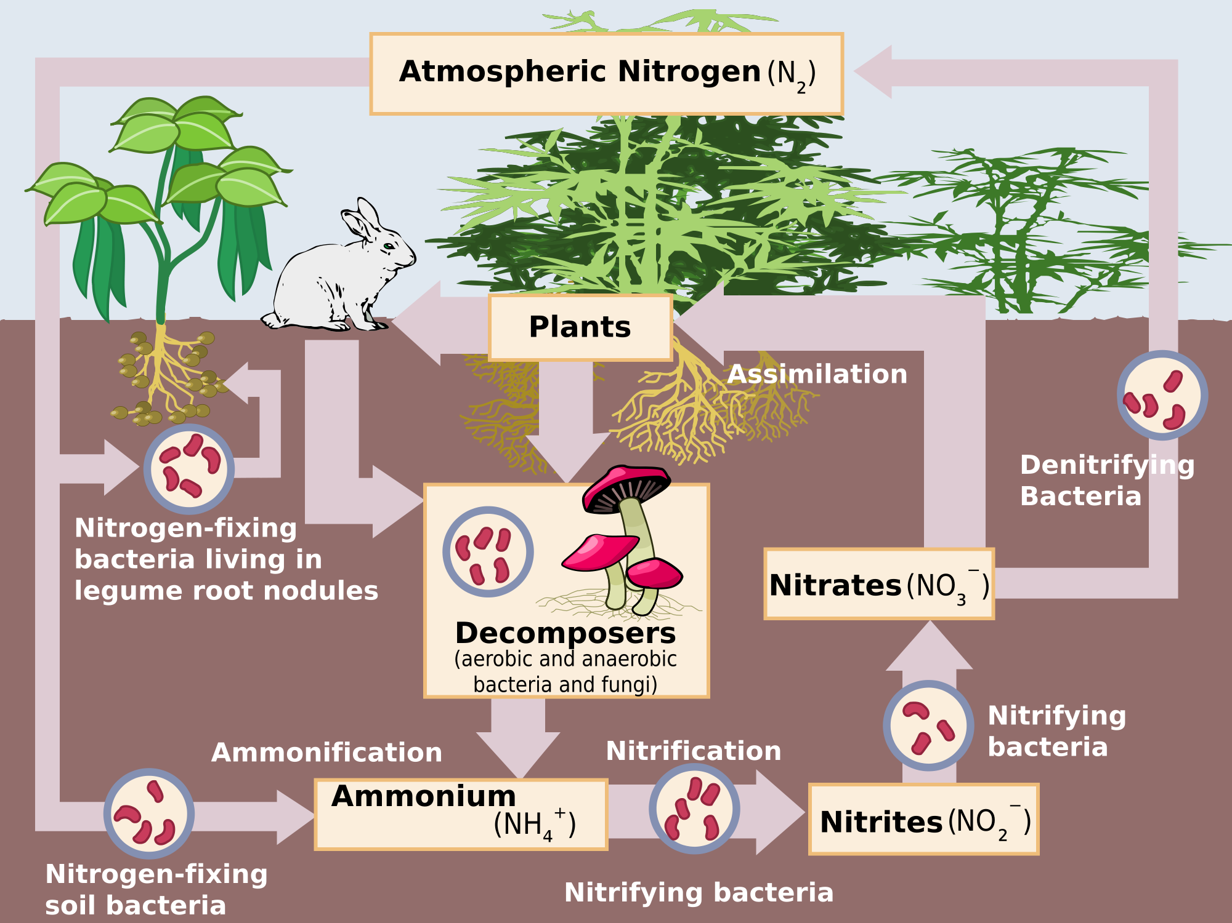
Dry Run: Nitrogen Cycle

Slide 5
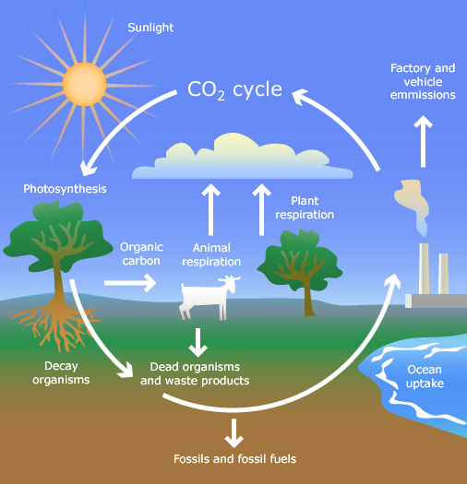
Dry Run: Carbon Cycle

Slide 6
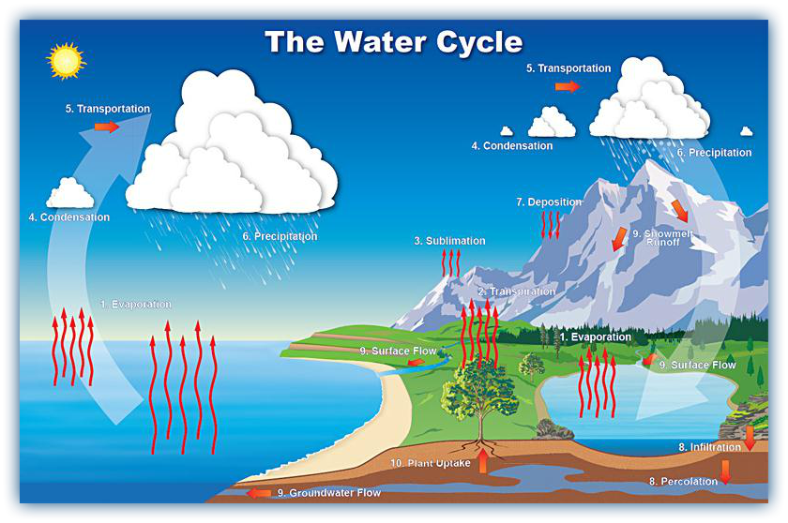
Dry Run: Water Cycle

Slide 7
Unit 8 Exams
Glows:
HUGE improvement on the math!!
Grows:
Remember to always include units!
Make sure you’re reading the question carefully ( i.e. if it asks for two examples give two examples)
The difference between modern and ancient carbon

Slide 8
What can Uncle Sam do?
Things the government can ALWAYS do:
Provide or increase/decrease taxes
Subsidize something
Run educational campaigns through commercials/ads or Public service announcements (PSAs)
Things the government can’t do:
Increase or decrease the price of BEV

Slide 9
More Practice
Discuss one environmental advantage of using biodiesel from microalgae rather than from crops:
Less land use
Less pesticide/fertilizer use
Discuss one advantage of increased use of biodiesel
Less reliance on fossil fuels of foreign countries

Slide 10
Hw:
Take home your binders!!!
FRQ rewrite due Tuesday

