Slide 1
SWBAT review ecosystems and math.
APES 4/11/16

Slide 2
Agenda:
Carousel activity- ecology review
MC questions
Math!

Slide 3
Announcements
Bubbling after school next Monday ( 4/18)
Mock exam after school tomorrow!
No final exam ☺
Come up at lunch tomorrow or before school to help with my room
Take home binders on Tuesday

Slide 4
Carousel Activity
Topics:
Keystone species/indicator species/endangered species
Aquatic biomes
Land biomes (not wetlands)
Wetlands
Biodiversity and Ecosystem Productivity
R vs. K selected species
Succession
Evolution
Ecosystem services

Slide 5
Euphotic vs. aphotic

Slide 6
Math Groups!

Slide 7
Math Problems
Sample problem #4
Sample problem #5
Sample problem #7
No Calculators ☺

Slide 8
Human Population Growth Review
Do Now:
Describe two ways human population growth will impact the environment

Slide 9
Agenda
MC
Carousel activity

Slide 10
Carousel Activity Topics
The Demographic Transition Model
Age Structure Diagrams
Examples of countries with each age structure graph
Carrying Capacity
Impacts of population growth
Strategies for lowering TFR
Survivorship Curves

Slide 11
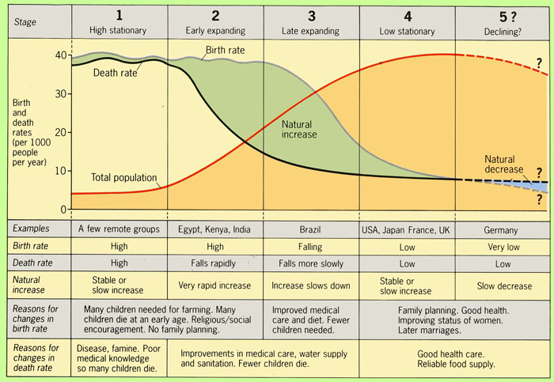
The demographic transition model

