Slide 1
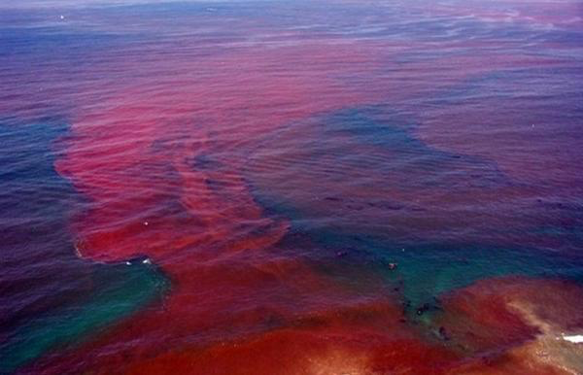
SWBAT review math for the A.P. exam.
APES 4/8/16

Slide 2
Reminders!
Monday after school: bubbling for A.P. exams
Tuesday after school: Mock A.P. exam until ~5:30
Lunch Review session on Monday- bring food!

Slide 3
Math groups!
Try to use calculators only when necessary!

Slide 4
Appendix C Conversion Factors
1 Acre= .002 square miles
1 Ha = 2.5 acres
1Kwh= 3412 BTUs
1 ton = 907 Kg
1 BTU= 252 calories
1 ton= 2000 lbs.
1 barrel = 117 liters
1 barrel = 41 gallons

Slide 5
Homework
Legislation MC
Barron’s: Ecosystem
FRQ reflection #3 and #4
Finish math worksheet!

