Slide 1
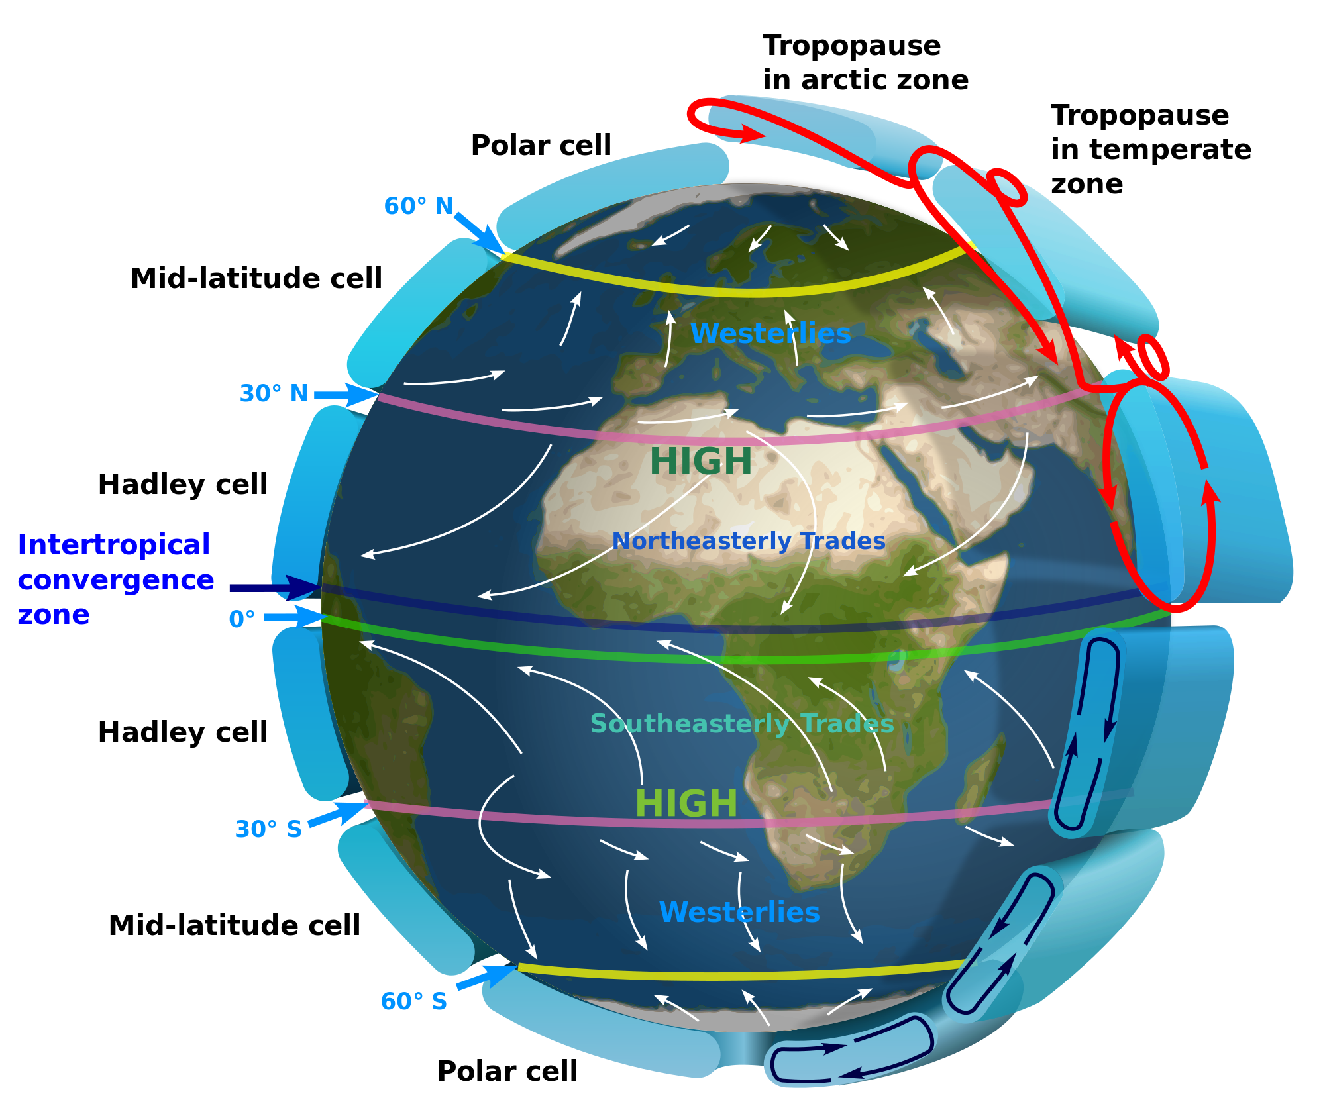
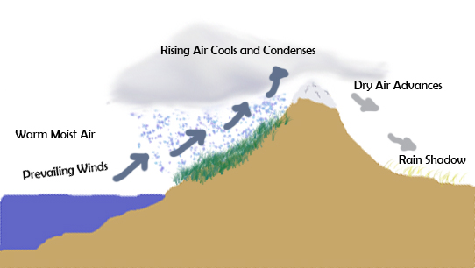
SWBAT review weather.
APES 4/5/16

Slide 2
Agenda:
Review Hw
El nino/la nina review
Weather dry run
MC practice
Improving FRQ writing

Slide 3
Announcements
Mock A.P. exam after school on Tuesday 4/12
90 min. MC
45 min. FRQ
Mandatory A.P. bubbling in Monday (4/11) after school
I will not see you tomorrow- student schedule is wrong
Barron’s flash cards will be collected on Friday!

Slide 4
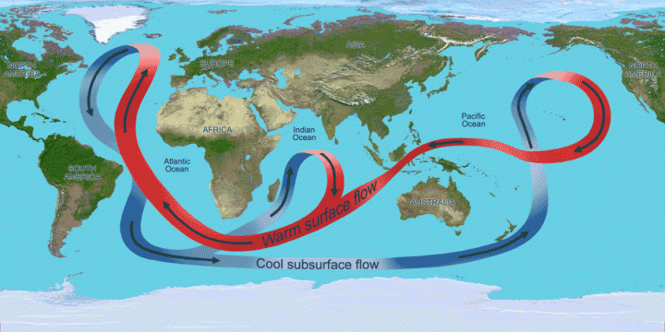
Thermohaline Circulation

Slide 5
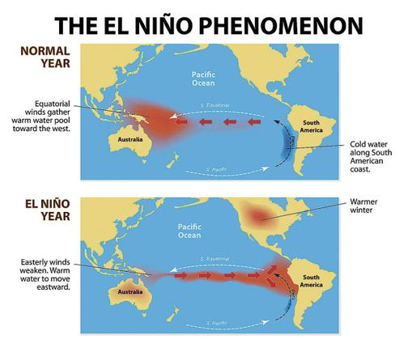
El Nino

Slide 6
El Nino (ENSO) Effects
Trade winds in equatorial pacific weaken or reverse directions
South America:
Milder winter
Upwelling decreases and there is less nutrient-rich water (less fish!)
Western U.S.
Rain!
Northeastern U.S. and Canada
Milder winters

Slide 7
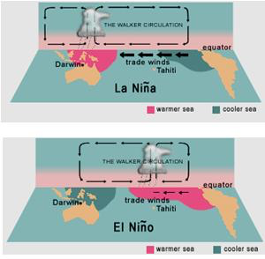

Slide 8
La Nina
South America:
Cold water
U.S.
Increase temp in southeast U.S.→ more hurricanes

Slide 10
Dry Run: Weather
Weather vs. climate
Hadley cells
Convection cells
Composition of the atmosphere

Slide 11
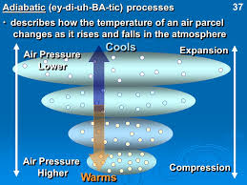
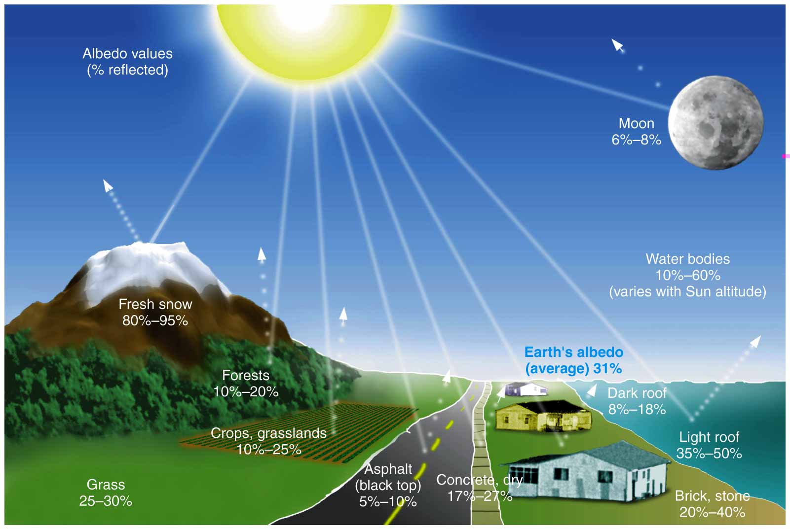

Slide 12
Flowery phrases on the A.P. Exam
Underline or star the phrases you think you use the most
Improve the weak phrases in groups

Slide 13
More Practice
Weak Phrase: One environmental impact of farming is runoff from fertilizers, which causes eutrophication.
Strong phrase:
Weak Phrase: One negative environmental impact of mining is pollution in the water
Strong phrase:

Slide 14
Identify and discuss TWO of the causes for the worldwide decrease TFR
Weak phrase: One cause of the worldwide decrease in TFR is that women have better access to contraceptives
Strong phrase:
Weak phrase: One cause of the worldwide decrease in TFR is that more women are entering the workplace
Strong phrase:

Slide 15
Homework
Look at your review schedule!!

