Slide 1
SWBAT review agriculture practices and land use. Do Now: How can farming practices negatively affect the soil?
APES 4/4/16

Slide 2
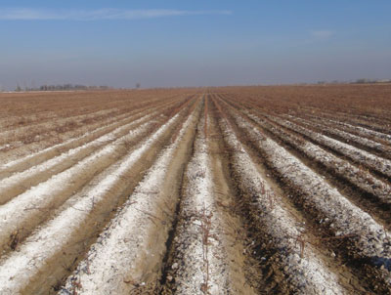
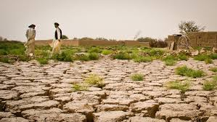
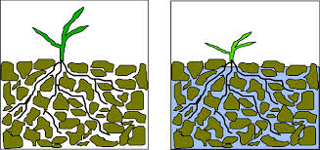

Slide 3
Carousel
Work with your group members to write down everything you remember about this topic
After two minutes rotate
Read over what the previous group has written and add anything they’ve forgotten/fix misconceptions
End with gallery walk

Slide 4
Topics
1st and 2nd green revolution
Irrigation
Fertilizers and pesticides
Monoculture
IPM
GMOs
Sustainable agriculture

Slide 5
Exit Ticket
Did you find the carousel or dry run individually more helpful?

