Slide 1
A.P.E.S. Please find your seat and take out your essay and notes!
Ramlah A.
Attia A.
Wendy C.
Hamna G.
Bukurie H.
Kaylah W.
Rimsha M.
Desire P.
Saliha N.
Shayna N.
Uzma K.
Amrat T.
Mahnoor z.
Cynthia C.
Rahila R.
Wyllana S.
Harmanpreet K.
20. Monica T.
21.Mehrangiz K.

Slide 2
Whip Around: Summer Share
What was one highlight from your summer?

Slide 3
Do Now:
What was the most surprising fact you learned from either book?
After reading these books, what would you say to someone who claims that global warming doesn’t exist?

Slide 4
Agenda
1. Course Outline
2. Class Expectations
3. The A.P. Exam
4.TED Talk
6. Diagnostic Test
7. Student Survey

Slide 5
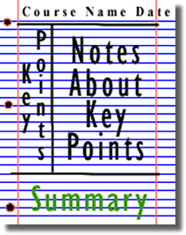
Homework
Note-taking strategies:

Slide 6
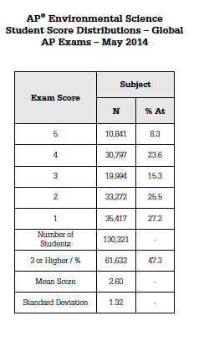

Slide 7
The question on everyone’s mind….
Will this class be hard???
YES!

Slide 8
TED Talk

Slide 9
Diagnostic Test
Use scantron for MC questions
Complete student survey when finished

Slide 10
Homework
Environmentalist Web Hunt

